Slide 1
CSC 3511 Security and Networking
Week 11, Lecture 1: Digital Signatures, Certificates, and PKI

Slide 2
Roadmap
Digital Signatures and RSA Signature
Certificates and Chain of Trust
Public Key Infrastructure

Slide 3
Cryptography Roadmap
 | Symmetric-key | Asymmetric-key
Confidentiality | One-time pads Block ciphers with chaining modes (e.g. AES-CBC) Stream ciphers | RSA encryption
Integrity, Authentication | MACs (e.g. HMAC) | Digital signatures (e.g. RSA signatures)
Hash functions
Pseudorandom number generators
Public key exchange (e.g. Diffie-Hellman)
Key management (certificates)

Slide 4

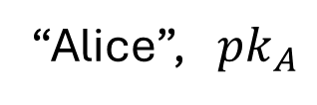
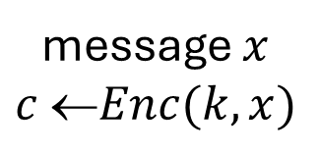


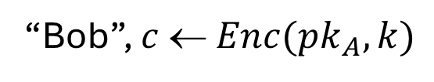
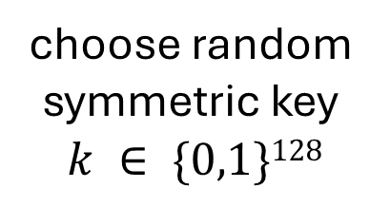
Last Week: Strawman Key Exchange and Data Transfer Protocol
Alice
Bob
$$({pk}_{A},{sk}_{A}) ⟵KeyGen()$$
“Alice”, ${pk}_{A}$
choose random
symmetric key
$$k ∈ \{0,1\}128$$
Key exchange
(asymmetric, e.g., RSA)
“Bob”, $c  Enc({pk}_{A}, k)$
$$k:= Dec({sk}_{A}, c)$$
message $x$ $c Enc(k, x)$
$$x:= Dec(k, c)$$
Data encryption
(symmetric, e.g., AES)

Slide 5
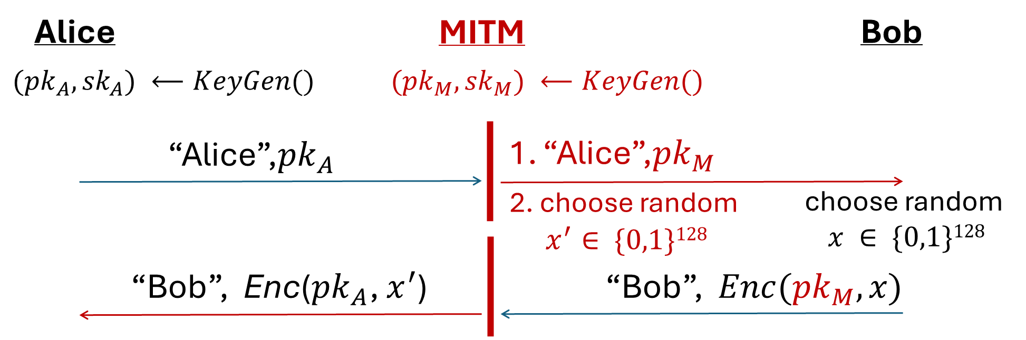
Last Week: MITM Targeting the Strawman Key Exchange and Data Transfer Protocol
The above protocol is insecure against MITM attacks
Root cause: Bob has no way to tell the message is from Alice or Mallory
Solution: Find a way to verify the integrity & authenticity of the received information

Slide 6

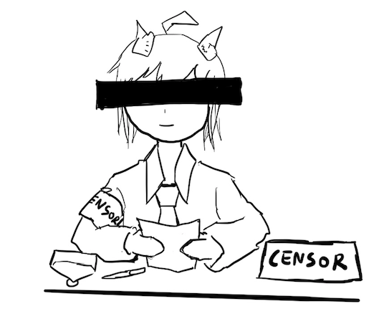

Digital Signatures
Digital signatures are the asymmetric way of providing integrity and authenticity to data
Assume that Alice and Bob can communicate public keys without Mallory changing them
  We will see how to fix this limitation later using certificates
Only the owner of the private key can sign messages with the private key
Everybody can verify the signature with the public key

Slide 7
Digital Signatures: Definition
Three parts:
  KeyGen() → PK, SK: Generate a public/private keypair, where PK is the verify (public) key, and SK is the signing (secret) key
  Sign(SK, M) → sig: Sign the message M using the signing key SK to produce the signature sig
  Verify(PK, M, sig) → {0, 1}: Verify the signature sig on message M using the verify key PK and output 1 if valid and 0 if invalid
Properties
  Correctness: Verification should be successful for a signature generated over any message ➔ Verify(PK, M, Sign(SK, M)) = 1 for all PK, SK ← KeyGen() and M
  Efficiency: Signing/verifying should be fast
  Security: EU-CPA (existentially unforgeable under chosen plaintext attack)

Slide 8
Defining Integrity: EU-CPA
Mallory may send messages to Alice and receive their tags
Eventually, Mallory creates a message-signature pair (M', sig')
  M' cannot be a message that Mallory requested earlier
  If sig' is verifies with PK for M', then Mallory wins. Otherwise, she loses.
A scheme is EU-CPA secure if for all polynomial time adversaries, the probability of winning is 0 or negligible
Mallory (adversary)
Alice (challenger)
PK
Keygen(): SK, PK
M
sign(SK, M)
(repeat)
Output (M', sig')

Slide 9
Digital Signatures in Practice: Sign
This is a really really long message about Bob’s bill
Message M
If you want to sign message M:
First hash message M using cryptographic hash function H() (e.g., SHA-1, SHA-2, etc.)
Then sign (Enc) H(M): Sign(SK, H(M)) → sig
Send M and sig to the receiver
Calculate a short message digest (fingerprint) from a long input using a one-way function (hash function)
Hash Function H(M)
Py75c%bn&*)9|fDe^bDFaq#xzjFr@g5=&nmdFg$5knvMd’rkvegMs”
Fixed-length hash value
Signer’s private key
Why do digital signatures use a hash?
Asymmetric encryption/decryption is slow! ➔ “Encrypt” a short message
Allows signing arbitrarily long messages
Sign(SK, H(M))
Jrf843kjfgf*£$&Hdif*7oUsd*&@:<CHDFHSD(**
Digital Signature

Slide 10
Digital Signatures in Practice: Verify
sig
M
Jrf843kjfgf*£$&Hdif*7oUsd*&@:<CHDFHSD(**
This is a really really long message about Bob’s bill
If you want to verify the signature of message M:
  Decrypt sig using singer’s public key
  Hash M using the same cryptographic hash function (e.g., SHA-1, SHA-2, etc.)
  Compare results in step 1 and 2
Signer’s public key
Dec(PK, sig)
Hash Function H(M)
Py75c%bn&*)9|fDe^bDFaq#xzjFr@g5=&nmdFg$5knvMd’rkvegMs”
Py75c%bn&*)9|fDe^bDFaq#xzjFr@g5=&nmdFg$5knvMd’rkvegMs”
Digital signatures provide integrity and authenticity for M
The digital signature acts as proof that the private key holder signed H(M), so you know that M is authentically endorsed by the private key holder
Are they same?
==?
1/0

Slide 11
RSA Signatures: Definition
KeyGen():
Same as RSA encryption:
  Public key: N and e
  Private key: d
Sign(d, M):
Compute: sig = H(M)^{d} mod N
Verify(e, N, M, sig):
Verify that H(M) ≡ sig^{e} mod N
Correctness: sig^{e} mod N ≡ H(M)^{de} mod N ≡ H(M) mod N
  Because recall x^{de} mod N ≡ x mod N for all x)
Recall RSA encryption: M^{ed} ≡ M mod N
Last week:
  Enc(e, N, M) → C
  Dec(d, C) → M
There is nothing special about using e first or using d first!
If we encrypt using d, then anyone can “decrypt” using e
Given x and x^{d} mod N, can’t recover d because of discrete-log problem, so d is safe

Slide 12
Summary: Public-Key Cryptography
Public-key cryptography: Two keys, private and public
Public-key encryption: One key encrypts, the other decrypts
  Security properties similar to symmetric encryption
  RSA Enc: Produce a pair e and d such that M^{ed} = M mod N
Hybrid encryption: Encrypt a symmetric key, and use the symmetric key to encrypt the message
Digital signatures: Integrity and authenticity for asymmetric schemes
  RSA Sigature: Sign (Encrypt) the hash with the private key
  Other popular signature schemes: DSA, ECDSA, EdDSA, BLS…

Slide 13
Roadmap
Digital Signatures and RSA Signature
Certificates and Chain of Trust
Public Key Infrastructure

Slide 14
Certificates
Public-key cryptography is great! We can communicate securely without a shared secret
  Public-key encryption: Everybody encrypts with the public key, but only the owner of the private key can decrypt
  Digital signatures: Only the owner of the private key can sign, but everybody can verify with the public key
How do we know the public key of an entity?
How do we distribute public keys securely?

Slide 15
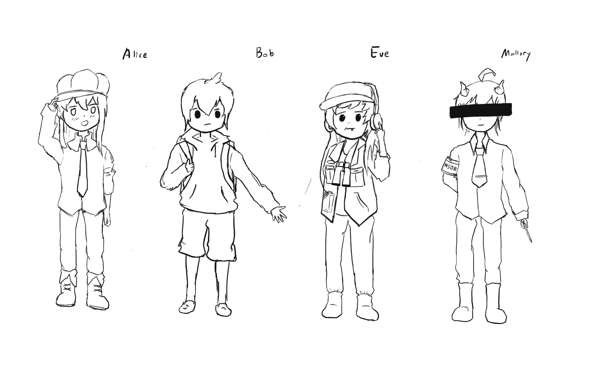
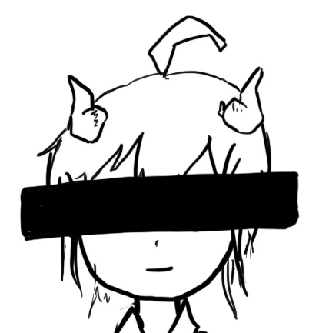

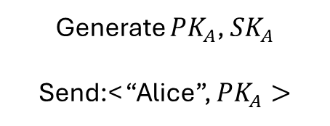

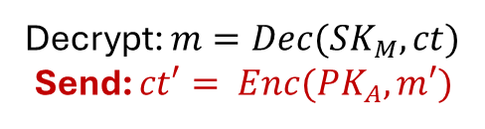


Problem: Distributing Public Keys
Alice
Bob
Mallory
Generate ${PK}_{A}$, ${SK}_{A}$
Send:< “Alice”, ${PK}_{A}>$
Send: <“Alice”, ${PK}_{M}$>
Receive: <“Alice”, ${PK}_{M}$>
Send: ${ct= Enc(PK}_{M}, m)$
Decrypt: ${m=Dec(SK}_{M}, ct)$
Send: ${ct′= Enc(PK}_{A}, m′)$
Decrypt: ${m′=Dec(SK}_{A}, ct′)$
Public-key cryptography alone is not secure against man-in-the-middle attacks

Slide 16
Problem: Distributing Public Keys
Root cause: No mechanism to verify that a public key belongs to its claimed owner
Idea: Sign Bob’s public key to prevent tampering ➔ Do no trust, verify!
Problem: who should sign Bob’s public key?
  If Bob signs his public key, we need his public key to verify the signature
  But Bob’s public key is what we were trying to verify in the first place!
  Chicken-and-egg problem: Alice can never trust any public key she receives
Solution: You cannot gain trust if you trust nothing. You need a root of trust!
  Trust anchor: Someone that we implicitly trust (e.g., DNS root name server?)
  From our trust anchor, we can begin to trust others

Slide 17
Certificates
Certificate: A signed endorsement (a signature) of someone’s public key and identity/attributes
  A certificate contains at least two things: The identity (Alice, Bob, David, etc.) of the person, and the key (PKA, PKB, PKD)
Abbreviated notation
  Encryption under Alice’s public key PK: {“Message”}PK_{A}
  Signing with Alice’s private key SK: {“Message”}SK_{A}⁻¹
  Recall: A signed message must contain the message along with the signature; you can’t check the signature by itself!
Scenario: Alice wants Bob’s public key. Alice trusts EvanBot (PKE, SKE)
  EvanBot is our trust anchor (root of trust)
  If we trust PKE, a certificate we would trust is {“Bob’s public key is PKB”}SK_{E}⁻¹

Slide 18
Certificates
Q1: How to use EvanBot?
Suppose Alice wants Bob's key. Alice trusts EvanBot (PKE, SKE)
Alice -> EvanBot: "What is Bob's public key?"
EvanBot -> Alice:
  Message M: “Bob’s public key is PK_{B}”
  Signature: {M}SK_{E}⁻¹
Q2: How to build EvanBot?
Idea 1: Make a central, trusted directory (a powerful server) from where you can fetch anybody’s public key
Idea 2: A hierarchical trust chain

Slide 19
Idea 1: A Central Trusted Directory
Idea: Make a central, trusted directory (TD) from where you can fetch anybody’s public key
  The TD has a public/private keypair PKTD, SKTD
  The directory publishes PKTD so that everyone knows it (baked into computers, phones, OS, etc.)
  When you request Bob’s public key, the directory sends a certificate for Bob’s public key
What do we have to trust?
  We have received TD’s key correctly
  TD won’t sign a key without verifying the identity of the owner

Slide 20
Idea 1: A Central Trusted Directory
Problem: Scalability
  One directory won’t have enough compute power to serve the entire world
Problem: Single point of failure
  If the directory fails, services depending on this become unavailable
  If the directory is compromised, you can’t trust anyone
  If the directory is compromised, it is difficult to recover
Any ideas? ➔ Drawing inspiration from the DNS name server hierarchy

Slide 21
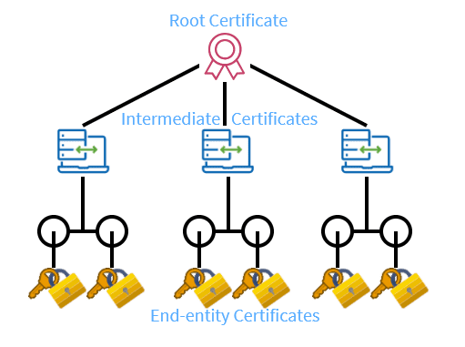
Idea 2: A Hierarchical Trust Chain
Addressing scalability: Hierarchical trust
The root of trust (trusted directory) may delegate trust and signing power to other authorities
  {“John Walz’s public key is PKJW, and I trust him to sign for MSOE”}SKTD⁻¹
    {“Chris Taylor’s public key is PKCT, and I trust him to sign for the DSAC”}SKJW⁻¹
      {“Zhonghao Liao’s public key is PK_{ZL} (but I don’t trust him to sign for anyone else)”}SKCT⁻¹
      {“Sean Jones’s public key is PK_{SJ} (but I don’t trust him to sign for anyone else)”}SKCT⁻¹
TD is still the root of trust (root certificate authority, or root CA)
  JW and CT receive delegated trust (intermediate CAs)
    ZL’s identity and public key can be trusted
    SJ’s identity and public key can be trusted
Chain of Trust!

Slide 22
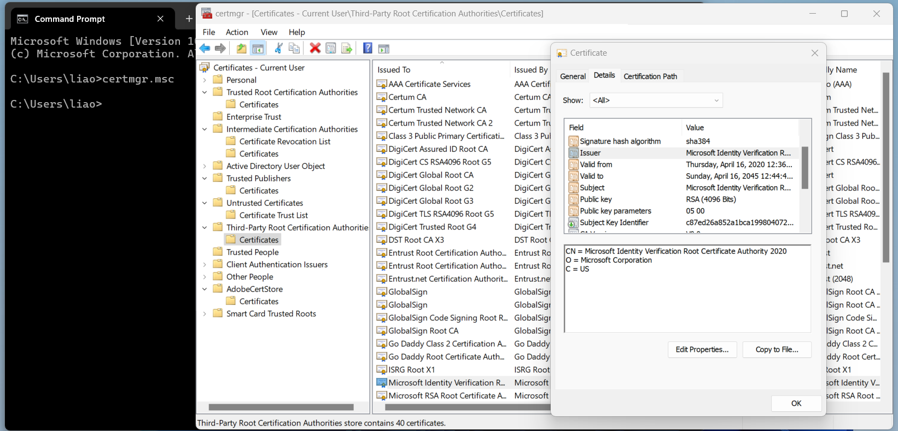
Idea 2: A Hierarchical Trust Chain
Addressing scalability/Single point of failure: Multiple trust anchors
There are ~150 root CAs who are implicitly trusted by most devices
Public keys are hard-coded into operating systems and devices
Each delegation step can restrict the scope of a certificate’s validity
Browse certificates on your machine:
  Open cmd and type “certmgr.msc”
Notes:
CN: common name; person/organization/device name. E.g., Microsoft Identity Verification Root CA 2020
O: organization; company/organization name. E.g., Microsoft Corporation
C: country; two-letter country code. E.g., US

Slide 23
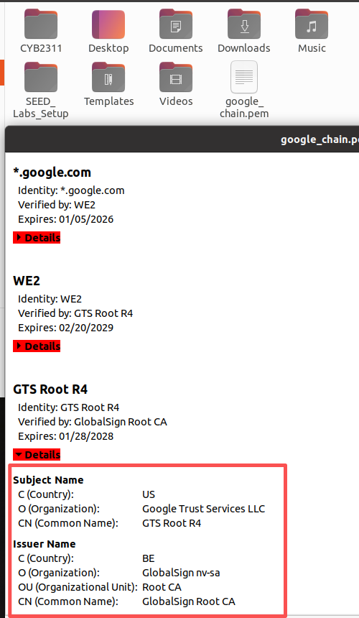
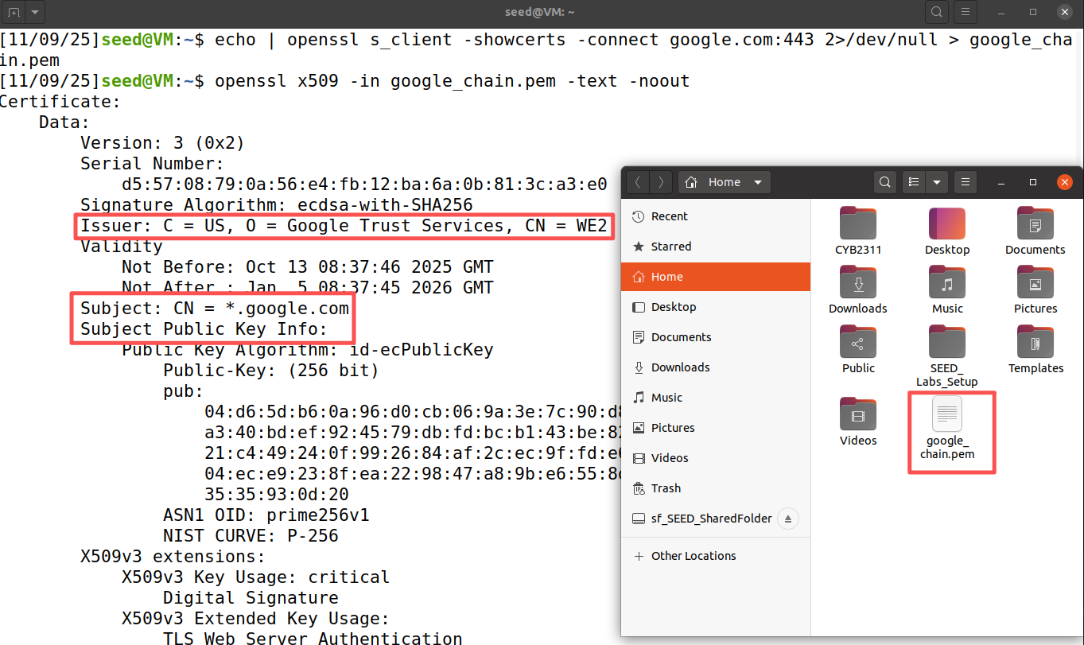
Browse Digital Certificates
Let's use OpenSSL on the SEED virtual machine to obtain Google's certificate chain
# Get the entire certificate chain and save them to the file google_chain.pem
$ echo | openssl s_client -showcerts -connect google.com:443 2>/dev/null > google_chain.pem
# Use the following command decode this file and print the first certificate out
$ openssl x509 -in google_chain.pem -text -noout
Notes:
1. An Actual X.509 certificate contains binary data. Therefore when stored in files, X.509 certificates use encoders.
2. A common scheme used here is Base64 encoder and are usually saved in a file with PEM extension (Privacy Enhanced Mail)
3. We can copy and paste the content into a file (google_chain.pem) and run another openssl command to decode it.
4. What's actually IN a certificate?
Version - Serial Number (unique identifier)
Signature Algorithm
Issuer (who signed it)
Validity Period (Not Before, Not After)
Subject (who it's for - domain name, organization)
Subject Public Key Info
Extensions (Key Usage, Subject Alternative Names, etc.)
Signature
5. When your browser connects to https://www.google.com:
Server sends its certificate + intermediate certificates
Browser checks certificate validity period
Browser verifies certificate chain up to trusted root CA
Browser checks certificate hasn't been revoked
Browser verifies domain name matches certificate Subject
Browser verifies signature on each certificate in chain
CN: common name; person/organization/device name. E.g., Microsoft Identity Verification Root CA 2020
O: organization; company/organization name. E.g., Microsoft Corporation
C: country; two-letter country code. E.g., US

Slide 24
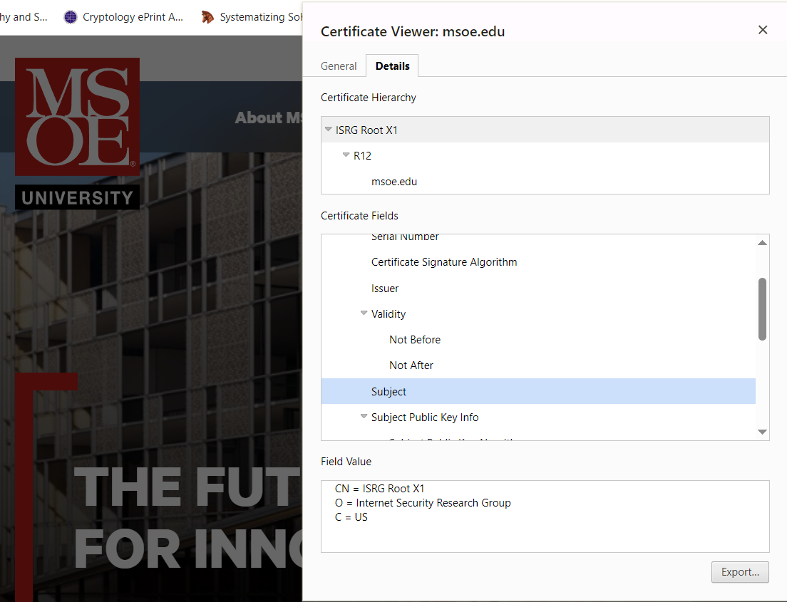
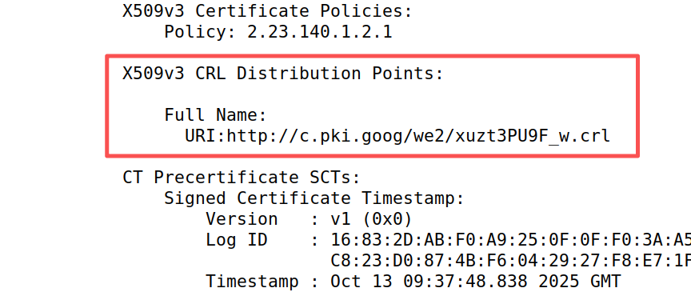
Certificate Validation Process
When you connects to https://www.msoe.edu:
Step 1: Receive Certificate Chain
  www.msoe.edu cert
↓ (signed by)
  R12 Let’s Encrypt Server CA
↓ (signed by)
  ISRG Root CA
Step 2: Validate each certificate
Check validity period: Not expired or not yet valid?
Verify signature
Check revocation: Is this certificate revoked? (certificate revocation list (CRL) )
Verify domain name: Does the certificate match the requested domain?
Check trust chain: Can we trace back to a trusted root CA?
Notes:
When your browser connects to https://www.google.com:
Server sends its certificate + intermediate certificates
Browser checks certificate validity period
Browser verifies certificate chain up to trusted root CA
Browser checks certificate hasn't been revoked
Browser verifies domain name matches certificate Subject
Browser verifies signature on each certificate in chain
CN: common name; person/organization/device name. E.g., Microsoft Identity Verification Root CA 2020
O: organization; company/organization name. E.g., Microsoft Corporation
C: country; two-letter country code. E.g., US

Slide 25
Roadmap
Digital Signatures and RSA Signature
Certificates and Chain of Trust
Public Key Infrastructure

Slide 26
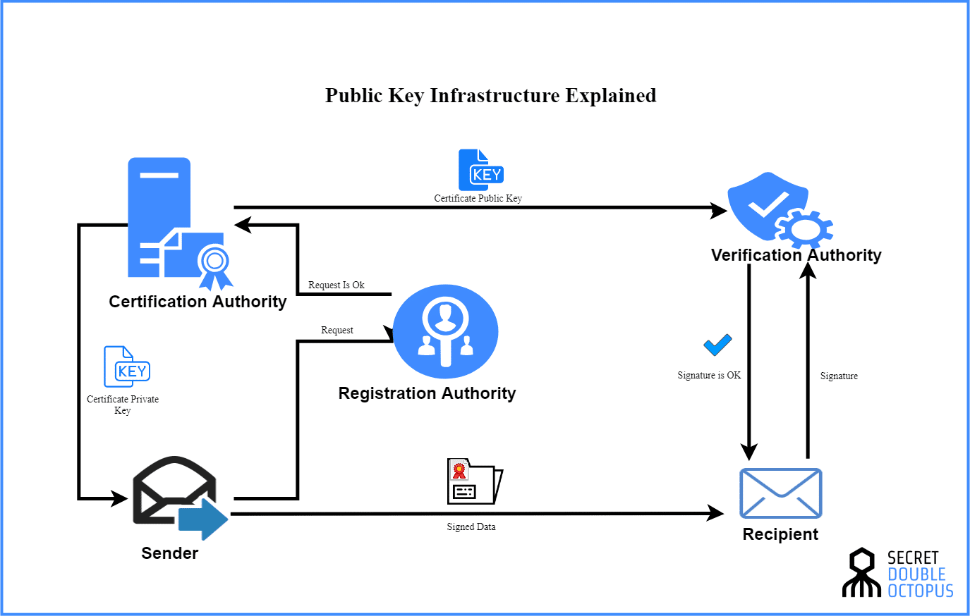
What is PKI?
A comprehensive framework for managing digital certificates and public-key cryptography system
Core Functions:
Create cryptographic keys
Distribute public keys securely
Verify identities
Revoke compromised certificates
Store certificates and keys
Archive historical records
https://doubleoctopus.com/security-wiki/digital-certificates/public-key-infrastructure/
Notes:
PKI isn't just certificates. It's an entire ecosystem.
Think of it like a government's system for issuing driver's licenses:
The Certificate Authority is like the DMV: issue certificates/licenses
The Registration Authority verifies identities/E.g., the Social Security Administration (SSA) does background check and issues SSNs
The Certificate Repository is like a public directory. Anyone can look up certificates
The End Entities (e.g., email clients, web servers, individual users) are everyone using the system

Slide 27
What is PKI?
A comprehensive framework for managing digital certificates and public-key cryptography system
Certificate Authority (CA):
The trusted issuer and signer of digital certificates
Manages certificate lifecycle: issuance, renewal, and revocation
Types: Root CA (self-signed, top-level) and Intermediate CA (delegated authority)
Examples: DigiCert, Let's Encrypt, GlobalSign
https://doubleoctopus.com/security-wiki/digital-certificates/public-key-infrastructure/
Notes:
PKI isn't just certificates. It's an entire ecosystem.
Think of it like a government's system for issuing driver's licenses:
The Certificate Authority is like the DMV: issue certificates/licenses
The Registration Authority verifies identities/E.g., the Social Security Administration (SSA) does background check and issues SSNs
The Certificate Repository is like a public directory. Anyone can look up certificates
The End Entities (e.g., email clients, web servers, individual users) are everyone using the system

Slide 28
What is PKI?
A comprehensive framework for managing digital certificates and public-key cryptography system
Registration Authority (RA):
Validates Certificate Signing Requests (CSRs) for authenticity
Authorizes or rejects certificate requests based on identity verification
Usually, a department or an automated system within the CA company. E.g., Let's Encrypt ACME protocol API
https://doubleoctopus.com/security-wiki/digital-certificates/public-key-infrastructure/
Notes:
PKI isn't just certificates. It's an entire ecosystem.
Think of it like a government's system for issuing driver's licenses:
The Certificate Authority is like the DMV: issue certificates/licenses
The Registration Authority verifies identities/E.g., the Social Security Administration (SSA) does background check and issues SSNs
The Certificate Repository is like a public directory. Anyone can look up certificates
The End Entities (e.g., email clients, web servers, individual users) are everyone using the system

Slide 29
What is PKI?
A comprehensive framework for managing digital certificates and public-key cryptography system
Certificate Repository:
Stores issued certificates and Certificate Revocation Lists (CRLs)
Implemented as web-based databases: When you visit HTTPS sites, server sends certificates
Try this page: https://crt.sh/
  A public certificate repository anyone can search!
  Search "msoe.edu“: see every certificate ever issued!
https://doubleoctopus.com/security-wiki/digital-certificates/public-key-infrastructure/
Notes:
PKI isn't just certificates. It's an entire ecosystem.
Think of it like a government's system for issuing driver's licenses:
The Certificate Authority is like the DMV: issue certificates/licenses
The Registration Authority verifies identities/E.g., the Social Security Administration (SSA) does background check and issues SSNs
The Certificate Repository is like a public directory. Anyone can look up certificates
The End Entities (e.g., email clients, web servers, individual users) are everyone using the system

Slide 30
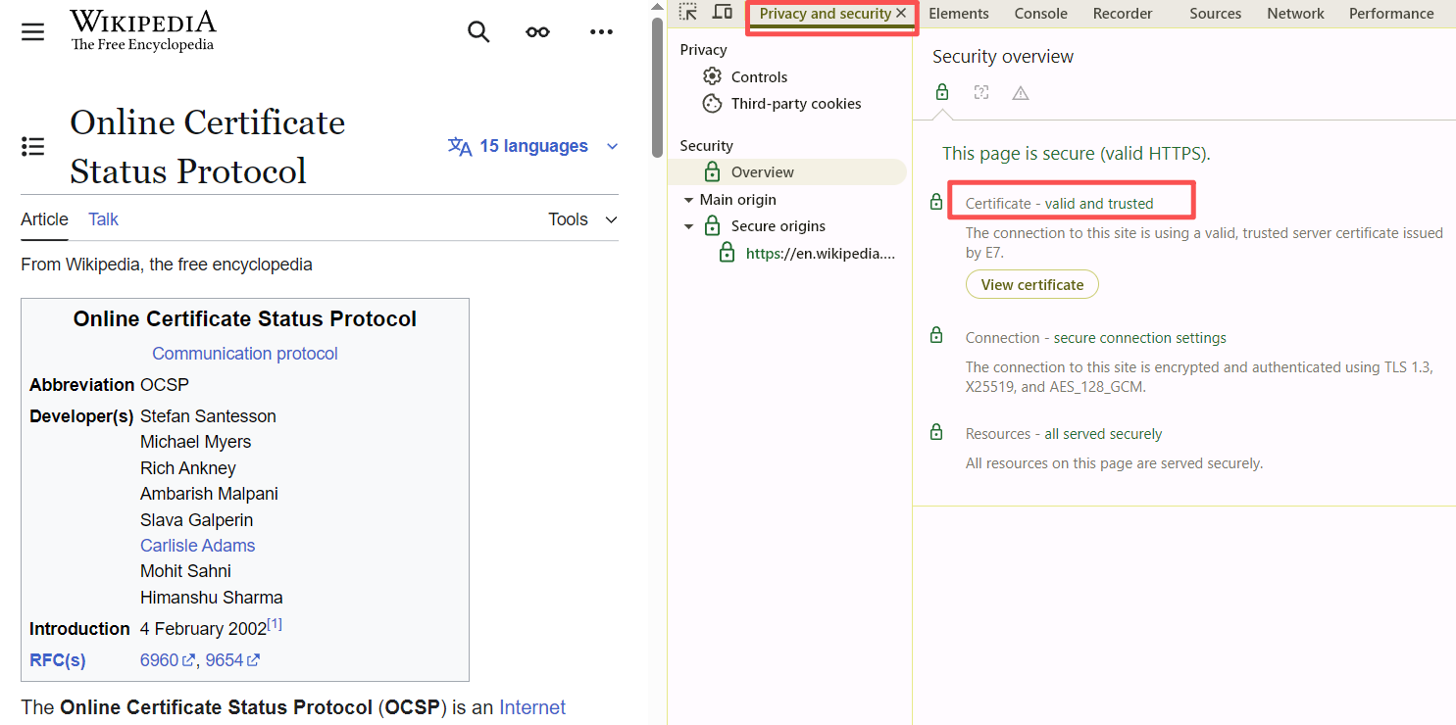
What is PKI?
Verification Authority (VA):
Provides online certificate status checking via OCSP protocol
Responds with certificate status: Valid, Revoked, or Unknown
More efficient than downloading large CRLs
Used by browsers and applications for real-time verification (see in DevTools)
Note: Optional component (some PKIs use only CRLs)
Notes:
PKI isn't just certificates. It's an entire ecosystem.
Think of it like a government's system for issuing driver's licenses:
The Certificate Authority is like the DMV: issue certificates/licenses
The Registration Authority verifies identities/E.g., the Social Security Administration (SSA) does background check and issues SSNs
The Certificate Repository is like a public directory. Anyone can look up certificates
The End Entities (e.g., email clients, web servers, individual users) are everyone using the system

