Slide 1
CSC 3511 Security and Networking
Week 11, Lecture 2: Cryptographic Hash, MACs, and Diffie-Hellman Key Exchange

Slide 2
Roadmap
Cryptographic Hash
Message Authentication Codes (MACs)
Diffie-Hellman Key Exchange

Slide 3
Cryptography Roadmap
 | Symmetric-key | Asymmetric-key
Confidentiality | One-time pads Block ciphers with chaining modes (e.g. AES-CBC) Stream ciphers | RSA encryption
Integrity, Authentication | MACs (e.g. HMAC) | Digital signatures (e.g. RSA signatures)
Hash functions
Pseudorandom number generators
Public key exchange (e.g. Diffie-Hellman)
Key management (certificates)

Slide 4
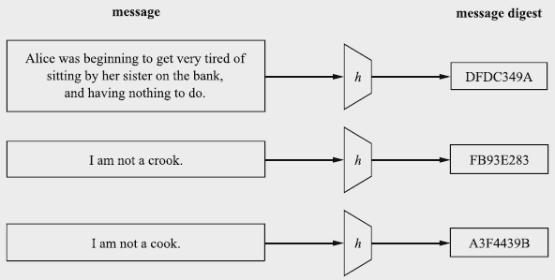
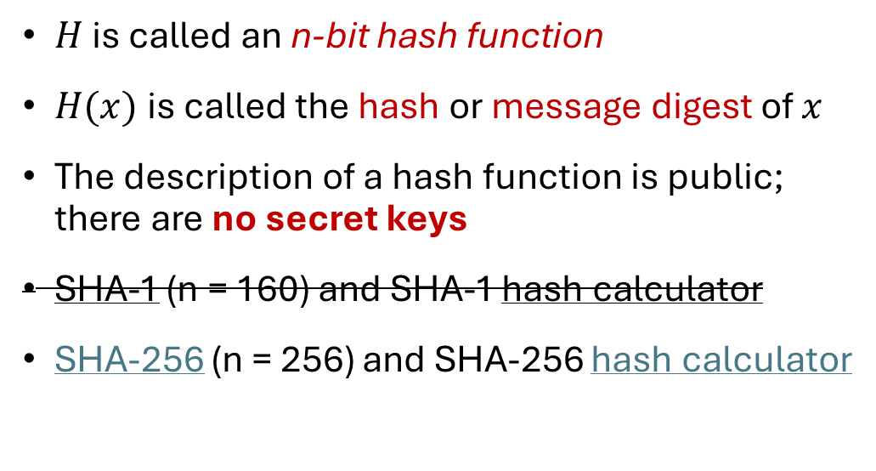
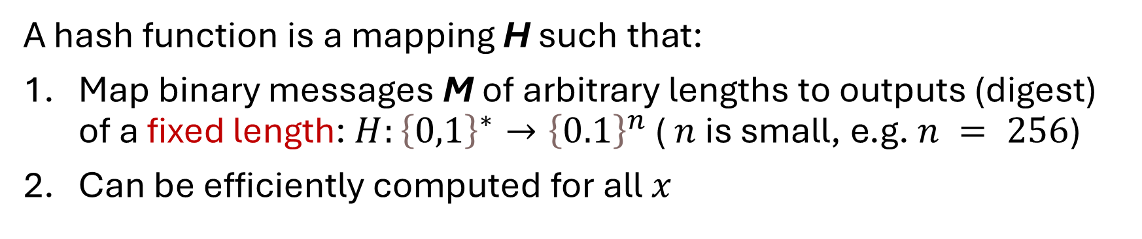
Cryptographic Hash Function: Definition
A hash function is a mapping H such that:
Map binary messages M of arbitrary lengths to outputs (digest) of a fixed length: $H:{\left\{0,1\right\}}^{∗}→{\left\{0.1\right\}}^{n}$ ( $n$ is small, e.g. $n = 256$)
Can be efficiently computed for all $x$
$H$ is called an n-bit hash function
$H(x)$is called the hash or message digest of $x$
The description of a hash function is public; there are no secret keys
SHA-1 (n = 160) and SHA-1 hash calculator
SHA-256 (n = 256) and SHA-256 hash calculator
Notes:
SHA 1: Secure Hash Algorithm 1

Slide 5
Cryptographic Hash Function: Properties
Correctness: Deterministic ➔ Hashing the same input always produces the same output
Efficiency: Efficient to compute
Security: Random/unpredictability, no predictable patterns for how changing the input affects the output
  Changing 1 bit in the input causes the output to be completely different
  Also called “random oracle” assumption
Security: One-way-ness (“preimage resistance”)
Security: Collision-resistance

Slide 6
Hash Function: One-way-ness or Preimage Resistance
Informal description of “One-way-ness”:
Given an output y, it is infeasible to find any input x such that H(x) = y
e.g., SHA-256(a) = ca978112ca1bbdcafac231b39a23dc4da786eff8147c4e72b9807785afee48bb
Here’s an output. Can you find an input that hashes to this output? NO!
  Note: The adversary just needs to find any input, not necessarily the input that was actually used to generate the hash
Counterexample: Is H(x) = x² one-way?
  No, because given output 100, an attacker can return a number x, s.t. H(x) = 100

Slide 7
Hash Function: Collision Resistance
Informal description of Collision:
Two different inputs with the same hash value
x ≠ x' and H(x) = H(x’)
Can we design a hash function with no collisions?
No! because there are more inputs than outputs
  How many inputs? ➔ Infinite
  How large is the output space? ➔ Fixed, e.g., SHA-256(), n = 256, 2²⁵⁶ outputs
However, we want to make finding collisions infeasible for an attacker
Collision resistance: It is infeasible to find any pair of inputs x' ≠ x such that H(x) = H(x')
Intuition: Can you find any two inputs that collide with the same hash output for any output?

Slide 8
Hash Function: Intuition
A hash function provides a fixed-length “fingerprint” over a sequence of bits
Example: Document comparison
  If Alice and Bob both have a 1 GB document, they can both compute a hash over the document and (securely) communicate the hashes to each other
  If the hashes are the same, the files must be the same, since they have the same “fingerprint”
  If the hashes are different, the files must be different
Example: Lab 10, Task 5
  Do you remember Bob’s bill? How can Bob prevent Trudy from altering his bills?
  Use a Hash function instead of a checksum!

Slide 9
Hash Function: Examples
MD5:
Security: Completely broken
SHA-1:
Security: Completely broken in 2017; Was known to be weak before, but still used sometimes
SHA-2:
Output: 256 (SHA-256), 384, or 512 bits (sometimes labeled SHA-256, SHA-384, SHA-512)
Not currently broken, but some variants are vulnerable to a length extension attack (demo)
Current standard
SHA-3 (Keccak):
Output: 256, 384, or 512 bits
Current standard (not meant to replace SHA-2, just a different construction)
Widely used in the blockchain ecosystem

Slide 10
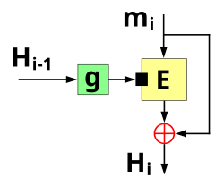


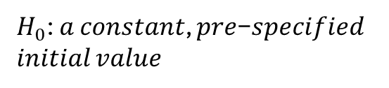
Hash Function: Algorithms
Block cipher-based construction:
  e.g, Matyas–Meyer–Oseas
  Usually somewhat slower than using a specially designed one-way compression function in the hash function
  In some cases, it is easier because a single implementation of a block cipher can be used for both a block cipher and a hash function (e.g., save code space in very tiny embedded systems )
The Matyas–Meyer–Oseas one-way compression function
$H_{0}$: 𝑎 𝑐𝑜𝑛𝑠𝑡𝑎𝑛𝑡, 𝑝𝑟𝑒−𝑠𝑝𝑒𝑐𝑖𝑓𝑖𝑒𝑑 𝑖𝑛𝑖𝑡𝑖𝑎𝑙 𝑣𝑎𝑙𝑢𝑒
$$H_{i}= E(g\left(H_{i−1}\right), m_{i})⨁m_{i}$$
$$H_{n}=h(x)$$
Notes:
The initialism "MD" stands for "Message Digest”
SHA: Secure Hash Algorithm

Slide 11
Does Hash Provide Integrity?
Integrity: An adversary cannot change our messages without being detected
It depends on your threat model. For example:
Alice and Bob want to communicate over an insecure channel
Mallory might tamper with messages
Idea: Use cryptographic hashes
Alice sends her message with a cryptographic hash over the channel
Bob receives the message and computes a hash on the message
Bob checks that the hash he computed matches the hash sent by Alice
Threat model: Mallory can modify the message and the hash
  No integrity!
  Why? There is no secret key being used as input, so any attacker can compute a hash on any value
  Next: Use hashes to design schemes that provide integrity
Alice
Bob
X
H(M’)
M, H(M)
X
M’
Notes:
Why digital signatures can provide integrity?

Slide 12
Roadmap
Cryptographic Hash
Message Authentication Codes (MACs)
Diffie-Hellman Key Exchange

Slide 13


How to Provide Integrity
Alice and Bob want to communicate over an insecure channel
Reminder: We’re in the symmetric-key setting
  Assume that Alice and Bob share a secret key, and attackers don’t know the key
We want to attach some piece of information to prove that someone with the key sent this message
This piece of information can only be generated by someone with the key

Slide 14

Message Authentication Codes (MACs): Usage
Integrity: An adversary cannot change our messages without being detected
Alice wants to send M to Bob, but doesn’t want Mallory to tamper with it
Alice and Bob share a secret key
Alice sends M and T = MAC(K, M) to Bob
Bob receives message, recomputes MAC(K, M) and checks that it matches T
If the MACs match, Bob is confident the message has not been tampered
Insecure
Channel
Alice
Key
Key
Bob
Message
MAC
Message
Verify
Yes/No
T

Slide 15
MACs: Definition
Two parts:
  KeyGen() → K: Generate a key K
  MAC(K, M) → T: Generate a tag T for the message M using key K
    Inputs: A secret key and an arbitrary-length message
    Output: A fixed-length tag on the message
Properties
  Correctness: Determinism
    Note: Some more complicated MAC schemes have an additional Verify(K, M, T) function that don’t require determinism, but this is out of scope
  Efficiency: Computing a MAC should be efficient
  Security: EU-CPA (existentially unforgeable under chosen plaintext attack)

Slide 16
Defining Integrity: EU-CPA
A secure MAC is existentially unforgeable: without the key, an attacker cannot create a valid tag on a message
  Mallory cannot generate MAC(K, M') without K
  Mallory cannot find any M' ≠ M such that MAC(K, M') = MAC(K, M)
Formally defined by a security game: existential unforgeability under chosen-plaintext attack, or EU-CPA
MACs should be unforgeable under chosen plaintext attack
  Intuition: Like IND-CPA, but for integrity and authenticity
  Even if Mallory can trick Alice into creating MACs for messages that Mallory chooses, Mallory cannot create a valid MAC on a message that she hasn't seen before

Slide 17
Defining Integrity: EU-CPA
Mallory may send messages to Alice and receive their tags
Eventually, Mallory creates a message-tag pair (M', T')
  M' cannot be a message that Mallory requested earlier
  If T' is a valid tag for M', then Mallory wins. Otherwise, she loses.
A scheme is EU-CPA secure if for all polynomial time adversaries, the probability of winning is 0 or negligible
Mallory (adversary)
Alice (challenger)
Keygen(): K
M
MAC(K, M)
(repeat)
Output (M', T')

Slide 18
MAC Instantiation: NMAC (Nested MAC)
Can we use secure cryptographic hashes to build a secure MAC?
Intuition: Hash output is unpredictable and looks random, so let’s hash the key and the message together
KeyGen():
  Output two random, n-bit keys K₁ and K₂, where n is the length of the hash output
NMAC(K₁, K₂, M):
  Output H(K₁ || H(K₂ || M))
NMAC is EU-CPA secure if the two keys are different
  Provably secure if the underlying hash function is secure
Intuition: Using two hashes prevents a length extension attack
  Otherwise, an attacker who sees a tag for M could generate a tag for M || M'
Notes:
Length Extension Attack: Many hash functions (like MD5 and SHA-1) are vulnerable to length extension attacks. In a length extension attack, if an attacker knows the hash of a message 𝑀 and the internal workings of the hash function, they can create a valid hash for 𝑀∥𝑀′ (where 𝑀′ is an extension of 𝑀) without knowing the actual contents of 𝑀.For example, if the attacker sees a hash of the form 𝐻(𝐾∥𝑀), they could exploit the hash structure to extend 𝑀 with additional data 𝑀′ , resulting in 𝐻(𝐾∥𝑀∥𝑀′) and generate a valid hash for this extended message. This allows them to "forge" a valid tag for a new message derived from 𝑀M without the actual secret key 𝐾K.
Using Two Keys to Prevent the Attack: NMAC (Nested MAC) uses two different keys, 𝐾1​ and 𝐾2 , and applies the hash function twice in a nested manner: 𝐻(𝐾1∥𝐻(𝐾2∥𝑀)). By doing this, the final output depends on both keys and on the nested structure, which breaks the conditions that length extension attacks rely on. Even if an attacker could perform length extension on 𝐻(𝐾2∥𝑀). the result would not be valid for 𝐻(𝐾1∥𝐻(𝐾2∥𝑀)) because they don’t know 𝐾1 , which is required in the outer hash.

Slide 19
MAC Instantiation: HMAC (Hash-based MAC)
Issues with NMAC:
  Recall: NMAC(K1, K2, M) = H(K1 || H (K2 || M))
  We need two different keys, and the length of the keys must be the same as the length of the hash output (n bits).
HMAC(K, M):
  Compute K' as a version of K that is the length of the hash output
    If K is too short, pad K with 0’s to make it n bits (be careful with keys that are too short, e.g., < 80 bits, and lack randomness, not recommended)
    If K is too long, hash it so it’s n bits
    Recommended key length: For example, HMAC-SHA256, a key length of 64 bytes (512 bits) is recommended to achieve the full 256-bit security level
  Output H((K' ⊕ opad) || H((K' ⊕ ipad) || M))

Slide 20
MAC Instantiation: HMAC (Hash-based MAC)
HMAC(K, M) = H((K' ⊕ opad) || H((K' ⊕ ipad) || M))
Use K' to derive two different keys
  opad (outer pad) is the hard-coded byte 0x5c repeated until it’s the same length as K’
  ipad (inner pad) is the hard-coded byte 0x36 repeated until it’s the same length as K’
  As long as opad and ipad are different, you’ll get two different keys
  For paranoia, the designers chose two very different bit patterns, even though they theoretically need only differ in one bit
HMAC is a hash function, so it has the properties of the underlying hash too:
  It is collision resistant
  Given HMAC(K, M) and K, an attacker can’t learn M
  If the underlying hash is secure, HMAC doesn’t reveal M, but it is still deterministic
You can’t verify a tag T if you don’t have K
  The attacker can’t brute-force the message M without knowing K (HMAC-SHA256: 1/2²⁵⁶)

Slide 21
Do MACs provide integrity?
Do MACs provide integrity?
  Yes! An attacker cannot tamper with the message without being detected
Do MACs provide confidentiality?
  MACs are deterministic ⇒ Same M & K lead to the same tag T
  MACs in general have no confidentiality guarantees; they can leak information about the message
Do MACs provide authenticity?
  It depends on your threat model
  If a message has a valid MAC, you can be sure it came from someone with the secret key, but you can’t narrow it down to one person
  If only two people have the secret key, MACs provide authenticity: it has a valid MAC, and it’s not from me, so it must be from the other person

Slide 22
Roadmap
Cryptographic Hash
Message Authentication Codes (MACs)
Diffie-Hellman Key Exchange

Slide 23


The Diffie-Hellman Key Exchange Protocol (informally)
Generate a symmetric cryptographic key over a public channel
Fix a large prime p (e.g. 2048 digits)
Fix an integer (generator) g in {1, …, p}
Alice
Bob
choose random a in {1,…,p-1}
choose random b in {1,…,p-1}
${A= g}^{a}(mod p)$
${B= g}^{b}(mod p)$
Bª (mod p) = (g^{b})ª =
k_{AB} = g^{ab} (mod p)
= (gª)^{b} = A^{b} (mod p)
Notes:
“Alice”, A = gª (mod p) ; “Bob”, B = g^{b} (mod p)

Slide 24
Discrete Log Problem and Diffie-Hellman Problem
Assume everyone knows a large prime p (e.g. 2048 bits long) and a generator g
  Don’t worry about what a generator g is; just treat it as a number.
Discrete logarithm problem (discrete log problem):
  Given g, p, gª mod p for random a, it is computationally hard to find a

Slide 25
Diffie-Hellman Key Exchange Protocol
Public: g, p
Eve
Alice
Bob
Generate a
Calculate gª mod p
Receive g^{b} mod p
Calculate (g^{b})ª mod p
Mallory
Generate b
Calculate g^{b} mod p
Receive gª mod p
Calculate (gª)^{b} mod p
Private parameter
gª
g^{b}
Public parameter
a, gª, g^{b} ⇒ g^{ab}
gª, g^{b} ⇒ g^{ab}
b, gª, g^{b} ⇒ g^{ab}
Shared symmetric key is
K=g^{ab}
Shared symmetric key is
K=g^{ab}

Slide 26
Diffie-Hellman Key Exchange Protocol
Public: g, p
Alice
Bob
Mallory
Q: What if Mallory can actively change messages (malicious attacker)?
Private parameter
Generate a
Calculate gª mod p
Receive g^{b} mod p
Calculate (g^{b})ª mod p
Generate b
Calculate g^{b} mod p
Receive gª mod p
Calculate (gª)^{b} mod p
gª
g^{b}
Public parameter
gª, g^{b} ⇒ g^{ab}
a, gª, g^{b} ⇒ g^{ab}
b, gª, g^{b} ⇒ g^{ab}
Shared symmetric key is K=g^{ab}
Shared symmetric key is K=g^{ab}

Slide 27

Diffie-Hellman: Man-in-the-middle Attack
Alice
Mallory
Bob
Public: g, p
Generate a
Calculate gª mod p
Receive g^{m} mod p
Calculate (g^{m})ª mod p
Generate b
Calculate g^{b} mod p
Receive g^{m} mod p
Calculate (g^{m})^{b} mod p
Generate m
Calculate g^{m} mod p
Receive gª mod p
Calculate (gª)^{m} mod p
Receive g^{b} mod p
Calculate (g^{b})^{m} mod p
a, gª, g^{m} ⇒ g^{am}
m, g^{m}, gª ⇒ g^{am}
m, g^{m}, g^{b} ⇒ g^{bm}
b, g^{b}, g^{m} ⇒ g^{bm}

Slide 28
Diffie-Hellman: Issues
Issues:
No Authentication: DH doesn't verify who you're exchanging keys with
  Vulnerable to Man-in-the-Middle (MITM) attacks
Active Protocol: Both parties must be online simultaneously
  Cannot encrypt a message for someone who's offline
Solutions to MITM Attacks:
Digital Signatures: Sign DH public parameters (gª mod p, g^{b} mod p) with certificate-based authentication
  Used in TLS/HTTPS (next week)
Pre-Shared Keys (PSK): Authenticate DH public parameters using MAC
  PSK provides authentication, DH provides forward secrecy
  Used in VPNs and IoT devices
Notes:
If Alice and Bob already share a PSK, why not just use it to encrypt everything? Why bother with Diffie-Hellman?
Short answer: We need forward secrecy
1. What is forward secrecy?
Forward secrecy (aka Perfect Forward Secrecy) is a cryptographic feature that ensures past encrypted communications remain secure even if current session keys or long-term private keys are compromised. In other words: Even if an attacker records all your encrypted traffic today and steals your long-term secret key tomorrow, they still cannot decrypt your past conversations.
It achieves this by using ephemeral session keys that are unique to each session and are deleted after the session ends, preventing a long-term key compromise from decrypting past messages.
2. Consider a counterexample, using PSK alone and NO forward secrecy:
Alice and Bob encrypt all messages directly with their shared PSK
They communicate for months, and an attacker records all encrypted traffic
One day, the PSK gets compromised (laptop stolen, key extracted, etc.)
Result: The attacker decrypts EVERY past conversation
3. Consider using PSK + DH:
PSK is used only for authentication via MAC(g^a, g^b)
For each session, they run DH with fresh random ephemeral values
After the session, they delete a and b
Result: Even if PSK is compromised later, past sessions remain secure because a and b were deleted

Slide 29
Summary: Diffie-Hellman Key Exchange
Algorithm:
  Alice chooses a and sends gª mod p to Bob
  Bob chooses b and sends g^{b} mod p to Alice
  Their shared secret is (gª)^{b} = (g^{b})ª = g^{ab} mod p
Diffie-Hellman provides forward secrecy: Nothing is saved or can be recorded that can ever recover the key
  Forward secrecy (aka Perfect forward secrecy): a cryptographic feature that ensures past encrypted communications remain secure even if current session keys or long-term private keys are compromised
Diffie-Hellman can be performed over other mathematical groups, such as Elliptic-curve Diffie-Hellman (ECDH)
Issues
  Does not provide authenticity
  Not secure against MITM
  Both parties must be online

