Slide 1
CSC 3511 Security and Networking
Week 12, Lecture 1: Transport Layer Security

Slide 2
Roadmap
Transport Layer Security (TLS)
TLS Handshake Protocol
TLS: Security Guarantees and Summary
TLS: Application (HTTPS)

Slide 3
Recap: TCP and UDP
Transmission Control Protocol (TCP): Reliably sending packets
Provides reliability, ordering, and byte stream abstraction
  3-way handshake
  Packet’s sequence number and ACK number
  Flow control and congestion control
Attack: TCP DoS attack by launching a SYN Flooding attack
Attack: TCP reset attack by injecting TCP Reset (RST) packets
  Blind attacks must guess the client’s or server’s sequence numbers
Attack: TCP session hijacking attack through data injection
  Blind attacks must guess the client’s or server’s sequence numbers
User Datagram Protocol (UDP): Non-reliably sending packets
No reliability or ordering, only datagram abstraction
Similar injection and spoofing attacks as TCP, but easier
Notes:
Mitigate SYN flood attacks: https://www.cloudflare.com/learning/ddos/syn-flood-ddos-attack/
Mitigate TCP sequence prediction attacks: https://www.linkedin.com/advice/3/how-can-you-prevent-tcp-sequence-number-prediction

Slide 4
Transport Layer Security (TLS)
TLS (Transport Layer Security): A protocol for creating a secure communication channel over the Internet
  Replaces SSL (Secure Sockets Layer), which is an older version of the protocol
TLS is built on top of TCP
  Relies upon: Byte stream abstraction between the client and the server
  Provides: Byte stream abstraction between the client and the server
  The abstraction appears the same to the end client, but TLS provides confidentiality, integrity and (server) authenticity!
Application
TLS
Transport
Network
Link
Physical
Notes:
TLS operates on top of TCP, leveraging its reliable byte-stream abstraction

Slide 5
Secure Internet Communication: Goals of TLS
Confidentiality: Ensure that attackers cannot read your traffic
Symmetric encryption
Protects against eavesdropping
Integrity: Ensure that attackers cannot tamper with your traffic
HMAC
Prevent replay attacks ➔ The attacker records encrypted traffic and then replays it to the server
Example: Replaying a packet that sends “Pay $10 to Mallory”
Authenticity: Make sure you’re talking to the legitimate server
Asymmetric encryption/Digital signature & Certificate
Defend against an attacker impersonating the server
Prevents man-in-the-middle (MITM) attacks

Slide 6
Roadmap
Transport Layer Security (TLS)
TLS Handshake Protocol
TLS: Security Guarantees and Summary
TLS: Application (HTTPS)

Slide 7
TLS Handshake Step 1: Exchange Hellos
Assume an underlying TCP connection has already been formed; Use TLS 1.2 as an example.
The client sends ClientHello with
  A 256-bit random number R_{C} (“client random”)
  A list of supported cryptographic algorithms (Cipher Spec)
The server sends ServerHello with
  A 256-bit random number R_{S} (“server random”)
  The algorithms to use (chosen from the client’s list)
R_{C} and R_{S} prevent replay attacks
  R_{C} and R_{S} are randomly chosen for every handshake
  This guarantees that two handshakes will never be exactly identical
Client
Server
ClientHello
ServerHello
Notes:
The Cipher Spec typically includes:
Encryption Algorithm; For example:
AES in GCM or CBC mode
ChaCha20-Poly1305
The key size (e.g., 128-bit, 256-bit) may also be specified.
Message Authentication Code (MAC) Algorithm; For example:
HMAC with SHA-256
HMAC with SHA-512
Key Exchange Algorithm; For example:
RSA (deprecated in TLS 1.3)
Diffie-Hellman (DHE or ECDHE for elliptic curve variants)
Compression Method (Optional):
Specifies whether the data will be compressed before encryption.
Compression is typically disabled in modern TLS due to security risks (e.g., CRIME attack).

Slide 8
TLS Handshake Step 2: Certificate
The server sends its certificate
  Recall certificates: The server’s identity and public key (PK_{server}), signed by a trusted certificate authority (CA)
The client validates the certificate
  Verify the signature in the certificate
The client now knows the server’s public key
  The client is not yet sure that they are talking to the legitimate server (not an impersonator)
  Recall: Certificates are public. Anyone can provide a certificate for anybody
Client
Server
ClientHello
ServerHello
Certificate

Slide 9
TLS Handshake Step 3: Premaster Secret
This step has two main purposes
  Make sure the client is talking to the legitimate server (not an impersonator)
    The attacker can collect legitimate certificates
    The server must prove that it owns the private key corresponding to the public key in the certificate
  Give the client and server a shared secret
    An attacker should not be able to learn the secret
    This will help the client and the server secure messages later
Two approaches to sharing a premaster secret: RSA or Diffie-Hellman (DHE)
Client
Server
ClientHello
ServerHello
Certificate

Slide 10
TLS Handshake Step 3: Premaster Secret (RSA)
The client randomly generates a premaster secret (PS)
The client encrypts PS with the server’s public key and sends it to the server
  The client knows the server’s public key from the certificate
The server decrypts the premaster secret PS
The client and server now share a secret
  Recall RSA encryption: Nobody except the legitimate server can decrypt the premaster secret
  Proves that the server owns the private key (otherwise, it could not decrypt PS)
Client
Server
ClientHello
ServerHello
Certificate
{PS}PKserver

Slide 11
Recap: Diffie-Hellman Key Exchange
Public: g, p
Alice
Eve
Bob
Generate a
Calculate gª mod p
Receive g^{b} mod p
Calculate (g^{b})ª mod p
Mallory
Generate b
Calculate g^{b} mod p
Receive gª mod p
Calculate (gª)^{b} mod p
Private
gª
g^{b}
Public
a, gª, g^{b} ⇒ g^{ab}
gª, g^{b} ⇒ g^{ab}
b, gª, g^{b} ⇒ g^{ab}
Shared symmetric key is
K=g^{ab}
Shared symmetric key is
K=g^{ab}

Slide 12
TLS Handshake Step 3: Premaster Secret (DHE)
The server generates a secret a and computes gª mod p
The server signs gª mod p with its private key (SK_{server}) and sends the message and signature
The client verifies the signature
  PKI and chain of certificates
  Proves that the server owns the private key
The client generates a secret b and computes g^{b} mod p
The client and server now share a premaster secret (PS): g^{ab} mod p
  Recall Diffie-Hellman: an attacker cannot compute g^{ab} mod p
Client
Server
ClientHello
ServerHello
Certificate
{gª mod p}SK⁻¹server
g^{b} mod p
g^{ab}
g^{ab}

Slide 13
TLS Handshake Step 4: Derive Symmetric Keys
The server and client each derive symmetric keys from random numbers RC, RS, and premaster secret PS
  Usually derived by seeding a PRNG (reproducible random numbers) with the three values
  Changing any of the values results in different symmetric keys
Four symmetric keys are derived
  C_{C}: For encrypting client-to-server messages
  C_{S}: For encrypting server-to-client messages
  IC: For MACing client-to-server messages
  IS: For MACing server-to-client messages
  Note: Both client and server know all four keys
Client
Server
{gª mod p}SK⁻¹server
g^{b} mod p
or
{PS}PKserver
Compute keys
Compute keys
Notes:
Using Cryptographic Hash Functions to instantiate a PRNG:
A cryptographic hash function (e.g., SHA-512) can be used as a PRNG by repeatedly hashing a seed and using parts of the output as random numbers.
Process: Start with a seed (𝑆). Compute 𝑅1=Hash(𝑆), 𝑅2=Hash(𝑅1), and so on.
Advantages: Output is highly unpredictable without knowing the seed. Suitable for cryptographic applications.

Slide 14
TLS Handshake Step 5: Exchange MACs
The server and client exchange MACs on all the messages of the handshake so far
  Recall MACs: Any tampering on the handshake will be detected
  Not to be confused with MAC addresses
Why Do We Need This Step
  Ensures message integrity & Validates key agreement:
    Verifying that no tampering occurred during the handshake process
  Synchronization:
    Confirming that both the client and server agree on the handshake messages and cryptographic parameters
Client
Server
Compute keys
Compute keys
MAC(IC, steps 1-4)
MAC(IS, steps 1-4)

Slide 15
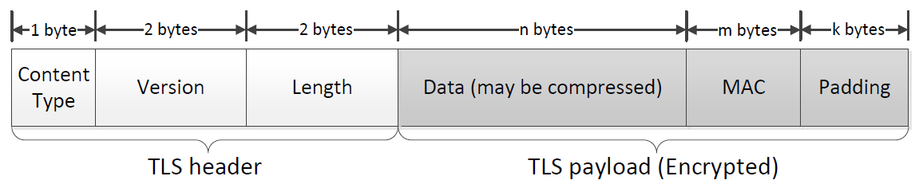
TLS Handshake Step 6: Send Messages
Messages can now be sent securely
  Encrypted AND MAC’d
  Note: TLS (up to version 1.2) uses MAC-then-encrypt, as shown in the right figure
  Modern cryptographic best practices favor Encrypt-then-MAC, where the message is first encrypted, and the MAC is calculated over the ciphertext. Send ciphertext and MAC
  This is generally considered more secure but is not used in earlier versions of TLS for legacy compatibility
Client
Server
Compute keys
Compute keys
MAC(IC, steps 1-4)
MAC(IS, steps 1-4)
{M || MAC(IC, M)}CC
{M || MAC(IS, M)}CS
Notes:
MAC-then-Encrypt (MtE):
Compute MAC over the plaintext: tag T = MAC(mac_key, plaintext)
Encrypt both plaintext and MAC: ciphertext C = Encrypt(enc_key, plaintext || tag)
Encrypt-then-MAC (EtM):
Encrypt the plaintext: ciphertext C = Encrypt(enc_key, plaintext)
Compute MAC over the ciphertext: tag T = MAC(mac_key, ciphertext)
Send both: C || T
EtM is better: verify authenticity before decrypting; EtM has been proven to provide authenticated encryption when using secure components
TLS header includes fields such as the content type, protocol version, and length of the payload:
Fields in the TLS Header
Content Type:
This field specifies the type of data contained in the TLS record.
Examples:
22 (Handshake): Indicates that the record contains handshake messages.
23 (Application Data): Indicates that the record contains encrypted application data.
20 (Change Cipher Spec): Indicates a Change Cipher Spec message.
This allows the recipient to differentiate between record types and handle them accordingly.
Protocol Version:
Specifies the version of the TLS protocol being used.
Examples:
0x0303: Indicates TLS 1.2.
0x0304: Indicates TLS 1.3.
This ensures compatibility between the client and server, as older versions may have different structures or vulnerabilities.
Length of the Payload:
Specifies the size (in bytes) of the payload carried by the record (excluding the header itself).
This field ensures that the recipient knows how much data to read and process.
Maximum length: 16 KB (as per the TLS specification).

Slide 16
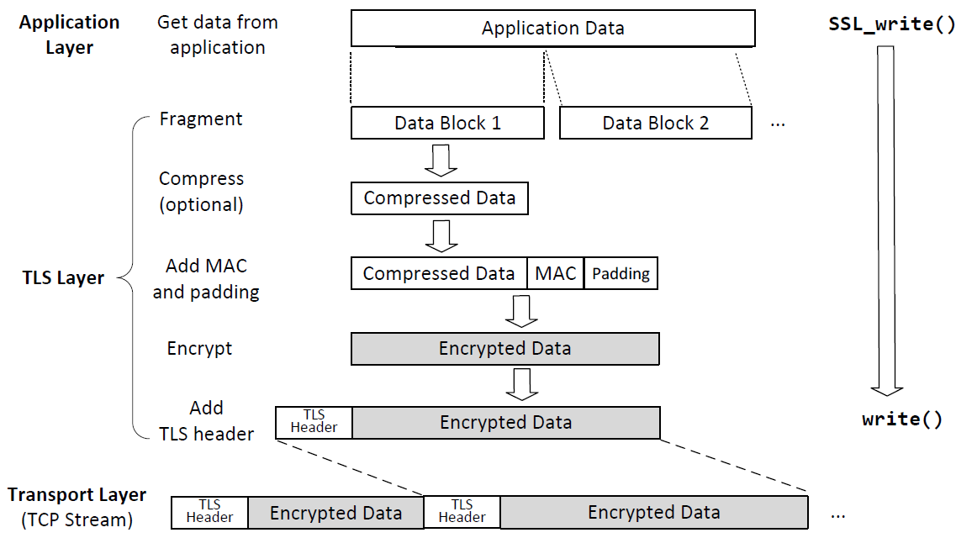
Sending Data with the TLS Protocol
TCP Header: Contains transport-layer metadata (e.g., ports, sequence numbers)
TCP Payload: Includes the TLS Header (unencrypted) and the Encrypted Data
Notes:
Applications invoke SSL_write() (a function written in C)to send data over TLS.
The ssl_write() function is part of the OpenSSL library and is used to send data securely over a TLS/SSL connection.
This API breaks data into blocks and generates MAC for each block before encrypting the block
TLS puts the encrypted block into the payload field of the TLS record, and gives it to the transport layer for transmission

Slide 17
Roadmap
Transport Layer Security (TLS)
TLS Handshake Protocol
TLS: Security Guarantees and Summary
TLS: Application (HTTPS)

Slide 18
TLS: Talking to the Legitimate Server
How can we be sure we are talking to the legitimate server (server authentication)?
  The server sent its certificate, so we know the server’s public key
  The server proved that it owns the corresponding private key
    RSA: The server decrypted the PS
    DHE: The server signed its half of the exchange
An attacker impersonating the server would not have the server’s private key (assuming they have not compromised the server)
Client
Server
ClientHello
ServerHello
Certificate
{gª mod p}SK⁻¹server
Or RSA exchange
g^{b} mod p
{M, MAC(IC, M)}CC
{M, MAC(IS, M)}CS

Slide 19
TLS: Securing Messages
How can we be sure that network attackers can’t read or tamper with our messages?
The attacker doesn’t know PS
  RSA: PS was encrypted with the server’s public key
  DHE: An attacker cannot learn the Diffie-Hellman secret
The symmetric keys are derived from PS
  The attacker doesn’t know the symmetric keys used to encrypt and MAC messages
Encryption and MACs provide confidentiality and integrity
Client
Server
ClientHello
ServerHello
Certificate
{gª mod p}SK⁻¹server
Or RSA exchange
g^{b} mod p
{M, MAC(IC, M)}CC
{M, MAC(IS, M)}CS

Slide 20
TLS: Replay Attacks
Client
Server
How can we be sure that the attacker hasn’t replayed old encrypted messages from a past TLS connection?
  Replaying a packet that sends “Pay $10 to Mallory”
Every handshake uses a different RC and RS
The symmetric keys are derived from RC and RS
  The symmetric keys are different for every connection
ClientHello
ServerHello
Certificate
{gª mod p}SK⁻¹server
Or RSA exchange
g^{b} mod p
{M, MAC(IC, M)}CC
{M, MAC(IS, M)}CS

Slide 21
TLS: Replay Attacks
How can we be sure that the attacker hasn’t replayed old messages from the current TLS connection?
Add record numbers (in the encrypted TLS message)
  Every message uses a unique record number (used in MAC calculation, not explicitly transmitted)
  If the attacker replays a message, the record number will be repeated
TLS record numbers are not TCP sequence numbers
  Record numbers are used for security: ensure M is not replayed or reordered by attackers
  Sequence numbers are used for correctness, in the layer below
Client
Server
ClientHello
ServerHello
Certificate
{gª mod p}SK⁻¹server
Or RSA exchange
g^{b} mod p
{M, MAC(IC, M)}CC
{M, MAC(IS, M)}CS
Notes:
In the TLS protocol, a record number is a unique identifier assigned to each record (or message) exchanged between the client and the server during a session. Its purpose is to ensure that messages are not replayed or reordered by attackers.
Key features of record numbers
Uniqueness:
Each record within a TLS session has a unique record number.
Replay attacks can be detected because a repeated record number indicates a retransmitted message.
Different from TCP Sequence Numbers:
Record Numbers: Operate at the TLS layer and are encrypted.
TCP Sequence Numbers: Operate at the Transport layer, are unencrypted, and ensure in-order delivery and retransmissions.

Slide 22
TLS: Forward Secrecy
Forward secrecy: If an attacker records a connection now and compromises secret values later, they cannot compromise the recorded connection
Client
Server
ClientHello
RSA TLS: No forward secrecy is guaranteed
The adversary can record RC, RS, and the encrypted PS
If the adversary later compromises the server’s private key, they can decrypt PS and derive the keys!
ServerHello
Certificate
{PS}PKserver
TLS Handshake Step 3: Premaster Secret (RSA)

Slide 23
TLS: Forward Secrecy
Forward secrecy: If an attacker records a connection now and compromises secret values later, they cannot compromise the recorded connection
Client
Server
ClientHello
DHE TLS: Guaranteed forward secrecy
Diffie-Hellman provides forward secrecy: gª is deleted after the TLS session is over
Adversary can’t learn the keys, even if they later compromise the server’s private key
ServerHello
Certificate
{gª mod p}SK⁻¹server
g^{b} mod p
g^{ab}
g^{ab}
TLS Handshake Step 3: Premaster Secret (DHE)

Slide 24
TLS Provides End-to-End Security
TLS provides end-to-end security: Secure communication between the two endpoints, with no need to trust intermediaries
  End-to-end security does not help if one of the endpoints is malicious (e.g. communicating with a malicious server)
  Even if everybody between the client and the server is malicious, TLS provides a secure communication channel
  Example: A local network attacker (on-path) tries to read our Wi-Fi session, but can’t read TLS messages
  Example: A man-in-the-middle tries to inject TCP packets, but packets will be rejected because the MAC won’t be correct
Using TLS defends against most lower-level network attacks

Slide 25
TLS 1.3 Changes
TLS 1.3: The latest version of the TLS protocol (2018)
RSA no longer supported (only DHE)
  Guarantees forward secrecy
Performance optimization: The client sends g^{b} mod p in ClientHello
  If the server agrees to use DHE, the server sends gª mod p (with signature) in ServerHello message
  Potentially saves two messages later in the handshake
Only supports AEAD mode encryption
  AEAD (authenticated encryption with additional data): a block cipher mode that guarantees confidentiality and integrity at the same time
  Eliminates attacks associated with the insecure MAC-then-encrypt pattern
Notes:
For your interest only

Slide 26
TLS Does Not Provide Anonymity
Anonymity: Hiding the client’s and server’s identities from attackers
An attacker can figure out who is communicating with TLS
  The certificate is sent during the TLS handshake, containing the server’s name
  The client may also indicate the name of the server in the ClientHello (called Server Name Indication, or SNI)
  An attacker can see IP addresses and ports of the underlying IP and TCP protocols

Slide 27
TLS Does Not Provide Availability
Availability: Keeping the connection open in the face of attackers
An attacker can stop a TLS connection
  MITM can drop encrypted TLS packets
  On-path attacker can still do RST injection to abort the underlying TCP connection
Result: A TLS connection can still be censored
  The censor can block TLS connections

Slide 28
TLS: Summary
TLS Handshake
Nonces make every handshake different (prevents replay attacks across connections)
Certificate proves server’s public key
RSA or DHE proves that the server owns the private key
RSA or DHE helps client and server agree on a shared secret key
MAC exchange ensures no one tampered with the handshake
Messages are sent with symmetric encryption and MACs
TLS record numbers prevent replay attacks within a connection
Client
Server
ClientHello
ServerHello
Certificate
{gª mod p}SK⁻¹server
Or RSA exchange
g^{b} mod p
{M, MAC(IC, M)}CC
{M, MAC(IS, M)}CS

Slide 29
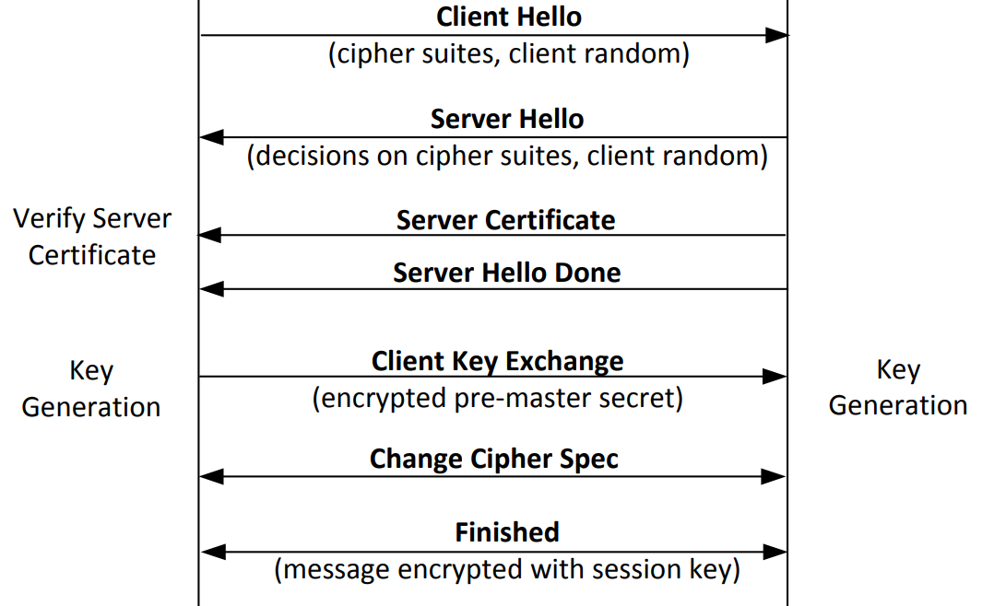
TLS Handshake Protocol: Workflow
See the slide notes at the bottom of this page for details
Notes:
TLS Change Cipher Spec (CCS) message:
1. A protocol message that signals: "Starting now, I'm using the encrypted mode"
2. Marks the transition from plaintext/old cipher to new cipher suite
3. When it’s sent:
TLS 1.2 and earlier:
Sent by both client and server during handshake
Comes after key exchange, before Finished message
TLS 1.3:
Removed! No longer exists as a separate message
Encryption starts immediately after key exchange (cleaner design)
4. Security note:
CCS itself is not encrypted (it can't be, as it signals when encryption starts)
Was exploited in attacks like CCS Injection attack (CVE-2014-0224)

Slide 30
Roadmap
Transport Layer Security (TLS)
TLS Handshake Protocol
TLS: Security Guarantees and Summary
TLS: Application (HTTPS)

Slide 31
TLS for Applications
TLS provides services to higher layers (the application layer)
HTTPS: The HTTP protocol run over TLS
  In contrast, HTTP runs over plain TCP, with no TLS added
Other secure application-layer protocols besides HTTPS exist
  Pretty much anything that runs over TCP can also run over TLS, since the byte stream abstraction is maintained
  Example: Email protocol can use the STARTTLS command to uses TLS to secure communications
TLS does not defend against application-layer vulnerabilities
  Example: SQL injection, XSS, CSRF, and buffer overflow vulnerabilities in the application are still exploitable over TLS

Slide 32


TLS in Browsers
Original design:
  When your browser communicates with a server over TLS, your browser displays a lock icon
  If TLS is not used, there is no lock icon
What the lock icon means
  Communication is encrypted (TLS guarantee)
  You are talking to the legitimate server (TLS guarantee)
  Any external images or scripts are also fetched over TLS
This website uses HTTP: no lock icon
This website uses HTTPS: lock icon

