Slide 1
CSC 3511 Security and Networking
Week 12, Lecture 2: DNS Security

Slide 2
Roadmap
Review
DNS over TLS
DNSSEC: Design Ideas
DNSSEC: Implementation
DNS Security: Summary

Slide 3
Week 3 Lecture 1: DNS
www.google.com
DNS
74.125.25.99
DNS queries always start with a request to the root name server, which is responsible for all requests.
Stub Resolver
(Laptop)
1
8
2
. (root)
Root
Recursive Resolver
(Router)
3
4
.edu
.org
.com
TLD
5
6
msoe.edu
mit.edu
cs101.org
piazza.com
google.com
7
Authoritative
The recursive resolver contacts all the name servers to answer the query
Notes:
A stub resolver is a simple DNS client library built into the operating system that applications use to perform DNS lookups:
Accepts DNS queries from applications (like web browsers)
Formats DNS queries
Sends queries to a configured recursive resolver (DNS server)
Receives and returns responses to the application
Handles basic caching

Slide 4





Week 9 Lecture 1: DNS Cache Poisoning Attacks
What is the IP address of google.com?
Cache poisoning attack:
Returning a false information into the DNS cache
The victim will cache the malicious records, “poisoning” it
Later, DNS queries return an incorrect response, and users are directed to the wrong websites
Example: Supply a malicious record mapping the attacker’s IP address to a legitimate domain
    Now when the victim visits google.com, they’ll actually be sending packets to the attacker (6.6.6.6), who can launch the MITM attack!
8.8.8.8
Recursive Resolver
Authoritative Name Server
What is the IP address of google.com?
Hi, I am an authoritative name server. IP address is 6.6.6.6
Attacker
What is the IP address of google.com?
User
6.6.6.6 (cached)
Recursive Resolver
Malicious website
IP address: 6.6.6.6
google.com
IP address:8.8.8.8
Notes:
https://www.cloudflare.com/learning/dns/dns-cache-poisoning/

Slide 5
Week 9 Lecture 1: Kaminsky Attack
What is the IP address of fake_photo.google.com
2a
.(root)
Attacker’s client
1
Victim Recursive Resolver
3
4
.com
2b
5
Attacker’s name server
6
7
google.com
Flood of forged answers with randomly guessed Query IDs
“fake_photo.google.com doesn’t exist! This response has ID 774.”
“I don’t know. But I have delegated authority to the fake1.google.com. NS. This response has ID 570.
Authority: fake1.google.com NS www.google.com
Additional: www.google.com. A 6.6.6.6 ”
“I don’t know. But I have delegated authority to the fake1.google.com. NS. This response has ID 673.
Authority: fake1.google.com NS www.google.com
Additional: www.google.com. A 6.6.6.6 ”
“I don’t know. But I have delegated authority to the fake1.google.com NS. This response has ID 774.
Authority: fake1.google.com NS www.google.com
Additional: www.google.com A 6.6.6.6”
“I don’t know. But I have delegated authority to the fake1.google.com. NS. This response has ID 812.
Authority: fake1.google.com NS www.google.com
Additional: www.google.com. A 6.6.6.6 ”

Slide 6
Roadmap
Review
DNS over TLS
DNSSEC: Design Ideas
DNSSEC: Implementation
DNS Security: Summary

Slide 7
Securing DNS Lookups: What do we Really Need?
We want integrity on the response
Recall: Integrity means an attacker can’t tamper with the results
Prevent cache poisoning attacks through cryptographic verification
We want authenticity on the response
Recall: Authenticity means verifying the response came from the legitimate DNS server
Mitigate Kaminsky attacks and MITM attacks
We do not need confidentiality on the response
DNS results are public: The attacker can always look up the results themselves!
Even if the attacker couldn’t see the DNS response, they can see which IP you connect to later (source and destination IPs are visible regardless, really?)
  DNS queries leak information about user activities to network observers

Slide 8
DNS over TLS
DNS over TLS (DoT) is one way to send DNS queries over an encrypted connection
Idea: TLS is end-to-end secure, so let’s send all DNS requests and responses over TLS
DNS traditionally uses UDP (port 53), but can use TCP; DoT uses TLS over TCP (port 853)
Two resolvers make a TLS connection; DoT encrypts the link between resolvers.
Optional: Recursive resolver MAY use DoT when querying authoritative servers (not widely deployed)
Does DoT solve our problems?
Stub Resolver
1
8
.(root)
2
Recursive Resolver
3
4
.edu
5
6
msoe.edu
7
Notes:
Week 9: DNS uses UDP protocol
In fact:
UDP is used for most standard queries due to its speed and efficiency for small data packets;
TCP is used for larger, more complex tasks like zone transfers or when a UDP response is too large and gets truncated.

Slide 9
DNS over TLS: Issues
Performance: DNS needs to be lightweight and fast
Recall: TLS requires a long handshake
Security: DoT only secures the link between the stub resolver and the recursive resolver
Malicious RR has full MITM capability
    Can modify any responses before encryption
  User must trust their recursive resolver
Security: DoT doesn't authenticate authoritative responses
Active attackers can still poison the DNS cache
No cryptographic verification of DNS data
Stub Resolver
1
8
.(root)
2
Recursive Resolver
3
4
.edu
5
6
msoe.edu
7

Slide 10
DNS over TLS in Practice
Implemented by Google and Cloudflare:
  Google Public DNS (8.8.8.8): DoT available on port 853
  Cloudflare (1.1.1.1): DoT available on port 853
  Want to try DoT? Install Knot DNS tools on SEED VM and follow Cloudflare tutorial
Benefits:
  Prevents on-path tampering of DNS traffic
  Modern networks minimize TLS overhead (TLS 1.3); The overhead is not a big deal.
Limitations:
  Only defends against network attackers
  Malicious recursive resolver can still poison responses
  Does not authenticate DNS data from authoritative name servers
DNS over TLS is not enough to fully secure DNS!

Slide 11
DNS over TLS: Object Security and Channel Security
Channel security: Securing the communication channel between two end hosts
Provides confidentiality/integrity/authenticity/anonymity for data in transit
For example: TLS, VPN
Object security: Securing the data itself (in transit or in storage)
Data is encrypted/signed/verified
For example: Encryption, Digital Signature
Main problem of DNS over TLS:
DoT provides channel security (stub resolver and recursive resolver)
To fully secure DNS, we need object security:
  Cryptographically sign DNS records at the source
  Verify signatures at the user (stub resolver), regardless of intermediaries
  This is what DNSSEC provides

Slide 12
Roadmap
Review
DNS over TLS
DNSSEC: Design Ideas
DNSSEC: Implementation
DNS Security: Summary

Slide 13
DNSSEC
DNSSEC (DNS Security Extensions): An extension of the DNS protocol that ensures integrity and authenticity on the results
Designed to cryptographically prove that returned answers are correct
Uses a hierarchical, distributed trust system to validate records
DNSSEC is backwards-compatible
DNSSEC is built on top of ordinary DNS
Some, but not all name servers support DNSSEC
DNSSEC Visualization tool: DNSViz | A DNS visualization tool

Slide 14
DNSSEC from Scratch: Let’s Build it Together
Question 1: What kind of cryptographic primitive should we use to ensure integrity on the DNS records?
MACs (symmetric-key) or digital signatures (public-key)
Digital signatures are the best solution: We want everyone to be able to verify integrity (not just the people with the symmetric key)
Question 2: How do we ensure the returned record is authentic?
The name servers should sign the record with their private key
Users verify the record with the name servers’ public key

Slide 15
DNSSEC from Scratch: Let’s Build it Together
Question 3: What does the name server need to send in order to ensure authenticity and integrity on a record?
The DNS record
A signature over the record, signed with the name server’s private key
The name server’s public key
How do we make sure nobody tampered with the public key?
  Chain of trust! (but DNSSEC does not use PKI)
Recursive Resolver
What is the IP address of eecs.msoe.edu?
msoe.edu name server
“The IP address of dsac.msoe.edu is 24.175.3.1.”
Here is a signature on the above record
Here is my public key so you can verify the signature

Slide 16
DNSSEC from Scratch: Let’s Build it Together
Question 4: PKIs need a trust anchor. Who do we implicitly trust in DNSSEC?
We implicitly trust the top of the certificate hierarchy, which is the root name server
The root name server’s public key (self-signed) is hard-coded into resolvers
Question 5: How does a name server delegate trust to a child name server?
Just like in a certificate chain, the parent sign the child’s public key
If you trust the parent name server, then now you trust the child name server
Recursive Resolver
What is the IP address of dsac.msoe.edu?
.root name server
I don’t know, but you should ask the .edu name server.
Here is a signature on the the public key of the .edu name servers. If you trust me, then now you trust them too.
Here is my public key so you can verify the signature.

Slide 17
Roadmap
Review
DNS over TLS
DNSSEC: Design Ideas
DNSSEC: Implementation
DNS Security: Summary

Slide 18
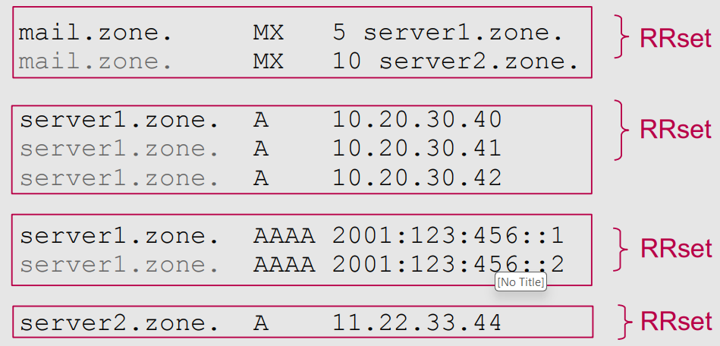
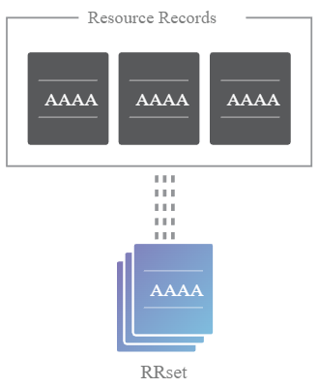
Resource Record Sets (RRSETs)
Recall: A DNS resource record has a fixed format
RR format: (name, [TTL], class, type, value)
E.g.,: edu. 172800 IN NS a.edu-servers.net
In DNSSEC: A group of DNS records with the same name and type form a Resource Record Set (RRset)
Example: All the type AAAA records for a given domain
Example: All the DNSKEY records
RRSETs will be useful for simplifying signatures
Instead of signing every record separately, name server can sign an entire RRset at once

Slide 19
New DNSSEC Record Types
We need new record types to send cryptographic information in DNSSEC packets
DNSKEY:
  Contains the name server’s own public keys
DS (delegated signer):
  The parent signs the DS record to delegate trust to child
  Contains the signer’s (owner’s) name
  Contains the hash of child’s public keys
RRSIG (resource record signature):
  Contain a Type Covered field that specifies which type of record it covers
  RRSIG (covering DNSKEY): Contains a signature on DNSKEY records
  RRSIG (covering DS): Contains a signature on DS records
  RRSIG (covering A and AAAA): Contains a signature on resource records (sign an entire RRset )
  Note: DNSSEC requires a significant amount of metadata; the above description is oversimplified!

Slide 20
DNSSEC Lookup Steps
Recall: We implicitly trust the top of the certificate hierarchy, which is the root name server
Recall: The root name server’s public key (self-signed) is hard-coded into resolvers
Recursive Resolver
What is the IP address of dsac.msoe.edu?
.root name server
I don’t know, but you should ask the .edu name server.
NS record: Domain of the .edu name server
A record: IP address of the .edu name server
Here is a signature on the public key of the .edu name server. If you trust me, then now you trust them too.
DS record: Hash of the .edu name server’s public key
RRSIG DS record: Signature on the DS record
Here is my public key so you can verify the signature.
DNSKEY record: The root name server’s public key

Slide 21
DNSSEC Lookup Steps
Recall: We implicitly trust the top of the certificate hierarchy, which is the root name server
Recall: The root name server’s public key (self-signed) is hard-coded into resolvers
Recursive Resolver
What is the IP address of dsac.msoe.edu?
.edu name server
I don’t know, but you should ask the msoe.edu name server.
NS record: Domain of the msoe.edu name server
A record: IP address of the msoe.edu name server
Here is a signature on the public key of the .edu name server. If you trust me, then now you trust them too.
DS record: Hash of the msoe.edu name server’s public key
RRSIG DS record: Signature on the DS record
Here is my public key so you can verify the signature.
DNSKEY record: The.edu name server’s public key

Slide 22
DNSSEC Lookup Steps
Recall: We implicitly trust the top of the certificate hierarchy, which is the root name server
Recall: The root name server’s public key (self-signed) is hard-coded into resolvers
Recursive Resolver
What is the IP address of dsac.msoe.edu?
msoe.edu name server
A record: IP address of the msoe.edu name server is 69.20.113.171
Here is a signature on the above record.
RRSIG A record: Signature on the A record
Here is my public key so you can verify the signature.
DNSKEY record: The msoe.edu name server’s public key

Slide 23
New DNSSEC Keys
Problem 1: What if a name server wants to change its key pair?
A key change is necessary if, for example, an attacker steals the private key of a name server.
Option 1: Notify its parent name server; the parent change the DS record
  Synchronization and communication cost
  Time consuming and easily go wrong

Slide 24
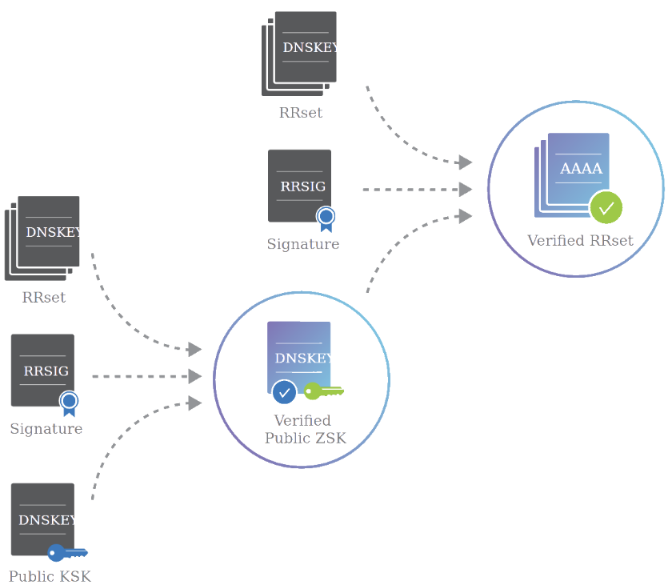
New DNSSEC Keys
Option 2: Each DNSSEC name server generates two public/private key pairs
Key signing key (KSK): sign the zone signing key
Zone signing key (ZSK): sign everything else (e.g., RRset)
Name server sends:
The public KSK (endorsed by the parent)
The public ZSK
A signature on the public ZSK (signed by KSK)
The DNS resolver:
Uses the public KSK to verify the signature
Accepts the public ZSK
Uses ZSK to verify RRSIG and accepts RRSET

Slide 25
DNSSEC: Trust Delegation
Trust anchor: root name server & its KSK
[DNSKEY] Public KSK (Root KSK)
[DNSKEY] Public ZSK
[RRSIG] Signature on (2), signed by KSK
KSK is the “parent” and the ZSK is the “child”; both within one name server
KSK endorses the ZSK by signing the public ZSK
Each color (blue, green, orange) represents a name server
The lighter shade represents records signed with the KSK
The darker shade represents records signed with the ZSK
Root, KSK
[DS] Hash of (6. child’s public KSK)
[RRSIG] Signature on (4), signed by ZSK
Root, ZSK
[DNSKEY] Public KSK
[DNSKEY] Public ZSK
[RRSIG] Signature on (7), signed by KSK
.edu, KSK
[DS] Hash of (11. child’s public KSK)
[RRSIG] Signature on (9), signed by ZSK
.edu, ZSK
[DNSKEY] Public KSK
[DNSKEY] Public ZSK
[RRSIG] Signature on (12), signed by KSK
msoe.edu, KSK
DS (delegated signer):
Contains the signer’s (owner’s) name
Contains the hash of child’s public keys
[A] Answer record
[RRSIG] Signature on (14), signed by ZSK
msoe.edu, ZSK

Slide 26
DNSSEC: Trust Delegation
Trust anchor: root name server & its KSK
Verification process:
Trust anchor:
Root KSK is hard-coded in resolvers
Root KSK signs DNSKEY RRset, so we can verify root’s ZSK
Dark blue:
  We trust the root’s ZSK. The root’s ZSK signs the hash of .edu’s KSK, so now we can verify .edu’s KSK.
  Note: the root’s ZSK also signs its own NS RRset at the zone
Steps 6-10: Similar as steps 1-5.
[DNSKEY] Public KSK (Root KSK)
[DNSKEY] Public ZSK
[RRSIG] Signature on (2), signed by KSK
Root, KSK
[DS] Hash of (6. child’s public KSK)
[RRSIG] Signature on (4), signed by ZSK
Root, ZSK
[DNSKEY] Public KSK
[DNSKEY] Public ZSK
[RRSIG] Signature on (7), signed by KSK
.edu, KSK
[DS] Hash of (11. child’s public KSK)
[RRSIG] Signature on (9), signed by ZSK
.edu, ZSK
[DNSKEY] Public KSK
[DNSKEY] Public ZSK
[RRSIG] Signature on (12), signed by KSK
msoe.edu, KSK
[A] Answer record
[RRSIG] Signature on (14), signed by ZSK
msoe.edu, ZSK
Notes:
The root's KSK signs the DNSKEY RRset (which contains both KSK and ZSK)

Slide 27
DNSSEC: Trust Delegation
Trust anchor: root name server & its KSK
[DNSKEY] Public KSK (Root KSK)
[DNSKEY] Public ZSK
[RRSIG] Signature on (2), signed by KSK
Verification process:
msoe.edu name server:
Light orange: We verify the msoe.edu’s KSK; msoe.edu’s KSK signs msoe.edu’s ZSK; So now we trust msoe.edu’s ZSK (12-13).
Dark orange: We trust msoe.edu’s ZSK. msoe.edu’s ZSK signs the type A answer records, so we trust the final answer.
Root, KSK
[DS] Hash of (6. child’s public KSK)
[RRSIG] Signature on (4), signed by ZSK
Root, ZSK
[DNSKEY] Public KSK
[DNSKEY] Public ZSK
[RRSIG] Signature on (7), signed by KSK
.edu, KSK
[DS] Hash of (11. child’s public KSK)
[RRSIG] Signature on (9), signed by ZSK
.edu, ZSK
[DNSKEY] Public KSK
[DNSKEY] Public ZSK
[RRSIG] Signature on (12), signed by KSK
msoe.edu, KSK
[A] Answer record
[RRSIG] Signature on (14), signed by ZSK
msoe.edu, ZSK
Notes:
The root's KSK signs the DNSKEY RRset (which contains both KSK and ZSK)

Slide 28
DNSSEC: Offline Signature Generation
Problem 2: DNS is designed to be fast and lightweight.
However, public-key cryptography is slow!
Solution: Offline signatures ➔ The name server computes signatures (for RRSET, DNSKEY) in advance; serves the signatures when they are needed
Benefit: Efficiency
Generating a signature each time a user requests it is slow (and can lead to DoS attacks)
Benefit: Availability and Security
Redundancy: One secure signature generation system, and many mirrored name servers providing the same records and signatures
If the signature generation system is separate from the name server, compromising the name server is not enough!

Slide 29
DNSSEC: Signing Non-Existent Domains
Problem 3: What if the user queries for a domain that doesn’t exist?
Option 1: Don’t authenticate nonexistent domain (NXDOMAIN) responses
Issue: If NXDOMAIN responses don’t have to be signed, the attacker can still spoof NXDOMAIN responses and cause denial-of-service (DoS)
Option 2: Keep the private key in the name server, ask it signs NXDOMAIN responses
Issue: Signing in real time is slow
Issue: Name servers stores the private key, which is an issue if they are malicious or hacked
We need a way that can prove that a domain doesn’t exist ahead of time

Slide 30
New DNSSEC Record Types: NSEC
NSEC (and NSEC3, and NSEC5): Prove nonexistence of a DNS record
NSEC record: Next Secure Record
Provide two adjacent domains alphabetically, so that the resolver knows that no domain in the middle exists
For example, suppose a website has 3 subdomains (hostnames):
  b.example.com g.example.com q.example.com
  Query for “c.example.com”, name server returns a signed NSEC record: “No domains exist between b.example.com and g.example.com”
  Query for “x.example.com”, name server returns a signed NSEC record: “No domains exist between q.example.com and b.example.com” (wrapping around from z to a)

Slide 31
Roadmap
Review
DNS over TLS
DNSSEC: Design Ideas
DNSSEC: Implementation
DNS Security: Summary

Slide 32
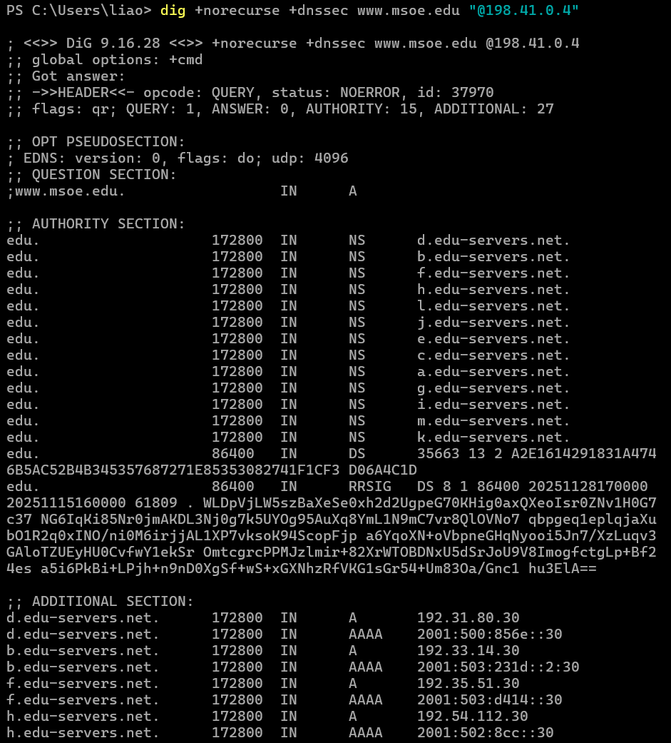
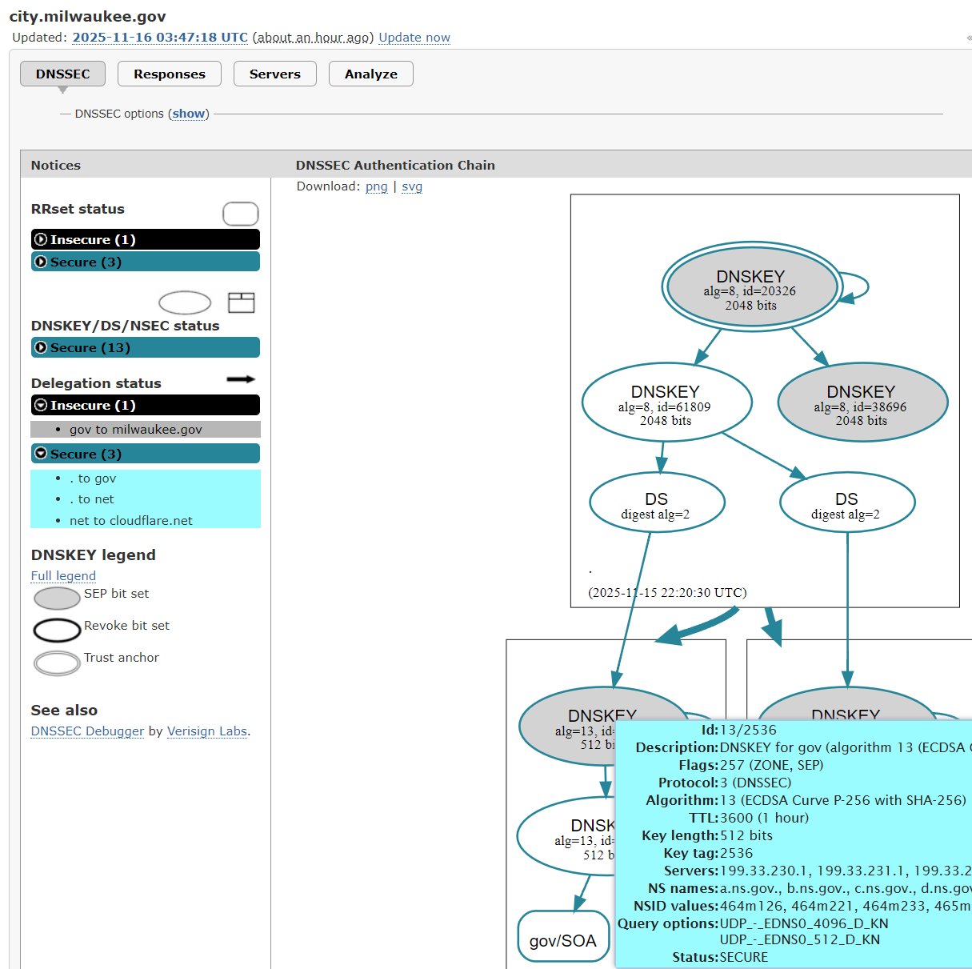
DNSSEC in Practice
DNSSEC lookup walkthrough (PowerShell):
$ dig +norecurse +dnssec www.msoe.edu “@198.41.0.4”
DNSSEC Visualization tool:
DNSViz | A DNS visualization tool
Notes:
edu/SOA refers to the SOA (Start of Authority) record for the .edu domain. It contains administrative information about a DNS zone, including:
Primary nameserver for the zone
Email address of the zone administrator
Serial number (version number for the zone file)
Refresh, retry, and expire timers for zone transfers
Minimum TTL
MSOE has not published DS records with the .edu registry, which means DNSSEC is not enabled for the domain, making it "insecure" in DNSSEC

Slide 33
DNSSEC: Summary
DNSSEC: An extension of the DNS protocol that ensures integrity on the results
Provides object security (unlike DNS over TLS, which provides channel security)
Uses a hierarchical public key infrastructure to delegate trust from the trust anchor (root name server)
Uses signatures to cryptographically verify records
DNSSEC Implementation:
Each name server replies with its public key (DNSKEY type record)
When delegating trust, each name server signs the public key of the next name server (DS and RRSIG type records)
When providing a final answer, the name server signs the final answer (RRSIG type)
Zones are split into key-signing keys and zone-signing keys
NSEC signs a message saying no domains exist alphabetically between two records

Slide 34
DNS Security Solutions: Comparison
DoT (DNS over TLS):
✓ Provides confidentiality (privacy)
✓ Protects against on-path eavesdropping
✗ Requires trust in recursive resolver
✗ No authentication of DNS data
DNSSEC:
✓ Provides integrity and authenticity
✓ Cryptographically verifies DNS data
✓ Works with any name server
✗ No confidentiality
✗ Complex key management
DoT + DNSSEC: Best of both worlds!

