Slide 1
CSC 3511 Security and Networking
Week 13, Lecture 1: Anonymity and Tor

Slide 2
Roadmap
Anonymity
Proxies and VPNs
Tor
Tor Onion Services

Slide 3
Anonymity
Anonymity: Concealing your identity
Wikipedia: “Anonymity describes situations in which the acting person's identity is unknown”
Anonymous communication on the Internet: The identity of the source and/or destination are concealed
Anonymity is not confidentiality
Confidentiality hides the contents of the communication
Anonymity hides the identities of who is communicating with whom
Anonymity on the Internet is hard
Packets contain the source IP address and destination IP address
Main strategy for anonymity: Ask someone else to send messages for you

Slide 4
Roadmap
Anonymity
Proxies and VPNs
Tor
Tor Onion Services

Slide 5
Proxies
Alice wants to send a message to Bob
  Bob shouldn’t know the message is from Alice
  An eavesdropper (Eve) cannot deduce that Alice is talking to Bob
Proxy: A third party that relays our Internet traffic, e.g., HTTP, DNS, …
  Alice sends the message to the proxy, and the proxy forwards the message to Bob
  The recipient’s name (and optionally the message) is encrypted (optional, not mandatory), so an eavesdropper does not see a packet with both Alice and Bob’s identities in plaintext
  Bob receives the message from the proxy, with no indication it came from Alice
  Mask the original IP address
Alice
Proxy
Bob
From: Alice | To: Proxy
{Message, Bob}Kproxy
From: Proxy | To: Bob
Message
Notes:
The identity of the source and/or destination are concealed (if encryption is enabled)
Proxy example scenarios: Configuring Chrome to use a proxy to access region-restricted content on one website

Slide 6
Virtual Private Networks (VPNs)
VPNs: A virtual, encrypted, point-to-point tunnel
Creates an encrypted tunnel between your device and a remote VPN server, which acts as an intermediary for your internet traffic
Creates an alternative use case:
  Appear as though you are coming from the virtually connected network instead of your real network!
  E.g., a remote worker using a corporate VPN to securely access company resources
  Proxies operate at the application layer, while VPNs operate at the network layer
Alice
From: VPN | To: Bob
Message
VPN
Bob
From: VPN | To: Bob
Message
Notes:
proxy = just the protocol going through the proxy (http/https or dns or smtp or …)
VPN = all traffic ….

Slide 7
Proxies and VPNs: Issues
Performance
  Sending a packet requires additional hops across the network
Cost
  VPNs can cost $80 to $200 per year
Trusting the proxy
  The proxy can see the sender and recipient’s identities
  Attackers might convince the proxy to tell them about your identity

Slide 8
Roadmap
Anonymity
Proxies and VPNs
Tor
Tor Onion Services

Slide 9
The Onion Router (Tor)
Idea: Send the packet through multiple proxies instead of just one proxy
Tor: A network that uses multiple proxies (relays) to enable anonymous communications
Tor Browser
Website
Relay
Relay
Relay

Slide 10
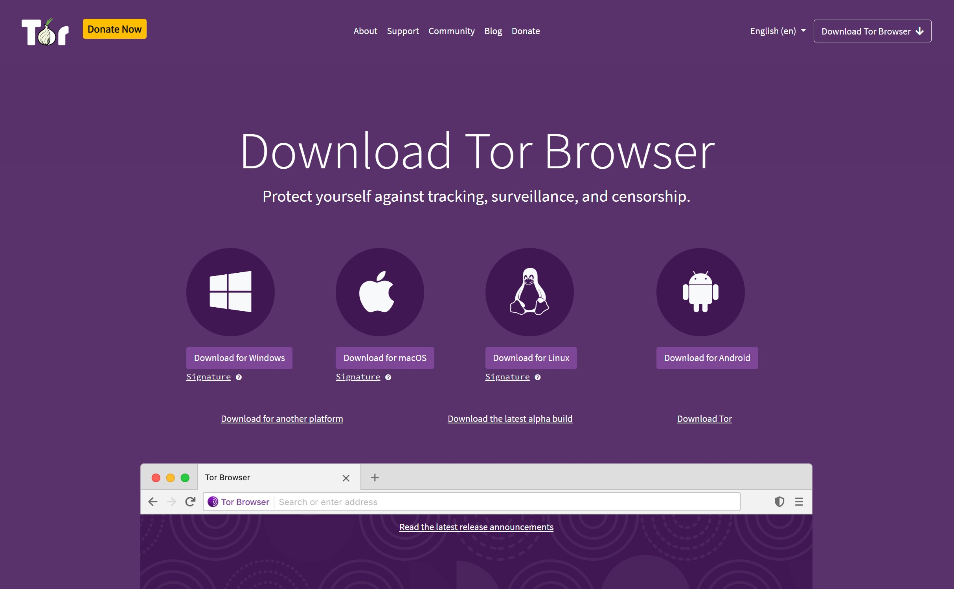
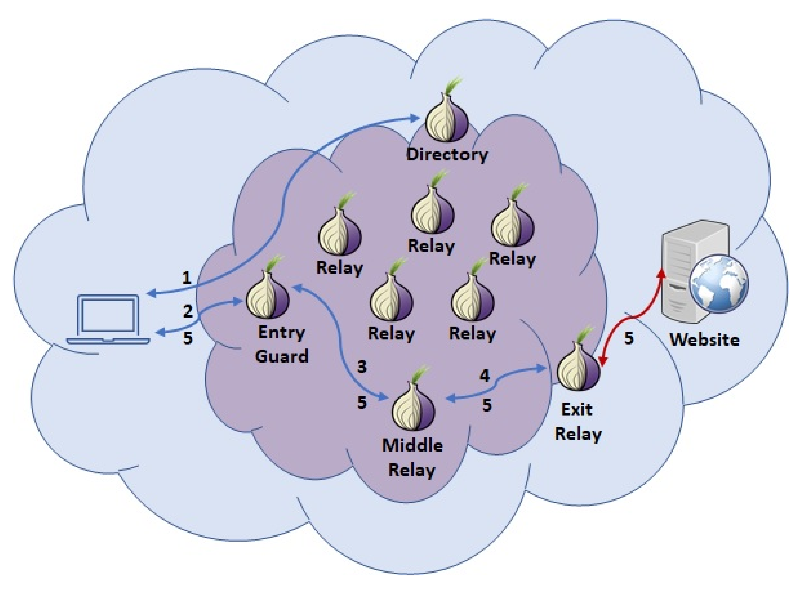
The Onion Router (Tor)
Components of Tor
Tor Browser: A web browser configured to connect to the Tor network (based on Firefox)
Tor network: A network of many Tor relays (proxies) for forwarding packets
Directory server: A server that holds and distributes a list of all active Tor relays (and their public keys ➔ why? MITM attacks!); also known as Directory Authorities
Tor onion services: Servers that can only be reached through the Tor network
Tor bridges: Tor relays that try to hide the fact that a user is connecting to the Tor network

Slide 11
The Goals of Tor
Security: Client anonymity and censorship resistance
  Optional: Server anonymity with onion services
Performance: Low latency; communication should be fast.
Tor preserves anonymity against local adversaries
  Example: An on-path attacker sees Alice send a message to a Tor relay, but not the final destination of the message
  Example: The server should not know the identity of the client

Slide 12
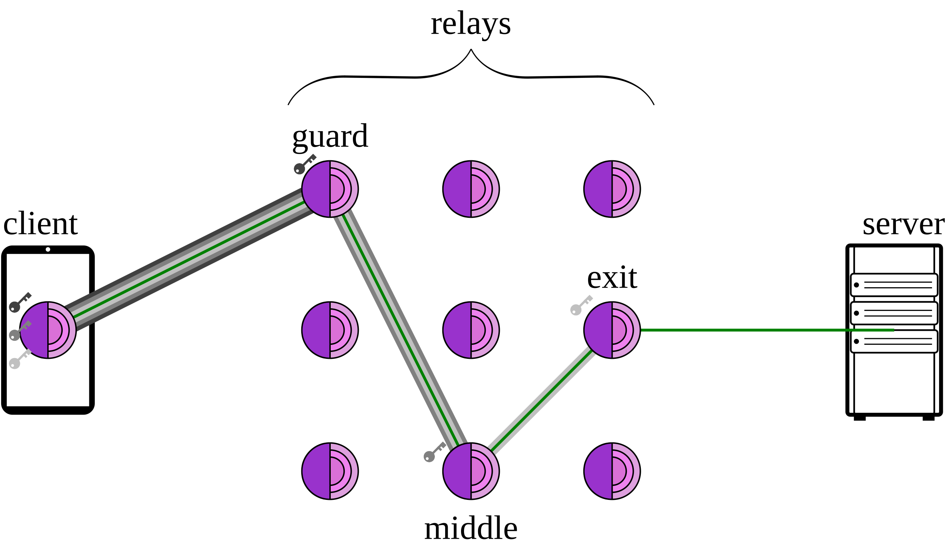
Tor Circuits
To communicate anonymously with a server, the Tor client forms a circuit consisting of 3 relays (by default)
Query the directory server for a list of relays
  Directory server: Lists all Tor relays and their public keys
Choose 3 relays to form a Tor circuit
Connect to the first relay, forming an end-to-end TLS connection
Connect to the second relay through the first relay, forming an end-to-end TLS connection
Connect to the third relay through the second relay, forming an end-to-end TLS connection
Connect to the web server
  If the web server is using HTTPS, then an end-to-end TLS connection will be formed through the third relay

Slide 13
Tor Circuits
Relay
Relay
Relay
Relay
Relay
Alice
Relay
Bob
Relay
Relay
Relay
Suppose Alice wants to talk to Bob anonymously.
Alice queries the directory server and chooses 3 relays

Slide 14
Tor Circuits
Relay
Relay
Relay
Relay
Relay
Alice
Relay
Bob
Relay
Relay
Then she forms a TLS connection with the second node (Tor EXTEND protocol), through the first node
Relay
Then she forms a TLS connection with the exit node (3rd relay), through the second node
Alice forms a TLS connection with the entry node
Notice: Relay 1 is only relaying TLS packets. It doesn’t know the contents of the packets!
Finally, she connects to Bob (optionally forming a TLS connection with Bob)
Notes:
Before circuit creation, Alice already knows the public keys of all relays
These are distributed through Tor directory services
This prevents MITM attacks by relays
The real process:
First, Alice establishes TLS with Relay 1 (entry node) - this is normal TLS
To extend to Relay 2:
Alice creates a symmetric key K2 for use with Relay 2
Encrypts K2 with Relay 2's public key
Sends this through the TLS connection with Relay 1
For Relay 3, repeats with K3
So, the actual structure is:
Layer 3 (outer): TLS between Alice-Relay1
Layer 2: Symmetric encryption with K2 for Alice-Relay2 traffic
Layer 1 (inner): Symmetric encryption with K3 for Alice-Relay3 traffic

Slide 15
What a Relay Does
Function of the relays:
Listen for someone to initiate a TLS connection
When receiving a packet, decrypt using the key obtained through TLS
If the destination of the packet is another relay, forward the packet to the next relay
If the destination of the packet is an external server, forward the packet to that server

Slide 16
Tor Packet Construction
Wrap the packets via encryption
  For example, the packet sent to Bob is encrypted under K₃ since Relay 3 is the one to forward that information to Bob
Ensures that no one can read or tamper with the messages, since these are all sent over TLS connections
Alice
Relay 1: K1
Relay 2: K2
To: Relay 1
Encrypted with K1
Relay: K3
To: Relay 2
To: Relay 3
Encrypted with K2
To: Bob
Hello world
Bob
Encrypted with K3

Slide 17
Tor Circuits
Relay
Relay
Relay
Relay
Relay
Relay
Alice
K₁, K₂, K₃
Relay
K₂
Bob
Relay
K1
Relay
K₃
To: Relay 1
To: Relay 2
To: Relay 3
To: Bob
Hello world

Slide 18
Tor Circuits
Relay
Relay
Relay
Relay
Relay
Relay
Alice
K₁, K₂, K₃
Relay
K₂
Bob
Relay
K1
Relay
K₃
To: Relay 1
To: Relay 2
Relay 1 peels off the first layer;
Can’t read what the contents for Relay 2 is for, since it’s encrypted!
To: Relay 3
To: Bob
Hello world

Slide 19
Tor Packet Construction
What does Relay 1 see?
Alice
To: Relay 1, From: Alice
Encrypted with K1
Relay 1: K1
To: Relay 2, From: R1
???
Encrypted with K2
Relay 2: K2
Relay: K3
All Relay 1 knows is the message came from Alice and is going to Relay 2. They don’t know Alice is talking to Bob!
Bob

Slide 20
Tor Circuits
Relay
Relay
Relay
Relay
Relay
Relay
Alice
K₁, K₂, K₃
Relay
K₂
Bob
Relay
K1
Relay
K₃
To: Relay 2
To: Relay 3
To: Bob
Hello world

Slide 21
Tor Packet Construction
What does Relay 2 see?
Alice
To: Relay 2, From: R1
Relay 1: K1
To: Relay 3, From: R2
Encrypted with K2
Relay 2: K2
??????
Encrypted with K3
Relay: K3
All Relay 2 knows is the message came from Relay 1 and is going to Relay 3. They know nothing about Alice and Bob!
Bob

Slide 22
Tor Circuits
Relay
Relay
Relay
Relay
Relay
Relay
Alice
K₁, K₂, K₃
Relay
K₂
Bob
Relay
K1
Relay
K₃
To: Relay 3
To: Bob
Hello world

Slide 23
Tor Packet Construction
What does Relay 3 see?
Alice
Relay 1: K1
To: Relay 3, From: R2
Relay 2: K2
To: Bob
Hello world
Encrypted with K3
Relay: K3
All Relay 3 knows is the message came from Relay 2 and is going to Bob. They don’t know Alice sent the message!
Bob

Slide 24
Tor Circuits
Relay
Relay
Relay
Relay
Relay
Relay
Alice
K₁, K₂, K₃
Relay
K₂
Bob
Relay
K1
Relay
K₃
To: Bob
Hello world

Slide 25
Tor Circuits
Relay
Relay
Relay
Relay
Relay
Relay
Alice
K₁, K₂, K₃
Relay
K₂
Bob
Relay
K1
Relay
K₃
Relay 1 knows that Alice is using Tor but not who Alice is talking to
Relay 2 knows nothing (other than that someone is using Tor)
Relay 3 knows that someone is talking to Bob, but not who

Slide 26
Tor Exit Nodes
Notice: The exit node (e.g., Relay 3) can see the message and the recipient
Without collusion, the exit node doesn’t know the sender
The exit node is a man-in-the-middle attacker
If the user is not using TLS to connect to the end host (using HTTP), the exit node can see and modify the traffic
If the user is using TLS (using HTTPS), the exit node cannot see or tamper with the traffic
Relay
Alice
Bob
Relay
Relay
Relay
Relay

Slide 27
Tor Weaknesses: Collusion
Collusion: Multiple nodes working together and sharing information
  Collusion is adversarial (dishonest) behavior
  If all nodes in the circuit collude, anonymity is broken
  If at least one nodes in the circuit is honest, anonymity is preserved
It is easy to form some amount of colluding nodes
  An adversary can create/control hundreds nodes in the Tor network to increase the chance that your circuit consists entirely of the attacker’s nodes!
  The more nodes we use, the more confident we are that they are not all colluding
Relay
Relay
Alice
Relay
Bob
Relay
Relay
Relay
Relay
Relay
Relay

Slide 28
Tor Weaknesses: Distinguishable Traffic
Tor does not hide the fact that you are using Tor!
Packet Size Pattern:
  HTTPS: Variable sizes reflecting the actual content length
  Tor: Always fixed 514-byte cells
Connection Pattern:
  HTTPS: Direct connection to destination
  Tor: Always connects to Tor relay first
Anonymity only works in a crowd
  Example: A Harvard student sends an anonymous threatening message using Tor. The administrators notice that only one student on the Harvard network is using Tor!

Slide 29
Tor Weaknesses: Timing Attacks
A network adversary who has a full (global) view of the network can learn that Alice and Bob are talking
Exploit a timing attack: Observe when Alice sends a message, when Bob receives a message, and link the two together
Global adversaries are outside of Tor’s threat model and are not defended against
Tor only defends against local adversaries with partial views of the network
Timing attacks could be defended against by delaying the timing of packets, but this violates Tor’s performance goal
German law enforcement has been identified as having a capability to deanonymize Tor users
Notes:
German law enforcement has been identified as having a capability to deanonymize Tor users through methods like a timing attack, which involves secretly recording traffic entering and leaving Tor nodes in Germany to correlate user activity.

Slide 30
Summary: Anonymity and Tor
Anonymity conceals an individual’s identity, but it’s difficult to achieve on the web
Proxies and VPNs relay traffic through a single machine
  Issue: The single relay knows who you are and what you are doing!
Tor routes your traffic through multiple relays
  No one machine knows both who you are and what you are doing
  Circuits are established by performing TLS handshakes with (at least) three nodes, nesting encrypted channels
  Weakness:
    Collusion between relay nodes can deanonymize users by working together
    Tor traffic is distinguishable from normal traffic
    Timing attacks

Slide 31
Roadmap
Anonymity
Proxies and VPNs
Tor
Tor Onion Services

Slide 32
Tor Onion Services
Sometimes, the server wants to be anonymous, so no one knows where the server is located
Tor onion services: Websites that are only accessible through the Tor network
    Gives the server anonymity protection
    Sometimes called the dark web
Big idea: Route the server’s traffic through the Tor network so that no one knows who the server is

Slide 33
Tor Onion Services
Recall: Standard domain names translate to IP addresses, which would break server anonymity
Instead, identify servers using the hash of the service’s public key encoded as “abcxyz .onion” address
  Example: http://pwoah7foa6au2pul.onion
  Example: https://facebookcorewwwi.onion (Facebook brute-forced key pairs until they found one with a human-readable hash)
Any .onion address can only be accessed through the Tor browser (or other software specifically configured to use the Tor network)
Only the Tor network knows how to route traffic to .onion services through its encrypted relay system

Slide 34
Tor Onion Services
Regular Domain names vs .onion:
  Regular domains must resolve to IP addresses, which reveal the server's network location
  .onion addresses are hashes of public keys, which don't contain any location information
Where the anonymity comes from:
  The .onion address being a hash of the public key means it's just a cryptographic identifier, not a network location
  When clients connect to an onion service, they establish an encrypted connection through multiple Tor relays (detailed in the following slides)
  The service's actual IP address is hidden behind these relay layers (hence "onion")
  No single relay knows both the client and the server's real location
Why use the hash of the public key
  The server proves it owns the address by proving it has the private key that matches the public key hash

Slide 35
Tor Onion Services
The server chooses nodes to be the introduction points
Relay
Relay
Relay
Relay
Relay I1
Client
Server
Relay
Relay
Relay I2
Relay
Hash | Public Key | Introduction Points
... | ... | ...
expuy….onion | PK | I₁, I₂
The server publishes its public key and the introduction points
Notes:
The server needs to publish how to contact the server:
The server chooses a set of nodes to be introduction points and forms a Tor circuit to each of them
For example: The server forms a full Tor circuit relay with I1 and I2, which are its introduction points
The server publishes its public key and its introduction points to a publicly available directory
In the distributed hash table, there’s information regarding the server’s public key and its set of introduction points

Slide 36
Tor Onion Services
Now, the client connects to the server
The client queries the directory using the hash of the public key to get the server’s full public key and the introduction points
The client chooses an introduction point and forms a Tor circuit to it
The client chooses a rendezvous point (relay) and secret used to communicate to the server, encrypts them with the server’s public key, and sends them to the introduction point, which relays them to the server
The client and server both form Tor circuits to the rendezvous point and perform an end-to-end TLS handshake, and the server sends the decrypted secret to the client to authenticate itself

Slide 37
Tor Onion Services
Relay
Relay
Relay
Relay
Relay I₁
Client
Server
Relay
Relay
Relay I₂
Relay R
The client queries the directory and connects to an introduction point
Hash | Public Key | Introduction Points
... | ... | ...
expuy….onion | PK | I₁, I₂

Slide 38
Tor Onion Services
Relay
Relay
Relay
Relay
Relay I₁
Client
Server
Relay
{“Rendezvous at R. The secret is K.”}PK
Relay
Relay I₂
Relay R
The client chooses a rendezvous point and secret, encrypts using the public key, and sends them to the server through the introduction point
Hash | Public Key | Introduction Points
... | ... | ...
expuy….onion | PK | I₁, I₂

Slide 39
Tor Onion Services
Relay
Relay
{“Rendezvous at R. The secret is K.”}PK
Relay
Relay
Relay I₁
Client
Server
Relay
Relay
Relay I₂
Relay R
The client chooses a rendezvous point and secret, encrypts using the public key, and sends them to the server through the introduction point
Hash | Public Key | Introduction Points
... | ... | ...
expuy….onion | PK | I₁, I₂

Slide 40
Tor Onion Services
Relay
Relay
Relay
Relay
Relay I₁
Client
Server
Relay
Relay
{“Rendezvous at R. The secret is K.”}PK
Relay I₂
Relay R
The client chooses a rendezvous point and secret, encrypts using the public key, and sends them to the server through the introduction point
Hash | Public Key | Introduction Points
... | ... | ...
expuy….onion | PK | I₁, I₂

Slide 41
Tor Onion Services
Relay
Relay
Relay
Relay
Relay I₁
Client
Server
Relay
Relay
{“Rendezvous at R. The secret is K.”}PK
Relay I₂
Relay R
The client connects to the rendezvous point and waits
The server connects to the rendezvous point
Notes:
The server connects to the rendezvous point through the introduction point

Slide 42
Tor Onion Services
Relay
Relay
Relay
Relay
Relay I₁
Client
Server
Relay
Relay
The secret that was encrypted is K
Relay I₂
Relay R
The client and server perform a handshake, and the server sends the decrypted secret

Slide 43
Tor Onion Services
Relay
Relay
Relay
Relay
Relay I₁
Client
Server
Relay
Relay
Relay I₂
Relay R
The secret that was encrypted is K
The client and server perform a handshake, and the server sends the decrypted secret

Slide 44
Tor Onion Services
Relay
Relay
Relay
Relay
Relay I₁
Client
Server
Relay
Relay
The secret that was encrypted is K
Relay I₂
Relay R
The client and server perform a handshake, and the server sends the decrypted secret

Slide 45
Tor Onion Services
Relay
Relay
Relay
Relay
Relay I₁
Client
Server
Relay
Relay
Relay I₂
Relay R
Notice: The client and server never directly communicate, and the introduction and rendezvous points don’t know the client or the server

Slide 46
Hosting Illegal Services on Tor
Tor onion services are often used for services widely considered illegal around the world
  Legitimate hosting services like Cloudflare will refuse to host these services
  Most countries will take legal action against these services if hosted on the regular web
Dark markets: Marketplaces for buying and selling illegal goods
  Transactions processed with a censorship-resistant currency like Bitcoin
    Services like PayPal will refuse to process illegal transactions
  Ratings system with mandatory feedback
  Escrow service to handle disputes between sellers and buyers
  Can only be accessed as a Tor onion service
Cybercrime forums: Websites for discussing illegal activity

