Slide 1
CSC 3511 Security and Networking
Week 14, Lecture 1: Firewalls

Slide 2
Roadmap
Motivation and Security Policies
Firewalls: Packet Filters
Firewall Limitations and Evasion

Slide 3
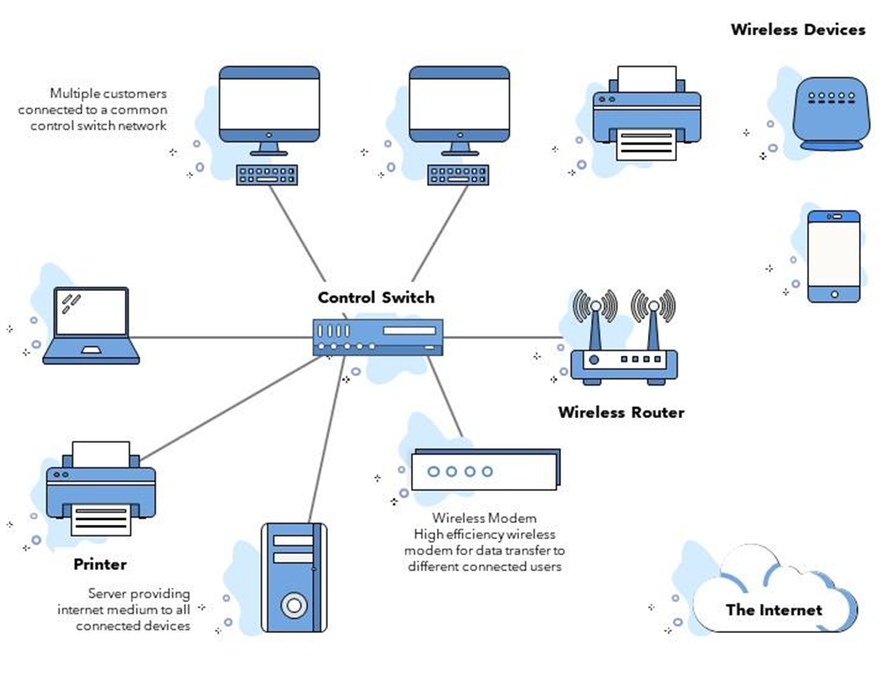
Motivation: Scalable Defenses
How do you protect a set of systems against external attack?
  Example: A company network with many servers and employee computers
Observation: More network services = more risk
Each network connection creates more opportunities for attacks (greater attack surface)
Various connections/protocols
Observation: More networked machines = more risk
What if you have to secure hundreds of systems with different hardware, operating systems, and users?
What if there are some devices (e.g., guest’s computer) in the network that you aren't aware of?
Instead of securing individual machines, we want to secure the entire network!

Slide 4
Firewalls and Security Policies
Idea: Add a single point of access in and out of the network, with a monitor
  Any traffic that could affect vulnerable systems must pass through the firewall
  Ensure “complete mediation”
Network access is controlled by a policy
  A security policy is a set of rules that defines what traffic is allowed or denied
  Defines what traffic is allowed to exit the network (outbound policy)
  Defines what traffic is allowed to enter the network (inbound policy)
  Policy model based on our threat model: We usually assume users “inside” the network are trusted, and those outside are not
Internet
Firewall
Notes:
Complete mediation is a fundamental security principle that means every access attempt must be checked. In other words, there should be no way to bypass the security mechanism.

Slide 5
Firewalls and Security Policies
For example, what’s the policy of a standard home network?
Outbound policy: Allow outbound traffic
  Users inside the network can connect to any service
Inbound policy: Only some traffic is able to enter the network
  Allow inbound traffic in response an outbound connection (e.g., FTP)
  Allow inbound traffic to certain, trusted services (e.g. SSH)
  Deny all other inbound traffic (e.g., IP forwarding)
Allow outbound traffic
Internet
Firewall
Allow trusted inbound traffic
Deny other inbound traffic
Notes:
SSH: secure shell

Slide 6
Default Security Policies?
How should we handle traffic that isn’t explicitly allowed or denied?
  For example, an employee clicks a phishing link, and ransomware tries to connect to an AWS EC2 instance on port 8443
Default-allow policy: Allow all traffic, but deny those on a specified denylist
  For the above example: Connection succeeds ➔ Ransomware communicates with attacker, encrypts files, exfiltrates data.
  As problems arise, add them to the denylist
Default-deny policy: Deny all traffic, but allow those on a specified allowlist
  For the above example: Connection blocked ➔ Attack is contained, ransomware can't receive instructions or send data out.
  As needs arise, add them to the allowlist

Slide 7
Default Security Policies?
Default-allow policy vs. Default-deny policy, which default policy is better?
Default-allow is more flexible, but flaws are vulnerabilities and can be catastrophic
Default-deny is more conservative, but flaws are less painful
Default-deny is generally accepted to be the best default policy
  Never trust, always verify
Aspect | Default Accept (Blocklist/Denylist) | Default Deny (Allowlist)
Security | Less secure: Any traffic not explicitly blocked is allowed, which can expose vulnerabilities. | More secure: All traffic is blocked unless explicitly allowed, minimizing the attack surface.
Functionality | Maximizes functionality: All traffic works unless explicitly blocked. | Reduces functionality initially: Services and applications may not work until specific rules are created.
Ease of Configuration | Easier to configure: No need to identify every necessary traffic flow up front. | More effort required: Every service, port, or protocol needs to be explicitly configured.
Use Case | Suitable for home networks, personal devices, or less critical systems where functionality is prioritized. | Best for organizations, data centers, or sensitive systems where security is a top priority.

Slide 8
Roadmap
Motivation and Security Policies
Firewalls: Packet Filters
Firewall Limitations and Evasion

Slide 9
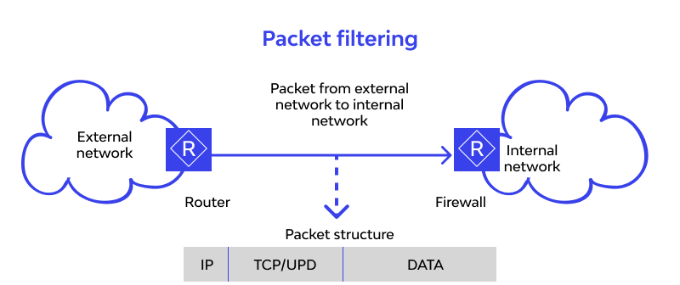
Packet Filters
Firewalls are often packet filters
Filtering with incoming and outgoing interfaces
Inspect network packets and chooses a handling method: forward or drop
Works at network layer and transport layer;
Filter based on packet header fields:
  Source & destination IP addresses
  Protocols (TCP, UDP, ICMP):
    Source & destination port number
    Control flags (TCP SYN, ACK, FIN, etc.)
Fast and efficient: Minimal processing overhead
https://www.wallarm.com/what/the-concept-of-a-firewall

Slide 10
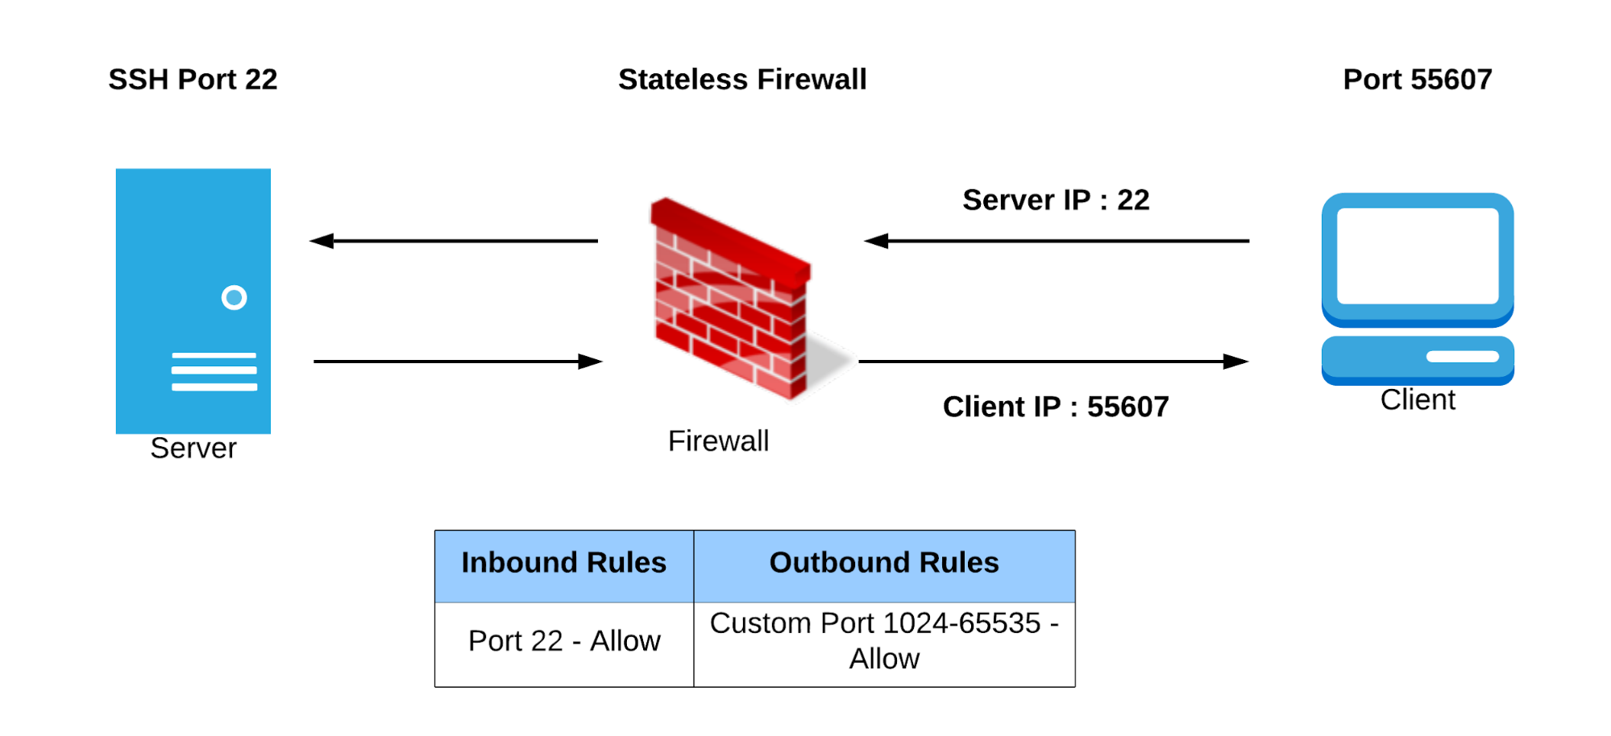

Packet Filters
Stateless packet filters
Packet filters that have no history
All decisions must be made using only the information in the packet itself
Can have trouble implementing complex policies that require knowledge of history
Stateful packet filters
Maintain a state table that tracks all active connections and sessions passing through it
Notes:
Stateless Firewall
Definition: A stateless firewall filters packets based solely on pre-defined rules (e.g., IP addresses, ports, protocols) without considering the context of the traffic.
Key Features:
Each packet is treated independently.
No knowledge of connection states (e.g., whether it's part of an ongoing session).
Faster and simpler but less secure.
Use Case: Suitable for simple networks or specific use cases like blocking or allowing traffic based on static rules.
Example Rule: Block all incoming traffic on port 22 (SSH), regardless of whether it's part of an existing connection.
Stateful Firewall
Definition: A stateful firewall tracks the state of active connections and makes decisions based on the context (e.g., whether a packet is part of an established connection).
Key Features:
Maintains a connection table to track ongoing sessions.
Can distinguish between new, established, or related connections.
Provides more security as it evaluates traffic in context.
Use Case: Ideal for modern, complex networks where connection state matters (e.g., enterprise networks, application servers).
Example Rule: Allow incoming traffic on port 22 (SSH) only if it’s part of an already established connection.

Slide 11
Stateless Packet Filters
Consider implementing the typical home network policy:
Allow outbound traffic
Allow inbound traffic in response to an outbound connection
Deny all other inbound traffic
Issue: How do we know what inbound traffic is in response to an outbound connection?
TCP: Can be implemented with a hack
  Deny inbound traffic without an ACK flag set
  Allow inbound traffic with the ACK flag set
  If the internal computer sees an ACK packet without having formed a connection (through the OS), it will ignore it or send a RST packet
UDP (e.g., DNS responses): Impossible to implement
  UDP “connections” are typically implemented at the application layer, so we can’t inspect much
Stateless packet filters are not good enough!
Notes:
Stateless Firewall
Definition: A stateless firewall filters packets based solely on pre-defined rules (e.g., IP addresses, ports, protocols) without considering the context of the traffic.
Key Features:
Each packet is treated independently.
No knowledge of connection states (e.g., whether it's part of an ongoing session).
Faster and simpler but less secure.
Use Case: Suitable for simple networks or specific use cases like blocking or allowing traffic based on static rules.
Example Rule: Block all incoming traffic on port 22 (SSH), regardless of whether it's part of an existing connection.
Stateful Firewall
Definition: A stateful firewall tracks the state of active connections and makes decisions based on the context (e.g., whether a packet is part of an established connection).
Key Features:
Maintains a connection table to track ongoing sessions.
Can distinguish between new, established, or related connections.
Provides more security as it evaluates traffic in context.
Use Case: Ideal for modern, complex networks where connection state matters (e.g., enterprise networks, application servers).
Example Rule: Allow incoming traffic on port 22 (SSH) only if it’s part of an already established connection.

Slide 12
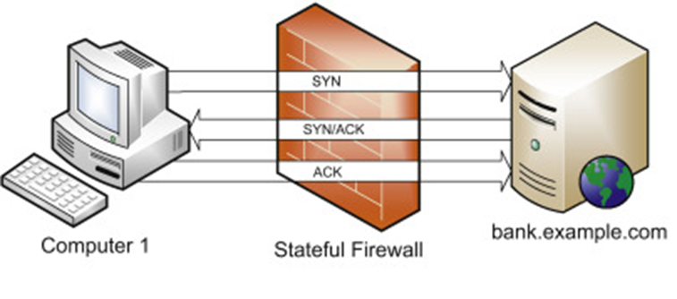
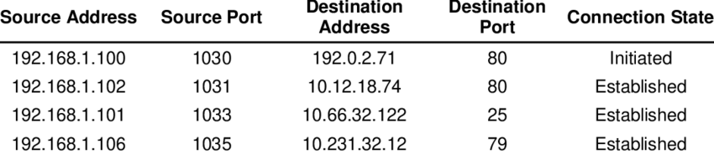
Stateful Packet Filters
A better idea: Keep “state” in the implementation of the packet filter
The filter keeps track of inbound/outbound connections and sessions passing through it, rather than individual packets
Phase 1: Session handling
  The firewall tracks and remembers active connections by maintaining a connection state table
  Remembers details about active connections
    Source/destination IP addresses and ports
    Connection states (NEW, ESTABLISHED, RELATED, etc.)
    Protocol-specific parameters (e.g., TCP SEQ and ACK #, TCP flags seen, ICMP Seq #)
    Timestamps (created, last activity)

Slide 13
Stateful Packet Filters
A better idea: Keep “state” in the implementation of the packet filter
Phase 2: Decision making
  Makes decisions based on both static rules and connection context
    For ESTABLISHED connections: Automatically allowed (already in state table)
    For NEW connections: Must pass all firewall rules
    For INVALID packets: Rejected (don't match any known connection)
Example rules:
allow tcp connection 4.5.5.4:* -> 3.1.1.2:80
  Allow connections from 4.5.5.4 to 3.1.1.2 with destination port 80
allow tcp connection *:*/int -> *:80/ext
  Allow outbound connections with destination port 80
allow icmp connection *:*/int -> *:*/ext
  Allow outbound ICMP connections from any internal host to any external host
allow udp connection *:*/int -> *:53/ext
  Allow outbound UDP connections from any internal host to any external DNS servers
  Stateful firewall automatically allows UDP responses back
Notes:
int = interface connected to the internal network (trusted network)
ext = interface connected to the external network (Internet/untrusted)
-> means "connecting to" (outbound initiation)
<- would mean "connecting from" (inbound initiation)

Slide 14
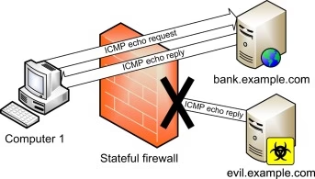
Stateful Packet Filters
A better idea: Keep “state” in the implementation of the packet filter
Phase 2: Decision making
  Makes decisions based on both static rules and connection context
Outbound ICMP Echo Request to bank.example.com
  Firewall creates state table entry, containing Session ID, connection type, des IP, ICMP ID & Seq, State (NEW ➔ ESTABLISHED), and expected reply
Inbound ICMP Echo Reply from bank.example.com
  Validates session ID, ICMP ID and Seq match expected values
Unsolicited ICMP Echo Reply from evil.example.com
  Checks state table: No matching ICMP request to evil.example.com
  Marks as INVALID && Drops the packet
  Computer 1 never receives this malicious ICMP reply
Notes:
NEW ➔ ESTABLISHED: after request sent
Expected reply: ICMP Type 0 (ICMP response) from bank.example.com
In networking context, unsolicited traffic means packets arriving at your network that you did not initiate or ask for

Slide 15
Stateless vs. Stateful Packet Filters
Consider implementing the typical home network policy:
Allow inbound traffic in response to an outbound connection
Issue: How do we know what inbound TCP traffic is in response to an outbound connection?
Attempted solutions with stateless filters:
Rule 1: Allow outbound TCP (all ports)
Rule 2: Deny inbound TCP WITHOUT ACK flag ← Attempts to block new connection initiations
Rule 3: Allow inbound TCP WITH ACK flag
Rule 4: Deny all other inbound
Problem:
Attacker can set ACK flag on malicious packets!
  SRC addr && Port ➔ evil.com:80
  DST addr && Port ➔ your_ip_addr:12345 [ACK = 1] && [RST = 1]
Some legitimate packets might be blocked: Server → Client: [FIN = 1] (ACK flag might be 0)

Slide 16
Stateless vs. Stateful Packet Filters
Consider implementing the typical home network policy:
Allow inbound traffic in response to an outbound connection
Issue: How do we know what inbound traffic is in response to an outbound connection?
Attempted solutions with stateful filters and state sable:
Rule 1: Check if packet matches existing session ➔ Allow
Rule 2: If not, check if it's starting a new valid session ➔ Check rules
Rule 3: Otherwise ➔ Deny
Session ID | Protocol | SRC IP:Port | DST IP:Port | State | Timeout
#4738 | TCP | 192.168.1.100:52341 | 93.184.216.34:443 | ESTABLISHED | 3600s
#4739 | UDP | 192.168.1.100:53128 | 8.8.8.8:53 | ESTABLISHED | 30s
Legitimate responses: Matched to sessions ➔ allow
Spoofed packets: Don't match any session ➔ block
Unsolicited inbound: No matching session ➔ block
In networking context, unsolicited traffic means packets arriving at your network that you did not initiate or ask for
Notes:
Unsolicited means “not requested” or “not expected”

Slide 17
Stateless vs. Stateful Packet Filters
Aspect | Stateless Packet Filters | Stateful Packet Filters
Traffic Evaluation | Individual packets only (no memory) | Tracks and evaluates connection states (maintain state table)
Decision Based On | Static rules: IP addr, ports, protocols, flags | Static rules + connection context (NEW, ESTABLISHED, RELATED, INVALID)
Performance | Faster, less resource-intensive | Slower, more resource-intensive (state table maintenance, memory overhead)
Security | Basic filtering (less secure); vulnerable to spoofing, e.g., ACK flag attacks | Context-aware filtering (more secure); validates connections, prevents spoofing
Use Case | Simple networks, legacy systems | Modern enterprise networks, dynamic connections

Slide 18
Stateless vs. Stateful Packet Filters: Example 1
Web Browsing
Scenario | Stateless Behavior | Stateful Behavior
User visits website | Rule 1: Allow outbound port 443 Rule 2: Allow inbound from any source with ACK flag (insecure) | Rule 1: Allow outbound port 443 Rule 2: Response automatically allowed
Attacker sends packet with ACK flag | Allowed through (insecure) | Checked against state table, blocked
Notes:
HTTPS common port: 443

Slide 19
Stateless vs. Stateful Packet Filters: Example 2
ICMP Ping
Scenario | Stateless Behavior | Stateful Behavior
Internal user pings external host | Rule 1: Allow outbound ICMP Rule 2: Allow inbound ICMP from anywhere | Rule1: Allow outbound ICMP Rule 2: Reply automatically allowed
Attacker sends unsolicited ICMP | Allowed through (insecure) | No matching state, blocked
ICMP has no ports, seq #, or connection states like TCP. How stateful firewalls track ICMP “connection”?
Solution: Firewall creates pseudo-connection by tracking ICMP-specific fields
Notes:
ICMP packets are sent directly over IP layer.

Slide 20
Stateless vs. Stateful Packet Filters: Example 2
Step 1: User pings google.com
192.168.1.100 → 8.8.8.8
Step 2: Firewall creates state table entry
Step 3: Google replies
8.8.8.8 → 192.168.1.100
Step 4: Firewall checks incoming packet
  Protocol: ICMP
  Type: 0 (Echo Reply)
  ICMP Identifier: 1234
  ICMP Sequence: 1
  Source IP: 8.8.8.8
  Destination IP: 192.168.1.100
Field | Value | Purpose
Session ID | #4740 | Unique identifier for this "connection"
Protocol | ICMP | Protocol type
Type | 8 (Echo Request) | ICMP message type sent
Expected Reply Type | 0 (Echo Reply) | Expected response type
ICMP Identifier | 1234 | Unique ID from ping command
ICMP Sequence | 1 | Sequence number from ping
Source IP | 192.168.1.100 | Internal host
Destination IP | 8.8.8.8 | External host (google.com)
State | ESTABLISHED | Waiting for reply
Timestamp | 14:30:45.123 | When request was sent
Timeout | 10 seconds | How long to wait for reply
Attacker sends unsolicited ICMP reply?
No entry matches this ICMP message
Notes:
ICMP packets are sent directly over IP layer. No TCP or UDP, no “connection”, no port number

Slide 21
Sample Question
RULE # | Action | Source | Destination | Port | Protocol | Flags/ State | Comment
Rule 1 | Allow | * | 192.168.1.10 | 80 | TCP | New | Allow new HTTP connections to web server
Rule 2 | Allow | 192.168.1.10 | * | * | TCP | Established | Allow web server HTTP responses
Rule 3 | Deny | * | * | * | * | * | Default deny rule
Packet to Evaluate:
  Source IP: 203.0.113.5
  Destination IP: 192.168.1.10
  Destination Port: 443
  Protocol: TCP
  Flags: SYN
Question a: Will this packet be allowed or denied by the policy? Justify your answer with reference to the rules and flags.
Question b: Modify the given policy (if needed) to ensure the packet is handled according to the scenario requirements.
Notes:
Rule 1 (Allow HTTP to Web Server):
Source: Matches (* allows all sources).
Destination: Matches (192.168.1.10 is the destination).
Port: Matches (port 80 is specified).
Protocol: Matches (TCP is specified).
Flags: Matches (* accepts all flags, including SYN).
Action: ALLOW. This rule allows the packet.
Rule 2 (Allow HTTPS Outbound Replies):
Does not match because:
The source IP (203.0.113.5) is not in the internal subnet (192.168.2.0/24).
The port (80) does not match (443 specified).
This rule does not apply.
Rule 3 (Default Deny):
This rule would block any traffic that does not match earlier rules.

Slide 22
Sample Question
Question a:
  The packet will be denied.
  Justification: The packet violates Rule 1, which only allows HTTP traffic (port 80) to the web server (192.168.1.10) from any source.
Question b:
  Add a new rule as follows
RULE # | Action | Source | Destination | Port | Protocol | Flags/ State | Comment
Rule 1 | Allow | * | 192.168.1.10 | 80 | TCP | New | Allow new HTTP connections to web server
Rule NEW | Allow | * | 192.168.1.10 | 443 | TCP | New | Allow new HTTPS connections to web server
Rule 2 | Allow | 192.168.1.10 | * | * | TCP | Established | Allow web server HTTP/HTTPS responses
Rule 3 | Deny | * | * | * | * | * | Default deny rule

Slide 23
Roadmap
Motivation and Security Policies
Firewalls: Packet Filters
Firewall Limitations and Evasion

Slide 24
New Challenge: Deep Packet Inspection
From: A | To: B
Seq = 4
Hello world
What We've Learned So Far:
Packet filters inspect headers (IP addresses, ports, protocols, flags)
They don't examine payload
Problem: What if malicious content is hidden inside the payload?
Example scenario:
  Firewall Rule: Deny all packets containing the word root
  Goal: Block exploitation attempts that use 'root' command
Question: How does the firewall detect "root" in the payload?
Must perform Deep Packet Inspection (DPI)
Must reconstruct TCP streams to see complete messages
✓
From: C | To: D
Seq = 2
Log in
✓
From: C | To: D
Seq = 8
as root
✗

Slide 25
Evading Packet Filters
Question: How does the firewall detect "root" in the payload?
Recall: TCP
  Messages are split into packets before being sent
  Packets can arrive out of order: The application will use sequence numbers to reorder packets
Attack 1: Payload Fragmentation
  Split the word root across multiple packets
  No single packet contains root, so the firewall won’t stop any of these packets
  Destination host reassembles TCP stream ➔ sees complete malicious content
o
Seq = 6
o
Seq = 4
r
r
Firewall
Seq = 5
o
o
Seq = 7
t
t
Notes:
Firewall can reconstruct those fragments

Slide 26
Evading Packet Filters
Question: How does the firewall detect "root" in the payload?
Dies before reaching server
Recall: IP packets have a time-to-live (TTL)
  The number of hops a packet may take before the packet is dropped
  The attacker can easily find how many hops away a given server is ➔Send ping packets with increasing TTLs until the server responds
Attack 2: TTL Evasion Attack
  Confuse firewall by sending duplicate packets with different TTLs
  What the firewall sees: 'nroiocet'
  What the server sees: 'root'
n
Seq = 4, TTL = 16
r
Seq = 4, TTL = 22
r
o
Seq = 5, TTL = 22
o
Seq = 5, TTL = 16
i
Firewall
Seq = 6, TTL = 22
o
o
Seq = 6, TTL = 16
c
e
Seq = 7, TTL = 16
t
Seq = 7, TTL = 22
t
Notes:
How to set up the TTL values? Use traceroute and ping commands; do some research and analysis from the outputs

Slide 27
Evading Packet Filters
Dies before reaching server
Defense strategies
  Reconstruct TCP streams
  Inspect reassembled payload, not individual packets
  Apply content filters to complete messages
  Example: next-generation firewall (NGFW)
n
Seq = 4, TTL = 16
r
Seq = 4, TTL = 22
r
o
Seq = 5, TTL = 22
o
Seq = 5, TTL = 16
i
Firewall
Seq = 6, TTL = 22
o
o
Seq = 6, TTL = 16
c
e
Seq = 7, TTL = 16
t
Seq = 7, TTL = 22
t

Slide 28
Other Types of Firewalls
Proxy firewall: Instead of forwarding packets, form two TCP connections: One with the source, and one with the destination
  Avoids problems with packets, since the firewall has direct access to the TCP byte streams
Application proxy firewall: Certain protocols allow for proxying at the application layer
  Example: HTTP proxies will make an HTTP request on behalf of the user then return the HTTP response to the client
Client (outside)
TCP
Firewall
TCP
Server (inside)

Slide 29
Summary: Firewalls
Firewalls: Defend many devices by defending the network
  Security policies dictate how traffic on the network is handled
Packet filters: Choose to either forward or drop packets
  Stateless packet filters: Choose depending on the packet only
  Stateful packet filters: Choose depending on the packet and the history of the connection
  Attackers can subvert packet filters by splitting key payloads or exploiting the TTL
Proxy firewalls: Create a connection with both sides instead of forwarding packets
ML-Powered NGFW: https://www.paloaltonetworks.com/cyberpedia/what-is-an-ml-powered-ngfw

