Slide 1
CSC 3511 Security and Networking
Week 6, Lecture 1: IP Header and IP Security

Slide 2
Roadmap
IP(v4) Header
IP Security

Slide 3
IP Header Design Goals
Think of the IP header as an interface:
Forwarding and routing: allows the source and intermediate routers to exchange information
Data exchange: allows the source and destination to exchange information
Design goals:
Small: A larger IP header makes every single IP packet (IP datagram) larger
Simple: Routers have to process packets quickly
What fields are in the IP header?
It depends on what tasks IP needs to perform

Slide 4
Introducing the IP Header
What IP does (functions):
Addressing: IP addr, addr configuration & translation
Encapsulation: Wraps segments in IP datagrams
Forwarding: Moves packets hop-by-hop
Fragmentation: Breaks/reassembles packets
Our goal:
Understand the fields in IP header
Understand the design choices in making this header
32 bits
Version (4) | Hdr len (4) | Type of Service (8) |  | Total Length in Bytes (16)
Identification (16) |  |  |  | Flags (3) | Fragment Offset (13)
TTL (8) |  | Protocol (8) |  | Header Checksum (16)
Source IP Address (32)
Destination IP Address (32)
Options (if any)
Payload
IP Header
IP Payload

Slide 5
IP Tasks
IP functionality can be classified into 6 tasks. Some tasks are done by only routers or the destination host; Others are done by both:
Parse the packet (both router and destination)
Forward packet to the next hop (router only)
Tell the destination what to do next (destination only)
Send responses back to the source (both router and destination)
Handle errors (both router and destination)
Specify any special packet handling (both router and destination)

Slide 6
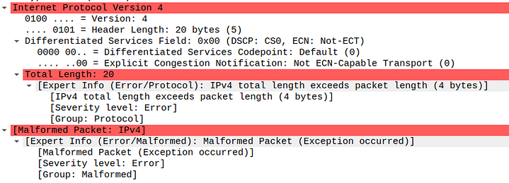
Task 1: Parse the Packet
Version: What version of IP?
Header length (Internet Header Length (IHL)):
A 4-bit field called IHL that specifies the header length
Each value represents 4 bytes instead of 1 byte
Total length (measured in bytes):
Total Length = IP Header Length + IP Payload Length
Where does the packet end?
Version (4) | Hdr len (4) | Type of Service (8) | Total Length in Bytes (16)
“Malformed Packet: IPv4”:
Wireshark detected something wrong
Packet capture error: Only part of the packet was captured
Network corruption: Packet was damaged in transit
Malicious packet: Deliberately crafted to be malformed, etc.
In a healthy IP packet, you'd see something like:
IHL: (0101) 20 bytes Total Length: 1500 bytes ➔ IP Payload: 1500 - 20 = 1480 bytes (TCP/UDP/ICMP data)
Notes:
IHL concrete examples:
IHL (Bin) IHL value (Dec) Calculation Actual header length
0101 5 5 × 4 bytes 20 bytes (minimum, no options)
1010 10 10 × 4 bytes 40 bytes
15 15 × 4 bytes 60 bytes (maximum)

Slide 7
Task 2: Forward Packet to Next Hop
Destination IP address
32 bits
Version (4) | Hdr len (4) | Type of Service (8) |  | Total Length in Bytes (16)
Identification (16) |  |  |  | Flags (3) | Fragment Offset (13)
TTL (8) |  | Protocol (8) |  | Header Checksum (16)
Source IP Address (32)
Destination IP Address (32)
Options (if any)
Payload
IP Header
IP Payload

Slide 8
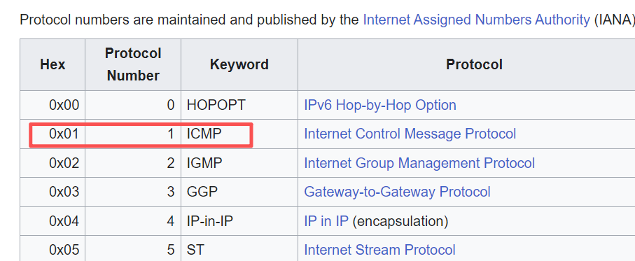
Task 3: Tell Destination What to Do Next
Protocol field:
Identify the Layer 4 (Transport Layer) protocol to pass the payload to
List of IP protocol numbers: https://en.wikipedia.org/wiki/List_of_IP_protocol_numbers
32 bits
Version (4) | Hdr len (4) | Type of Service (8) |  | Total Length in Bytes (16)
Identification (16) |  |  |  | Flags (3) | Fragment Offset (13)
TTL (8) |  | Protocol (8) |  | Header Checksum (16)
Source IP Address (32)
Destination IP Address (32)
Options (if any)
Payload
IP Header
IP Payload

Slide 9
Task 3: Tell Destination What to Do Next
We need to indicate which protocol should handle the packet next
De-multiplexing: Picking one of several possible Layer 4 protocols
IP Header
IP Header
Protocol = 6
IP Header
Protocol = 17
IP Payload
TCP Header
UDP Header
TCP Payload
UDP Payload
Without the protocol field, we have no idea what to do with the bits in red
If we see protocol = 6:
Pass the red bits to TCP code
If we see protocol = 17:
Pass the red bits to UDP code

Slide 10
Task 4: Send Response Back to Source
Source IP address
Note: We said both the router and destination might do this
The router might want to send a response back to the source too
(e.g. Ping 10.9.0.7 in Lab 5, an error occurs)
32 bits
Version (4) | Hdr len (4) | Type of Service (8) |  | Total Length in Bytes (16)
Identification (16) |  |  |  | Flags (3) | Fragment Offset (13)
TTL (8) |  | Protocol (8) |  | Header Checksum (16)
Source IP Address (32)
Destination IP Address (32)
Options (if any)
Payload
IP Header
IP Payload

Slide 11
Task 5: Handle Errors - TTL
Problem: Forwarding errors (e.g., loops) cause packets to cycle indefinitely; Wastes bandwidth
Time-to-live (TTL):
Specifies maximum number of hops a packet can take
TTL is decremented at every hop by the router.
If router receives packet with TTL 1:
Router decrements TTL: 1 - 1 = 0
Router sees TTL = 0 after decrementing
Router drops the packet and sends ICMP “Time Exceeded” packet back to the source
32 bits
Version (4) | Hdr len (4) | Type of Service (8) |  | Total Length in Bytes (16)
Identification (16) |  |  |  | Flags (3) | Fragment Offset (13)
TTL (8) |  | Protocol (8) |  | Header Checksum (16)
Source IP Address (32)
Destination IP Address (32)
Options (if any)
Payload
IP Header
IP Payload

Slide 12
Task 5: Handle Errors - Checksum
Problem: The packet could get corrupted in transit
Checksum: Small number of bits used to verify that data hasn't been corrupted
The checksum is only computed on the IP header, not the payload (How does TCP/UDP calculate the checksum? ➔ including the pseudo-header, header, and payload data):
IP header can't detect the payload being corrupted
Why this design? End-to-end principle ➔ The payload should be checked by the end hosts, not intermediate routers
The checksum has to be updated at every router:
Why? Because the TTL changes
32 bits
Version (4) | Hdr len (4) | Type of Service (8) | Total Length in Bytes (16)
Identification (16) |  |  | Flags (3) | Fragment Offset (13)
TTL (8) |  | Protocol (8) | Header Checksum (16)

Slide 13
Task 5: Handle Errors - Fragmentation
Problem:
The packet might be too large for a link: IPv4 total length field is 16 bits ➔ Maximum IP packet has 65,535 bytes
Every link has a Maximum Transmission Unit (MTU): Largest number of bits the link can carry as one unit. E.g., Ethernet has an MTU of 1500 bytes, some wide area networks (WANs), such as X.25, have an MTU of 576 bytes
Sender doesn't know the path (and MTU). If a packet size exceeds a link's MTU, the router must split the packet into multiple fragments
Then, the receiver has to reassemble the fragments to recover the original packet
32 bits
Version (4) | Hdr len (4) | Type of Service (8) | Total Length in Bytes (16)
Identification (16) |  |  | Flags (3) | Fragment Offset (13)
TTL (8) |  | Protocol (8) | Header Checksum (16)

Slide 14
Task 5: Handle Errors - Fragmentation
ID: Each fragment of the same packet has the same ID. The destination needs to know which fragments belong together
Flags (3 bits, 1 bit unused):
DF: Don't Fragment. If this packet is too large, just drop it
MF: More Fragments. There's more data after this fragment
Offset:
Identifies which bytes of the original packet are in this fragment
Offset = (Position of fragment data in original packet) ÷ 8
32 bits
Version (4) | Hdr len (4) | Type of Service (8) | Total Length in Bytes (16)
Identification (16) |  |  | Flags (3) | Fragment Offset (13)
TTL (8) |  | Protocol (8) | Header Checksum (16)

Slide 15
Task 5: Handle Errors - Fragmentation
Source host assigns the ID, mandatory
IP Header
ID: 25930
DF = F, MF = F
Offset: 0
IP Payload
(Bytes 0~2999)
Don't Fragment = False allows us to fragment
IP Header
ID: 25930
DF = F, MF = T
Offset: 0
IP Payload
(Bytes 0~999)
IP Header
ID: 25930
DF = F, MF = T
Offset: 125
IP Payload
(Bytes 1000~1999)
IP Header
ID: 25930
DF = F, MF = F
Offset: 250
IP Payload
(Bytes 2000~2999)
Router assigns the same ID on each fragment of this packet
More Fragments = True
on all but the last fragment
Offset measured in multiples of 8 bytes 1000 / 8 = 125
2000 / 8 = 250
More Fragments = False
on the last fragment
IP header size = 20 bytes, payload size = 1000 bytes
Notes:
The source host typically uses one of these strategies:
Simple counter (most common):
Start at some value (often random);
Increment by 1 for each packet sent;
Wraps around at 65,535 (16 bits)
Per-destination counter:
Different counter for each destination
Helps avoid ID conflicts
Random (less common):
Generate random ID for each packet

Slide 16
Task 6: Specify Special Packet Handling
Type of Service: Treat packets differently depending on application / customer needs
Options: Request advanced functionality for this packet
32 bits
Version (4) | Hdr len (4) | Type of Service (8) |  | Total Length in Bytes (16)
Identification (16) |  |  |  | Flags (3) | Fragment Offset (13)
TTL (8) |  | Protocol (8) |  | Header Checksum (16)
Source IP Address (32)
Destination IP Address (32)
Options (if any)
Payload
IP Header
IP Payload

Slide 17
Task 6: Specify Special Packet Handling
Original idea:
Request different forms of delivery depending on these bits
Based on priority, delay, throughput, reliability, cost, etc.
These bits were frequently re-defined and never fully deployed
Only the notion of priorities remained
Modern usage:
Request advanced functionality for this packet. For example:
Record Route: Tell me the path that this packet took (useful for diagnostics)
Source Route: Send the packet along the route I provide
Timestamp: Record when each router processes this packet
Version (4) | Hdr len (4) | Type of Service (8) | Total Length in Bytes (16)
……
Options (if any)
Payload

Slide 18
IP Header: Summary
Parse the packet (both router and destination)
Forward packet to the next hop (router only)
Tell the destination what to do next (destination only)
Send responses back to the source (both router and destination)
Handle errors (both router and destination)
Specify any special packet handling (both router and destination)
Version (4) | Hdr len (4) | Type of Service (8) |  | Total Length in Bytes (16)
Identification (16) |  |  |  | Flags (3) | Fragment Offset (13)
TTL (8) |  | Protocol (8) |  | Header Checksum (16)
Source IP Address (32)
Destination IP Address (32)
Options (if any)
Payload

Slide 19
Roadmap
IP(v4) Header
IP Security

Slide 20
Exploiting Source IP: Spoofing
Spoofing: Lie about the source address
Attacker pretends to be somebody else and sends the packet.
Using spoofing to attack the impersonated user (Lab 5):
Attacker pretends to be Bob and sends a virus
Now Bob is wrongly blamed for sending the virus
Return traffic (e.g. angry messages) goes to Bob instead
Using spoofing to attack a destination:
Denial-of-service (DoS) attack: Overwhelm a service by flooding it with packets
Without spoofing: The service can block your source address
Spoofing makes DoS more effective: Server doesn't know which packets to block

Slide 21
Exploiting Type of Service
Recall type of service (ToS): Bits indicating priority of the packet
Attack: Prioritize your own traffic
If anybody can set ToS bits, attackers can make their own packets high-priority ➔ Network prefers attacker traffic
Today, ToS bits are mostly set/used by operators, not end hosts
Attack: Use spoofing to make someone else pay for priority traffic
Suppose the network charges for high-priority traffic
Attacker sends a spoofed packet: "I am Bob and this packet is high-priority."
Network makes Bob pay for that packet

Slide 22
Exploiting Fragmentation and Options
Recall: Fragmentation and options are more work for the router
Denial-of-service (DoS) attack: Overwhelm routers by making them do more work. For example:
Fragmentation: Send large packets on purpose
Options: Send packets with complicated options on purpose
  Defense: Routers often ignore options, or drop packets with options

Slide 23
Exploiting TTL: Traceroute
Traceroute: Exploiting the TTL to discover the path a packet travels along
You have done this in Lab 5
Key idea: When TTL expires, the router sends back a "TTL Exceeded" error.
This allows you to learn the identity one of the routers on the path
Basic approach: Send packets with TTL=1, TTL=2, TTL=3, etc.
In practice, not all routers respond with the "TTL Exceeded" message
From: S To: T
TTL = 1
S
A
B
C
T
From: A To: S
TTL Exceeded

Slide 24
Exploiting TTL: Traceroute
Traceroute: Exploiting the TTL to discover the path a packet travels along
You have done this in Lab 5
Key idea: When TTL expires, the router sends back a "TTL Exceeded" error.
This allows you to learn the identity one of the routers on the path
Basic approach: Send packets with TTL=1, TTL=2, TTL=3, etc.
In practice, not all routers respond with the "TTL Exceeded" message
From: S To: T
TTL = 2
S
A
B
C
T
From: B To: S
TTL Exceeded

Slide 25
Exploiting TTL: Traceroute
Traceroute: Exploiting the TTL to discover the path a packet travels along
You have done this in Lab 5
Key idea: When TTL expires, the router sends back a "TTL Exceeded" error.
This allows you to learn the identity one of the routers on the path
Basic approach: Send packets with TTL=1, TTL=2, TTL=3, etc.
In practice, not all routers respond with the "TTL Exceeded" message
From: S To: T
TTL = 3
S
A
B
C
T
From: C To: S
TTL Exceeded

Slide 26
Exploiting Other Fields?
Exploiting protocol field?
If protocol is set incorrectly, the next layer will find the packet malformed.
Exploiting checksum?
A bad checksum causes the network to drop the packet.
These are not effective attacks.

Slide 27
Summary of IP Attacks
Source IP address: Spoofing
Type of service: Prioritize attacker traffic
Fragmentation, Options: Denial-of-service
TTL: Traceroute
Protocol, Checksum: No apparent problems
Version | Hdr len | Type of Service |  | Total Length in Bytes
Identification |  |  |  | Flags | Fragment Offset
TTL |  | Protocol |  | Header Checksum
Source IP Address (32 bits)
Destination IP Address (32 bits)
Options (if any)
Payload

