Slide 1
CSC 3511 Security and Networking
Week 7, Lecture 1: Link Layer, Switches, and ARP

Slide 2
Roadmap
Layer 2 Networks
Switches and Self-learning
ARP

Slide 3
Layer 2 Networks
We could use more than one wire in a local network:
Previously: Layer 2 operating on a single shared link with multiple computers
Now: We introduce multiple links and build a network entirely using Layer 2
Switches interconnect these links:
  Create a larger local network by connecting multiple links
  Switches forward frames between different network segments
Packet forwarding and routing (e.g., Spanning Tree Protocol) in Layer 2:
Forwarding uses MAC addresses as destinations
Switches maintain MAC address tables to forward frames
A
B
C
D
E
B
S3
C
A
S1
S2
S3
D
Q1: If switches can forward packets like routers, why do we need routers?
Q2: Could we scale Layer 2 switching to the entire Internet?
Switches

Slide 4
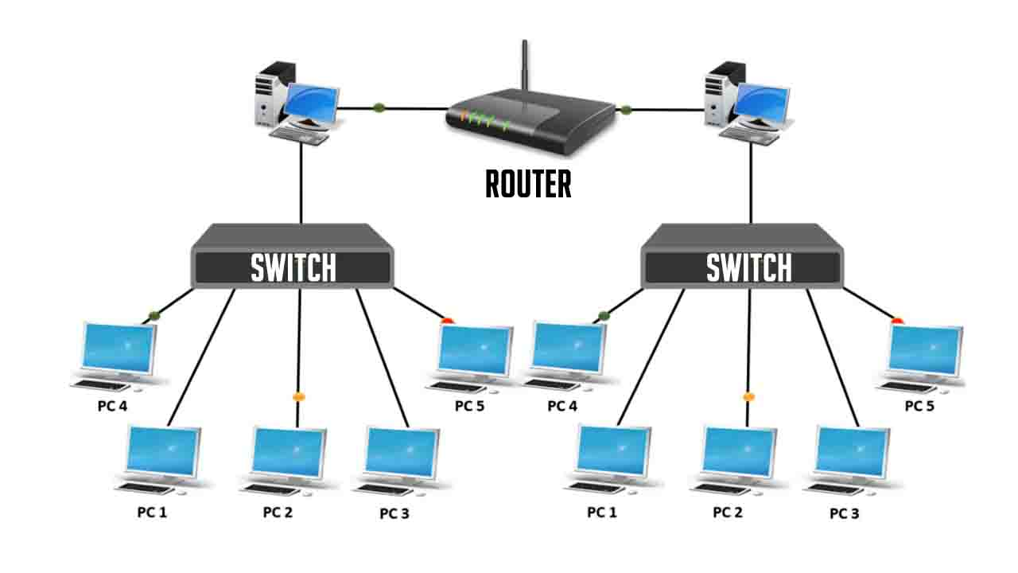
Switches vs. Routers
A switch connects devices within a single network using MAC addresses; while a router connects multiple networks
Switches (Layer 2):
Connect devices within a local network (LAN)
Fast, simple forwarding based on MAC addresses
Transparent: hosts unaware of presence of switches
Random and unique MAC addresses means no scalability beyond local networks
  Switches must remember every single device; Can't group addresses together (E.g., Can't say "all devices starting with XX go to output port 1")
Routers (Layer 3):
Designed to interconnect different networks
Intelligent path selection between networks using logical addresses (IP address)
Hierarchical IP addressing enables route aggregation and Internet-scale routing ➔ More complex, requires configuration, but scales globally
Modern convergence of switches and routers: Layer 3 switches blur the lines, but fundamental scalability differences remain
Notes:
The hosts cannot sense the presence of the switches

Slide 5
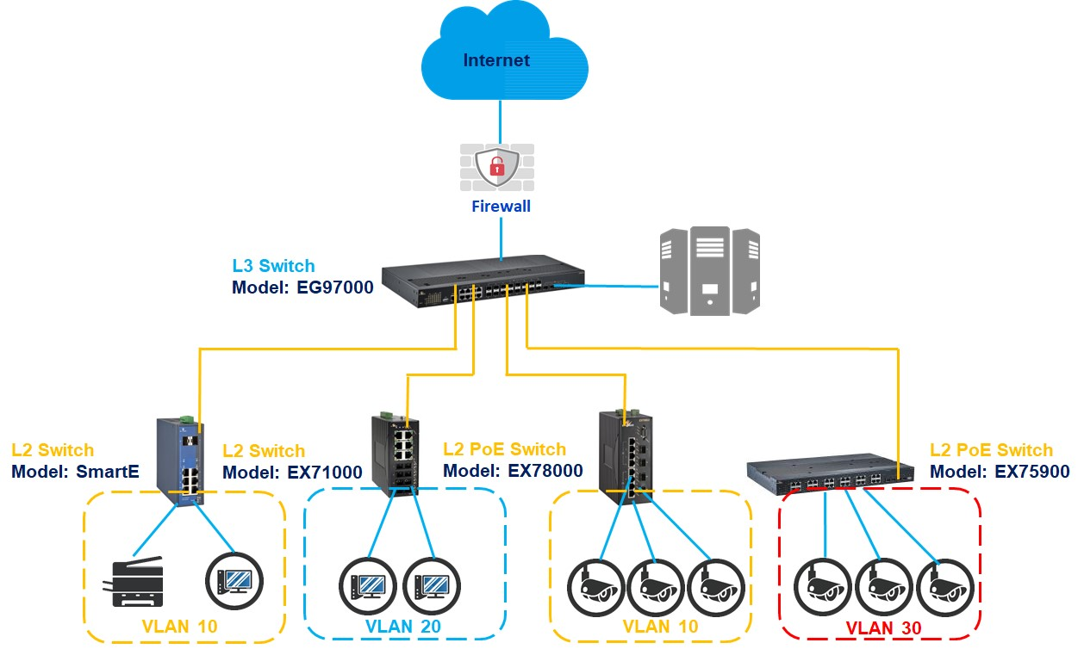
Why Layer 2 Cannot Scale to Internet
Layer 2 cannot scale to Internet-size networks ➔ Problem: MAC addresses have no structure
No route aggregation: Every MAC needs separate forwarding table entry; Internet: 5 billion devices
No hierarchy: Can't build efficient routing
  Can't say “all US traffic → this way” ➔ Must know exact path to every MAC
Broadcast storms:
  DHCP/ARP flood entire network ➔ millions of broadcast messages/second
Reference Link
Layer 3 (IP) solves these problems:
Hierarchical addressing: IPs assigned by geographic location
Route aggregation (Longest Prefix Matching): 10.0.0.0/8 = 16M addresses in ONE entry
Result: BGP handles 900K+ routes efficiently

Slide 6



Ethernet and Ethernet Physical Topology
“Dominant” wired LAN technology:
First widely used LAN technology (1980s)
Simpler, cheap
Kept up with speed race: 10 Mbps – 400 Gbps
Single chip, multiple speeds (e.g., Broadcom BCM5761)
Bus: popular through mid 90s
All nodes in same collision domain (can collide with each other)
bus: coaxial cable
Switched: prevails today
Active link-layer 2 switch in center
Each “spoke” runs a (separate) Ethernet protocol (nodes do not collide with each other)
switched
Bob Metcalfe: Ethernet co-inventor,
2022 ACM Turing Award recipient

Slide 7
Roadmap
Layer 2 Networks
Switches and Self-learning
ARP

Slide 8
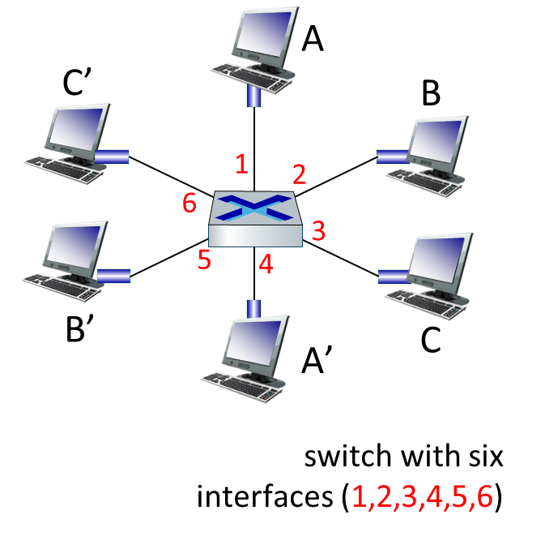
Ethernet Switch
Switch is a link-layer device:
Hosts have dedicated, direct connection to switch
Store, buffer, and forward Ethernet frames
Switches vs. Routers:
Router forwarding tables: Must be manually configured
  Network admin configures IP routing tables
  Requires knowledge of network topology
Switch MAC Address Table (aka switch table or forwarding table for switches):
  Plug-and-play: No configuration needed
  Learns MAC addresses by observing traffic
  Automatically builds forwarding table ➔ Self-learning
Dedicated wires for each connection ➔ Each link is point-to-point
No shared medium = impossible to collide!
Each port has its own buffer
Switching: A-to-A’ and B-to-B’ can transmit simultaneously, without collisions

Slide 9
Self-learning and Forwarding
Q: How to “learn” and build a forwarding table?
Key idea: When you receive a data packet, you get a clue about where the sender is
If a packet from host A comes from the west...
...then host A must be to my west!
Use this idea to add a table entry for the sender
As more packets get sent, more table entries get added
Note: The packet only helps you learn about the sender, not the receiver
This packet from A came from S1 (to my west)
Therefore, A must be toward S1 (to my west)
S3
S1
S2
From: A, To: B
From: A, To: B
S4
R2's Table
To: | Next-hop:
R2's Table
To: | Next-hop:
A | S1

Slide 10
Self-learning and Forwarding
Q: How to forward a frame?
Key idea: Use the destination to decide the next-hop
If the destination exists in the table: Forward to corresponding next-hop
If the destination is not in the table: Flood of all ports (except incoming port)
S3
S3
S1
S2
S4
S1
S2
S4
From: A, To: B
From: A, To: B
S5
From: A, To: B
From: A, To: B
S5
S2's Table
To: | Next-hop:
S2's Table
To: | Next-hop:
B | S3
Case 1: No entry for B (destination) in table
Flood the packet to all ports
(except incoming port)
Case 2: Entry for B (destination) is in table
Use table entry to forward to next-hop

Slide 11
Self-learning and Forwarding
Let’s build the forwarding table using “self-learning”:
Host A wants to send a frame to host B
All tables start empty. Nobody has an entry for B, so the packet gets flooded
Along the way, everyone gets a clue about A's location, and adds a table entry for A
A forwards the packet to S1 (Port 1)
S1 learns A must be toward Port 1
S1 floods this packet out of all ports (except the incoming port)
S2 and S4: Both receive the “From A, to B” packet from S1; Add a mapping for A to their forwarding tables; Flood…
S3 and S5: Update forwarding tables; Flood the packet… (except…)
C: Receives packet; Check the header; Drop the packet
B: Receives this packet
R2's Table
To: | Next-hop:
S2's Table
To: | Next-hop:
A | S1
R3's Table
To: | Next-hop:
S3's Table
To: | Next-hop:
A | S2
R1's Table
To: | Next-hop:
S1's Table
To: | Next-hop:
A | Direct
S2
S3
B
From: A, To: B
From: A, To: B
From: A, To: B
A
S1
From: A, To: B
From: A, To: B
From: A, To: B
From: A, To: B
From: A, To: B
S4
S5
C
R4's Table
To: | Next-hop:
S4's Table
To: | Next-hop:
A | S1
R5's Table
To: | Next-hop:
S5's Table
To: | Next-hop:
A | S4

Slide 12
Self-learning and Forwarding
When host B wants to reply to host A:
This packet can get directly forwarded to A (no flooding) using the forwarding tables
Switches along the B-to-A path get a clue about B's location, and add a table entry for B
R2's Table
To: | Next-hop:
A | R1
S2's Table
To: | Next-hop:
A | S1
B | S3
R3's Table
To: | Next-hop:
A | R2
B forwards the packet to S3 (Port 2)
S3 learns B must be toward Port 2
S3 forwards the packet along the next-hop to A (instead of flooding the packet)
S2: Adds a mapping for B to its forwarding table; Forwards packet to S1
S1: Adds a mapping for B to its forwarding table; Forwards packet to A
S3's Table
To: | Next-hop:
A | S2
B | Direct
R1's Table
To: | Next-hop:
A | Direct
S1's Table
To: | Next-hop:
A | Direct
B | S2
S2
S3
B
From: B, To: A
From: B, To: A
From: B, To: A
A
S1
From: B, To: A
From: B, To: A
S4
S5
C
S4's Table
To: | Next-hop:
A | S1
S5's Table
To: | Next-hop:
A | S4

Slide 13
Self-Learning and Forwarding Algorithm
When frame received at switch:
Step 1: Learn (from source MAC)
Record incoming port and source MAC address in table
  “MAC_source_addr is reachable via port X”
Step 2: Forward (using destination MAC)
Look up destination MAC address in table
Step 3: Forwarding decision
if entry found for destination:
  forward frame out the port indicated in table entry
else (destination unknown):
  flood ➔ forward on all ports except arriving port
Learning:
Uses source MAC to build table
Forwarding:
Uses destination MAC to make decisions
Plug-and-play:
No configuration needed, learns automatically

Slide 14
Roadmap
Layer 2 Networks
Switches and Self-learning
ARP

Slide 15
ARP: Connect Layer 2 and Layer 3
Recall: Packet gets passed down the stack, picking up more headers
Layer 3 fills in the IP addresses
Then, Layer 2 needs to fill in the MAC addresses
What goes here?
Source MAC:
My MAC
Destination MAC:
???
Source IP:
My IP
Q: How to fill in the destination MAC address?
Destination IP:
Server's IP
Payload
If the destination IP is in our local network:
  Find the destination's MAC address, and send to destination on Layer 2
If the destination IP is not in our local network:
  Find the router's MAC address, and send to the router on Layer 2
  Router can forward our packet toward the destination

Slide 16
ARP: Connect Layer 2 and Layer 3
Q: How do we send packets to the destination (local) or the router (non-local)?
A: We need some way to translate IP addresses to MAC addresses.
ARP translates Layer 3 IP addresses to Layer 2 MAC addresses
Example: Alice knows Bob's IP address is 1.2.3.4
She wants to know Bob's MAC address
Steps of the protocol:
Alice checks her cache (ARP table) to see if she already knows Bob's MAC address
If Bob's MAC address is not in the cache, Alice broadcasts:
"What is the MAC address of 1.2.3.4?"
Bob responds by unicasting to Alice:
"My IP is 1.2.3.4 and my MAC address is ca:fe:f0:0d:be:ef."
Everyone else does nothing.
Alice caches the result
What goes here?
Source MAC:
My MAC
Destination MAC:
???
Source IP:
My IP
Destination IP:
Server's IP
Payload

Slide 17
ARP: Address Resolution Protocol
Q: How to determine interface’s MAC address, knowing its IP address?
ARP table: each node (host, router) on LAN has table
< IP address; MAC address; TTL>
ARP
137.196.7.78
ARP table
1A-2F-BB-76-09-AD
ARP
IP addr
MAC addr
TTL
TTL
ARP
137.196.7.14
58-23-D7-FA-20-B0
500
LAN
71-65-F7-2B-08-53
58-23-D7-FA-20-B0
137.196.7.23
137.196.7.14
0C-C4-11-6F-E3-98
IP/MAC address mappings for some LAN nodes
TTL (Time To Live): time after which address mapping will be forgotten (typically 20 min)
ARP
137.196.7.88

Slide 18
ARP: Address Resolution Protocol
Example: A wants to send datagram to B
  B’s MAC address not in A’s ARP table, so A uses ARP to find B’s MAC address
A broadcasts ARP query, containing B's IP addr
  destination MAC address = FF-FF-FF-FF-FF-FF
  all nodes on LAN receive ARP query
1
Ethernet frame (sent to FF-FF-FF-FF-FF-FF)
C
Source MAC: 71-65-F7-2B-08-53
Source IP: 137.196.7.23
Target IP address: 137.196.7.14
…
ARP table in A
IP addr
MAC addr
TTL
TTL
A
B
1
71-65-F7-2B-08-53
58-23-D7-FA-20-B0
137.196.7.23
137.196.7.14
D

Slide 19
ARP: Address Resolution Protocol
Example: A wants to send datagram to B
  B’s MAC address not in A’s ARP table, so A uses ARP to find B’s MAC address
ARP message into Ethernet frame (sent to 71-65-F7-2B-08-53)
C
Target IP address: 137.196.7.14
Target MAC address:
58-23-D7-FA-20-B0
…
ARP table in A
IP addr
MAC addr
TTL
TTL
A
B
2
71-65-F7-2B-08-53
58-23-D7-FA-20-B0
137.196.7.23
137.196.7.14
2
B replies to A with ARP response, giving its MAC address
D

Slide 20
ARP Protocol in Action
Example: A wants to send datagram to B
  B’s MAC address not in A’s ARP table, so A uses ARP to find B’s MAC address
C
ARP table in A
IP addr
MAC addr
TTL
TTL
A
B
137.196.7.14
58-23-D7-FA-20-B0
500
71-65-F7-2B-08-53
58-23-D7-FA-20-B0
137.196.7.23
137.196.7.14
3
A receives B’s reply, adds B entry into its local ARP table
D

Slide 21
Using ARP in Routers and Hosts
ARP runs directly on Layer 2 (not Layer 3)
Source MAC:
Alice's MAC
ARP requests (aka solicitations) are broadcast
Destination MAC:
FF:FF:FF:FF:FF:FF
Source MAC:
Bob's MAC
ARP responses (aka advertisements) are unicast
Destination MAC:
Alice's MAC
Note: Any router/host can broadcast an unsolicited response ("Gratuitous ARP")
Device broadcasts its own IP-to-MAC mapping without being asked
Common when device boots up or changes IP/MAC
Purpose: Announce presence, detect IP conflicts, update neighbors' ARP caches
Example: "My IP is 1.2.3.4, and my MAC is ca:fe:f0:0d:be:ef"
Notes:
Detect IP conflicts: If another device has same IP, it will respond

Slide 22
Connecting ARP and Forwarding Tables
R1's Forwarding Table
Destination | Next Hop
192.0.2.0/24 | Direct
The IP forwarding table contains IP addresses...
190.1.3.250
NO IP address
H11
192.0.2.1
H21
S2
R1
S1
H12
192.0.2.2
...and addresses can be aggregated!
190.1.3.21
H13
192.0.2.3
192.0.2.254
Our subnet
The router’s forwarding table contains a single entry, mapping the entire subnet’s range of IP addresses to be direct
If the router (R1) receives a packet whose destination (e.g., H1) is in this local range:
The router runs ARP (or look in our cached ARP table) to find the corresponding MAC address
  H1 replies through S1 with its MAC address
Uses Layer 2 to send the unicast Ethernet frames to the correct host on the link
  R1 sends packet in frame (dest MAC = H1's MAC) to S1
  S1 looks up H1's MAC in its table && S1 forwards to H1
Router doesn't "skip" the switch ➔ the switch is transparent but still in the data path!
Notes:
Basic Layer 2 switches:
NO IP address; Operate purely at Layer 2
Completely transparent to network traffic
Forward frames based on MAC table only
Advanced switches, e.g., managed layer 2 switches or L3 switches:
Have ONE or MORE IP addresses
Used for: network management and configuration, SSH, etc.
Out of the scope of this course

Slide 23
Using ARP in Hosts
How do hosts forward packets?
Determine if destination is local (same LAN) or non-local:
  Uses subnet mask to check. (See note at bottom of slide for example)
Use ARP based on destination:
  If destination IP is local:
  Use ARP to find MAC of destination. Send packet to destination
  If destination IP is non-local:
  Use ARP to find MAC of router. Send packet to router
Q: How does host know router's IP and subnet mask?
A: DHCP provides all network configuration:
IP address for the host (e.g., 192.168.1.5)
Subnet mask (e.g., 255.255.255.0)
Default gateway (router's IP, e.g., 192.168.1.1)
DNS server(s) (e.g., 8.8.8.8)
Lease time (how long IP is valid)
Notes:
How to use subnet mask to check local vs non-local?
A subnet mask tells you which part of an IP address is the "network" and which part is the "host“. If two IP addresses have the same network portion ➔ they're on the same subnet (local)
Example:
Host IP 192.168.1.5
Subnet mask: 255.255.255.0
Destination IP: 192.168.1.100
Apply subnet mask (AND operation, extract the network portion) to host IP and destination IP:
Host IP 192.168.1.5 ➔ Network portion: 192.168.1
Destination 192.168.1.100 ➔ Network portion: 192.168.1
MATCH ➔ Local!

Slide 24
Sending to Another Network:
MAC = Next Hop, IP = Final Destination
A creates IP datagram with IP source A, destination B
A creates link-layer frame containing A-to-B IP datagram
  R's MAC address is frame’s destination
MAC src: 74-29-9C-E8-FF-55
MAC dest: E6-E9-00-17-BB-4B
IP
Eth
Phy
IP src: 111.111.111.111
IP dest: 222.222.222.222
A
R
B
111.111.111.111
74-29-9C-E8-FF-55
222.222.222.222
49-BD-D2-C7-56-2A
222.222.222.220
1A-23-F9-CD-06-9B
111.111.111.112
111.111.111.110
CC-49-DE-D0-AB-7D
E6-E9-00-17-BB-4B
222.222.222.221
88-B2-2F-54-1A-0F

Slide 25
Sending to Another Network:
MAC = Next Hop, IP = Final Destination
Frame sent from A to R
Frame received at R, datagram removed, passed up to IP
MAC src: 74-29-9C-E8-FF-55
MAC dest: E6-E9-00-17-BB-4B
IP src: 111.111.111.111
IP dest: 222.222.222.222
IP
Eth
Phy
IP src: 111.111.111.111
IP dest: 222.222.222.222
IP
Eth
Phy
A
R
B
111.111.111.111
74-29-9C-E8-FF-55
222.222.222.222
49-BD-D2-C7-56-2A
222.222.222.220
1A-23-F9-CD-06-9B
111.111.111.112
111.111.111.110
CC-49-DE-D0-AB-7D
E6-E9-00-17-BB-4B
222.222.222.221
88-B2-2F-54-1A-0F

Slide 26
Sending to Another Network:
MAC = Next Hop, IP = Final Destination
R determines outgoing interface, passes datagram with IP source A, destination B to link layer
R creates link-layer frame containing A-to-B IP datagram. Frame destination address: B's MAC address
MAC src: 1A-23-F9-CD-06-9B
MAC dest: 49-BD-D2-C7-56-2A
IP
Eth
Phy
IP src: 111.111.111.111
IP dest: 222.222.222.222
A
R
B
111.111.111.111
74-29-9C-E8-FF-55
222.222.222.222
49-BD-D2-C7-56-2A
222.222.222.220
1A-23-F9-CD-06-9B
111.111.111.112
111.111.111.110
CC-49-DE-D0-AB-7D
E6-E9-00-17-BB-4B
222.222.222.221
88-B2-2F-54-1A-0F

Slide 27
Sending to Another Network:
MAC = Next Hop, IP = Final Destination
R determines outgoing interface, passes datagram with IP source A, destination B to link layer
R creates link-layer frame containing A-to-B IP datagram. Frame destination address: B's MAC address
MAC src: 1A-23-F9-CD-06-9B
MAC dest: 49-BD-D2-C7-56-2A
Transmits link-layer frame
IP
Eth
Phy
IP
Eth
Phy
IP src: 111.111.111.111
IP dest: 222.222.222.222
A
R
B
111.111.111.111
74-29-9C-E8-FF-55
222.222.222.222
49-BD-D2-C7-56-2A
222.222.222.220
1A-23-F9-CD-06-9B
111.111.111.112
111.111.111.110
CC-49-DE-D0-AB-7D
E6-E9-00-17-BB-4B
222.222.222.221
88-B2-2F-54-1A-0F

Slide 28
Sending to Another Network:
MAC = Next Hop, IP = Final Destination
B receives frame, extracts IP datagram destination B
B passes datagram up protocol stack to IP
IP src: 111.111.111.111
IP dest: 222.222.222.222
IP
Eth
Phy
IP
Eth
Phy
A
R
B
111.111.111.111
74-29-9C-E8-FF-55
222.222.222.222
49-BD-D2-C7-56-2A
222.222.222.220
1A-23-F9-CD-06-9B
111.111.111.112
111.111.111.110
CC-49-DE-D0-AB-7D
E6-E9-00-17-BB-4B
222.222.222.221
88-B2-2F-54-1A-0F

