Slide 1
CSC 3511 Security and Networking
Week 9, Lecture 2: Introduction to Cryptography

Slide 2
Roadmap
What is Cryptography?
Definitions and Cryptography Roadmap
Symmetric-Key Encryption
Caesar Cipher

Slide 3
What is cryptography
Older definition: The study of secure communication over insecure channels
Newer definition: Provide rigorous guarantees about the data and computation in the presence of an attacker
  Not just confidentiality but also integrity and authenticity
Modern cryptography involves a lot of math:
Discrete Math
Probability Theory
Linear Algebra
Abstract Algebra
Number Theory, and more…
We will teach you the basic building blocks of cryptography without going into the details
It’s very easy to make a mistake that makes your code insecure
Lots of tricky edge cases that we won't cover
One small bug could compromise the security of your code (SONY PlayStation 3 Hack)
Never try to write your own cryptographic algorithms:
Use existing well-vetted cryptographic libraries
This portion of the class is mostly about making you a good consumer of cryptography

Slide 4
Roadmap
What is Cryptography?
Definitions and Cryptography Roadmap
Symmetric-Key Encryption
Caesar Cipher

Slide 5
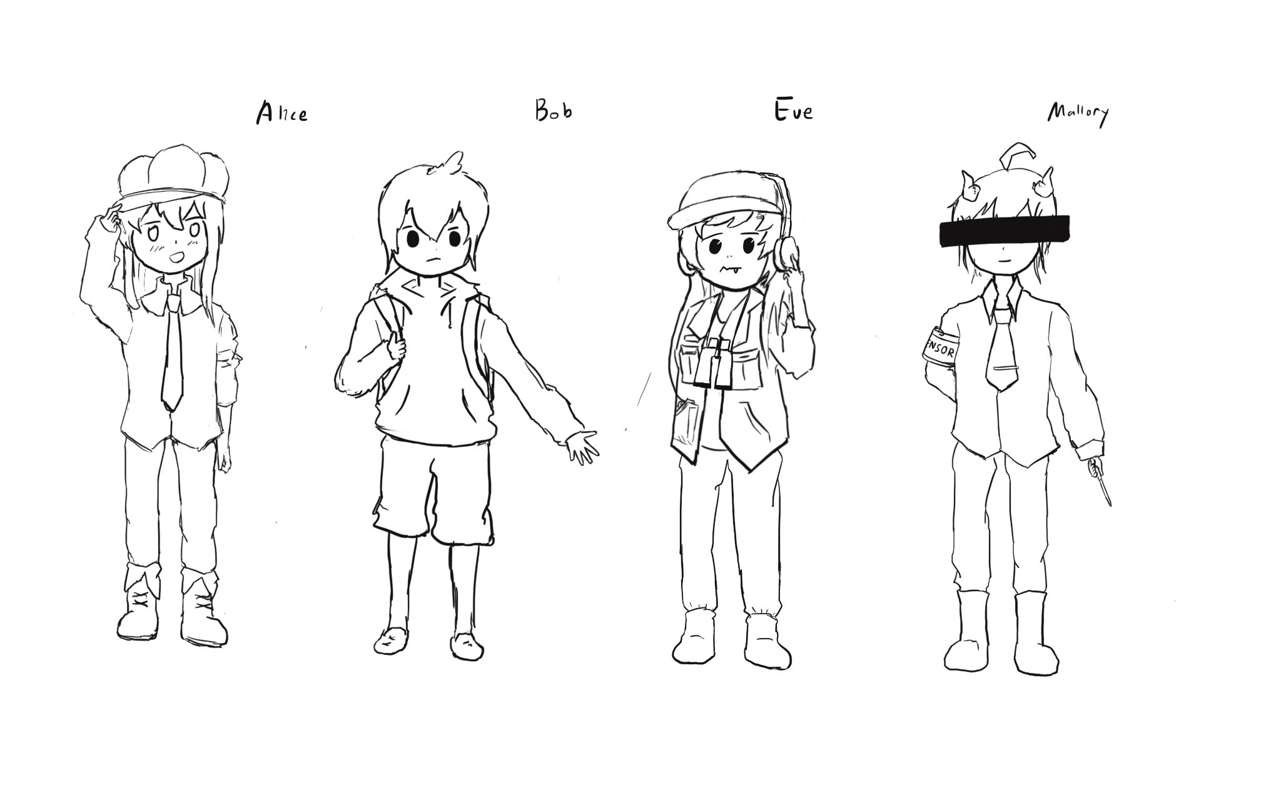
Meet Alice, Bob, Eve, and Mallory
Alice and Bob: The main characters trying to send messages to each other over an insecure communication channel
Eve: A passive attacker (eavesdropper) who can observe and read data sent over the channel, but cannot modify it
Mallory: An active attacker (man-in-the-middle) who can intercept, read, modify, and even inject data sent over the channel

Slide 6
Meet Alice, Bob, Eve, and Mallory
We often describe cryptographic problems using a common cast of characters (Alice and Bob)
For example:
Alice wants to send a message to Bob.
However, Eve is going to eavesdrop on the communication channel.
How does Alice send the message to Bob without Eve learning about the message?
Another example:
Bob wants to send a message to Alice.
However, Mallory is going to tamper with the communication channel.
How does Bob send the message to Alice without Mallory changing the message?

Slide 7
Three Goals of Cryptography
In cryptography, there are three common properties that we want on our data
Confidentiality: An adversary cannot read our messages
Integrity: An adversary cannot change our messages without being detected
Authenticity: I can prove that this message came from the person who claims to have written it
  Integrity and authenticity are closely related properties:
    Before I can prove that a message came from a certain person, I have to prove that the message wasn’t changed!
    But they’re not identical properties. Later we’ll see some edge cases

Slide 8
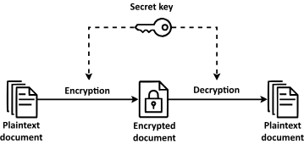
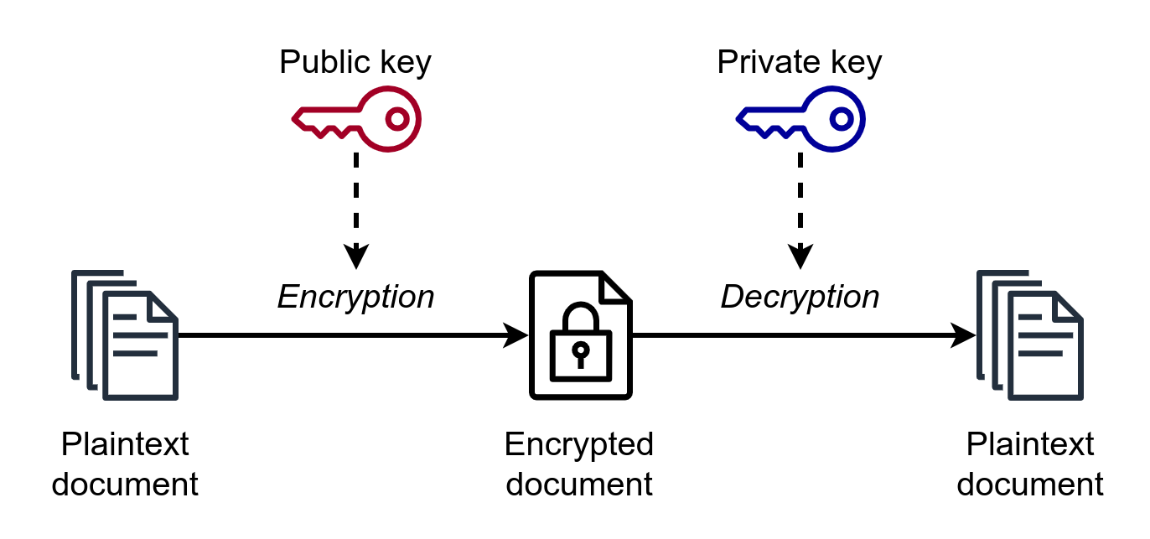
Keys
The most basic building block of any cryptographic scheme: The key
We can use the key in our algorithms to secure messages
Two models of keys:
  Symmetric key model: Alice and Bob both know the value of the same secret key
  Asymmetric key model: A user has two keys, a private key and a public key

Slide 9
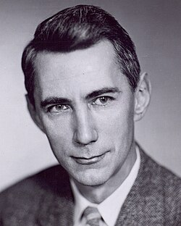
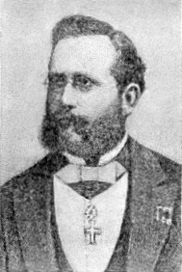
Security Principle: Kerckhoff’s Principle
Kerckhoff’s principle says:
  Cryptosystems should remain secure even when the attacker knows all internal details of the system
  The key should be the only thing that must be kept secret
  The system should be designed to make it easy to change keys that are leaked (or suspected to be leaked)
  If your secrets are leaked, it is usually a lot easier to change the key than to replace every instance of the running software
Our assumption: The attacker knows all the algorithms we use. The only information the attacker is missing is the secret key(s).
This principle is closely related to Shannon’s Maxim:
  "one ought to design systems under the assumption that the enemy will immediately gain full familiarity with them"
Claude Shannon
Auguste Kerckhoffs

Slide 10
Confidentiality
Confidentiality: An adversary cannot read our messages
Schemes provide confidentiality by encrypting messages
Analogy: Locking and unlocking the message
  Alice uses the key to lock (encrypt) the message (plaintext) in a box
  Alice sends the locked message (ciphertext) over the insecure channel
  Eve sees the locked box, but cannot access the message without the key
  Bob receives the locked message and uses the key to unlock (decrypt) the message
Alice
Key
Key
Bob
Insecure Channel
Message
Lock
Message in locked box
Unlock
Message
Plaintext
Encryption Algorithm
Ciphertext
Decryption Algorithm
Plaintext

Slide 11
Integrity (and Authenticity)
Integrity: An adversary cannot change our messages without being detected.
Schemes provide integrity by adding a tag or signature on messages
Analogy: Adding a seal on the message
  Alice uses the key to add a special seal on the message (e.g. puts tape on the envelope)
  Alice sends the message and the seal over the insecure channel
  If Mallory tampers with the message, she’ll break the seal (e.g. break the tape on the envelope)
  Without the key, Mallory cannot create her own seal
  Bob receives the message and the seal and checks that the seal has not been broken
Alice
Key
Insecure Channel
Key
Bob
Message
Create Seal
Message
Check Seal
Message
Seal
Plaintext
Create Tag
Message
Verify Tag
Plaintext
Tag

Slide 12
Integrity (and Authenticity)
Schemes provide integrity by adding a tag or signature on messages
  Alice uses the key to generate a special tag for the message
  Alice sends the message and the tag over the insecure channel
  If Mallory tampers with the message, the tag will no longer be valid
  Bob receives the message and the tag and checks that the tag is still valid
More on Integrity and Authenticity in a future lecture
Alice
Key
Insecure Channel
Key
Bob
Message
Create Seal
Message
Check Seal
Message
Seal
Plaintext
Create Tag
Message
Verify Tag
Plaintext
Tag

Slide 13
Threat Models
What if Eve can do more than eavesdrop?
Real-world schemes are often vulnerable to more sophisticated attackers, so cryptographers have created more sophisticated threat models too
Some threat models for analyzing confidentiality:
 | Can Eve trick Alice into encrypting messages of Eve’s choosing? | Can Eve trick Bob into decrypting messages of Eve’s choosing? | Can Eve eavesdrop on Alice's encrypted communications?
Ciphertext-only | No | No | Yes
Chosen-plaintext (AF is short of water) | Yes | No | Yes
Chosen-ciphertext | No | Yes | Yes
Chosen plaintext-ciphertext | Yes | Yes | Yes
Notes:
It’s super important to think about threat models when designing secure systems because if our attacker couldn’t read or modify messages, then we wouldn’t even need to be here.
There’s lots of different models, here’s a couple! Maybe Eve can do more than just eavesdrop. For example, chosen plaintext is a common model because these problems commonly occur in the real world. Here’s two additional powers Eve can have. For instance, if Eve walks up to Alice and asks whether Alice can encrypt the word “Evanbot”, if Alice correctly encrypts and sends the encrypted “Evanbot” back, then yes, Eve has the first power of chosen-plaintext).
The second example is whether Eve can trick Bob by asking hey, can you tell me what the decrypted value of <insert garbage here> is? And if Bob dutifying responds yes, then this is chosen-ciphertext.
Why would this happen? It turns out these vulnerabilities that exist in real life. We’re not being mean to write harder exam questions, it’s because this actually simulates real life pretty well.

Slide 14
Threat Models
In this class, we’ll focus primarily on chosen plaintext attacks, for simplicity
In practice, cryptographers use the chosen plaintext-ciphertext model
  It’s the most powerful
  It can actually be defended against
 | Can Eve trick Alice into encrypting messages of Eve’s choosing? | Can Eve trick Bob into decrypting messages of Eve’s choosing? | Can Eve eavesdrop on Alice's encrypted communications?
Ciphertext-only | No | No | Yes
Chosen-plaintext | Yes | No | Yes
Chosen-ciphertext | No | Yes | Yes
Chosen plaintext-ciphertext | Yes | Yes | Yes
Notes:
Chosen plaintext: For any message, Alice will faithfully encrypt.
You can pick whichever model depending on who you think your attackers are. In the real world, cryptographers use chosen plaintext-ciphertext because the security guarantees from working under that model are strongest.
Why don’t we choose the other ones? Well, this is the model that we believe best replicates real life as we want for this class. We’re not as interested in what Eve wants to do, but rather what Eve can do. In our model, we believe that it’s not super helpful for Eve to have the second power, but you can have your own model!
chosen plaintext-ciphertext model: real-world attackers often have this level of power, e.g., Padding Oracle Attack

Slide 15
Cryptography Roadmap
 | Symmetric-key | Asymmetric-key
Confidentiality | One-time pads Block ciphers with chaining modes (e.g. AES-CBC) Stream ciphers | RSA encryption ElGamal encryption
Integrity, Authentication | MACs (e.g. HMAC) | Digital signatures (e.g. RSA signatures)
Hash functions
Pseudorandom number generators
Public key exchange (e.g. Diffie-Hellman)
Key management (certificates)

Slide 16
Roadmap
What is Cryptography?
Definitions and Cryptography Roadmap
Symmetric-Key Encryption
Caesar Cipher

Slide 17
Symmetric-Key Encryption
The next few schemes are symmetric-key encryption schemes:
  Encryption schemes aim to provide confidentiality (but not integrity or authentication)
  Symmetric-key means Alice and Bob share the same secret key that the attacker doesn’t know
  Don’t worry about how Alice and Bob share the key for now
For modern schemes, we’re going to assume that messages are bitstrings
  Bitstring: A sequence of bits (0 or 1), e.g. 11010101001001010
  Text, images, etc. can usually be converted into bitstrings before encryption
Alice
Key
Key
Bob
Insecure Channel
Plaintext
Encryption Algorithm
Ciphertext
Decryption Algorithm
Plaintext

Slide 18
Symmetric-Key Encryption
A symmetric-key encryption scheme has three algorithms:
  KeyGen() → K: Generate a key K
  Enc(K, M) → C: Encrypt a plaintext M using the key K to produce ciphertext C
  Dec(K, C) → M: Decrypt a ciphertext C using the key K
What properties do we want from a symmetric encryption scheme?
  Correctness: Decrypting a ciphertext should result in the message that was originally encrypted
    Dec(K, Enc(K, M)) = M for all K ← KeyGen() and all M
  Efficiency: Encryption/decryption algorithms should be fast: >1 Gbps on a standard computer
  Security: Confidentiality of M from attackers who don't know K
Alice
Key
Key
Bob
Insecure Channel
Plaintext
Encryption Algorithm
Ciphertext
Decryption Algorithm
Plaintext

Slide 19
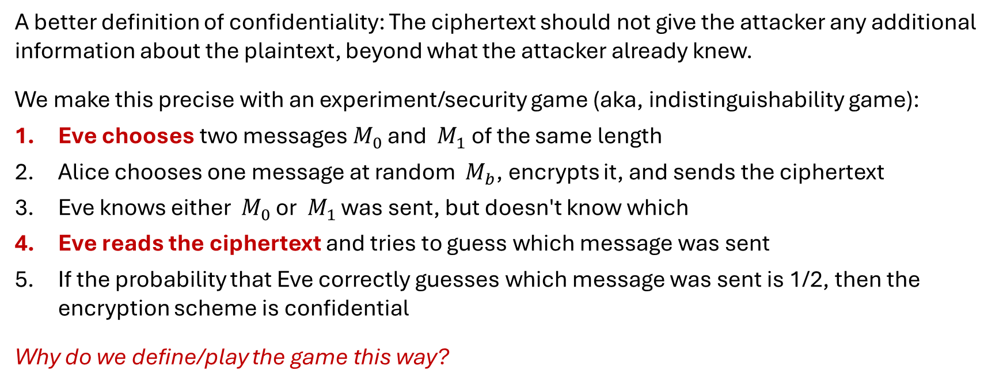
Defining Confidentiality
Recall our definition of confidentiality from earlier: “An adversary cannot read our messages”
This definition isn’t very specific:
What if Eve can read the first half of Alice’s message, but not the second half?
What if Eve figures out that Alice’s message starts with “Dear Bob”?
A better definition of confidentiality: The ciphertext should not give the attacker any additional information about the plaintext, beyond what the attacker already knew.
We make this precise with an experiment/security game (aka, indistinguishability game):
Eve chooses two messages $M_{0}$ and $M_{1}$ of the same length
Alice chooses one message at random $M_{b}$, encrypts it, and sends the ciphertext
Eve knows either $M_{0}$ or $M_{1}$ was sent, but doesn't know which
Eve reads the ciphertext and tries to guess which message was sent
If the probability that Eve correctly guesses which message was sent is 1/2, then the encryption scheme is confidential
Why do we define/play the game this way?
Notes:
Page 19 to page 27 are not required

Slide 20
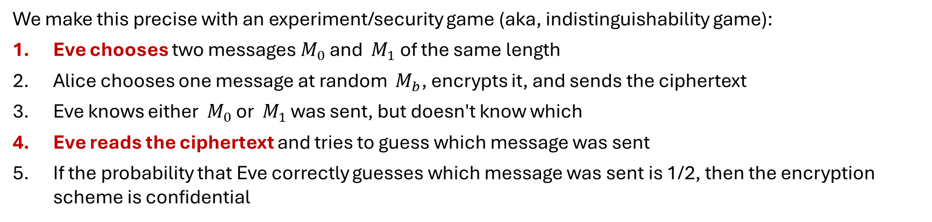
Defining Confidentiality
A better definition of confidentiality (Semantic Security): The ciphertext should not give the attacker any additional information about the plaintext, beyond what the attacker already knew.
Intuition
If the scheme is confidential, Eve can only guess with probability 1/2, which is no different than if Alice hadn’t sent the ciphertext at all
The ciphertext gave Eve no additional information about which plaintext was sent!
In other words: The ciphertext is indistinguishable: an adversary cannot tell which of two messages was encrypted, even when they get to choose what those two messages are.
We make this precise with an experiment/security game (aka, indistinguishability game):
Eve chooses two messages $M_{0}$ and $M_{1}$ of the same length
Alice chooses one message at random $M_{b}$, encrypts it, and sends the ciphertext
Eve knows either $M_{0}$ or $M_{1}$ was sent, but doesn't know which
Eve reads the ciphertext and tries to guess which message was sent
If the probability that Eve correctly guesses which message was sent is 1/2, then the encryption scheme is confidential

Slide 21
Defining Confidentiality: IND-CPA
Let's think about confidentiality from another perspective:
Recall our threat model: Eve can also perform a chosen plaintext attack
  Eve can trick Alice into encrypting arbitrary messages of Eve's choice
We can adapt our experiment to account for this threat model
A specific (formal and more accurate) definition of confidentiality: Even if Eve is able to trick Alice into encrypting other messages, Eve can still only guess what message Alice sent with probability ½
This definition is called IND-CPA (indistinguishability under chosen plaintext attack):
Proven to be equivalent to semantic security
More commonly used in modern cryptography courses and research: easy to use in proofs; easy to extend to IND-CCA, IND-CCA2, etc.
Let’s improve our security game!

Slide 22
Defining Confidentiality: IND-CPA
Eve may choose plaintexts to send to Alice and receives their ciphertexts
Eve (adversary)
Alice (challenger)
M
Enc(K, M)
(repeat)

Slide 23

Defining Confidentiality: IND-CPA
Eve may choose plaintexts to send to Alice and receives their ciphertexts
Eve issues a pair of plaintexts $M_{0}$ and $M_{1}$ to Alice
Eve (adversary)
Alice (challenger)
M
Enc(K, M)
(repeat)
M0 and M1

Slide 24
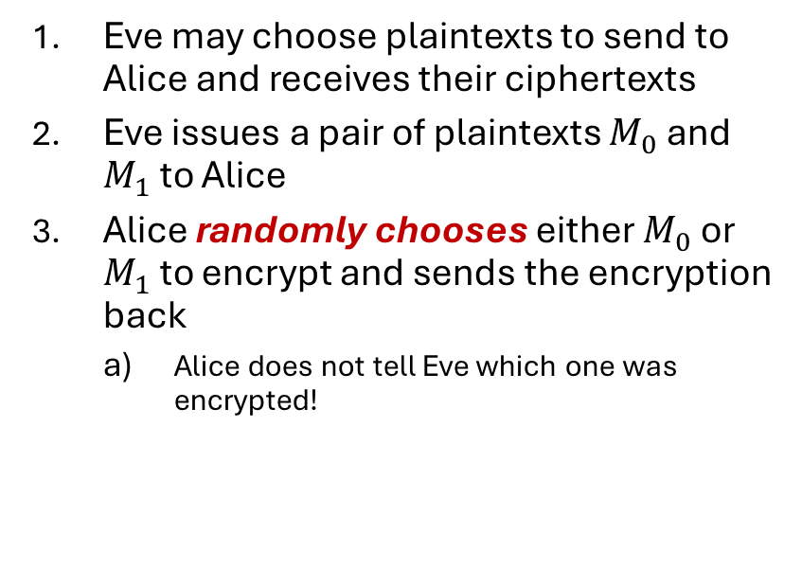
Defining Confidentiality: IND-CPA
Eve may choose plaintexts to send to Alice and receives their ciphertexts
Eve issues a pair of plaintexts $M_{0}$ and $M_{1}$ to Alice
Alice randomly chooses either $M_{0}$ or $M_{1}$ to encrypt and sends the encryption back
  Alice does not tell Eve which one was encrypted!
Eve (adversary)
Alice (challenger)
M
Enc(K, M)
(repeat)
M0 and M1
pick b
Enc(K, Mb)

Slide 25
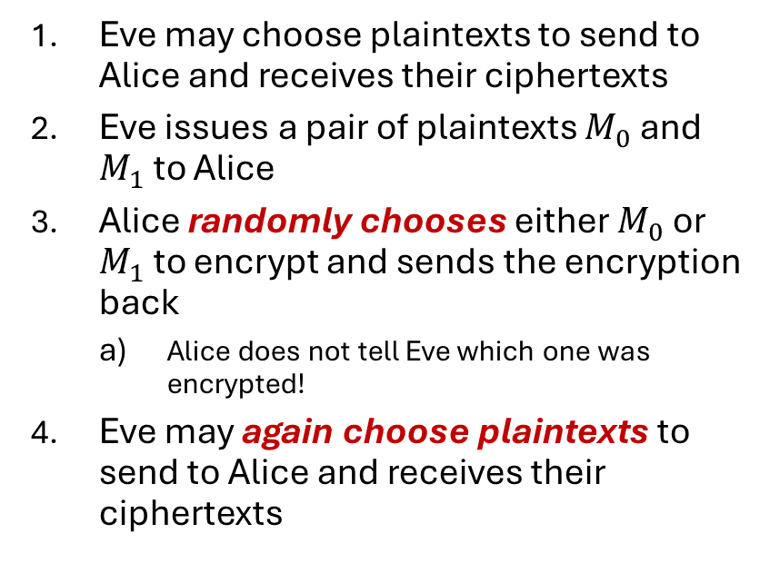
Defining Confidentiality: IND-CPA
Eve may choose plaintexts to send to Alice and receives their ciphertexts
Eve issues a pair of plaintexts $M_{0}$ and $M_{1}$ to Alice
Alice randomly chooses either $M_{0}$ or $M_{1}$ to encrypt and sends the encryption back
  Alice does not tell Eve which one was encrypted!
Eve may again choose plaintexts to send to Alice and receives their ciphertexts
Eve (adversary)
Alice (challenger)
M
Enc(K, M)
(repeat)
M0 and M1
pick b
Enc(K, Mb)
M
Enc(K, M)
(repeat)

Slide 26
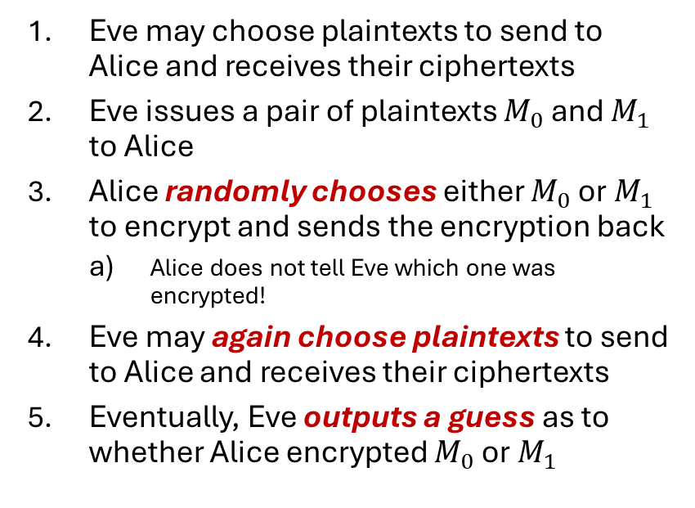
Defining Confidentiality: IND-CPA
Eve may choose plaintexts to send to Alice and receives their ciphertexts
Eve issues a pair of plaintexts $M_{0}$ and $M_{1}$ to Alice
Alice randomly chooses either $M_{0}$ or $M_{1}$ to encrypt and sends the encryption back
  Alice does not tell Eve which one was encrypted!
Eve may again choose plaintexts to send to Alice and receives their ciphertexts
Eventually, Eve outputs a guess as to whether Alice encrypted $M_{0}$ or $M_{1}$
Eve (adversary)
Alice (challenger)
M
Enc(K, M)
(repeat)
M0 and M1
pick b
Enc(K, Mb)
M
Enc(K, M)
(repeat)
The security guarantee becomes stronger:
Even if Eve (adversary) can encrypt whatever they want, whenever they want, before and after seeing the challenge ciphertext, they STILL cannot tell which of two messages was encrypted
Guess b = 0 or b = 1

Slide 27
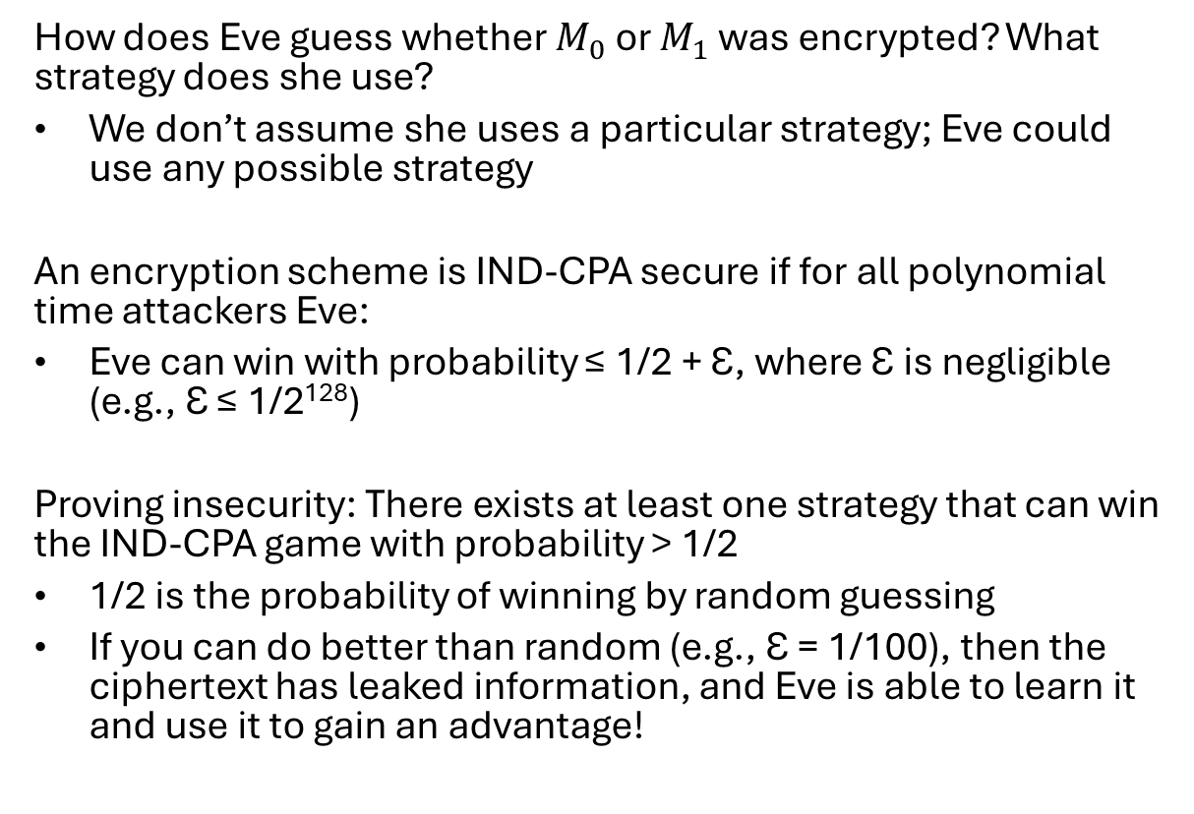
Defining Confidentiality: IND-CPA
How does Eve guess whether $M_{0}$ or $M_{1}$ was encrypted? What strategy does she use?
We don’t assume she uses a particular strategy; Eve could use any possible strategy
An encryption scheme is IND-CPA secure if for all polynomial time attackers Eve:
Eve can win with probability ≤ 1/2 + Ɛ, where Ɛ is negligible (e.g., Ɛ ≤ 1/2¹²⁸)
Proving insecurity: There exists at least one strategy that can win the IND-CPA game with probability > 1/2
1/2 is the probability of winning by random guessing
If you can do better than random (e.g., Ɛ = 1/100), then the ciphertext has leaked information, and Eve is able to learn it and use it to gain an advantage!
Eve (adversary)
Alice (challenger)
M
Enc(K, M)
(repeat)
M0 and M1
pick b
Enc(K, Mb)
M
Enc(K, M)
(repeat)
Guess b = 0 or b = 1

Slide 28
Roadmap
What is Cryptography?
Definitions and Cryptography Roadmap
Symmetric-Key Encryption
Caesar Cipher

Slide 29
Caesar Cipher
Change characters in plaintext to produce ciphertext
Caesar cipher
  Used by Julius Caesar over 2,000 years ago
  Simple idea: Shift each letter by a fixed number of positions in the alphabet
Example:
  Key is 3 (right shift each letter by 3 positions)
  Encryption rule: Replace each letter with the letter 3 positions ahead
  Plaintext is: HELLO WORLD
  Ciphertext is: KHOOR ZRUOG
    H + 3 ➔ K
    E + 3 ➔ H
    …
K = 3
PT | CT | PT | CT
A | D | N | Q
B | E | O | R
C | F | P | S
D | G | Q | T
E | H | R | U
F | I | S | V
G | J | T | W
H | K | U | X
I | L | V | Y
J | M | W | Z
K | N | X | A
L | O | Y | B
M | P | Z | C

Slide 30
Formalizing Cryptosystems
A cryptosystem is defined by five components (E, D, M, K, C)
M : message (plaintexts) space ➔ what can we encrypt?
K : key space ➔ what are the possible keys?
C :set of ciphertexts ➔ what does encryption produce?
E :set of encryption functions e: M × K → C ➔ How to encrypt the message?
D :set of decryption functions d: C × K → M ➔ How to decrypt the message?
Example: Caesar cipher
M = { sequences of letters }
K = { i | i is an integer and 0 ≤ i ≤ 25 }
C = M
E = { E_{k} | k ∈ K and for all letters m, E_{k}(m) = (m + k) mod 26 }
D = { D_{k} | k ∈ K and for all letters c, D_{k}(c) = (c – k) mod 26 }

Slide 31
Attacks on the Caesar Cipher
Eve sees the ciphertext JCKN ECGUCT, but doesn’t know the key K
If you were Eve, how would you try to break this algorithm?
Exhaustive search (Brute-force attack)
  If the key space is small enough, try all possible keys until you find the right one
  Caesar cipher has 26 possible keys → Try all 26 possible keys!

Slide 32
Attacks on the Caesar Cipher
Eve sees the ciphertext JCKN ECGUCT, but doesn’t know the key K
If you were Eve, how would you try to break this algorithm?
Chosen-plaintext attack: Eve tricks Alice into encrypting plaintext of her choice
  Eve sends a message M = AAA and receives C = CCC
  Eve can deduce the key: C is 2 letters after A, so K = 2
  Eve has the key, so she can decrypt the ciphertext

Slide 33
Attacks on the Caesar Cipher
Eve sees the ciphertext JCKN ECGUCT, but doesn’t know the key K
If you were Eve, how would you try to break this algorithm?
Statistical Attack:
  Compute frequency of each letter in ciphertext:
  G 0.1 H 0.1 K 0.1 O 0.3
  R 0.2 U 0.1 Z 0.1
  Apply 1-gram model of English
    Frequency of characters (1-grams) in English is on next slide
K = 3
PT | CT | PT | CT
A | D | N | Q
B | E | O | R
C | F | P | S
D | G | Q | T
E | H | R | U
F | I | S | V
G | J | T | W
H | K | U | X
I | L | V | Y
J | M | W | Z
K | N | X | A
L | O | Y | B
M | P | Z | C

Slide 34
Character Frequencies in English
a | 0.07984 | h | 0.06384 | n | 0.06876 | t | 0.09058
b | 0.01511 | i | 0.07000 | o | 0.07691 | u | 0.02844
c | 0.02504 | j | 0.00131 | p | 0.01741 | v | 0.01056
d | 0.04260 | k | 0.00741 | q | 0.00107 | w | 0.02304
e | 0.12452 | l | 0.03961 | r | 0.05912 | x | 0.00159
f | 0.02262 | m | 0.02629 | s | 0.06333 | y | 0.02028
g | 0.02013 |  |  |  |  | z | 0.00057

Slide 35
Breaking Caesar Cipher: Frequency Analysis Attack
The Weakness: Letter patterns remain visible
Even though letters are shifted, their relative frequencies stay the same!
How the Attack Works:
Collect ciphertext letter frequencies; Let f(c) = frequency of letter c in the ciphertext
Compare against known English letter frequencies; Let p(x) = frequency of letter x in the English
Try all 26 possible keys: For each possible shift/key i (0~25), calculate how well it matches English
  ϕ(i): correlation of frequency of letters in ciphertext with corresponding letters in English, assuming key is i
  ϕ(i) = Σ_{0 ≤ c ≤ 25} f(c)p(c – i)
Pick the key with highest correlation: The i that gives the highest ϕ(i) is likely the correct key!
Notes:
f(c): This represents the frequency of each character 𝑐c in the ciphertext. By counting how often each letter appears in the encrypted text, you can begin to infer possible shifts used in the Caesar cipher.
φ(i): This function, φ, measures the correlation between the frequency of letters in the ciphertext and the expected frequency of letters in English, assuming the Caesar cipher shift (key) is 𝑖i. The idea is that English text has a known frequency distribution of letters, and a correct shift should align ciphertext character frequencies closely with this distribution.
The formula for φ(i) sums the products of 𝑓(𝑐)f(c), the frequency of each letter in the ciphertext, and 𝑝(𝑐−𝑖)p(c−i), the frequency of the corresponding English letter adjusted by the shift 𝑖i.
The φ function uses weights (e.g., 0.1, 0.3, etc.) to emphasize certain letters in the English language that are more common, improving the alignment measurement.
Why do we focus on p(6 – i) , p(7-i), ..., p(25-i):
Common English Letter Frequencies: Certain letters in English (like E, T, A, O, I, N, etc.) are more frequent than others. By focusing on these high-frequency letters, we increase the likelihood of matching the ciphertext's most common letters to their corresponding plaintext letters, even when shifted.
Weighted Matching: The formula weights certain positions more heavily (e.g., 0.3 for 𝑝(14−𝑖)p(14−i) and 0.2 for 𝑝(17−𝑖)p(17−i)) to emphasize the contribution of these common letters. This improves the accuracy of the match between the observed frequencies in the ciphertext and the expected frequencies in English, as these letters provide stronger clues.
Shifted Correlation: By examining 𝑝(𝑐−𝑖)p(c−i) for each possible shift 𝑖i, we align the ciphertext with various hypothetical English distributions. If we use the most frequent English letters, we can detect the shift that most closely resembles natural English text.
Efficiency: Focusing on specific values like 𝑝(6−𝑖)p(6−i) through 𝑝(25−𝑖)p(25−i) rather than all possible letters reduces the computational load and increases the likelihood of identifying the correct key by leveraging known letter distributions effectively.

Slide 36
Correlation of ϕ(i) and Result
Most probable keys, based on ϕ:
i = 6, ϕ(i) = 0.0676
  plaintext EBIIL TLOLA
i = 10, ϕ(i) = 0.0631
  plaintext AXEEH PHKEW
i = 14, ϕ(i) = 0.0561
  plaintext WTAAD LDGAS
i = 3, ϕ(i) = 0.0586
  plaintext HELLO WORLD
Only English phrase is for i = 3
That’s the key (3 or ‘D’)
i | ϕ(i) | i | ϕ(i) | i | ϕ(i) | i | ϕ(i)
0 | 0.0469 | 7 | 0.0461 | 13 | 0.0505 | 19 | 0.0312
1 | 0.0393 | 8 | 0.0194 | 14 | 0.0561 | 20 | 0.0287
2 | 0.0396 | 9 | 0.0286 | 15 | 0.0215 | 21 | 0.0526
3 | 0.0586 | 10 | 0.0631 | 16 | 0.0306 | 22 | 0.0398
4 | 0.0259 | 11 | 0.0280 | 17 | 0.0386 | 23 | 0.0338
5 | 0.0165 | 12 | 0.0318 | 18 | 0.0317 | 24 | 0.0320
6 | 0.0676 |  |  |  |  | 25 | 0.0443

Slide 37
Caesar’s Problem
Key is too short
  Can be found by exhaustive search
  Statistical frequencies not concealed well
    They look too much like regular English letters
So, make it longer
  Multiple letters in key
  Idea is to smooth the statistical frequencies to make cryptanalysis harder

Slide 38
Vigènere Cipher
Like Caesar cipher, but use a phrase
  So, it’s effectively multiple Caesar ciphers
  Usually, the key is a repeating keyword
Example
  Message: A T T A C K A T D A W N
  Key: L E M O N L E M O N L E
Encrypt:
Convert Letters to Numbers
(0+11) % 26 = 11 (19+4) % 26 = 23 (19+12) % 26 = 5 (0+14) % 26 = 14 (2+13) % 26 = 15 (10+11) % 26 = 21 (0+4) % 26 = 4 (19+12) % 26 = 5 (3+14) % 26 = 17 (0+13) % 26 = 13 (22+11) % 26 = 7 (13+4) % 26 = 17
Convert Numbers back to Letters:
Ciphertext: L X F O P V E F R N H R
Notes:
Determine the Key Length: To apply frequency analysis effectively, you first need to know the length of the key. This can be estimated using methods like the Kasiski Examination (Kasiski examination - Wikipedia) or the Friedman Test (Friedman test - Wikipedia) (Index of Coincidence). Once you know the key length (let’s say it’s 𝑛n), you can proceed to analyze the ciphertext.
Divide the Ciphertext into Key-Length Groups: Divide the ciphertext into 𝑛n groups, where each group corresponds to characters encrypted with the same letter of the key.
For example, if the key length is 4, then split the ciphertext into four separate groups, where: The first group contains all characters encrypted with the first letter of the key. The second group contains all characters encrypted with the second letter of the key, and so on.
Analyze Each Group Separately: Each group can be thought of as a Caesar cipher, where each letter in the group was shifted by a specific amount according to the corresponding letter in the key.
For each group, apply frequency analysis as if it were a separate Caesar cipher. In English text, certain letters (like E, T, A, O, N, and R) appear more frequently than others. By comparing the frequency distribution in each group to typical English frequencies, you can make educated guesses about the shift value.
Frequency Distribution Matching:
For each group, calculate the frequency of each letter. This will give you a frequency distribution for that group.
Compare this distribution to the expected distribution of letters in English. English text has a known letter frequency order (e.g., E is the most common letter, followed by T, A, etc.).
Shift the letters in each group by different amounts until the distribution matches the typical English distribution as closely as possible.
Determine the Shift for Each Group (i.e., Each Letter in the Key): The amount you need to shift each group’s frequency distribution to align with English frequencies is the shift for that group, which corresponds to a letter in the key.
For example, if the most frequent letter in a group is "K" but you expect it to align with "E" (the most common letter in English), the shift is likely to be 𝐾−𝐸K−E (in alphabetical index positions).
Reconstruct the Key: After determining the shifts for each group, you can reconstruct the key by mapping each shift to a letter. For example, if you determined the shifts as 3, 15, 7, and 12, you’d convert these to letters (D, P, H, and M if using a 0-indexed alphabet). This gives you the key for the Vigenère cipher, which you can then use to decrypt the entire ciphertext.

