Slide 1
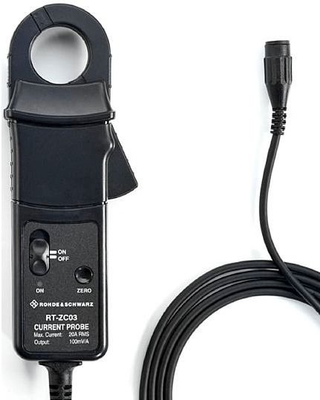
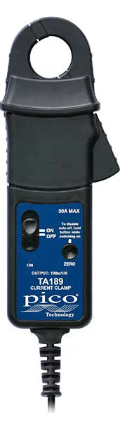
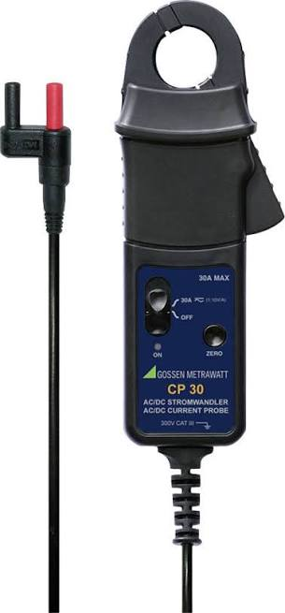
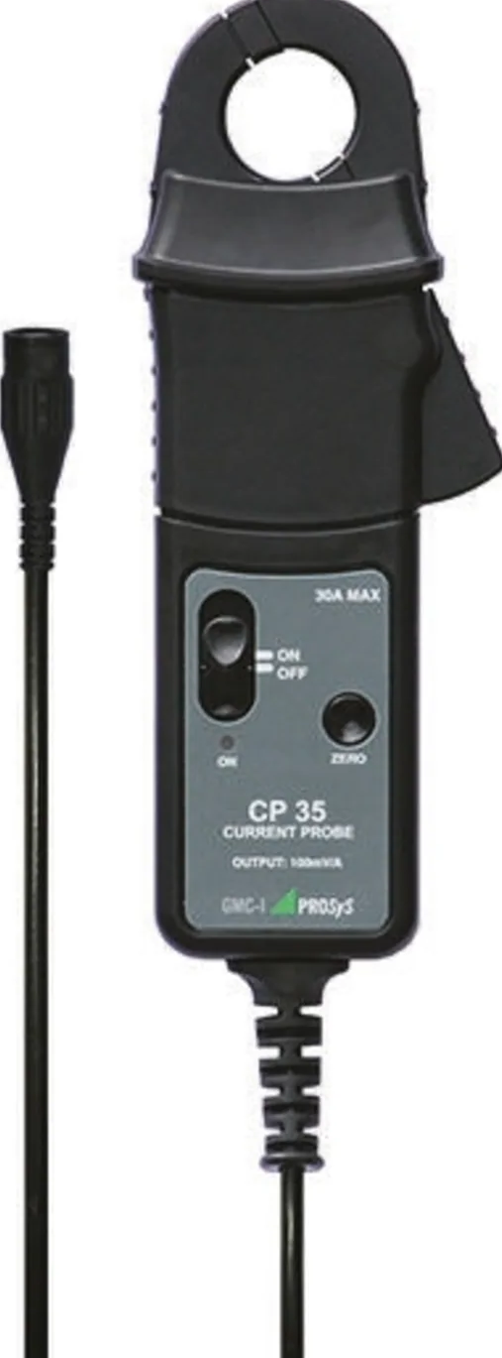
Rohde&Schwarz
RT-ZC03
Picoscope
TA189
Gossen Metrawatt
CP30
GMC-IProsys
CP30 /CP35

