Slide 1

Investigating the relationship between presidential candidate media coverage and electoral success
Mikhail Zolotilin
Sofia Gruk
Mitja Sainio
Photo resource: Pinterest

Slide 2
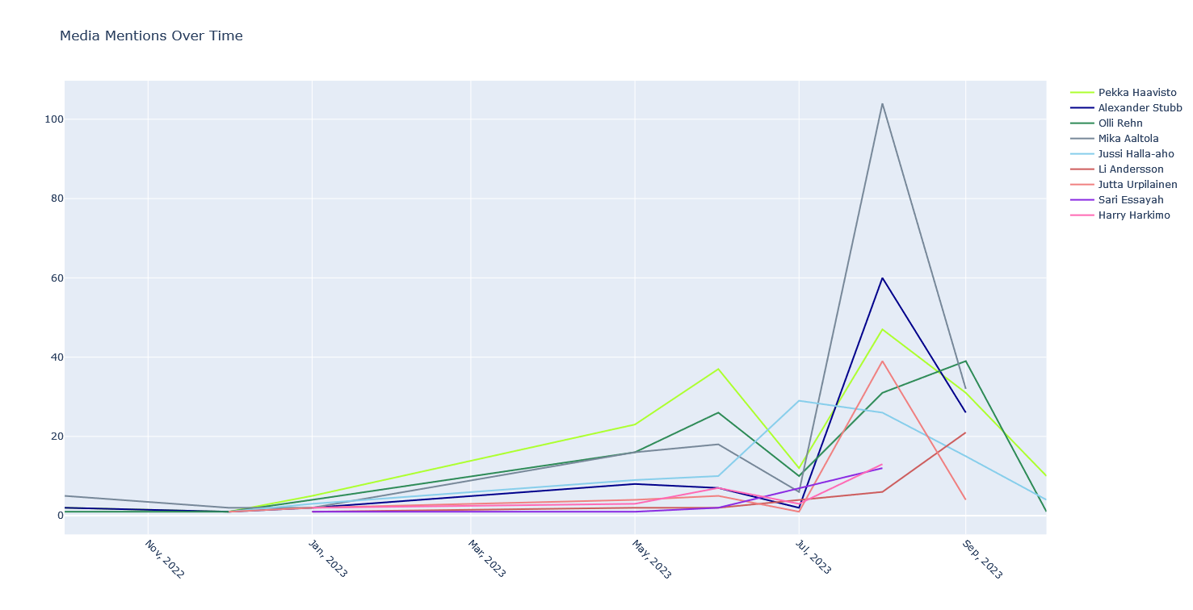
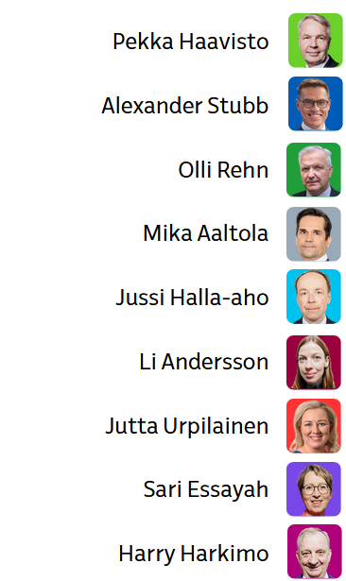
Candidates’ photos: Yle

Slide 3
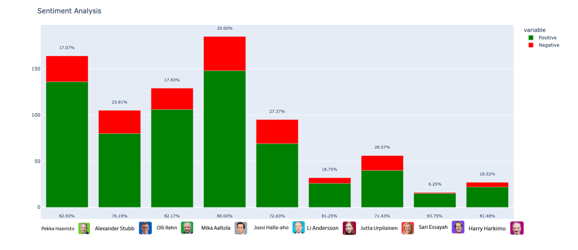
Candidates’ photos: Yle

