Slide 1
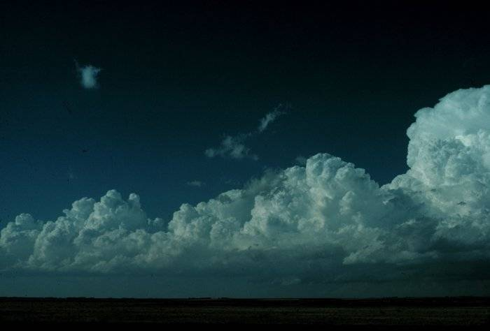
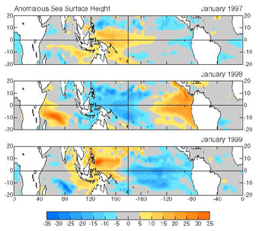
Outstanding R&D Needs
HYPOTHESIS:
The improvement will provide better initial conditions for NCEP’s coupled SFM and increase the system predictive skill.
Improved global ocean data assimilation system based on GFDL Modular Ocean Model migrating from MOM1 to MOM3 and MOM4 and incorporating new data sets as they become available.
OBJECTIVES:
1- Incorporate Argo float profiles of temperature and salinity and Jason satellite altimetry.
2- Improve model sub-grid scale mixing and better represent the warm pool in the western Pacific and the cold tongue in the eastern Pacific.
3- Improve tropical-subtropical interchanges in western boundary regions and interbasin exchanges through the Indonesian through-flow.
4- Assess model bias and estimate model and data error statistics.
GODAS assimilation of the 1997/98 El Nino and the following La Nina
From D. Behringer (2002)

