Slide 1
DMSP OPSCAP – 2 Mar 09
FLIGHT #
LAUNCH DATE
LTAN
REMARKS
F17
Nov 06
1728
Full mission capability
PRIMARY
SGYRO provides reduced pointing accuracy
F16
Oct 03
1937
SGYRO provides reduced pointing accuracy
F15
Dec 99
1827
SECONDARY
One of two operational recorders is degraded
F13
Mar 95
1825
Unable to provide global smooth data
Tactical Ops Only
TACTICAL
F14
Apr 97
1630
FULLY MISSION CAPABLE
- PARTIALLY MISSION CAPABLE
NOT MISSION CAPABLE

Slide 2
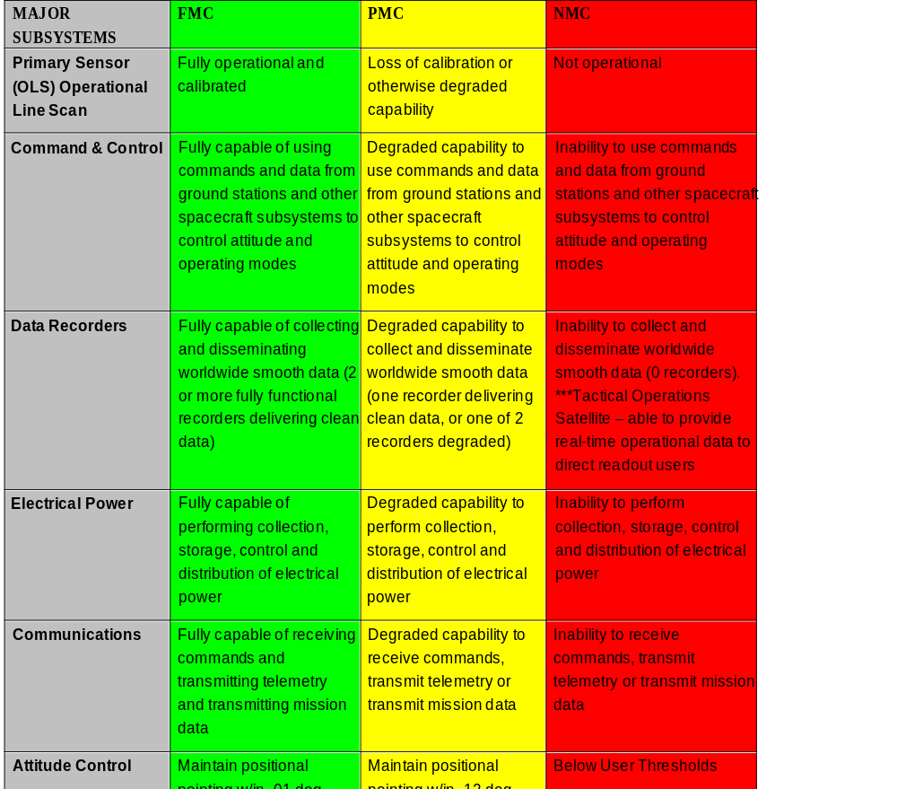
FOUO/UCI
DMSP OPSCAP Criteria
FOUO/UCI

Slide 3
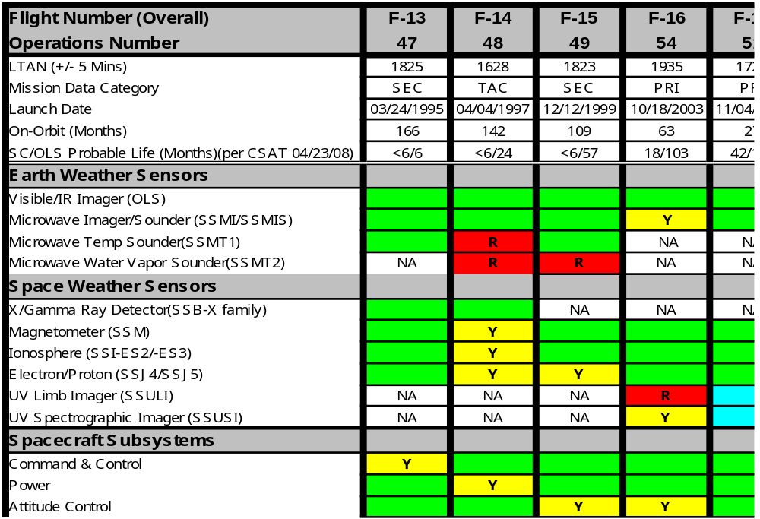
DMSP Spacecraft Status
2 Mar 09
FOUO/UCI
FOUO/UCI
* - Denotes Solid State Recorder (SSR) POC: Watch Officer (301-693-3196)

Slide 4
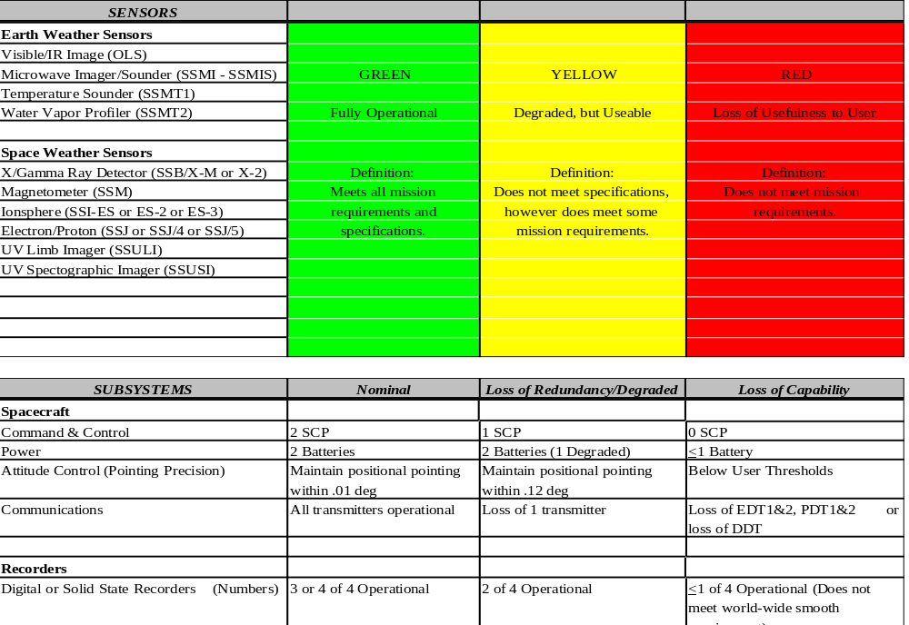
DMSP Spacecraft Status Criteria
FOUO/UCI
FOUO/UCI

