Slide 1

Lessons Learned from Biodiversity Collections Index (BCI) and the Global Registry of Biological Repositories (GRBio)
from data standards to websites and databases, clues we can glean for our individual and group attempts to move forward
Collection Descriptions Task Group, Data Model Development Meeting
10-11 September, 2019 Host: NHM London
Deborah L. Paul, Digitization and Workforce Development Manager, iDigBio

Slide 2
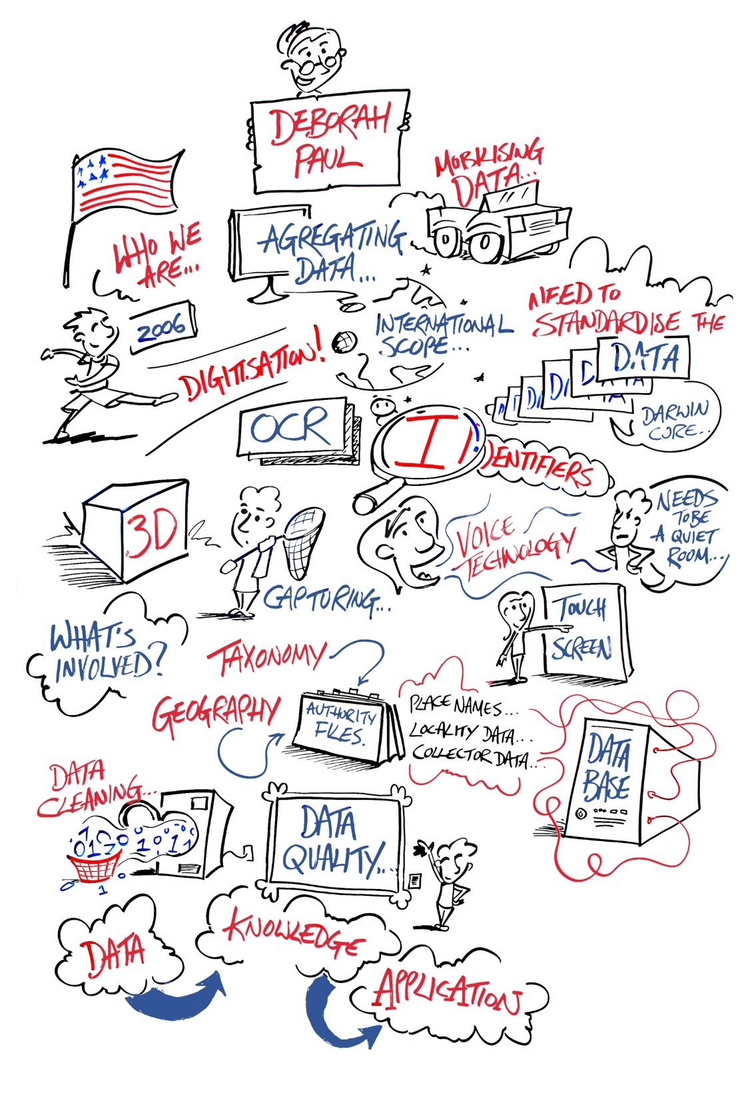
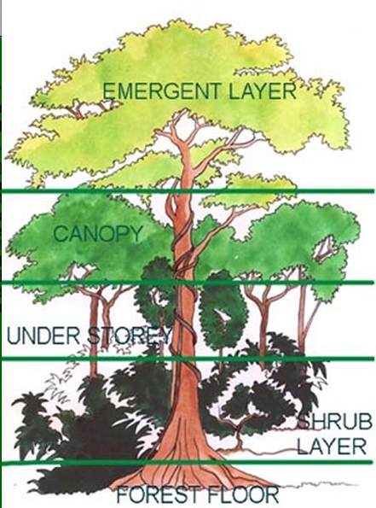
Collections
@GoodStickLtd
Notes:
Internationally, many collections work on mobilizing data associated with specimens they curate. It make sense that if we’re all working on the same tasks, with the same or similar goals, that we work together to not only benefit from collaboration, but to also work with a collective vision, an ecosystem, an integrated infrastructure, in mind. The rainforest ecosystem analogy – to make the point that all of us are needed. (Many doors in Data Science Heaven). You can “change course” or “change speed.” We need to shed light on the abyss. (My turtle story).

Slide 3
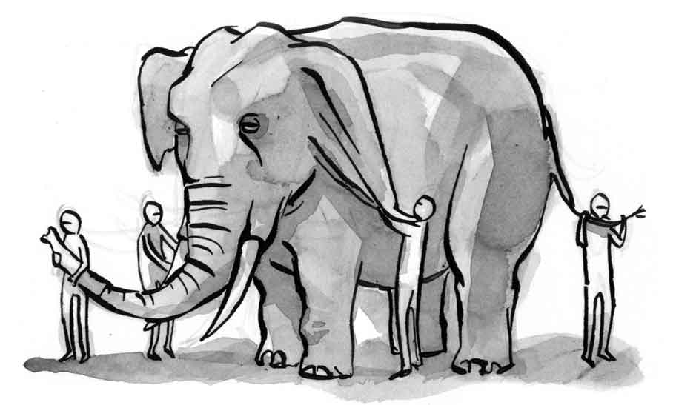
Keep these lessons in mind for multiple purposes such as the development of
a Collection Description Standard
and the data model for it
any collection metadata databases
any websites to access collection metadata
any data exchange

Slide 4
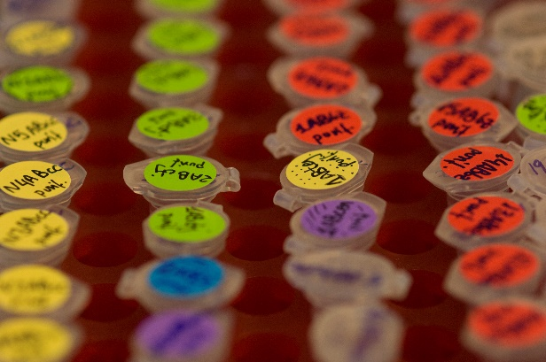
Lessons learned from Biodiversity Collections Index (BCI) insights from Roger Hyam
who needs this and why should I care? (impetus)
difficult to keep data up-to-date
hierarchies are hard for people
humans are required to make this work
not a high priority for local collections
“finite resources trying to build something that will last forever”
policy
alignment
sustainability
cyberinfrastructure
software
standard
metrics
definitions
carrots
human infrastructure

Slide 5
Lessons from the Global Registry of Biological Repositories (GRBio) insights from David Schindel
hard to define a collection
new stakeholders wanted new functions
no leverage
need to be able to show researcher and institution impact
need to link data curation to ability of collection to document its impact
need automated APIs
resource(s) need a secure home
lack of leadership and commitment
policy
alignment
sustainability
cyberinfrastructure
software
standard
metrics
definitions
carrots
human infrastructure

Slide 6
Lesson – do you need to build this?
What about photos of collections?
have the public itemize what’s in the photos.

Slide 7
Ideas to keep in mind - for the Collection Description Standard - for any collection metadata databases - for any websites - for any data exchange

Slide 8
Lesson – who needs this and why should I care? (Impetus)
Issues
Actions
too many agendas
different projects and programs want different resources serving different purposes
governments, funders, nations, museums, disciplines, individuals
different agendas
not all see what might be in it for them
provider vs other stakeholders
prioritize stakeholders to serve
set policies to support
cyberinfrastructure
software
carrots
?

Slide 9
Lesson – difficult to keep data up-to-date
Issues
Actions
naively thought people would do it
doesn’t happen
policy
cyberinfrastructure
software
carrots
?

Slide 10
Lesson – hierarchies are hard for people
Issues
Actions
Hard to think in hierarchies
Hard to agree on hierarchies
example: suggests “top-level” item is “herbarium”

Slide 11
Lesson – humans are required to make this work
Issues
Actions
humans (will) need to actively go after the information
likely need to be paid
will need a reason, example:
“we’re all going to digitize”
“regional-based” managers like Rob Cubey at RBGE - keeps data up-to-date for their institutions
seems coordination and alignment needed across such as SPNHC, ICOMNATHIST, NatSCA, …
policy
cyberinfrastructure
software
carrots
?

Slide 12
Lesson – not a high priority for local collections
Issues
Actions
no direct reason for them to do this work (what’s in it for them)
lack staffing resources
no requirement for them to advertise themselves
local science focus
don’t see how aggregation work helps them
communication
inclusion
funding
policy
cyberinfrastructure
software
carrots
?

Slide 13
Lesson – “finite resources trying to build something that will last forever”
Issues
Actions
sustainability
need to repeatedly find funding to care for this resource
need for shared long-term vision
alignment
policy
funding
communication
cyberinfrastructure
software
carrots
?

Slide 14
Lesson – hard to define a collection
Issue
Actions
decided a collection was a “set of objects with a given numbering system.”
if numbering system different, then a different collection.
likely this definition is not suitable
collections reside in the institution
define collection?
flexible (but defined) model
policy
cyberinfrastructure
software
carrots
?

Slide 15
Lesson – new stakeholders wanted new functions
Issue
Actions
started out with search by taxon and country
needed search by gene sequence, body size, drought resistance, (other traits)
data model flexibility
database flexibility
policy
cyberinfrastructure
software
carrots
?

Slide 16
Lesson – no leverage
Issue
Actions
trying to resolve institution codes and collection codes
most ambiguities (duplications) were between animal / plant collections
no authority to get these changed
some refused
model using GUIDS (not depending on codes to be unique)
policy
cyberinfrastructure
software
carrots
?

Slide 17
Lesson – need to be able to show researcher and institution impact
Issues
Actions
registries not seen as important until impact factors are affected
no standards for how researchers cite or attribute collections or specimens used in research or policy
metrics
linking
policy
cyberinfrastructure
software
carrots
?

Slide 18
Lesson – need to link data curation to ability of collection to document its impact
Issues
Actions
need to show value-added for the investment
sequencing
digitization
imaging
publications
policy / economic impact
Bloodhound-tracker.net
policy
cyberinfrastructure
software
carrots
?

Slide 19
Lesson – need automated APIs
Issues
Actions
plan was to build API between IH and GRBio (GRSciColl)
it never happened
alignment
sustainability
communication
staffing
policy
cyberinfrastructure
software
carrots
?

Slide 20
Lesson – resource(s) need a secure home
Issues
Actions
hard to develop and sustain without a sense the resource will be around in the long term
difficult to get “buy-in”
inclusion
alignment
sustainability
policy
cyberinfrastructure
software
carrots
?

Slide 21
Lesson – lack of leadership and commitment
Issues
Actions
lack of leadership
lack of commitment
recovery of results not important
use of the data – yes
but not on recovering
how often do we (specimens / institutions) show up in reports, workshops, symposia, data products, etc.
policy
cyberinfrastructure
software
carrots
?

