Slide 1
What is a ‘Collection’?
We can’t agree on a common collections hierarchy, because they:
differ between institutions:
Historical arrangement of the collections
Differences (and changes over time) in organisational structure
… and between audiences: taxonomic, famous collectors, collecting trips, storage location for condition management, preservation method for digitisation, different granularities e.g. country vs continent level…
We need a way to reflect these different contexts, but to maximise interoperability between them.

Slide 2
What is a Collection Description?
The use cases have different audiences and aims, but all are variants of the same requirement:
to identify subsets of an institution’s collection
to describe them using various attributes
to attach metrics such as numbers of items and taxa, assessment scores, volume
This means that we should be able to use the same generic data model and standards to support all of them, and link between them.
Each example (e.g. divisional summaries, Join the Dots, historical collections, collecting voyages) can be considered as different CD schemes, with different profiles.

Slide 3
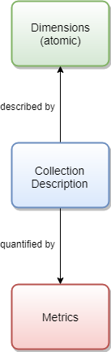

Slide 4
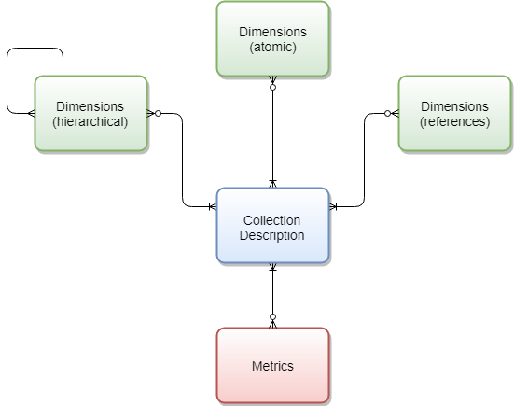

Slide 5
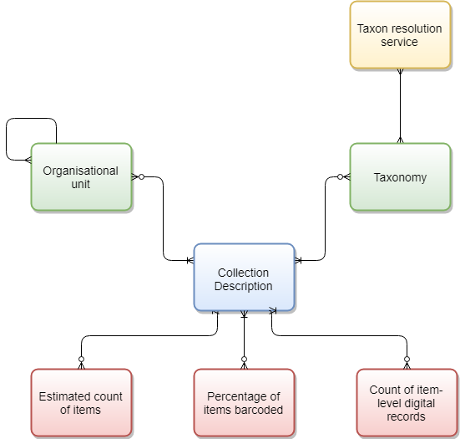
Notes:
Note – no hierarchy on the collection description.

Slide 6
CD standard as a template
Dimensions
Stratigraphy
Collection name
Short summary
Responsible curator
Taxonomy
Location
Collections hierarchy
Collector
History
Collection dates
Significance and strengths
Curatorial unit type
Acquisition details
Geographic coverage
Institution
Metrics
Item count
Curatorial unit count
% barcoded
Assessment scores
Species count
Notes:
The idea of the CD standard can be thought of as a template which contains all of the possible attributes metrics that might be needed to fulfil any of the CD use cases.

Slide 7
CD scheme profile: Join the Dots
Dimensions
Stratigraphy
Collection name
Short summary
Responsible curator
Taxonomy
Location
Collections hierarchy
Collector
History
Collection dates
Significance and strengths
Curatorial unit type
Acquisition details
Geographic coverage
Institution
Metrics
Item count
Curatorial unit count
% barcoded
Assessment scores
No. digitised
Notes:
Each CD scheme will have a profile which focuses on a subset of those attributes and metrics. E.g. Join the Dots prioritises the following attributes and metrics, which are a reflection of the purposes of Join the Dots as a CD scheme.

Slide 8
CD scheme profile: Collectors
Dimensions
Stratigraphy
Collection name
Short summary
Responsible curator
Taxonomy
Location
Collections hierarchy
Collector
History
Collection dates
Significance and strengths
Curatorial unit type
Acquisition details
Geographic coverage
Institution
Metrics
Item count
Curatorial unit count
% barcoded
Assessment scores
No. digitised
Notes:
A different CD scheme, e.g. one which focuses on collections grouped by collector, would focus on a different set of attributes and metrics from the same template. Some would be in common with Join the Dots, others would be different, reflecting the different purposes of the CD scheme. Those that are in common between the two, e.g. collections hierarchy, responsible curator and taxonomy, can be used to make links between the data in the two schemes.

Slide 9
CD scheme profile: Collections Digitisation Dashboard
Dimensions
Stratigraphy
Collection name
Short summary
Responsible curator
Taxonomy
Location
Collections hierarchy
Collector
History
Collection dates
Significance and strengths
Curatorial unit type
Acquisition details
Geographic coverage
Institution
Metrics
Item count
Curatorial unit count
% barcoded
Assessment scores
No. digitised
Notes:
A different CD scheme, e.g. one which focuses on collections grouped by collector, would focus on a different set of attributes and metrics from the same template. Some would be in common with Join the Dots, others would be different, reflecting the different purposes of the CD scheme. Those that are in common between the two, e.g. collections hierarchy, responsible curator and taxonomy, can be used to make links between the data in the two schemes.

Slide 10
CD scheme rules
While the CD data model and standards must be wide and flexible enough to support all of the use cases, CD scheme metadata can be used to make constraints on a specific implementation e.g.
Define rules
Whether it’s intended to reflect all, or just parts, of an institution’s collection
Which dimensions, properties and metrics are applicable
Which dimensions, properties and metrics are mandatory
Which controlled vocabularies etc are used for each dimension or term
To what level of a hierarchical dimension the collection should be split…
Prevent double counting i.e. a query should aggregate item counts from CD Scheme A only

Slide 11
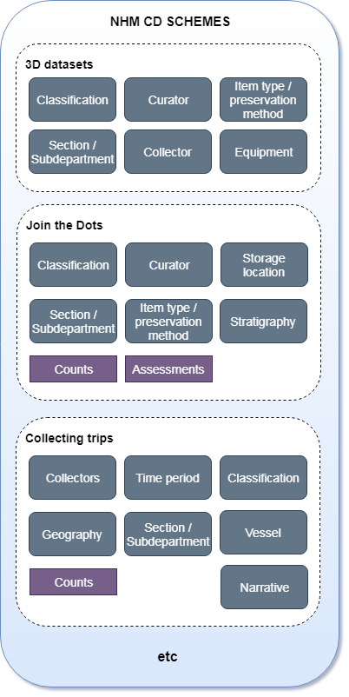
Managing multiple schemes
Notes:
Within the NHM, we would therefore have a number of Collection Description schemes, of which Join the Dots is one. Each would be a different use case, with a different purpose and potentially audience, and so have a different profile of attributes and metrics within the CD template.

Slide 12
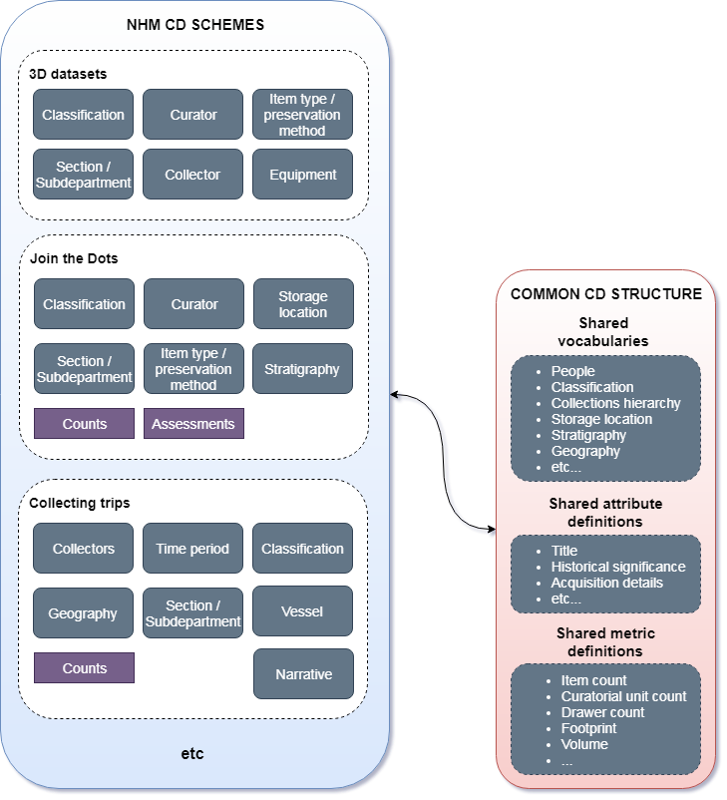
Using a common structure and standards
Notes:
The CD template is represented by a common CD structure, with shared vocabularies, attribute definitions and metric definitions that are standardised across all CD schemes. E.g. the collection hierarchy would be the same for all schemes, as would the definition of the ‘historical significance’ text attribute, and the definition of the ‘item count’ metric. This means that data can be linked between schemes using these common attributes, and metrics are potentially comparable. While the fact that the different schemes are split down to different levels using different attributes means that not everything will fit neatly together, the common standards give the best chance of retaining comparability and reducing duplicated effort as much as is feasible.

Slide 13
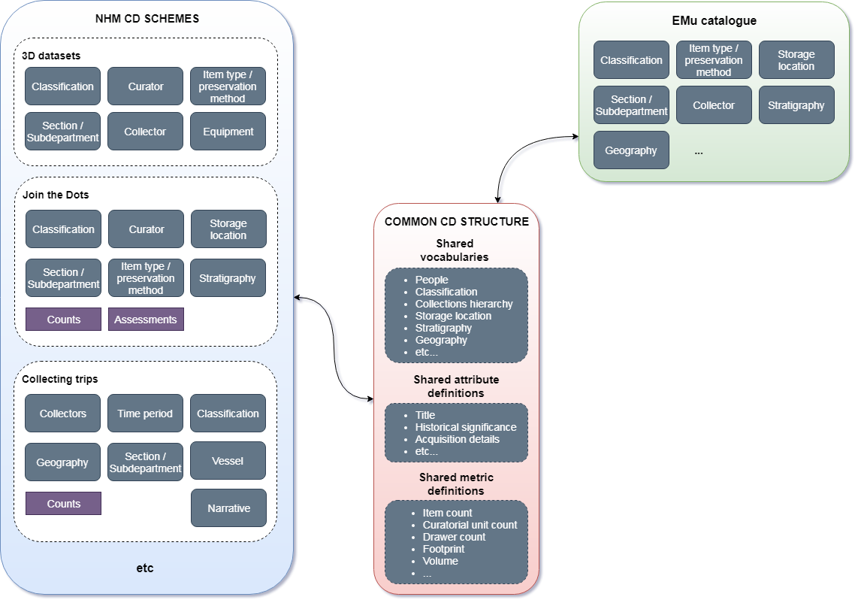
Linked to specimen records using common standards
Notes:
The common standards can also be harmonised or mapped to vocabularies and fields in EMu and other CMSs (e.g. Library), providing a degree of linkage to item-level records. With common standards, this mapping only has occur once rather than be defined for each individual CD scheme.

Slide 14
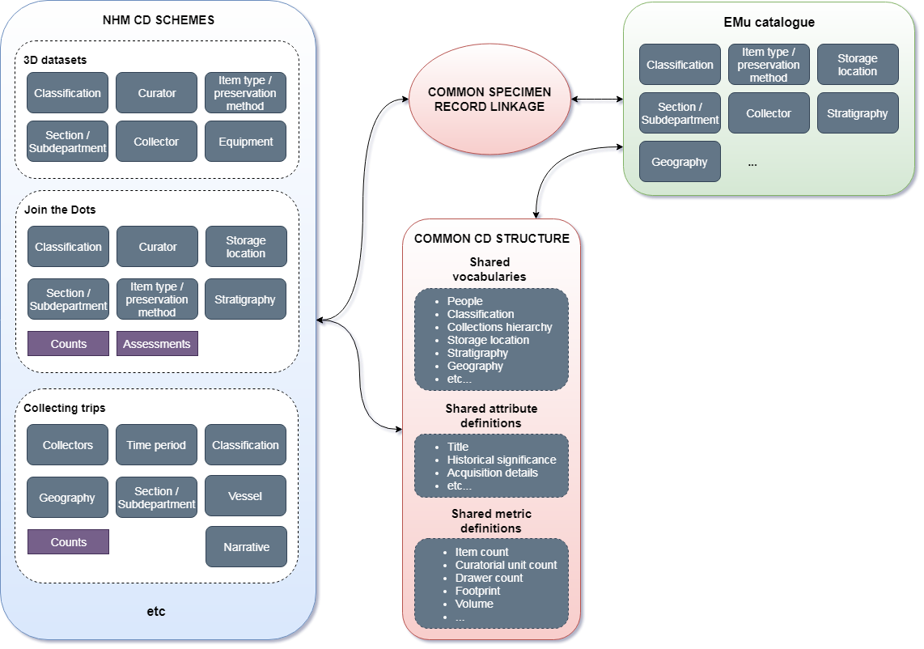
Linked explicitly to specimen records using a common mechanism
Notes:
As we know that mapping and harmonisation of standards between systems is not always straightforward, and that records don’t always have the metadata on them that we might want, we’re also likely to want to link item-level records directly to CDs. For example, ‘catalogue records 543594, 8957434 and 34238 are part of Join the Dots unit ‘X’ (CD ID 2364)’, or ‘catalogue records 543594, 8957434 and 999423 are part of the Darwin Collection Description (CD ID 99476)’. We can again use a common mechanism to handle those links, rather than a different one for each CD scheme.

Slide 15
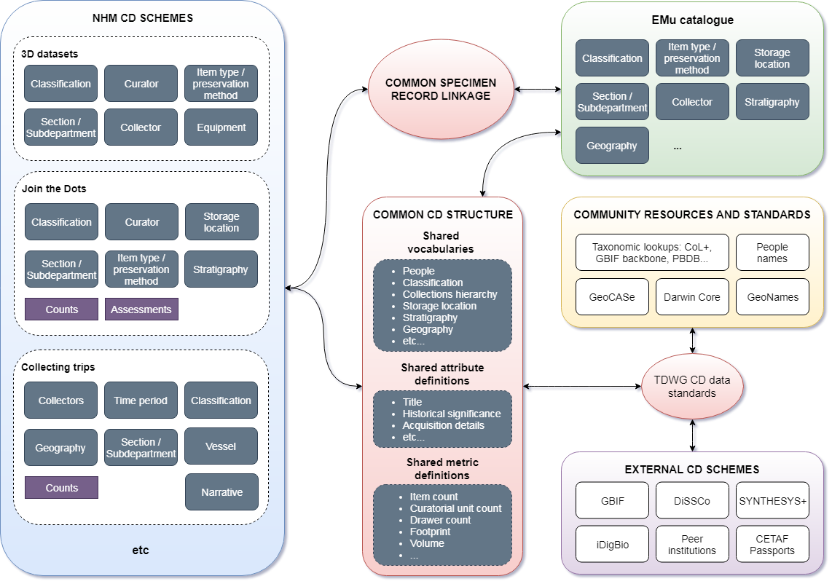
Linked to community CDs and resources using TDWG standards
Notes:
Finally, the common CD structure used will be based on, and conform to, the TDWG CD data standards that we’re developing. By this method, we’ll have the potential to link any of our CD schemes to those of external organisations, such as that in the DiSSCo/SYNTHESYS+ data architecture for Virtual Access and Digitisation on Demand, and to automate the submission of information for CETAF passports.
The TDWG CD standards are also the key to linking our CDs (and potentially catalogue records) to external services and standards, helping to validate, link and enrich our data.

Slide 16
Benefits to a common structure
Distinct CD schemes to avoid confusion of purpose
Avoid duplication of effort as much as possible
Starting template for any new schemes
A single mechanism for associating with specimen records
Richer experience from semantic links between CD schemes using shared attributes
Common standards for sharing data in SYNTHESYS+ (e.g. Virtual Access, Digitisation on Demand), DiSSCo, GBIF etc
Sustainable, growing resource of collections data for answering external questions

Slide 17
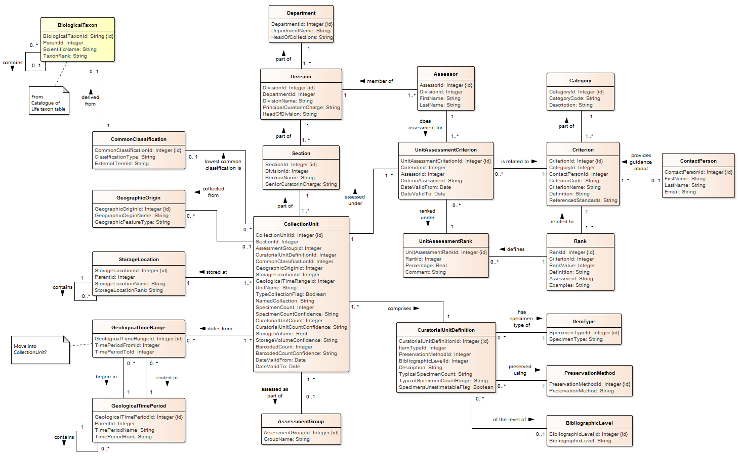
Link

