Slide 1
Updates to PathoSurveilR R package for pathogensurveillance parsing
Lab meeting 2025-06-11
Zachary Foster

Slide 2
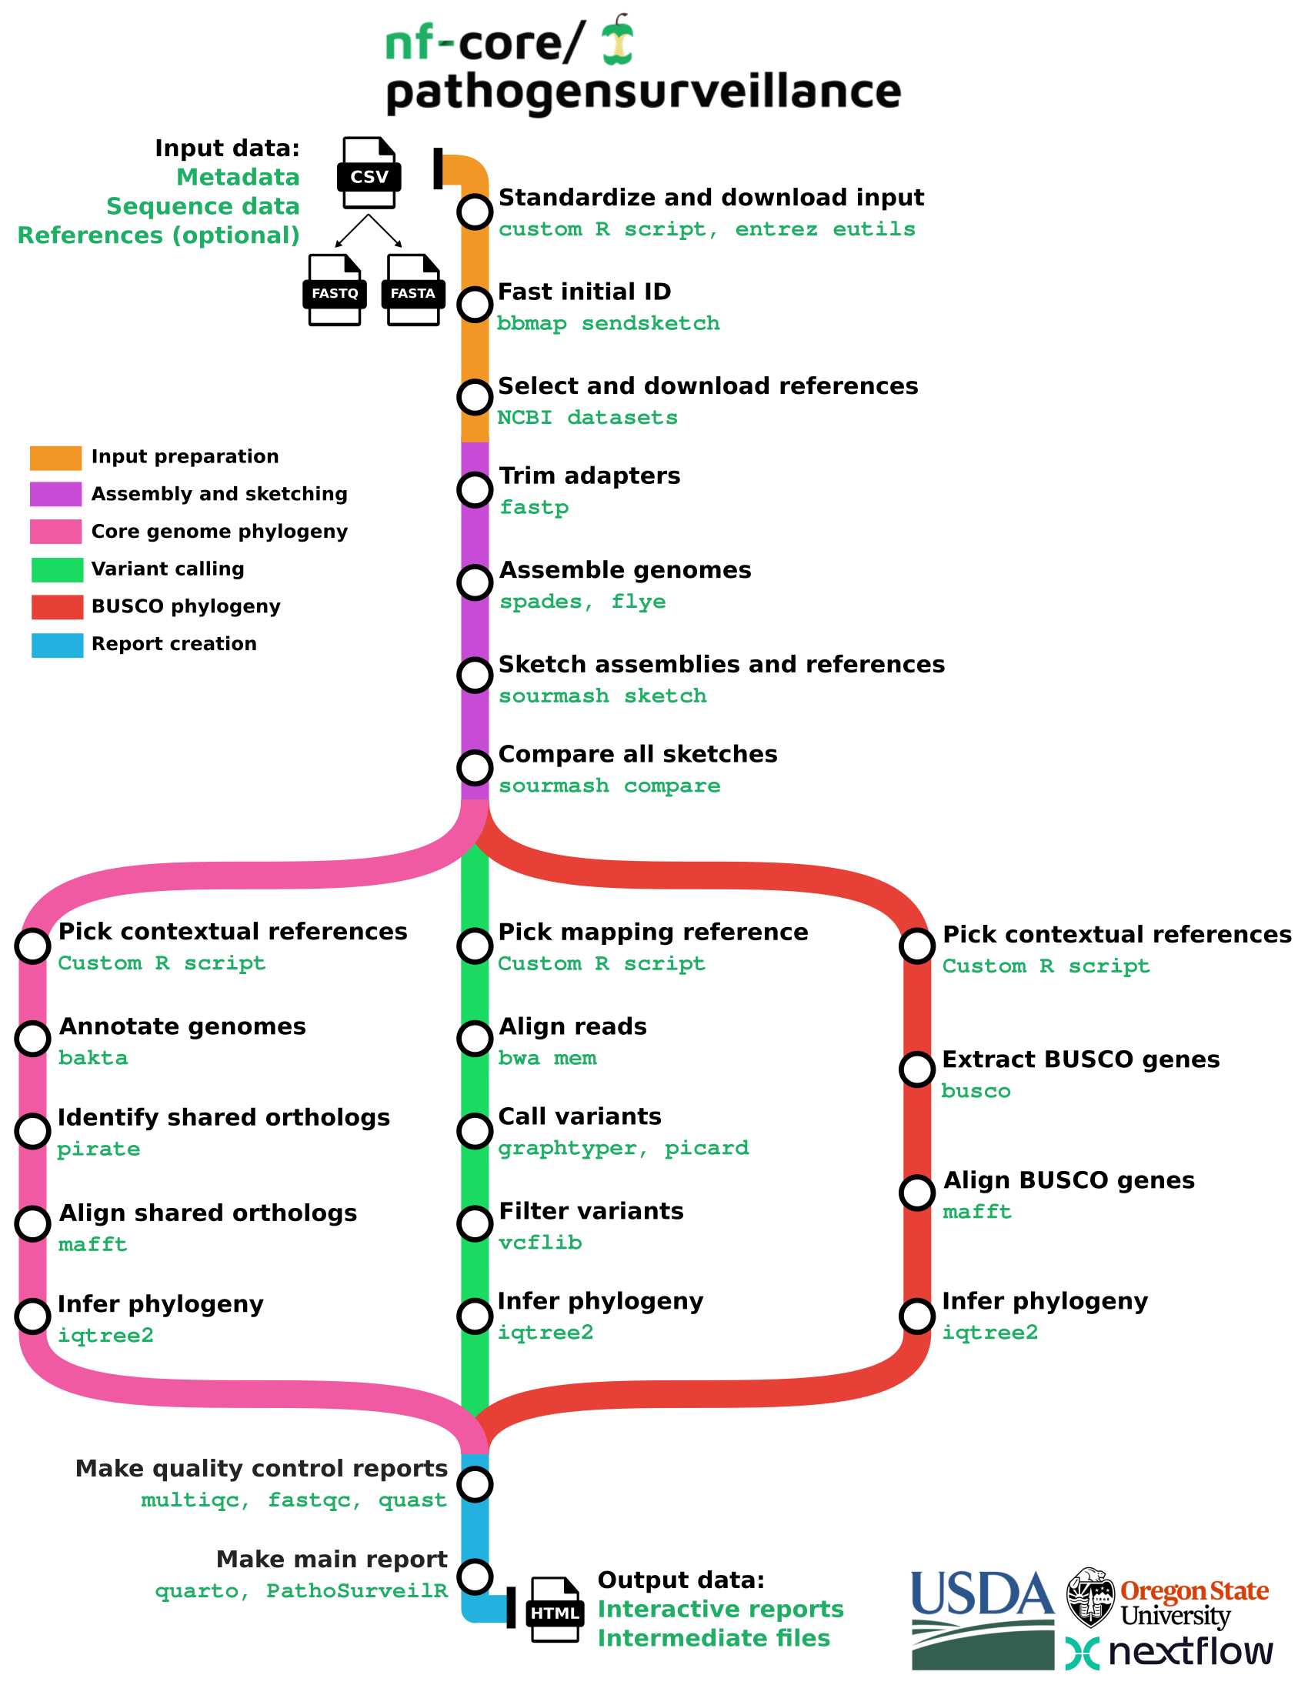
Review of pathogensurveillance pipeline
Nextflow pipeline for automated pathogen identification and population genomics
Produces an output directory with intermediate files and HTML reports
Under review for inclusion in nf-core, a standardized and non-redundant collection of pipelines
Uses Illumina/Pacbio/Nanopore reads as input
Works with Prokaryotes and Eukaryotes
Automatically selects and downloads references

Slide 3
New output directory structure
The output directory structure was redone in response to nf-core reviewer comments
Robust downstream analysis requies a consistent directory/file naming schema
The pipeline uses multiple IDs to differentiate data:
  Sample IDs
  Reference IDs
  Assembly IDs (Sample or Reference)
  Report IDs
  “Cluster” IDs
These IDs must be encoded in output directories in a machine readable format for automated parsing
outdir
├── aligned_reads
├── annotations
│ └── bakta
├── assemblies
│ ├── flye
│ └── spades
├── busco
├── downloads
│ ├── annotations
│ ├── assemblies
│ └── reads
├── fastp
├── metadata
├── pipeline_info
├── pirate
├── pocp
├── quality_control
│ ├── fastqc
│ ├── multiqc
│ ├── nanoplot
│ └── quast
├── reference_data
│ ├── considered
│ ├── downloaded
│ ├── indexes
│ └── selected
├── report_group_data
├── reports
├── sendsketch
├── shared_genes
│ ├── busco
│ └── core
├── sketch_comparisons
│ ├── ani_matricies
│ └── sketches
├── trees
│ ├── busco
│ ├── core
│ └── snp
└── variants

Slide 4
New output directory structure (in detail)
outdir
├── aligned_reads
│ ├── <reference_id>--<sample_id>.formatted.bam : Quality filtered reads alignements to references in BAM format
│ ├── <reference_id>--<sample_id>.formatted.bam.csi : Index for the filtered BAM files produced by samtools index
│ └── <reference_id>--<sample_id>.formatted.Mark... : Output from picard MarkDuplicates
├── annotations
│ └── <method>
│ ├── <sample_id>.embl : Annotations and sequences in (multi) EMBL format
│ ├── <sample_id>.faa : FASTA files of CDS/sORF amino acid sequences
│ ├── <sample_id>.ffn : FASTA files of feature nucleotide sequences
│ ├── <sample_id>.fna : FASTA files of replicon/contig DNA sequences
│ ├── <sample_id>.gbff : Annotations of sequences in (multi) GenBank format
│ ├── <sample_id>.gff3 : Annotations of sequences in GFF3 format
│ ├── <sample_id>.hypotheticals.faa : FASTA files of hypothetical protein CDS amino acid sequences
│ ├── <sample_id>.hypotheticals.tsv : TSV files of information on hypothetical protein CDS
│ ├── <sample_id>.tsv : TSV files of information for protein CDS
│ └── <sample_id>.txt : Summary in TXT format
├── assemblies
│ ├── flye
│ │ ├── <sample_id>.assembly_graph.gfa.gz : Genome assembly graphs in gzipped gfa format
│ │ ├── <sample_id>.assembly_graph.gv.gz : Genome assembly scaffolds in gzipped FASTA format
│ │ └── <sample_id>.assembly.fasta.gz : Genome assemblies in compressed FASTA format
│ └── spades
│ ├── <sample_id>.assembly.gfa.gz : Genome assembly graphs in gzipped gfa format
│ └── <sample_id>.scaffolds.fa.gz : Genome assemblies in compressed FASTA format
├── busco
│ └── <sample_id>--<database>-busco : BUSCO output directory
outdir
├── aligned_reads
├── annotations
│ └── bakta
├── assemblies
│ ├── flye
│ └── spades
├── busco
├── downloads
│ ├── annotations
│ ├── assemblies
│ └── reads
├── fastp
├── metadata
├── pipeline_info
├── pirate
├── pocp
├── quality_control
│ ├── fastqc
│ ├── multiqc
│ ├── nanoplot
│ └── quast
├── reference_data
│ ├── considered
│ ├── downloaded
│ ├── indexes
│ └── selected
├── report_group_data
├── reports
├── sendsketch
├── shared_genes
│ ├── busco
│ └── core
├── sketch_comparisons
│ ├── ani_matricies
│ └── sketches
├── trees
│ ├── busco
│ ├── core
│ └── snp
└── variants

Slide 5
New output directory structure (in detail)
├── downloads
│ ├── annotations
│ │ └── <reference_id>.gff.gz : Annotations downloaded by the pipeline in GFF format
│ ├── assemblies
│ │ └── <reference_id>.fasta.gz : Assemblies downloaded by the pipeline in FASTA format
│ └── reads
│ └── <reference_id>_<orientation>.fastq.gz : Reads downloaded by the pipeline in FASTQ format
├── fastp
│ ├── <sample_id>.fastp.html : FASTP report in HTML format
│ └── <sample_id>.fastp.json : FASTP report in JSON format
├── metadata
│ ├── reference_metadata.tsv : Reference metadata in TSV format
│ └── sample_metadata.tsv : Sample metadata in TSV format
├── pipeline_info
│ ├── execution_report_<date>.html : Statistics for pipeline execution as a HTML report
│ ├── execution_trace_<date>.txt : Statistics for pipeline execution in TSV format
│ ├── messages.tsv : Errors, warnings, and messages produced by the pipeline.
│ ├── params_<date>.json : Parameters use when running the pipeline format
│ ├── pathogensurveillance_run_info.yml : Pipeline run metadata
│ └── version_info.yml : Versions of software used in the pipeline
├── pirate
│ └── <report_id>_results : Pirate output directory with gene orthology information
├── pocp
│ └── <report_id>_pocp.tsv : Percentage of conserved proteins in TSV format
outdir
├── aligned_reads
├── annotations
│ └── bakta
├── assemblies
│ ├── flye
│ └── spades
├── busco
├── downloads
│ ├── annotations
│ ├── assemblies
│ └── reads
├── fastp
├── metadata
├── pipeline_info
├── pirate
├── pocp
├── quality_control
│ ├── fastqc
│ ├── multiqc
│ ├── nanoplot
│ └── quast
├── reference_data
│ ├── considered
│ ├── downloaded
│ ├── indexes
│ └── selected
├── report_group_data
├── reports
├── sendsketch
├── shared_genes
│ ├── busco
│ └── core
├── sketch_comparisons
│ ├── ani_matricies
│ └── sketches
├── trees
│ ├── busco
│ ├── core
│ └── snp
└── variants

Slide 6
New output directory structure (in detail)
├── reference_data
│ ├── considered
│ │ └── <taxon_id>.tsv : Metadata of available assemblies on NCBI in TSV format
│ ├── downloaded
│ │ └── <sample_id>.tsv : Metadata of references selected for download in TSV format
│ └── selected
│ ├── <report_id>_busco_references.tsv : IDs of references selected for multigene phylogenies
│ ├── <report_id>_core_references.tsv : IDs of references selected for multigene phylogenies
│ └── <report_id>_mapping_references.tsv : IDs of references selected for multigene phylogenies
├── sendsketch
│ └── <sample_id>.txt : Table returned by BBmap sendsketch with initial identifications
├── shared_genes
│ └── <method>
│ └── <gene_id>.aligned.fas : Aligned shared genes in FASTA format
├── sketch_comparisons
│ ├── ani_matricies
│ │ └── <report_id>_comp.csv : ANI similarity matrix in CSV format made by sourmash compare
│ └── sketches
│ └── <id>.sig : FracMinHash signature made by sourmash sketch
├── trees
│ ├── busco
│ │ └── <report_id>--<cluster_id>.treefile : Trees infered from multigene phylogeny in Newick format
│ ├── core
│ │ └── <report_id>--<cluster_id>.treefile : Trees infered from multigene phylogeny in Newick format
│ └── snp
│ └── <report_id>--<reference_id>.treefile : Tree inferred from variant analysis in Newick format
└── variants
├── <report_id>--<reference_id>.fasta : Filtered variants in FASTA format
├── <report_id>--<reference_id>.vcf.gz : Unfiltered variants in VCF format
└── <report_id>--<reference_id>.vcffilter.vcf.gz : Filtered variants in VCF format
outdir
├── aligned_reads
├── annotations
│ └── bakta
├── assemblies
│ ├── flye
│ └── spades
├── busco
├── downloads
│ ├── annotations
│ ├── assemblies
│ └── reads
├── fastp
├── metadata
├── pipeline_info
├── pirate
├── pocp
├── quality_control
│ ├── fastqc
│ ├── multiqc
│ ├── nanoplot
│ └── quast
├── reference_data
│ ├── considered
│ ├── downloaded
│ ├── indexes
│ └── selected
├── report_group_data
├── reports
├── sendsketch
├── shared_genes
│ ├── busco
│ └── core
├── sketch_comparisons
│ ├── ani_matricies
│ └── sketches
├── trees
│ ├── busco
│ ├── core
│ └── snp
└── variants

Slide 7
Review of last version of PathoSurveilR
Each type of file output had at least 3 functions:
  Path finder: returns paths found
  Path data finder: returns table of path data (e.g. IDs extracted from file names)
  Parser: returns parsed data
This was not ideal because
  Around 100 often very similar functions and counting
  Hard to maintain
  Annoying naming conventions (e.g. formatted_bam_path_data)
  Cannot parse older pathogensurveillance outputs
  Difficult to use inside pipeline with a subset of data

Slide 8
Updated PathoSurveilR path finding and parsing system
All of these functions are now replaced with a few general purpose functions:
  known_ps_outputs: makes table of types of data available
  print_ps_outputs: prints types of data available
  print_outdir_schema: prints tree of output directory structure
  find_ps_paths: makes table of paths found and parses IDs
  find_ps_data: finds and parses data in one step
These use a description of output format in the pipeline output itself
Only need a path to or inside of a pathogensurveillnace output directory
Every output type has a human readable ID called a “target”

Slide 9
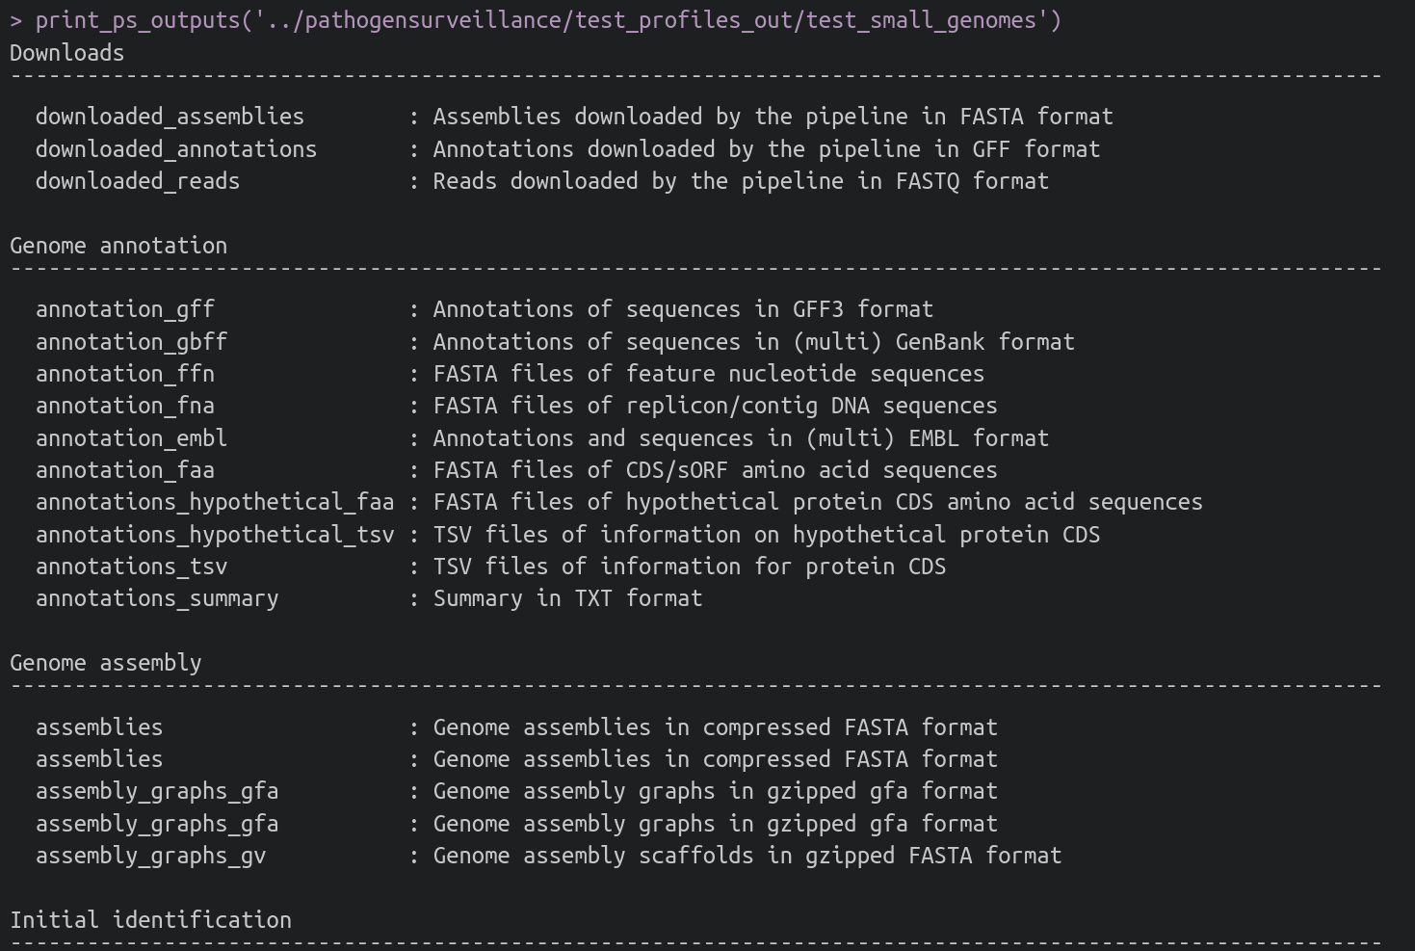
print_ps_outputs
Human-readable printing of available output data

Slide 10
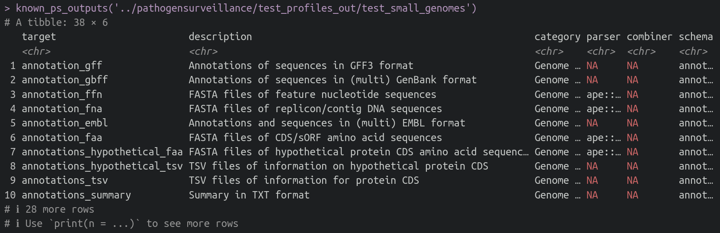
known_ps_outputs
Machine-readable table of available output data

Slide 11
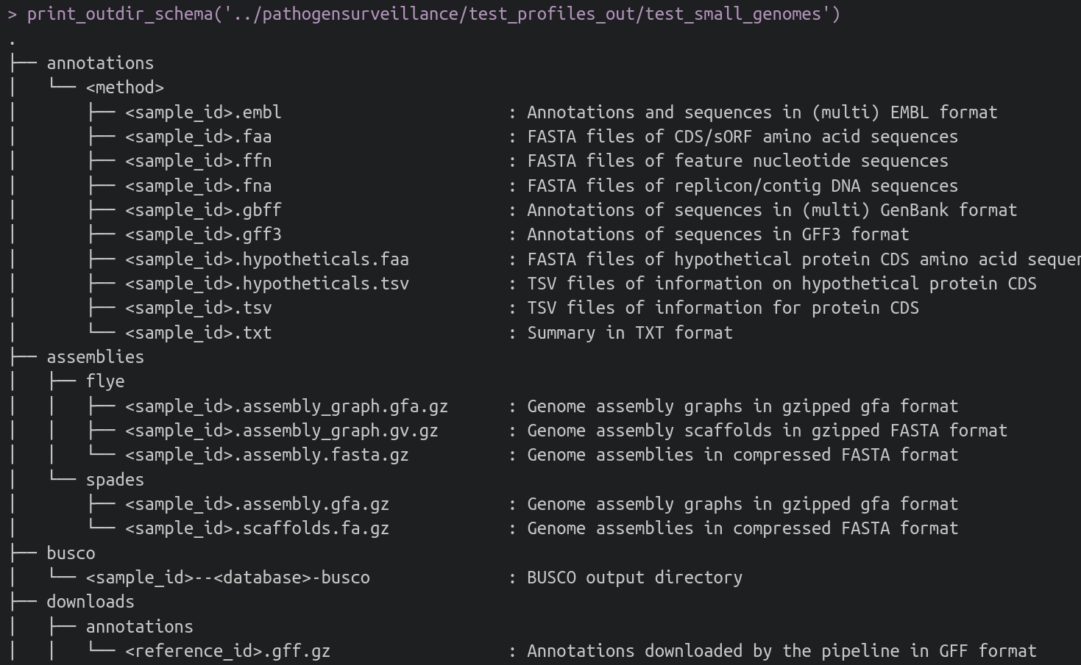
print_outdir_schema
Machine-readable table of available output data

Slide 12
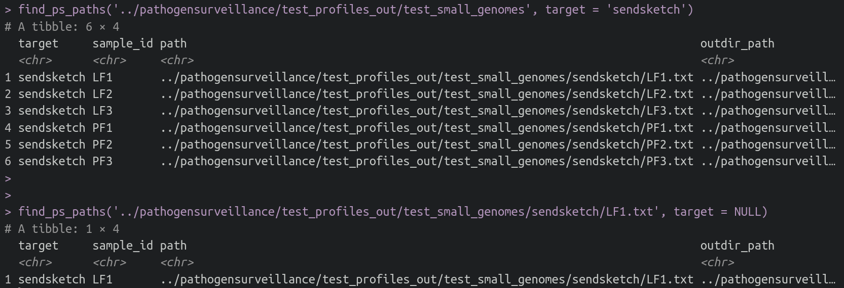
find_ps_paths
Find/parse path data for specific targets
  Can also search for all available paths with `target = NULL`

Slide 13
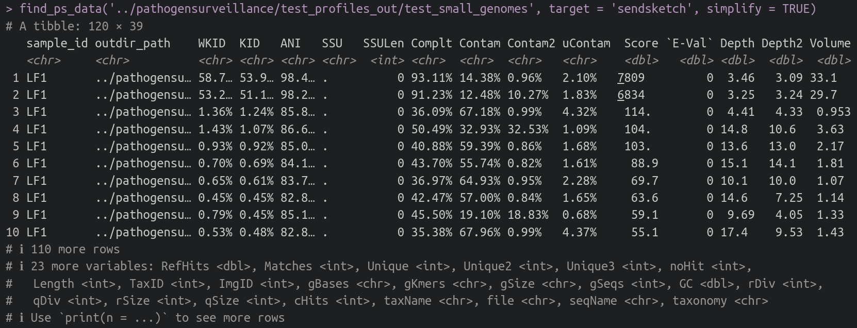
find_ps_data
Find/parse file contents into R for specific targets
  Can combine the output of multiple files with `simplify`

Slide 14
How it works
Data needed to find and parse files is included in pipeline output as a JSON file
The JSON file includes
  Description of the data
  Category to organize data
  Functions to parse data
  Functions to combine parsed data from multiple files
  Which directories to seach for files
  The names of files to search for
  What part of the file names correspond to IDs
"sendsketch": {
"description": "Table returned by BBmap send...",
"category": "Initial identification",
"parsers": {
"r": "PathoSurveilR:::parse_sendsketch"
},
"combiners": {
"r": "PathoSurveilR:::combine_tables"
},
"sources": [
{
"path": "sendsketch",
"pattern": "^(.+?)\\.txt$",
"capture_groups": ["sample_id"]
}
]
}

Slide 15
Why this matters
Easier and less error prone to maintain
Logic is extensible to other languages (e.g. python)
PathoSurveilR should work with output from older verisons of the pipleine
Greatly simplifies using PathoSurveilR within the pipeline on a subset of results (e.g. the main report input)
Automates parts of the documention on output format
Provides a foundation for a plugin system with custom reports
Could be extracted into its own package since it is generally useful for any pipeline

