Slide 1

nf-core/pathogensurveillance
Automated Analysis of Whole Genome Sequencing Data for the Identification and Surveillance of Pathogen Populations
Zachary S.L. Foster, Fernanda I. Bocardo, Hung Phan, Marina Witherell, Alexandra J. Weisberg, Melodie L. Putnam, Jeff H. Chang, Niklaus J. Grünwald

Slide 2
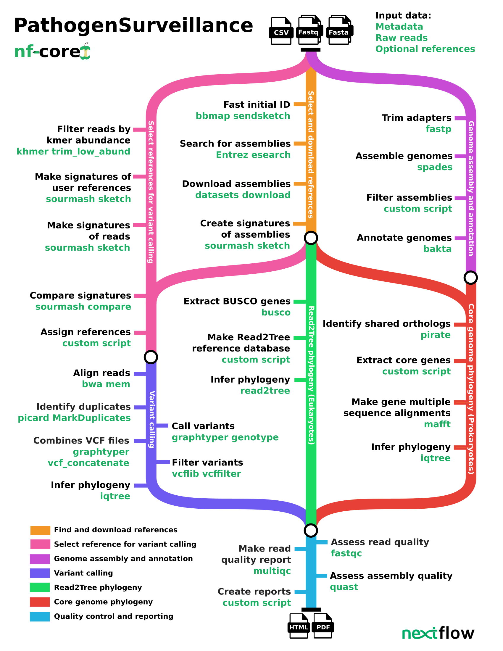
Features implemented
Takes raw reads as input
Rapid initial identification based on k-mer sketches
Automated selection and downloading of reference assemblies from NCBI RefSeq
Genome assembly and annotation (Prokaryotes only)
Core genome phylogeny with RefSeq genomes for context (Prokaryotes only)
Variant calling with a user-defined reference or one selected from RefSeq
A minimum spanning network and SNP phylogeny from variant data
Makes reports for each group of samples as interactive HTML or static PDF documents

Slide 3
Built using Nextflow
All programs needed to run the pipeline are installed automatically
Processes are run in parallel when possible
Can run on personal computers, high performance clusters, or commercial cloud services
Inputs, outputs, and the pipeline code itself can be stored on the internet
Samples can be added to an analysis without rerunning the entire pipeline.
The pipeline can pick up where it left off if interrupted
Each process is run in its own docker/singularity container or conda environment, enabling reproducibility

Slide 4
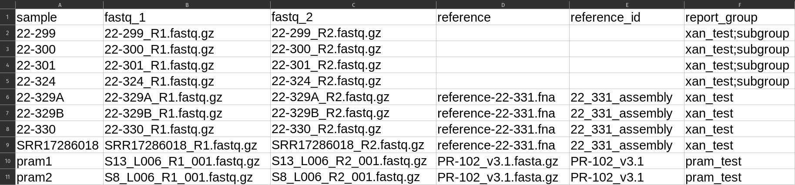
Inputs
The primary input is a spreadsheet with file paths or URLs to input files
Each row corresponds to a sample
Input files can be on the local computer or online
Users can define references for variant calling or let the pipeline find and download them from NCBI RefSeq
Each sample can be assigned to one or more “report groups”
A report will be made for all the samples in each report group

Slide 5
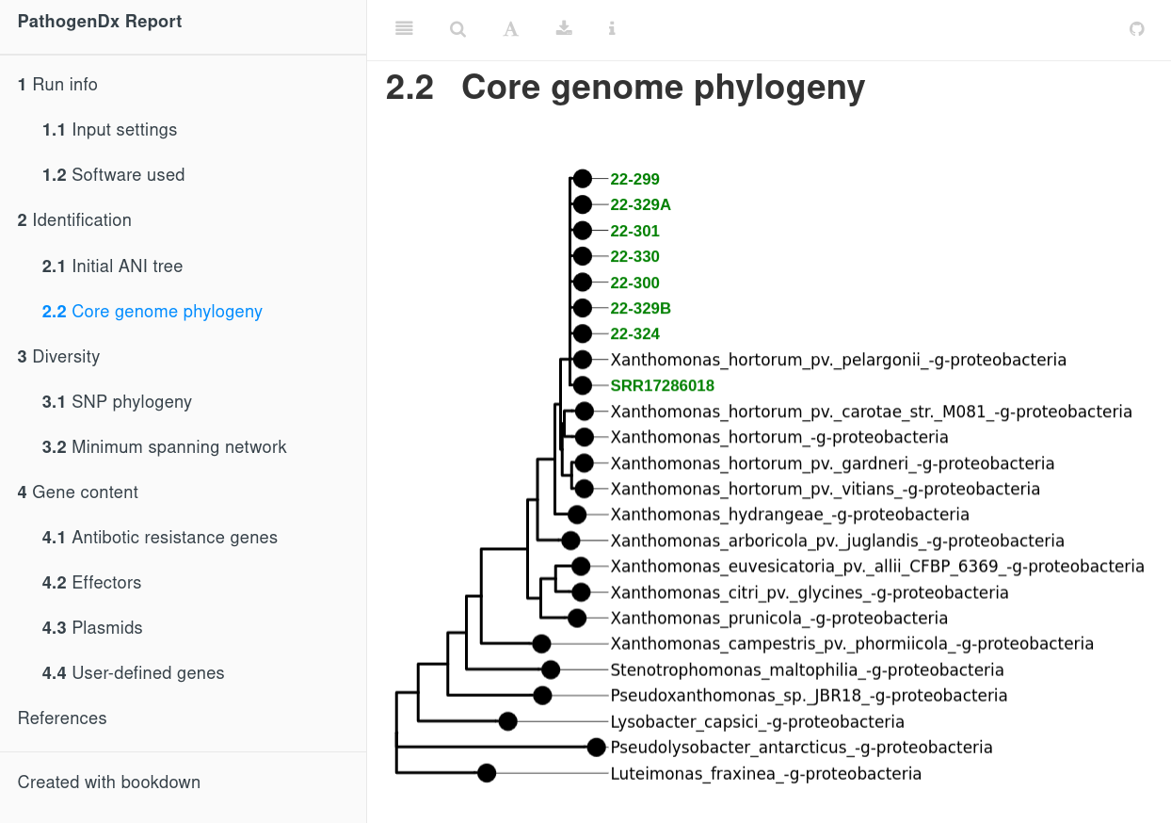
HTML report output (under development)

