Slide 1
What should I learn next?
Business Case: Jazz music is based on sequencical order of chords. Learning a new piece is easier if the sequence of chords is as similar as possible to the one learned first. The goal is to use text analytics in order to find the most similar piece of Jazz music in a repertoire. Proofing will be done by an experienced jazz pianist.
Methodological steps:
Parsing XML input files from iReal Pro, encode them to json with root, bass and degree for each chord.
Encode common chord progression for later n-gram mapping
Generate chords, three variants
Encode relative values into chord names, each tune is encoded into all 12 keys, resulting in 16'008 rows.
Encode each tune in it s default key, resulting in 1334 rows
Encode major tunes in C major, minor tunes in A minor, resulting in 1334 rows.
TF-IDF with single chords
TF-IDF with N-Grams as inputs
explorative procedure: check three methods and see what brings best results.
Our code can be found on our github: https://github.com/gruppeneun/chords
Data Set: 1334 pieces of Jazz music from the iReal Pro forum

Slide 2
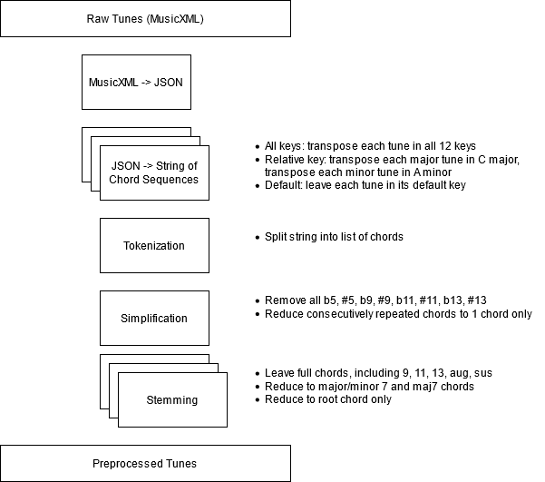
Data Preprocessing
Analogy to NLP:
Chord — Word
Tune — Document
Simplify Chords — Stemming
Source Code for MusicXML -> JSON: ​ adapted from https://github.com/felixxwu/Jazz-Chord-Generator

Slide 3
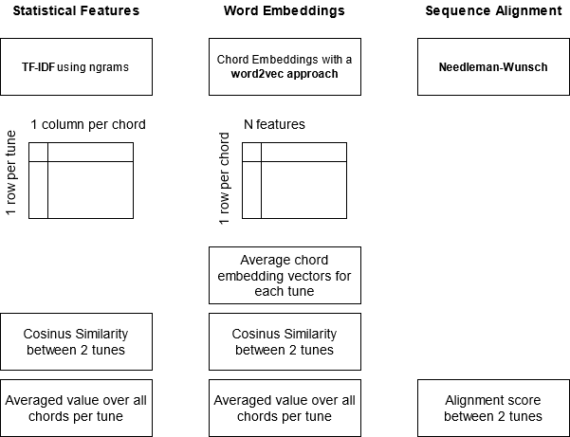
Methods
Smith-Waterman

Slide 4
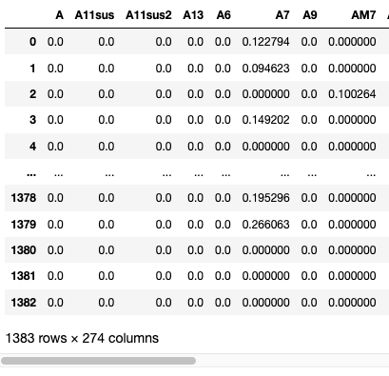
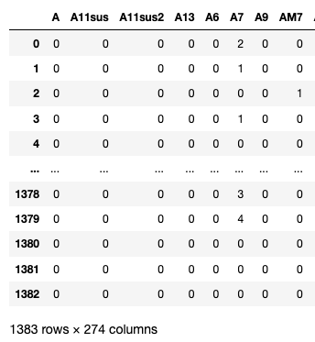
Bag of Chords
Bag of Chords Model: see which chords are prevalent in what song (right)
And calculate TF-IDF on single chords (left)

Slide 5
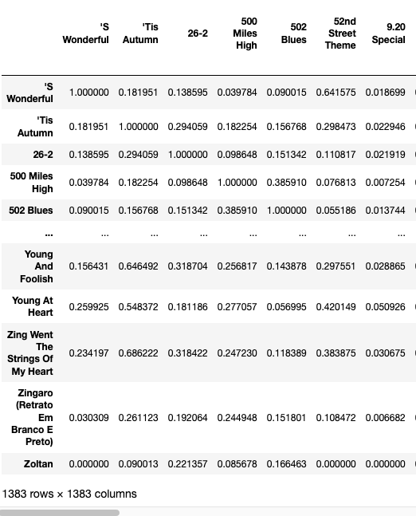
Bag of Chords
Input single chords from bag of words model
Use pair-wise cosinus similiarities to see what songs are similiar to each other

Slide 6
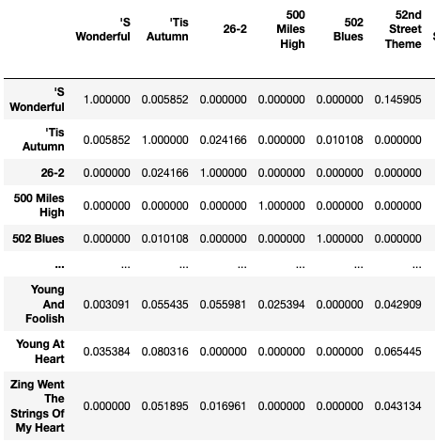
TF IDF: ngrams
Bag of ngrams Model with 2 chords as input
Using TF-IDF ngrams (3) method to find similar songs

Slide 7
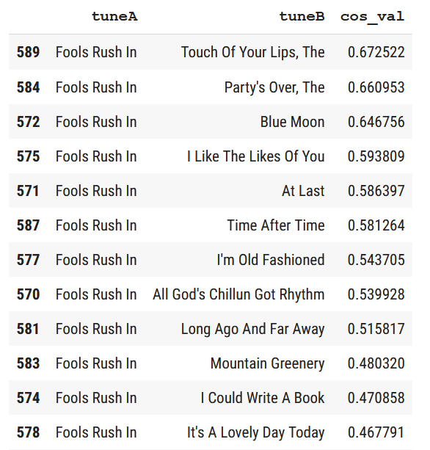
TF IDF: ngrams
Using TF-IDF ngrams (3) method to find songs most similar to another song

Slide 8
Word Embeddings
Word2Vec skip-gram approach with negative sampling
Unsupervised approach
Generate training samples from chord sequences
Window size 1 (1 chord each side of center chord); 2 negative samples
Subsample according to chord frequency to speed up training Sample code: https://www.tensorflow.org/tutorials/text/word2vec
Experiment 1: Reproduce Cycle of Fifths
Using tunes transposed to all 12 keys
Using single chords
Experiment 2: Recommend Similar Tunes
Using all tunes transposed to one common key (Cmaj / Amin)
Using chord ngrams of 3

Slide 9
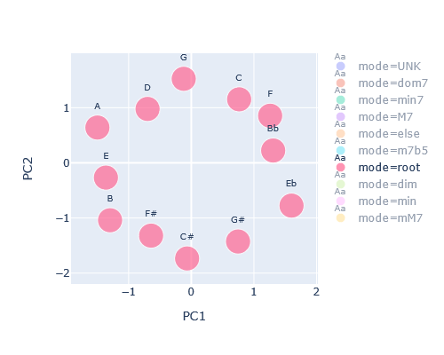
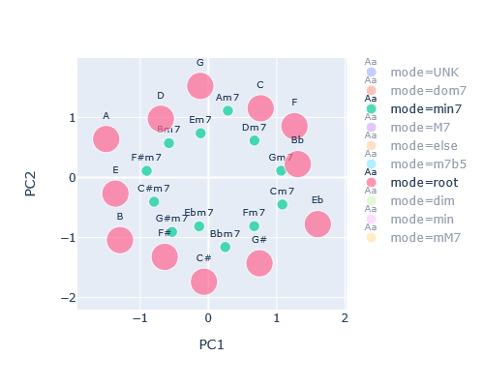
Reproduce the Cycle of Fifths
Input: 1334 tunes transposed to all 12 keys, full single chords.
Visualization: PCA of the resulting Embedding Matrix.
https://en.wikipedia.org/wiki/Circle_of_fifths

Slide 10
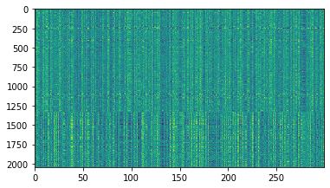
Recommend a Similar Tune
Train Embedding Matrix on 3-chord ngrams, full chords
Visualize Embedding Weights:
300 weights (columns)
Each row is 1 tune
2044 tunes used as input

Slide 11
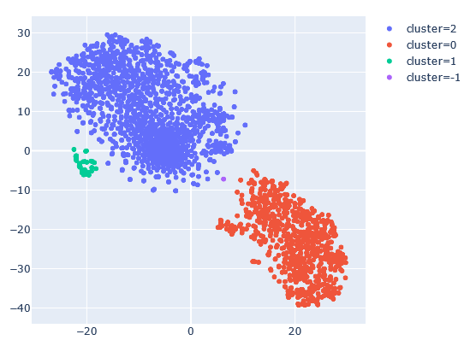
T-SNE Visualization of Embedding
2044 tunes
Clustering with HDBSCAN
Blue: tunes with major7 chords (jazz tunes)
Red: tunes with root triads or root6 chords (traditional tunes)
Green: Blues patterns
Manual inspection and validation of the result!

Slide 12
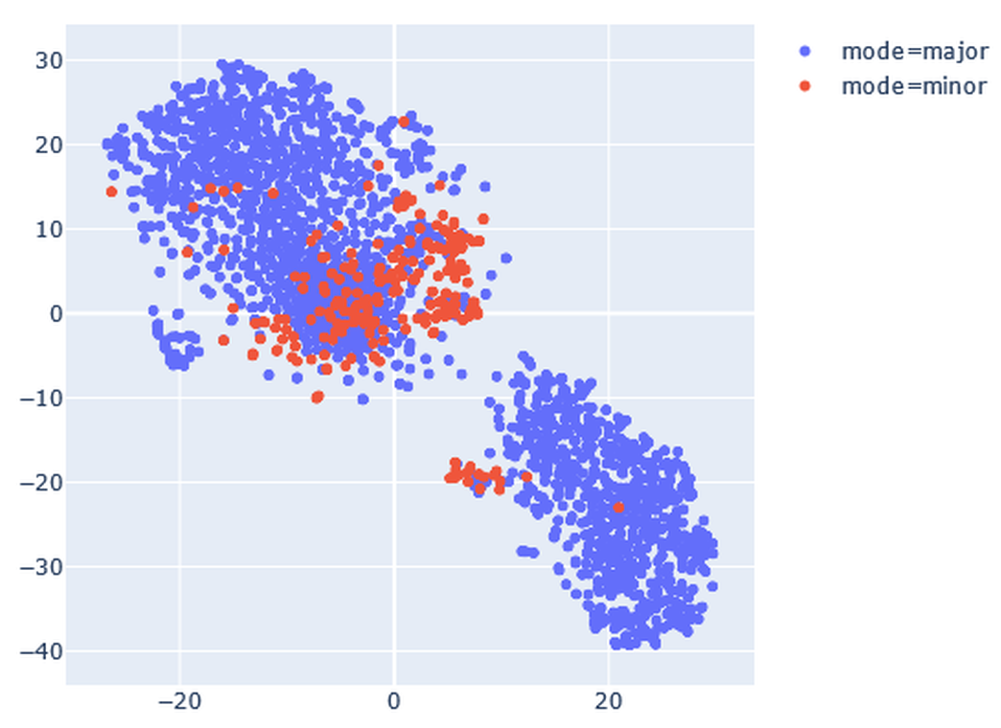
T-SNE Visualization of Embedding
2044 tunes
Tunes in C major: blue
Tunes in A minor: red

Slide 13
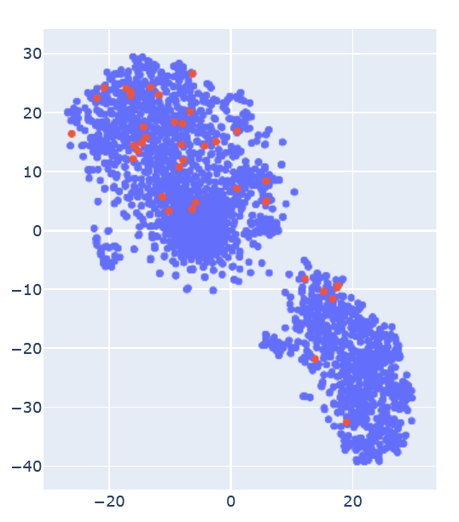
T-SNE Visualization of Embedding
2044 tunes
Explore different Composers
No clear patterns visible
Example here: Compositions by Cole Porter in red

Slide 14
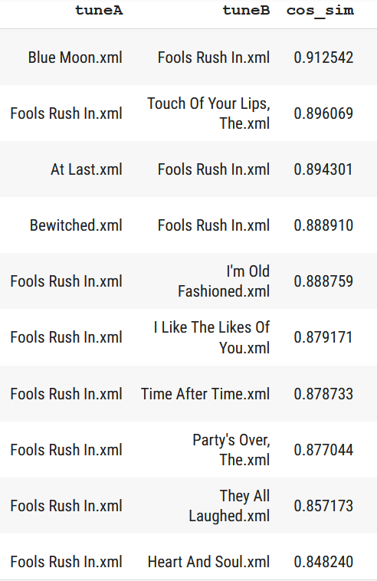
What is similar to "Fools Rush In"?
Word Embeddings
TF-IDF

Slide 15
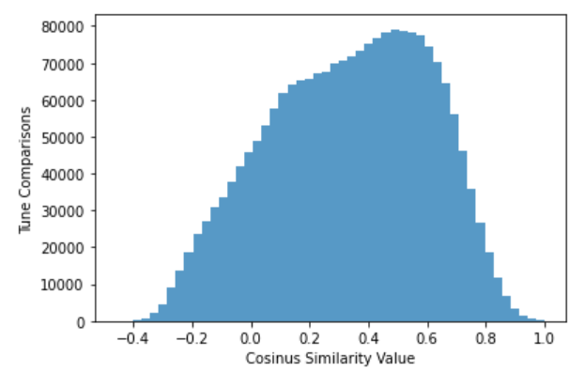
Cosinus Similarity to recommend Tunes
Pair-wise cosinus similarity for each tune
Fools Rush In vs Blue Moon
Dm7 G7 CM7 Am7 Dm7 G7 CM7 Am7 Dm7 G7 C6 Am7 D7 G7 Dm7 G7 CM7 Am7 Dm7 G7 --- -- Em7b5 A7 Dm7 Fm6 CM7 Am7 Dm7 G7 C6 Am7 Dm7 G7
| | | | | | | | X X X | | | | | | | | | | | | |
CM7 Am7 Dm7 G7 CM7 Am7 Dm7 G7 Bb7 A7 G#7 G7 --- -- CM7 Am7 Dm7 G7 CM7 F7 Em7b5 A7 Dm7 --- --- --- --- G7 C6 Am7 Dm7 G7 C6 F#7 Fm7 Bb7 EbM7 G D7 Dm7 G7 ...
Fools Rush In vs The Touch Of Your Lips
Dm7 G7 CM7 Am7 Dm7 G7 CM7 Am7 ------ -- --- --- -- --- -- --- -- Dm7 G7 C6 Am7 D7 G7 Dm7 G7 CM7 Am7 Dm7 G7 Em7b5 A7 Dm7 Fm6 CM7 Am7 Dm7 G7 C6 Am7 Dm7 G7
| | | | | | | | | | | | | | | X | | | | | | |
C6 Am7 Dm7 G7 CM7 ... C6 Fm6 C6 Am7 Dm7 G7 CM7 Am7 F#m7b5 B7 Em7 Am7 D7 GM7 E7 Am7 D7 Dm7 G7 C6 Am7 -- -- Dm7 G7 CM7 Am7 Dm7 G7 Em7 A7 Dm7 --- --- --- --- G7 C6 Am7 Dm7 G7

Slide 16
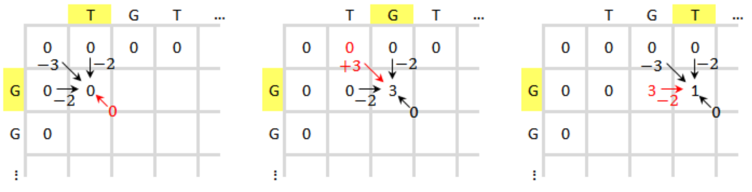
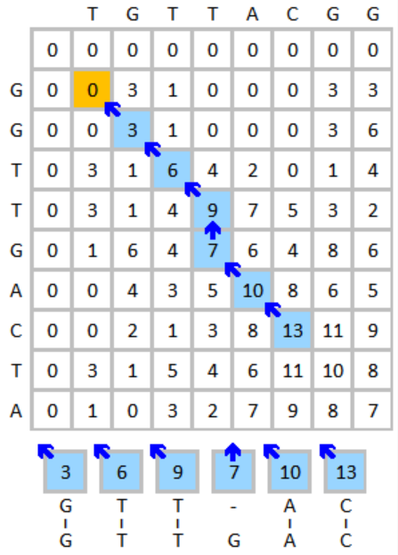
Tune Alignment
Aligning chord sequences
Takes chord progression into account.
Easier to learn if already familiar with transitions.
Borrowed algorithm from bioinformatics (Smith-Waterman (e.g. in FASTA, BLAST)) used to align nucleotide and protein sequences.
Essentially Levenshtein Distance with additional scoring options (substitution matrix, gap penalties).
Used here with fixed substitution score of 3 and linear gap penalty of –2.
Example:
Just Friends - Good Bait Dm7 G7 C6 Am7 -- Dm7 G7 CM7 C7 FM7 --- Bb7 | | X | | | | | | Dm7 G7 CM7 Am7 D7 Dm7 G7 --- C7 FM7 Fm7 Bb7
https://en.wikipedia.org/wiki/Smith–Waterman_algorithm

Slide 17
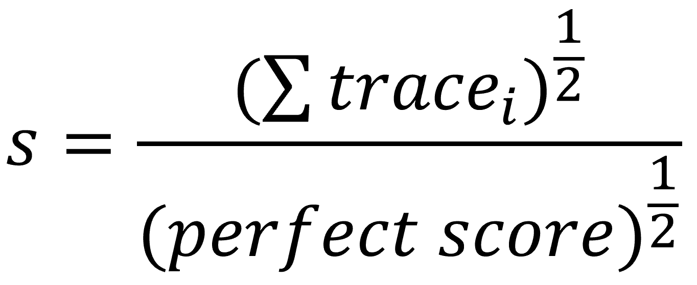
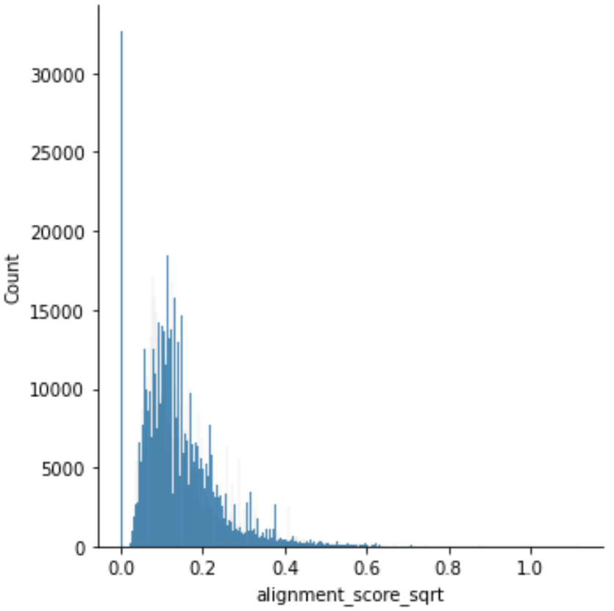
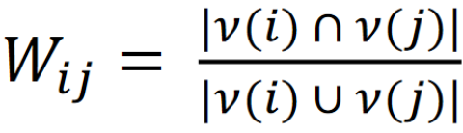
Tune Similarity
Took sum of scores in alignment traces as total score.
Similarity score defined as trace score divided by score for perfect alignment:
Similarity score used to create kNN graph:
Take N nearest neighbors for each tune.
For two tunes: Fraction of common neighbors is weight of connection.
Adapted from Phenograph (Levine et al., 2015, Cell)

Slide 18
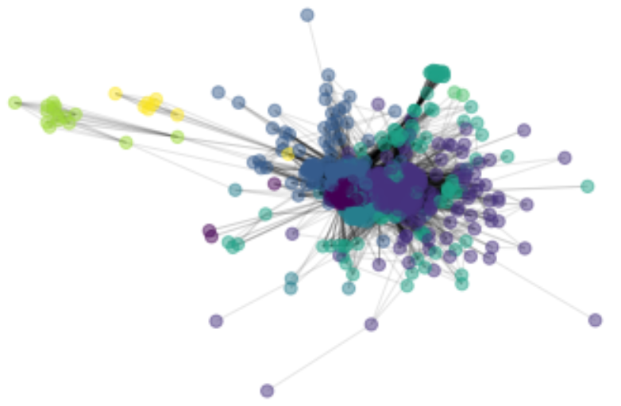
Tune Graph
Community detection using the Louvaine method yields some useful clusters but is not suited to find the next best song to practice.
Better: Look at direct neighbors in the graph (cliques) and shortest path:
All Of You - Get Happy Em7 A7 Dm7 G7 --- CM7 B7 Bb7 --- A7 Dm7 G7 | | | | X X | | | | Em7 A7 Dm7 G7 Gm7 C7 Fm7 Bb7 Em7 A7 Dm7 G7 All Of You - Days Of Wine And Roses Dm7 G7 CM7 B7 Bb7 --- A7 Dm7 | | | | | | Dm7 G7 CM7 -- Bb7 Em7 A7 Dm7 Get Happy - Days Of Wine And Roses Em7 Am7 Dm7 G7 C6 --- Dm7 G7 | X | | | | | Em7 A7 Dm7 G7 C6 Am7 Dm7 G7

Slide 19
What have we learned?
Unsupervised learning: no ground truth available
Expert knowledge needed; expensive process that can at best be used to check a small sample, but not the whole dataset.
Are the recommendations helpful? Maybe...
What is the best input data? More exploration needed.
"Best method" depends on the how you define "similar tunes": subjective.
Comparison of tunes with few chords to tunes with many chords can skew the overall picture.

