Slide 1

Microprogrammed Embedded Systems
Tic-Tac-Tile
Lucas Jung @gruvw
01 / 2024

Slide 2
NDS features: checklist (1/4)
ARM Processors
ARM9 to control the two screens, the buttons (Left, Right, Up, Down, A, Start, Select), send IPC messages to ARM7 to control sound and Wi-Fi.
ARM7 for audio, touchscreen and Wi-Fi.
Timers / Interrupts
Timer 0: variable speed, game time progress bar.
Timer 1: FREQ_64(60), game state FSM update.
Timer 2: TIMER_FREQ_64(10), button debounce, Wi-Fi spam prevention.

Slide 3
NDS features: checklist (2/4)
Graphics
Main display: Mode 5 with backgrounds 2 and 3 (ext. rotoscale), used to display the game pieces, and the board background + begin menu.
Sub display: Mode 5 with backgrounds 0 (tiled mode) and 2 (ext. rotoscale), used to display the settings selection + progress bar, and the game over screen.
Keypad
Controlling the top game board actions (interrupts):
Left, Right, Up, Down = Move selected cell
A = Place piece on selected cell
Start = Start, Terminate, Restart game
Select = Reinitiate NDS pairing (Wi-Fi)

Slide 4
NDS features: checklist (3/4)
Touchscreen
Select the game settings in the beginning menu, 6 different touch areas used, select game difficulty (speed) and game mode.
Reading touchscreen by polling.
Sound
There is a background music (MOD format) in the menu.
Another background music (MOD format) is playing during a game. It will speed up depending on the selected game difficulty.
Playing 3 sound effects (WAV format): when selecting a setting in the menu, when placing a piece on the board, and at the end of the game.

Slide 5
NDS features: checklist (4/4)
Sprites
7 sprites in the project: 4 sprites are used to display the outcome of the game on the Game Over screen: (1) crown for the winner, each side (2) has their sprite, (1) clock to indicate losing because of timer; 3 sprites indicate the status of the NDS connection/pairing (Wi-Fi).
Wi-Fi
Wi-Fi connection with AP is used to communicate between two NDS and play two player games.
Designed and implemented P2P-BOP protocol to pair two NDS.
Designed and implemented Message Queue and ACK system to avoid packet loss.
Added simultaneous message action recovery mechanism
See project README for more details!

Slide 6
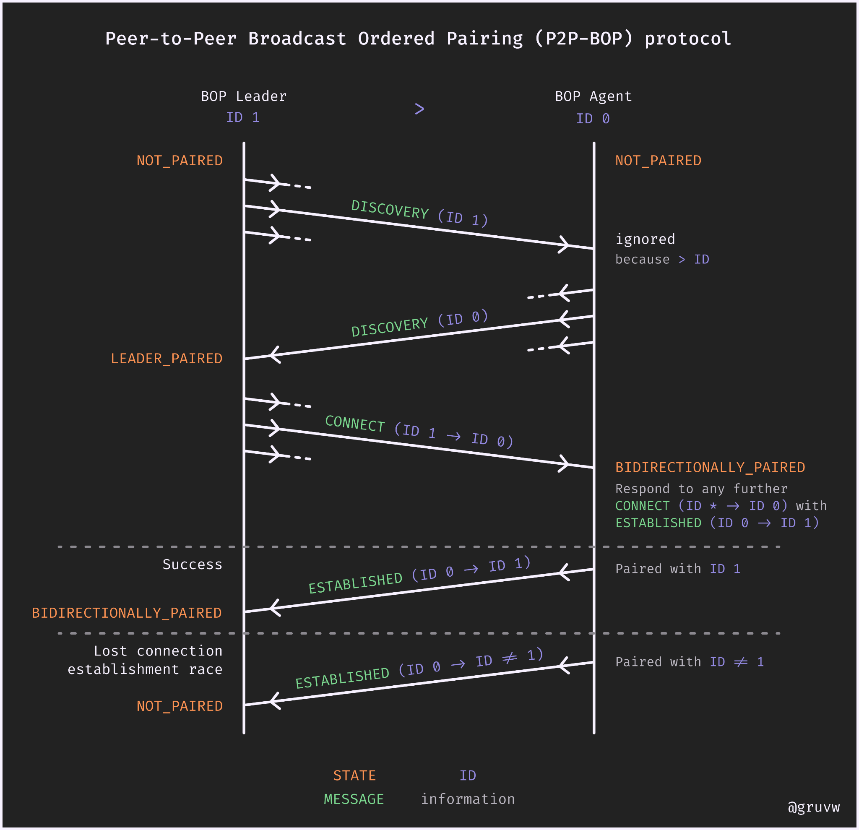
NDS Wi-Fi P2P-BOP

Slide 7
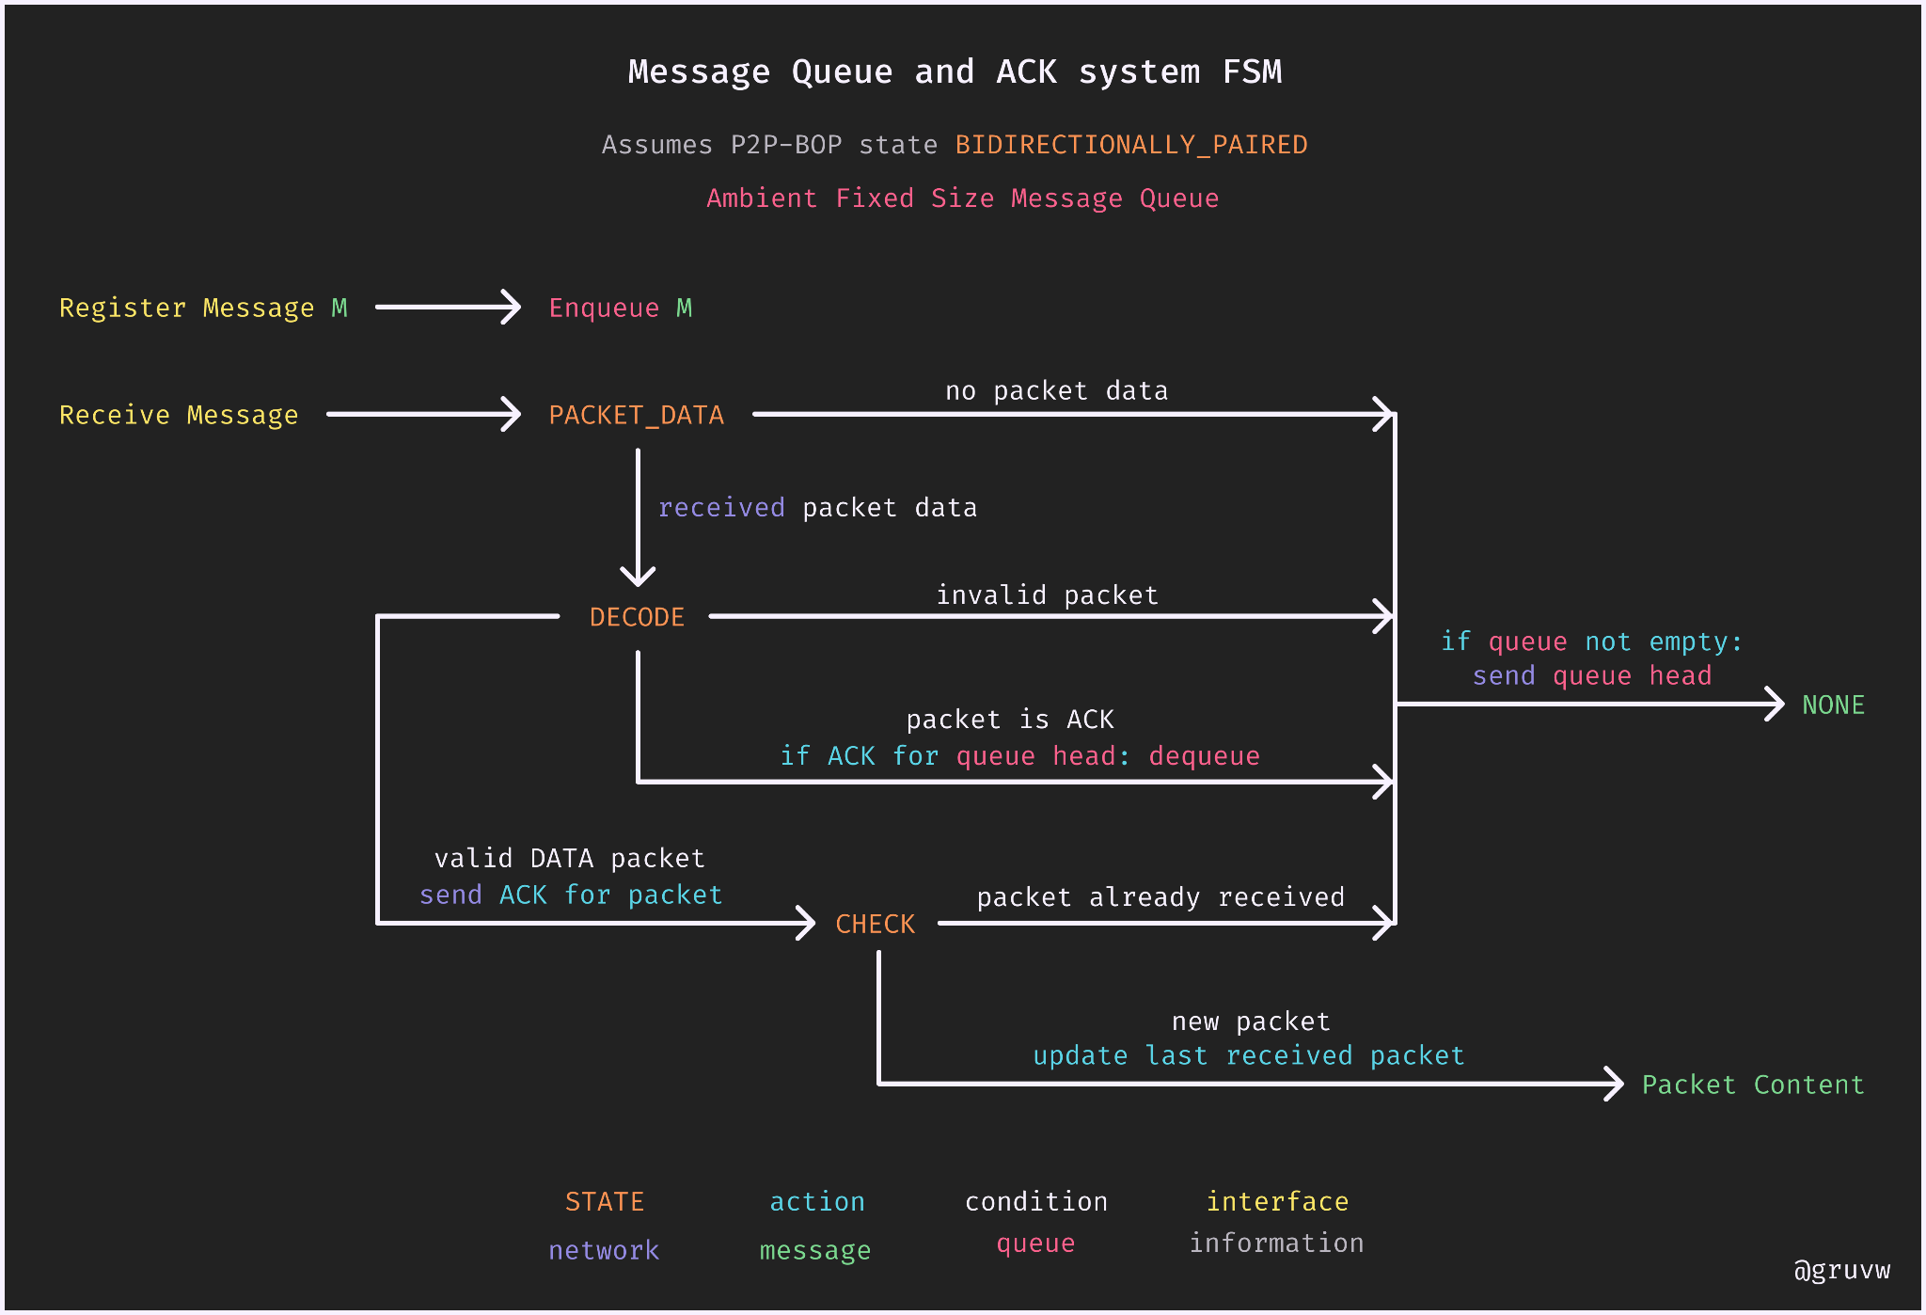
NDS Wi-Fi Message Queue

Slide 8
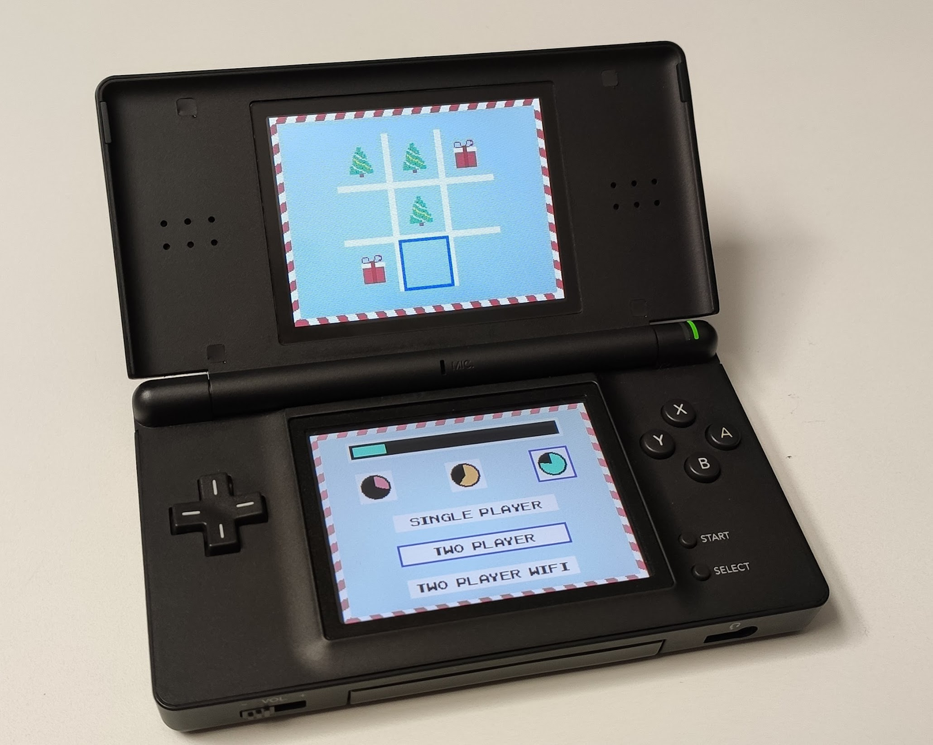
NDS project screenshot
Include an image with the final view/s of your project on the actual NDS device

