Slide 1

Systèmes Embarqués Microprogrammés
Tic-Tac-Tile
Lucas Jung @gruvw
01 / 2024

Slide 2
NDS features: checklist (1/2)
ARM Processors
ARM9 to control the two screens, the buttons (Left, Right, Up, Down, Start, A), send IPC messages to ARM7 to control sound.
ARM7 for audio, touchscreen and Wi-Fi.
Timers / Interrupts
Timer 1: FREQ_64(60), game state FSM update.
Timer 0: variable speed, game time progress bar.
Graphics
Main screen: Mode 5 with backgrounds 2 and 3 (ext. rotoscale), used to display the game pieces, and the board background + begin menu.
Sub screen: Mode 5 with backgrounds 0 (tiles) and 2 (ext. rotoscale), used to display the settings selection + progress bar, and the game over screen.
Keypad
Controlling the top game board actions (interrupts):
Left, Right, Up, Down = move selected cell
A

Slide 3
NDS features: checklist (2/2)
Touchscreen
Select the settings in the begin menu, 6 different touch areas used.
Reading touchscreen by polling.
Sound
There is a background music (MOD format) in the menu.
Another background music (MOD format) is playing during a game.
Playing 3 sound effects (WAV format): when selecting a setting in the menu, when placing a piece on the board, and at the end of the game.
WiFi
describe how you use the WiFi in the project TODO
Sprites
I used 4 sprites in the project, all of them are used to display the outcome of the game on the Game Over screen: a crown for the winner, each side (2) has their sprite, a clock to indicate the lack of time

Slide 4
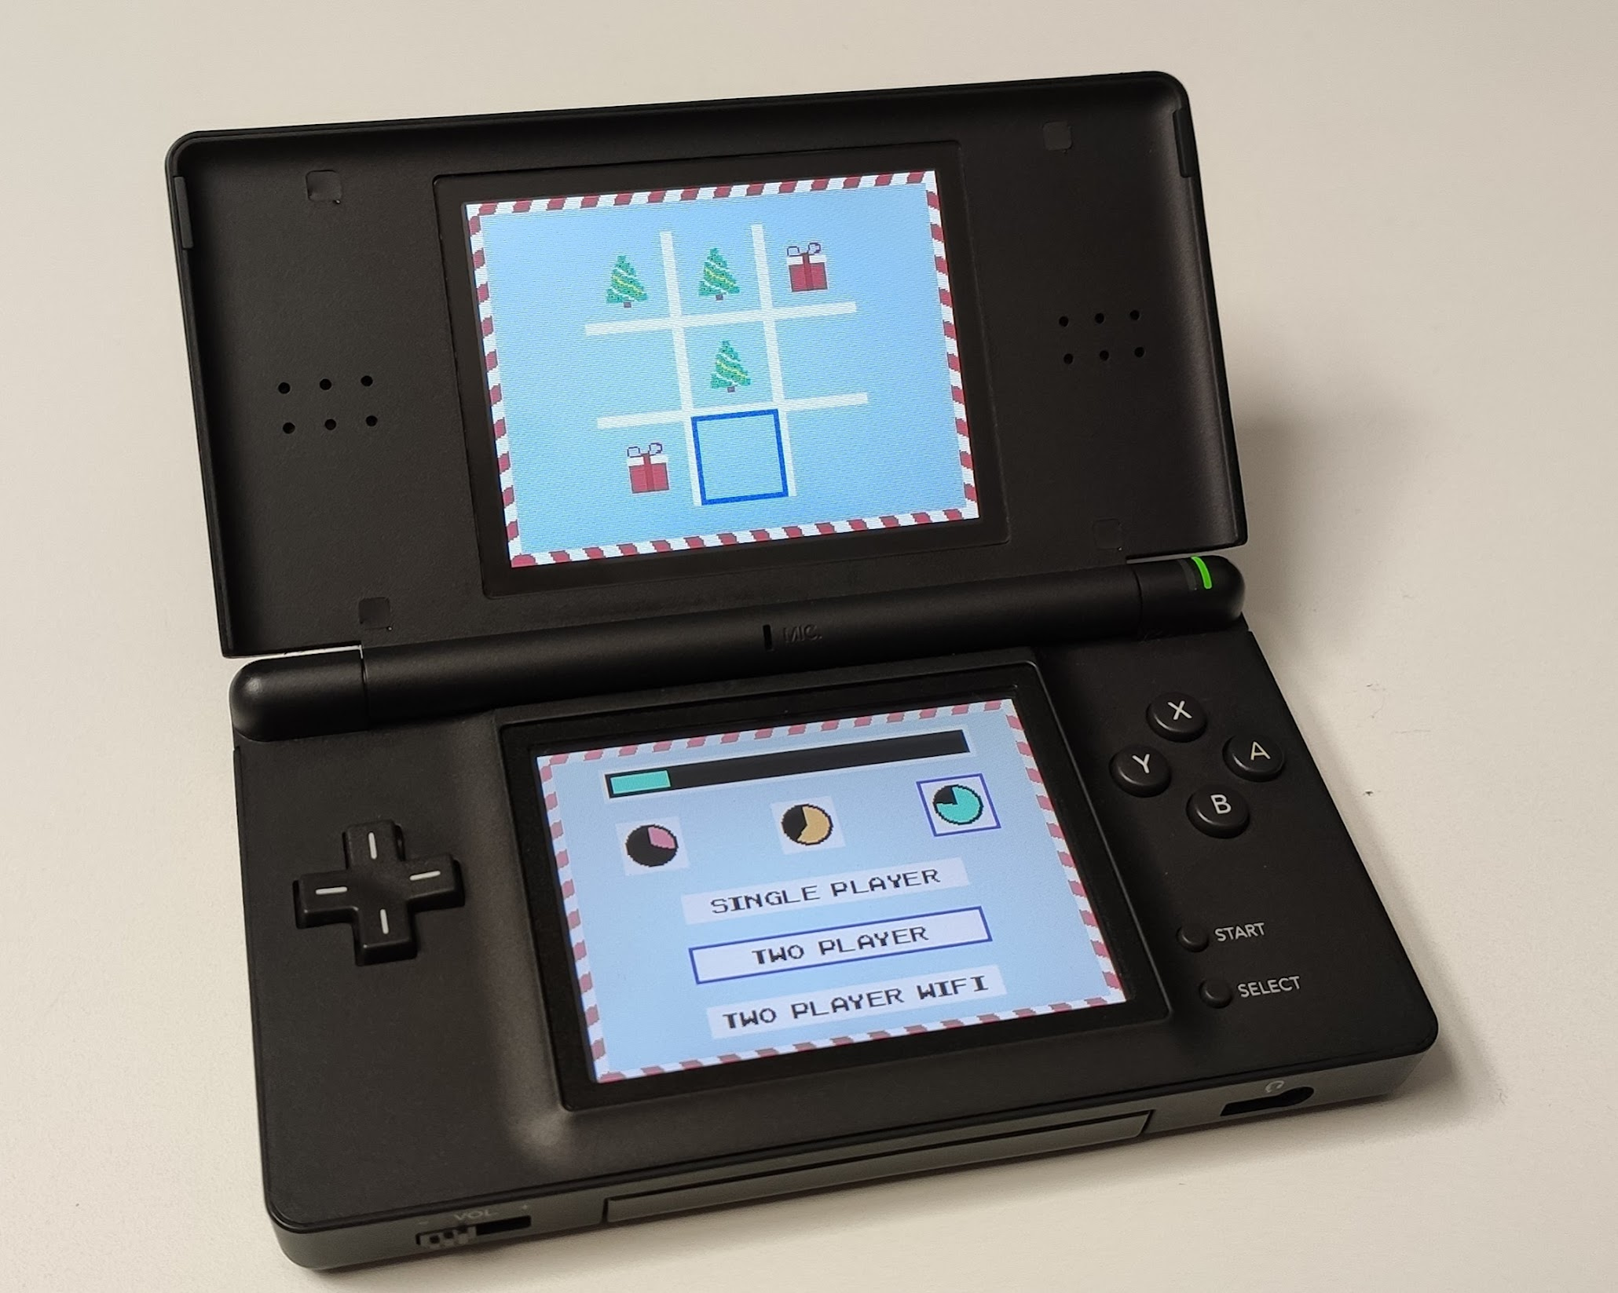
NDS project screenshot
Include an image with the final view/s of your project on the actual NDS device

