Slide 1
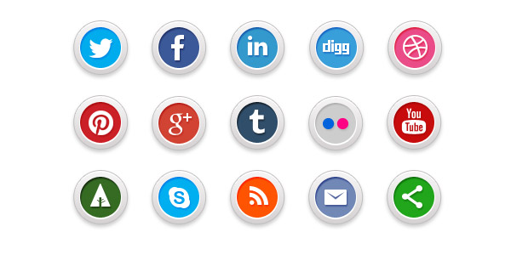
Social Media Channel Aggregation
Hydra

Slide 2
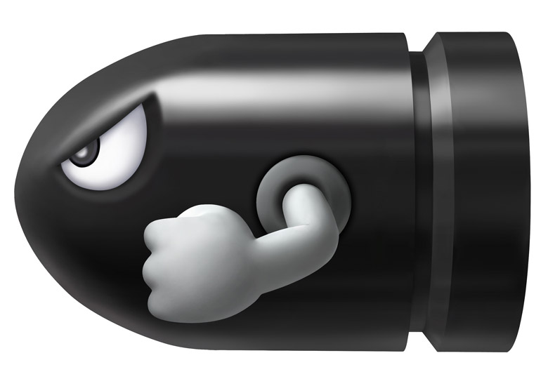
ma
Matthias Steinböck t: @gruzilla w: abendstille.at e: matthias.steinboeck@gmail.com

Slide 3
Agenda
Social Media & API's
OAuth
Hydra
Coding Session

Slide 4

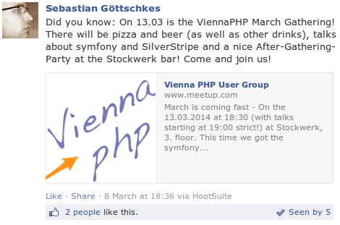
Social Media Data Structure
statuses[0].text
data[0].message

Slide 5
Social Media Data Structure
its a mess
statuses[0].text
data[0].message

Slide 6
APIs and Standards
apis sitting on HTTP
REST
SOAP
XML-RPC
Atom
MQTT / SSL?
exchange formats
JSON
XML
YAML
Binary?

Slide 7



Authentication and Limits
100M per day
OAuth 2.0
5000 per hour
OAuth2.0
180 per 15 minutes
OAuth 1.0a

Slide 8
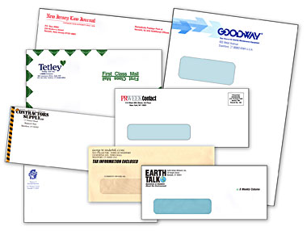
But...
Envelopes are different
paging, decoding, ...
Entities are different
(thats ok, different domains)
even OAuth2 implementation is different

Slide 9
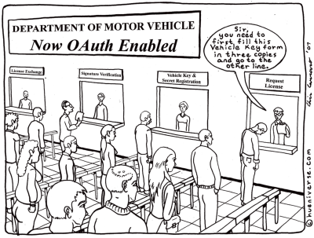

Slide 10
The OAuth Story
came from twitter
OAuth2 relies on SSL for encryption
OAuth2 is merely a blueprint, vendor implementations vary
considered “insecure”
OpenId seems to have lost against OAuth

Slide 11
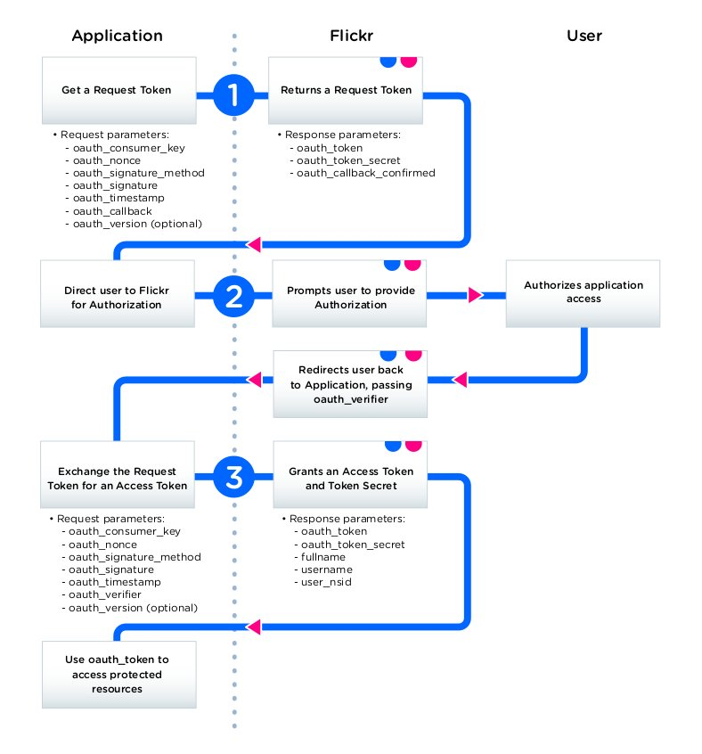
OAuth
Request
Token
Authorization
Request
OAuth Token

Slide 12
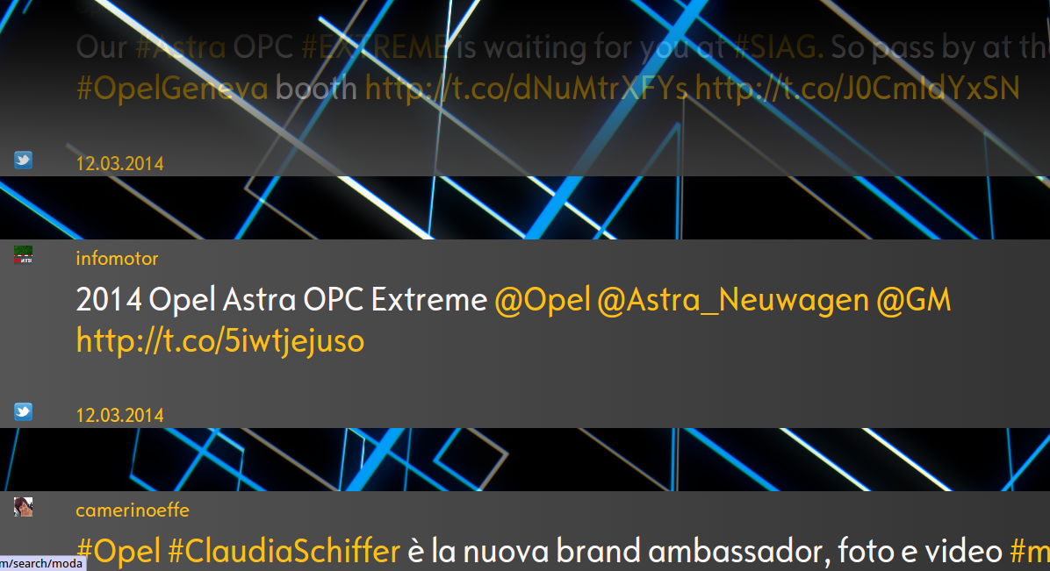
Why Social Media Aggregation?

Slide 13
New Hydra vs old Hydra
old
Symfony2 Framework dependend
neatly integrated
administration and configuration backend
php 5.3+
new
only dependend on sf2 components
separated into library and sf2-bundle
better extendibility
php 5.4+

Slide 14
Hydra architecture
ArrayMapper
+map(className,
string data)
(Mapped)Worker
+run(Job job)
+isRunning()
EntityRepository
+createOrFetchEntity(
className, array data)
Hydra
+addJob()
+run()
OAuthService
+request(string)
Get/Put/..MappedJob
+setRequest(string)
+getResult()

Slide 15
demo time

Slide 16


Slide 17
ty

