Slide 1

SMART INDIA HACKATHON 2026
TITLE PAGE
Problem Statement ID - SIH26120
Problem Statement Title - Digital Twin for Well-to-Surface Optimization of Cyclic Steam Stimulation and Sucker Rod Pump Operations
Theme - Smart Automation
PS Category - Software
Team ID - TBD (fill after SIH portal team registration)
Team Name (Registered on portal) - TEAM ________

Slide 2
Physics-Driven AI Optimizer for CSS & Sucker-Rod Pump Operations
TEAM ________
Proposed Solution (Describe your Idea/Solution/Prototype)
Problem: high Steam-Oil Ratio (industry CSS range 3-8, avg ~6), manual tuning, rod-floating
Digital twin fuses reservoir heating, viscosity, pump dynamics & inflow performance
Outputs real-time optimal steam volume, soak time, cutoff rate & pump speed
No commercial product (XSPOC, Lufkin, Weatherford, SLB) couples CSS + SRP like this
Killer number: targets SOR <3.5 t/m3 (20-30% cut vs literature CSS benchmark)

Slide 3
TECHNICAL APPROACH
TEAM ________
Physics: Marx-Langenheim heating, Andrade viscosity law, Vogel inflow curve
Dynamics: sucker-rod load, pump efficiency, floating-risk index (unsafe > 0.6)
Simulation: 3000+ synthetic CSS cycles via Latin-hypercube sampling (seed=42)
ML: XGBoost SOR predictor + floating-risk classifier + Bayesian optimizer
Stack: Python 3.12, NumPy/SciPy/XGBoost/scikit-optimize, FastAPI backend
Physics Engine
(Marx-Langenheim, Andrade, Vogel)
Synthetic Data
(3000+ CSS cycles)
ML Models
(XGBoost SOR + risk classifier)
Bayesian Optimizer
Feedback loop: optimizer output refines the next simulated CSS cycle

Slide 4
FEASIBILITY AND VIABILITY
TEAM ________
Physics validated: Marx-Langenheim, Andrade (ASTM D341), Vogel IPR models
Params from Oil India/SPE data (depth ~1150 m, 8-15k cP, <10% porosity)
Proven at Baghewala: India's first CSS (BGW-8, 2018) - 5-6x uplift
Scale: 52 wells drilled, 33 operational, 19 CSS'd in FY25-26 (+72% YoY)
Killer number: ~1,150 m confirmed depth (SPE-23APOG / Oil India)

Slide 5
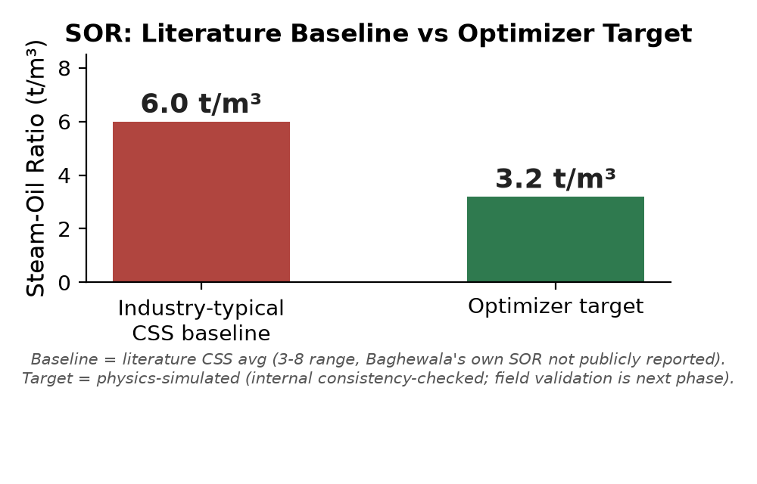
IMPACT AND BENEFITS
TEAM ________
Economics: $15k-$50k saved per avoided rod-workover (industry-typical)
Safety: alerts target the #1 SRP failure mode (rod/tubing wear)
Growth: Baghewala output up ~200x since CSS began (218t -> 43,773t)
Scale: 52 wells drilled, 33 operational, 19 CSS'd in FY25-26 (+72% YoY)
Killer number: 20-30% SOR cut (physics-simulated; field validation next)

Slide 6
RESEARCH AND REFERENCES
TEAM ________
Marx & Langenheim (1959), Reservoir Heating by Hot Fluid Injection, Trans. AIME
Andrade (1934), Viscosity of Liquids, Nature; ASTM D341 viscosity-temp standard
Vogel, J.V. (1968), Inflow Performance Relationships, J. Petrol. Tech., 20
SPE-23APOG-535203 (2023) - Baghewala reservoir/fluid data (depth, API, viscosity)
Oil India internal data (BGW-8 CSS cycle) + landscape.md competitive-gap check

