Slide 1

SMART INDIA HACKATHON 2026
TITLE PAGE
Problem Statement ID – SIH26120
Problem Statement Title- Digital Twin for Well-to-Surface Optimization of Cyclic Steam Stimulation and Sucker Rod Pump Operations
Theme- Smart Automation
PS Category- Software
Team ID- TBD
Team Name (Registered on portal)- TEAM ________
Organisation- Oil India Limited | Baghewala field, Rajasthan
“Physics + AI for India’s first cyclic-steam oilfield”

Slide 2
Digital Twin for CSS and Sucker Rod Pump Optimization
Your Team Name
Proposed Solution (Describe your Idea/Solution/Prototype)
A physics-driven AI twin of a Baghewala CSS well that tunes steam cycle and sucker-rod pump together to drive Steam-Oil Ratio down while keeping rod-floating risk safe.
Detailed explanation of the proposed solution
Digital twin of one CSS well, end to end
Physics: Marx–Langenheim heating, Andrade μ(T), Vogel IPR
Dynamics: rod load, pump efficiency, floating-risk index
ML: XGBoost SOR predictor + risk classifier
Bayesian optimizer returns steam volume, soak, cutoff, pump speed
How it addresses the problem
Replaces manual cycle-by-cycle tuning
Minimises SOR (heavy-oil CSS range 3–8 t/m³)
Warns of rod floating before the pump fails
Sub-second answers for a field 550–600 km from Jaipur
One dashboard: predict, optimize, replay, alert
Innovation and uniqueness of the solution
First twin to co-optimize CSS scheduling with SRP
XSPOC, Lufkin, Weatherford, AVEVA, Kongsberg do one, not both
Tuned to real Baghewala data: 1,150 m deep, 8,000–15,000 cP crude
India’s first CSS well (BGW-8, Dec 2018) as the proving ground
Fully open-source stack — no licence cost to Oil India

Slide 3












TECHNICAL APPROACH
Your Team Name
Technologies to be used: Python 3.13 · NumPy / SciPy · pandas · scikit-learn · XGBoost · scikit-optimize · FastAPI · Plotly · pytest
Methodology and process for implementation: physics engine → 3,000 synthetic cycles → ML emulator → true-physics grid optimiser → dashboard → advisory set-points + operating rule to the operator (SCADA hook planned)
1 · The well
2 · Digital twin
3 · Smart search
4 · Dashboard
5 · Operator
Oil India's heavy-oil well:
steam goes in,
oil comes out.
A computer copy
of the well —
heat, thick oil, the pump.
Tries 53,000 settings
in 36 seconds,
keeps the safe ones.
Shows the best plan
in plain words,
English and Hindi.
Decides.
Nothing is sent
to the well automatically.
Baghewala: 1,150 m, 11,500 cP
Heat flow (Marx–Langenheim)
Physics grid: 53,000 runs
4 pages, works offline
5 settings + when to stop
Oil India cycle records (CSV)
Thick oil: less flow + stuck rods
Fast what-if model (XGBoost)
Computed pump card (dyno)
Review, confirm, then load
Checked vs field data (CalGEM)
Pump loads, rod-float risk
Best / worst case (1,500 runs)
Upload records → twin learns
Field view: which well next
Real cycle records come back → the twin re-learns
What the operator gets
What it leads to
How much steam
& pressure
Pump speed
& stroke
When to stop before
the rods jam
Less diesel
per barrel
Safer pump
More oil
per cycle
Built on published physics · checked against real field data · 236 automated tests

Slide 4
FEASIBILITY AND VIABILITY
Your Team Name
Analysis of the feasibility of the idea
Physics is settled: Marx–Langenheim (1959), Andrade, Vogel (1968)
Field parameters published: 1,150 m depth, 8,000–15,000 cP at 50 °C
Steam at 280–305 °C and 60–70% quality — normal CSS practice
De-risked at this very field: India’s first CSS, BGW-8, Dec 2018
Open-source stack, laptop-scale compute, ~4 weeks to a live API
Potential challenges and risks
No public Baghewala SOR history to train on
Poor-to-fair reservoir: porosity below 10%
Physics model can drift from real well behaviour
Extreme viscosity makes pump behaviour non-linear
Operator trust in an automated set-point
Strategies for overcoming these challenges
Train on 3,000 physics-generated cycles, deterministic seed
Recalibrate on Oil India historical data at the finale
Parameter-sweep sanity tests on the physics modules
field_params.json as the single source of truth per well
Advisory mode first — the engineer approves every set-point

Slide 5
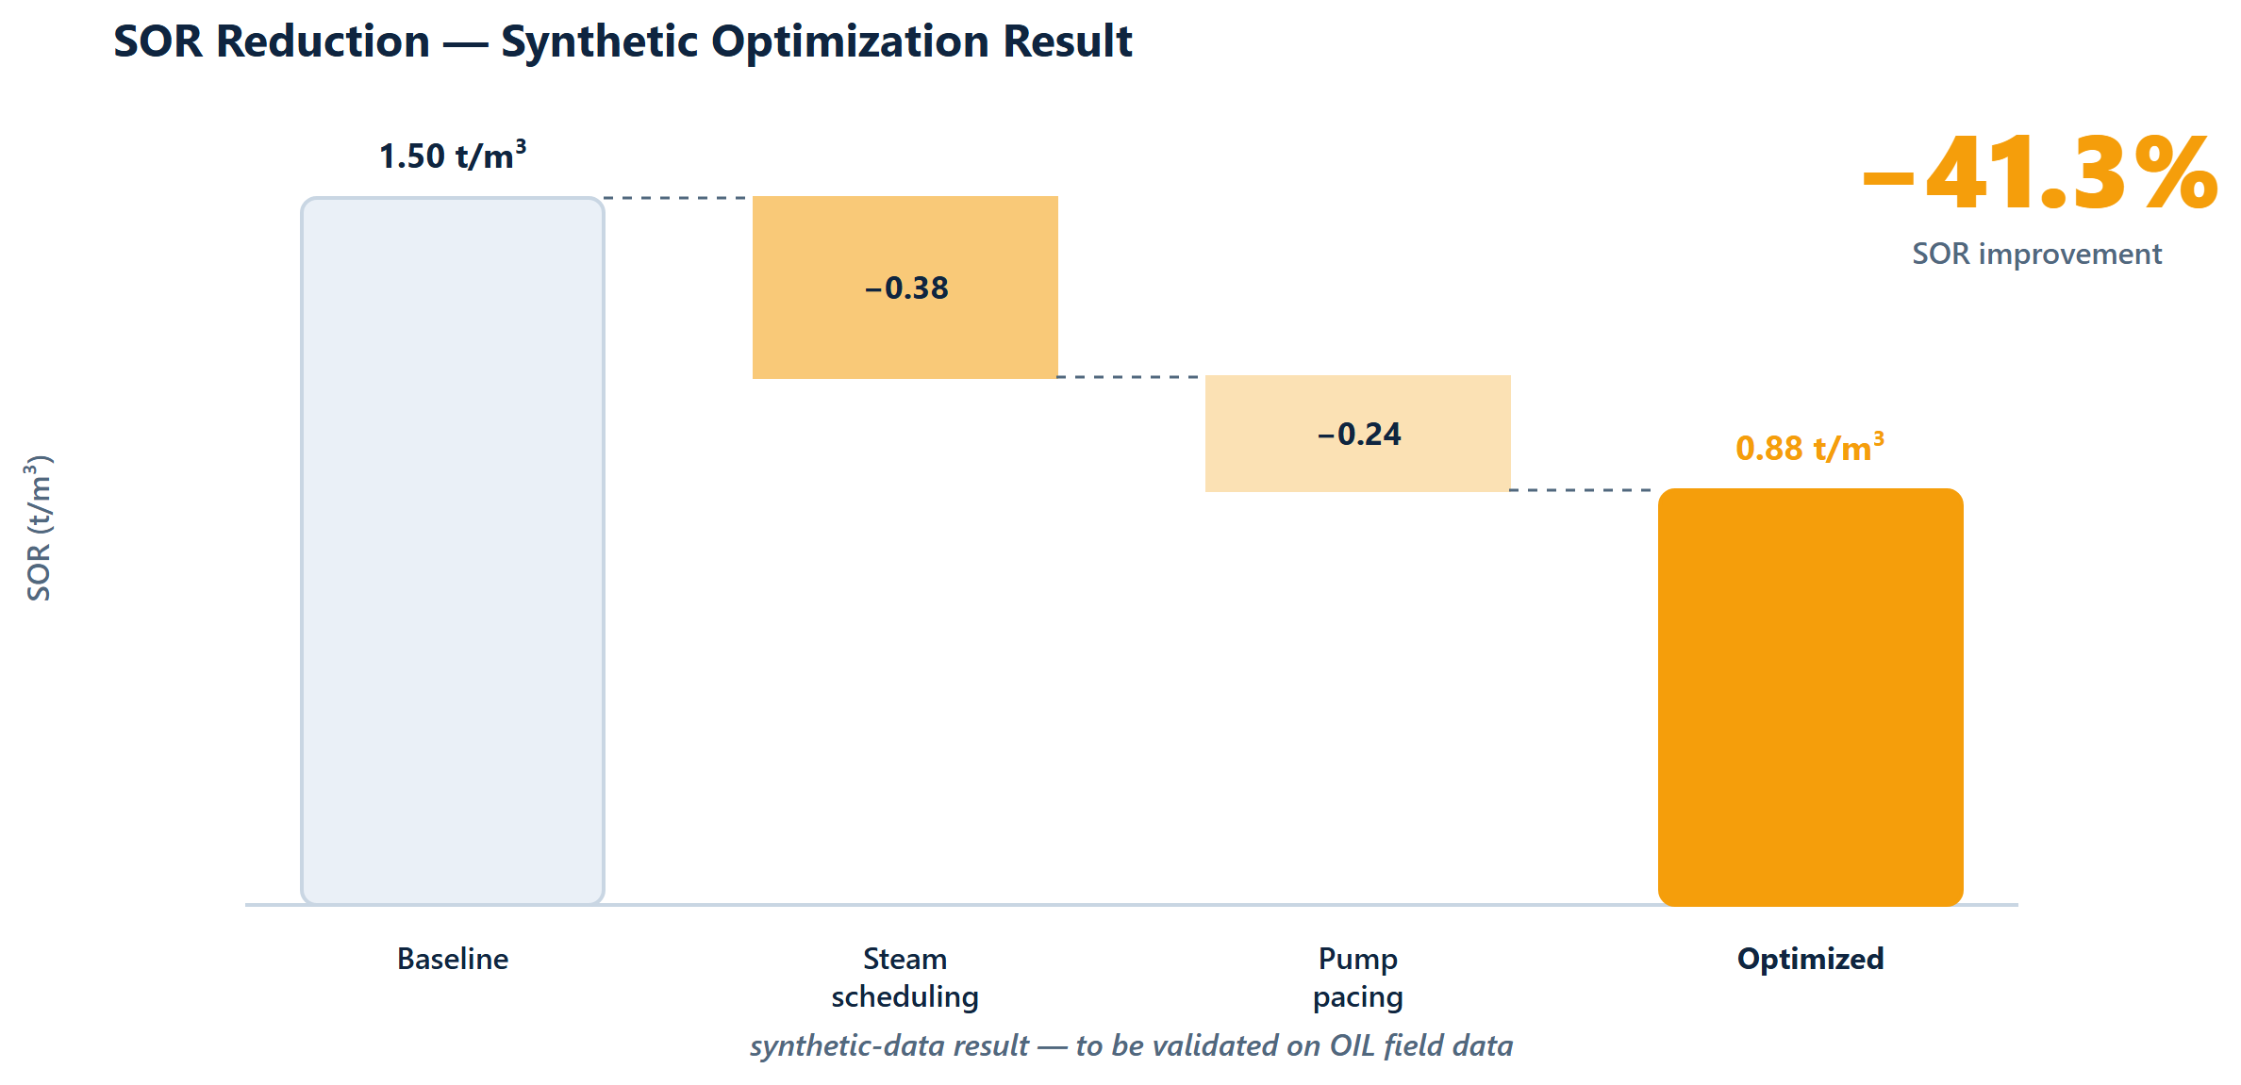
IMPACT AND BENEFITS
Your Team Name
Potential impact on the target audience
Oil India CSS operators at Baghewala — 52 wells drilled, 33 operational, 19 CSS’d in FY2025-26
Every avoided rod-pump workover saves $15k–$50k (industry-typical)
Output already scaling: 218 t (FY17) → 43,773 t (FY26) — the twin scales with it
Benefits of the solution (social, economic, environmental, etc.)
Economic: less steam fuel burned per barrel produced
Environmental: lower energy and GHG intensity per barrel
Social / safety: rod-floating alerts catch the failure mode behind most SRP workovers
Strategic: an indigenous twin for India’s first cyclic-steam asset, portable to future CSS wells
Prototype v1 simulation — to be validated on OIL field data.
SOR 1.50 → 0.88 t/m³ (−41.3%) across 3,000 synthetic cycles — self-audited, physics v2 recalibration in progress; literature benchmark for optimisation-driven SOR cuts is >20%.

Slide 6
RESEARCH AND REFERENCES
Your Team Name
Details / Links of the reference and research work
Marx, J. W., & Langenheim, R. H. (1959). Reservoir heating by hot fluid injection. Trans. AIME, 216, 312–315.
Vogel, J. V. (1968). Inflow performance relationships for solution-gas drive wells. J. Petrol. Tech., 20, 83–92.
Gibbs, S. G. (1963). Predicting the behavior of sucker-rod pumping systems. J. Petrol. Tech., 15, 769–778.
Andrade, E. N. da C. (1930). The viscosity of liquids. Nature, 125, 309–310; ASTM D341 viscosity–temperature standard.
SPE-23APOG-535203 (2023). Case study for enhancement of production of heavy and highly viscous crude oil using an electrical downhole heater — Baghewala depth, API and viscosity data.
Oil India Limited — Rajasthan Fields (Baghewala / BGW-8 CSS) https://www.oil-india.com/rajasthan-fields ; production and well-count figures from OIL annual reports.
Competitive landscape (docs/research/landscape.md): XSPOC, Lufkin SAM/SROD, Weatherford ForeSite, Schlumberger, AVEVA, Kongsberg Kognitwin — none couples CSS scheduling with SRP optimization.

