Slide 1

SMART INDIA HACKATHON 2026
TITLE PAGE
Problem Statement ID – SIH26120
Problem Statement Title- Digital Twin for Well-to-Surface Optimization of Cyclic Steam Stimulation and Sucker Rod Pump Operations
Theme- Smart Automation
PS Category- Software
Team ID- TBD
Team Name (Registered on portal)- TEAM ________
Organisation- Oil India Limited | Baghewala field, Rajasthan
“Physics + AI for India’s first cyclic-steam oilfield”

Slide 2
Digital Twin for CSS and Sucker Rod Pump Optimization
Your Team Name
Proposed Solution (Describe your Idea/Solution/Prototype)
A physics-driven AI twin of a Baghewala CSS well that tunes steam cycle and sucker-rod pump together to drive Steam-Oil Ratio down while keeping rod-floating risk safe.
Detailed explanation of the proposed solution
Digital twin of one CSS well, end to end
Physics: Marx–Langenheim heating, Andrade μ(T), Vogel IPR
Dynamics: rod load, pump efficiency, floating-risk index
ML: XGBoost SOR predictor + risk classifier
Bayesian optimizer returns steam volume, soak, cutoff, pump speed
How it addresses the problem
Replaces manual cycle-by-cycle tuning
Minimises SOR (heavy-oil CSS range 3–8 t/m³)
Warns of rod floating before the pump fails
Sub-second answers for a field 550–600 km from Jaipur
One dashboard: predict, optimize, replay, alert
Innovation and uniqueness of the solution
First twin to co-optimize CSS scheduling with SRP
XSPOC, Lufkin, Weatherford, AVEVA, Kongsberg do one, not both
Tuned to real Baghewala data: 1,150 m deep, 8,000–15,000 cP crude
India’s first CSS well (BGW-8, Dec 2018) as the proving ground
Fully open-source stack — no licence cost to Oil India

Slide 3
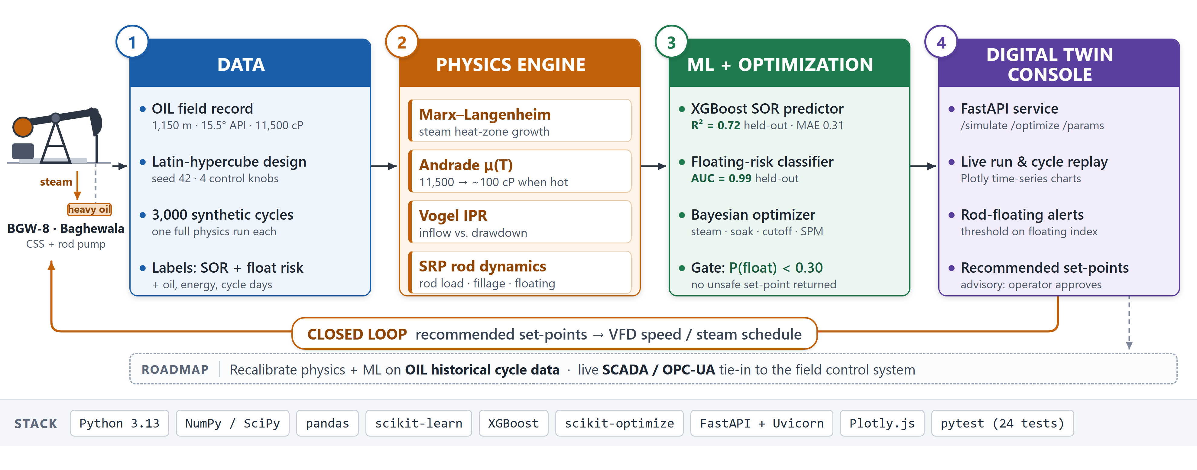
TECHNICAL APPROACH
Your Team Name
Technologies to be used: Python 3.13 · NumPy / SciPy · pandas · scikit-learn · XGBoost · scikit-optimize · FastAPI · Plotly · pytest
Methodology and process for implementation: physics engine → 3,000 synthetic CSS cycles (Latin-hypercube, seed 42) → ML layer → Bayesian optimizer → dashboard → advisory set-points to the operator (SCADA hook planned)

Slide 4
FEASIBILITY AND VIABILITY
Your Team Name
Analysis of the feasibility of the idea
Physics is settled: Marx–Langenheim (1959), Andrade, Vogel (1968)
Field parameters published: 1,150 m depth, 8,000–15,000 cP at 50 °C
Steam at 280–305 °C and 60–70% quality — normal CSS practice
De-risked at this very field: India’s first CSS, BGW-8, Dec 2018
Open-source stack, laptop-scale compute, ~4 weeks to a live API
Potential challenges and risks
No public Baghewala SOR history to train on
Poor-to-fair reservoir: porosity below 10%
Physics model can drift from real well behaviour
Extreme viscosity makes pump behaviour non-linear
Operator trust in an automated set-point
Strategies for overcoming these challenges
Train on 3,000 physics-generated cycles, deterministic seed
Recalibrate on Oil India historical data at the finale
Parameter-sweep sanity tests on the physics modules
field_params.json as the single source of truth per well
Advisory mode first — the engineer approves every set-point

Slide 5
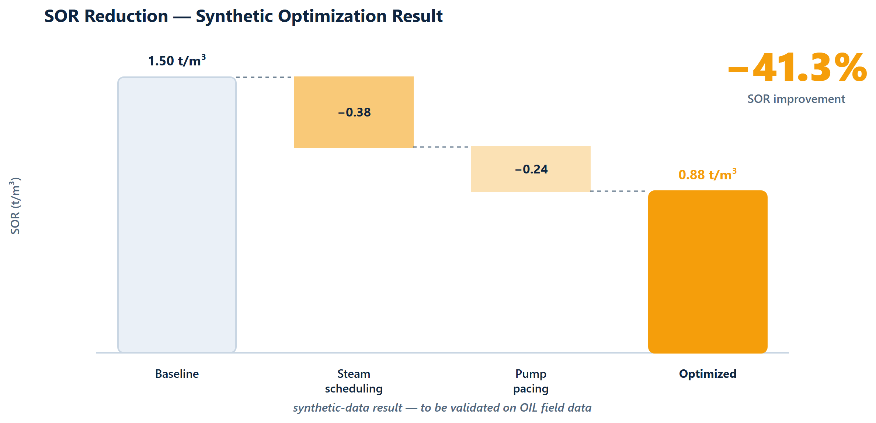
IMPACT AND BENEFITS
Your Team Name
Potential impact on the target audience
Oil India CSS operators at Baghewala — 52 wells drilled, 33 operational, 19 CSS’d in FY2025-26
Every avoided rod-pump workover saves $15k–$50k (industry-typical)
Output already scaling: 218 t (FY17) → 43,773 t (FY26) — the twin scales with it
Benefits of the solution (social, economic, environmental, etc.)
Economic: less steam fuel burned per barrel produced
Environmental: lower energy and GHG intensity per barrel
Social / safety: rod-floating alerts catch the failure mode behind most SRP workovers
Strategic: an indigenous twin for India’s first cyclic-steam asset, portable to future CSS wells
Prototype v1 simulation — to be validated on OIL field data.
SOR 1.50 → 0.88 t/m³ (−41.3%) across 3,000 synthetic cycles — self-audited, physics v2 recalibration in progress; literature benchmark for optimisation-driven SOR cuts is >20%.

Slide 6
RESEARCH AND REFERENCES
Your Team Name
Details / Links of the reference and research work
Marx, J. W., & Langenheim, R. H. (1959). Reservoir heating by hot fluid injection. Trans. AIME, 216, 312–315.
Vogel, J. V. (1968). Inflow performance relationships for solution-gas drive wells. J. Petrol. Tech., 20, 83–92.
Gibbs, S. G. (1963). Predicting the behavior of sucker-rod pumping systems. J. Petrol. Tech., 15, 769–778.
Andrade, E. N. da C. (1930). The viscosity of liquids. Nature, 125, 309–310; ASTM D341 viscosity–temperature standard.
SPE-23APOG-535203 (2023). Case study for enhancement of production of heavy and highly viscous crude oil using an electrical downhole heater — Baghewala depth, API and viscosity data.
Oil India Limited — Rajasthan Fields (Baghewala / BGW-8 CSS) https://www.oil-india.com/rajasthan-fields ; production and well-count figures from OIL annual reports.
Competitive landscape (docs/research/landscape.md): XSPOC, Lufkin SAM/SROD, Weatherford ForeSite, Schlumberger, AVEVA, Kongsberg Kognitwin — none couples CSS scheduling with SRP optimization.

