Slide 1
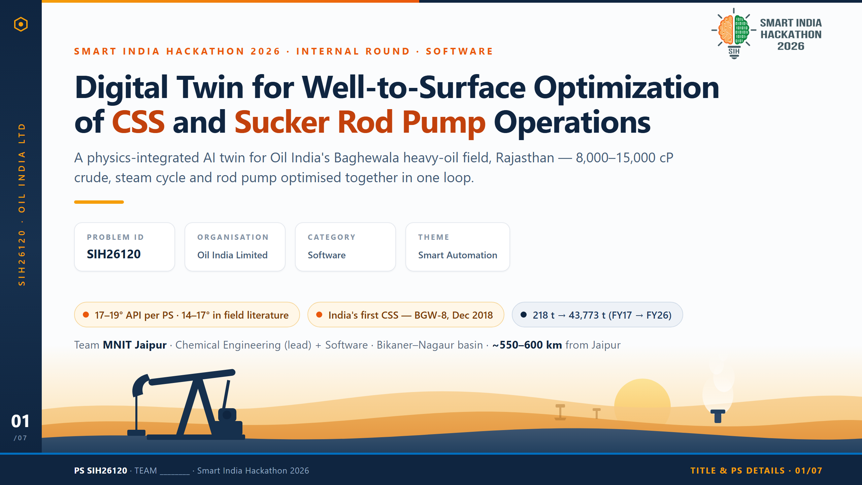
Notes:
SLIDE 1 — IDEA TITLE & PS DETAILS
Headline: Digital Twin for Well-to-Surface Optimization of CSS and Sucker Rod Pump Operations
PS ID SIH26120 | Oil India Limited | Category: Software | Theme: Smart Automation
Team: MNIT Jaipur — Chemical Engineering (lead) + Software members.
Opening line (say this): "Oil India's Baghewala field in Rajasthan produces some of
the most viscous crude in India — 14-17 degrees API, 8,000-15,000 cP at reservoir
temperature. It only flows because it is heated with steam. We are building the
digital twin that decides how to heat it and how to pump it, together."
Chips on this slide:
- 14-17 degrees API heavy crude (SPE-23APOG-535203; OIL internal deck)
- India's first Cyclic Steam Stimulation — well BGW-8, December 2018 (Oil & Gas Journal)
- Annual output 218 t (FY2016-17) to 43,773 t (FY2025-26) — roughly 200x since
commercial CSS began (OIL internal deck; PSU Watch)
ChemE term to land early: Cyclic Steam Stimulation (CSS) — inject steam, soak, then
produce the same well; repeat. Sucker Rod Pump (SRP) — the beam pump ("pumpjack")
that lifts the heated oil to surface.

Slide 2
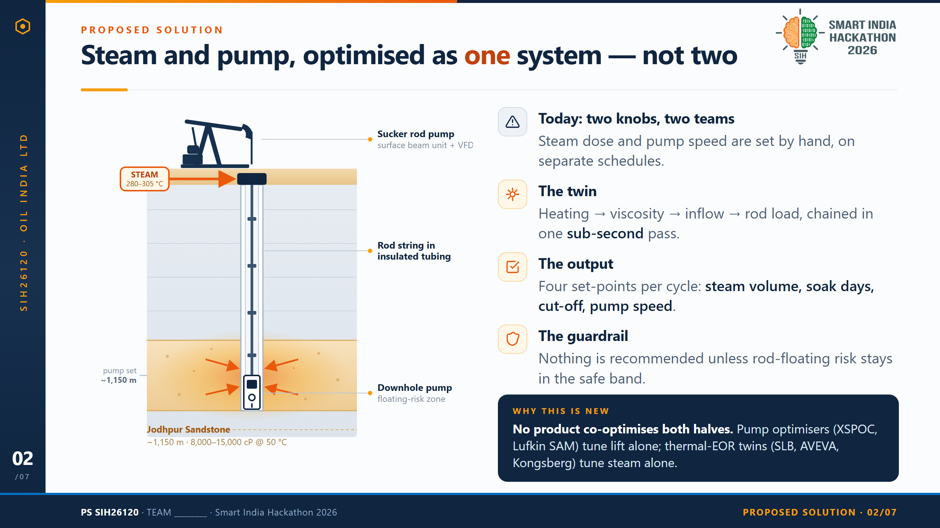
Notes:
SLIDE 2 — PROPOSED SOLUTION
Headline: Steam and pump, optimised as one system — not two.
Problem framing: at Baghewala the steam dose (how much, how long a soak) and the
rod-pump settings (speed, stroke, cut-off) are decided separately and largely by
hand. The result is wasted steam — a high Steam-Oil Ratio — and rod/tubing wear
failures that cost a workover each time.
The solution: a digital twin that chains four physics blocks in one pass —
reservoir heating (Marx-Langenheim) -> oil viscosity at the new temperature
(Andrade) -> well inflow (Vogel IPR) -> sucker-rod load and pump efficiency —
so one CSS cycle simulates in well under a second.
Outputs (the recommendation card): steam injection volume, soak duration,
production cut-off rate, pump speed — each shown with the SOR it is predicted to
achieve.
Guardrail: every candidate set-point is screened by a rod-floating risk index
before it is ever shown to an operator.
Uniqueness (the panel at bottom right): pump-side optimisers — ChampionX XSPOC,
Lufkin SAM/SROD, Weatherford ForeSite — optimise lift in isolation. Reservoir and
facility thermal twins — SLB OptiSite/ProcessOps, AVEVA, Kongsberg Kognitwin —
optimise steam in isolation. Our landscape scan found no commercial product that
closes the loop across both. Source: docs/landscape.md.
Diagram: well cutaway — surface beam pump and wellhead, rod string inside
vacuum-insulated tubing (which Baghewala genuinely uses to limit heat loss),
downhole pump at ~1,150 m, and the steam-heated halo in the Jodhpur Sandstone pay
zone with inflow arrows through the perforations. Steam is injected at 280-305 °C,
85-97 kgf/cm2 — the real first-cycle numbers from well BGW-08.
ChemE term: Steam-Oil Ratio (SOR) — tonnes of steam injected per cubic metre of
oil produced. Lower is better; a CSS cycle is considered thermally efficient below
about 3.

Slide 3
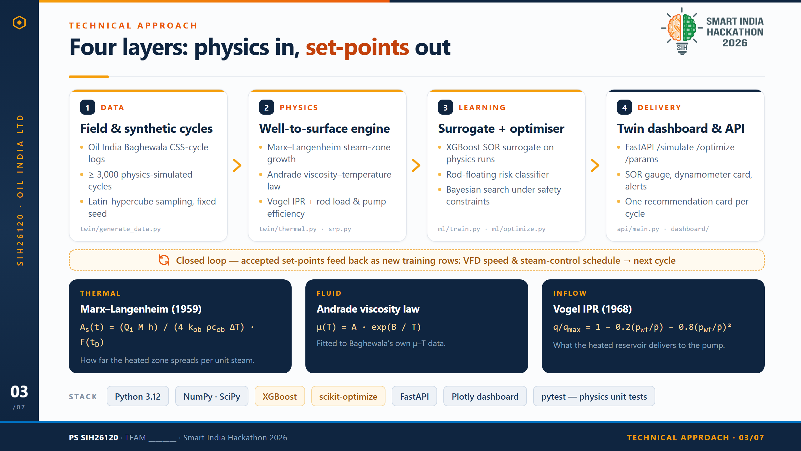
Notes:
SLIDE 3 — TECHNICAL APPROACH
Headline: Four layers — physics in, set-points out.
LAYER 1 — DATA. Oil India's Baghewala well and CSS-cycle logs, plus >= 3,000
synthetic cycles generated by the physics engine itself using Latin-hypercube
sampling across the parameter ranges. Fixed random seed, so every run is
reproducible. (twin/generate_data.py)
LAYER 2 — PHYSICS. The well-to-surface chain: Marx-Langenheim steam-zone growth
gives the heated volume and temperature; Andrade gives oil viscosity at that
temperature; Vogel IPR gives the inflow the reservoir can deliver; the SRP model
gives rod load, pump fillage/efficiency and the floating-risk index.
(twin/thermal.py, viscosity.py, ipr.py, srp.py, cycle.py)
LAYER 3 — LEARNING. XGBoost surrogate predicts SOR far faster than re-running the
physics; a second model classifies rod-floating risk; Bayesian optimisation
(scikit-optimize gp_minimize) searches the four control variables to minimise SOR
subject to the floating-risk constraint. (ml/train.py, ml/optimize.py)
LAYER 4 — DELIVERY. FastAPI endpoints /simulate, /optimize, /params behind a
Plotly dashboard: SOR gauge, dynamometer card, floating-risk alert, and a
recommendation card per well per cycle. (api/main.py, dashboard/index.html)
CLOSED LOOP: accepted set-points go back in as new training rows, and out to the
VFD speed and steam-control schedule for the next cycle.
THE THREE GOVERNING EQUATIONS (be ready to defend these):
- Marx-Langenheim (1959): heated area grows with cumulative steam enthalpy
injected, discounted by conduction loss into the overburden.
- Andrade: mu(T) = A exp(B/T). Critical point — we fit A and B to Baghewala's own
measured 8,000-15,000 cP at 50 degC, NOT to a generic API-gravity correlation,
because this crude is ~90-100x more viscous than a typical 18 deg API oil.
- Vogel (1968): the standard solution-gas-drive inflow performance relationship.
Stack: Python 3.12, NumPy/SciPy, XGBoost, scikit-optimize, FastAPI, Plotly,
pytest for the physics unit tests.

Slide 4
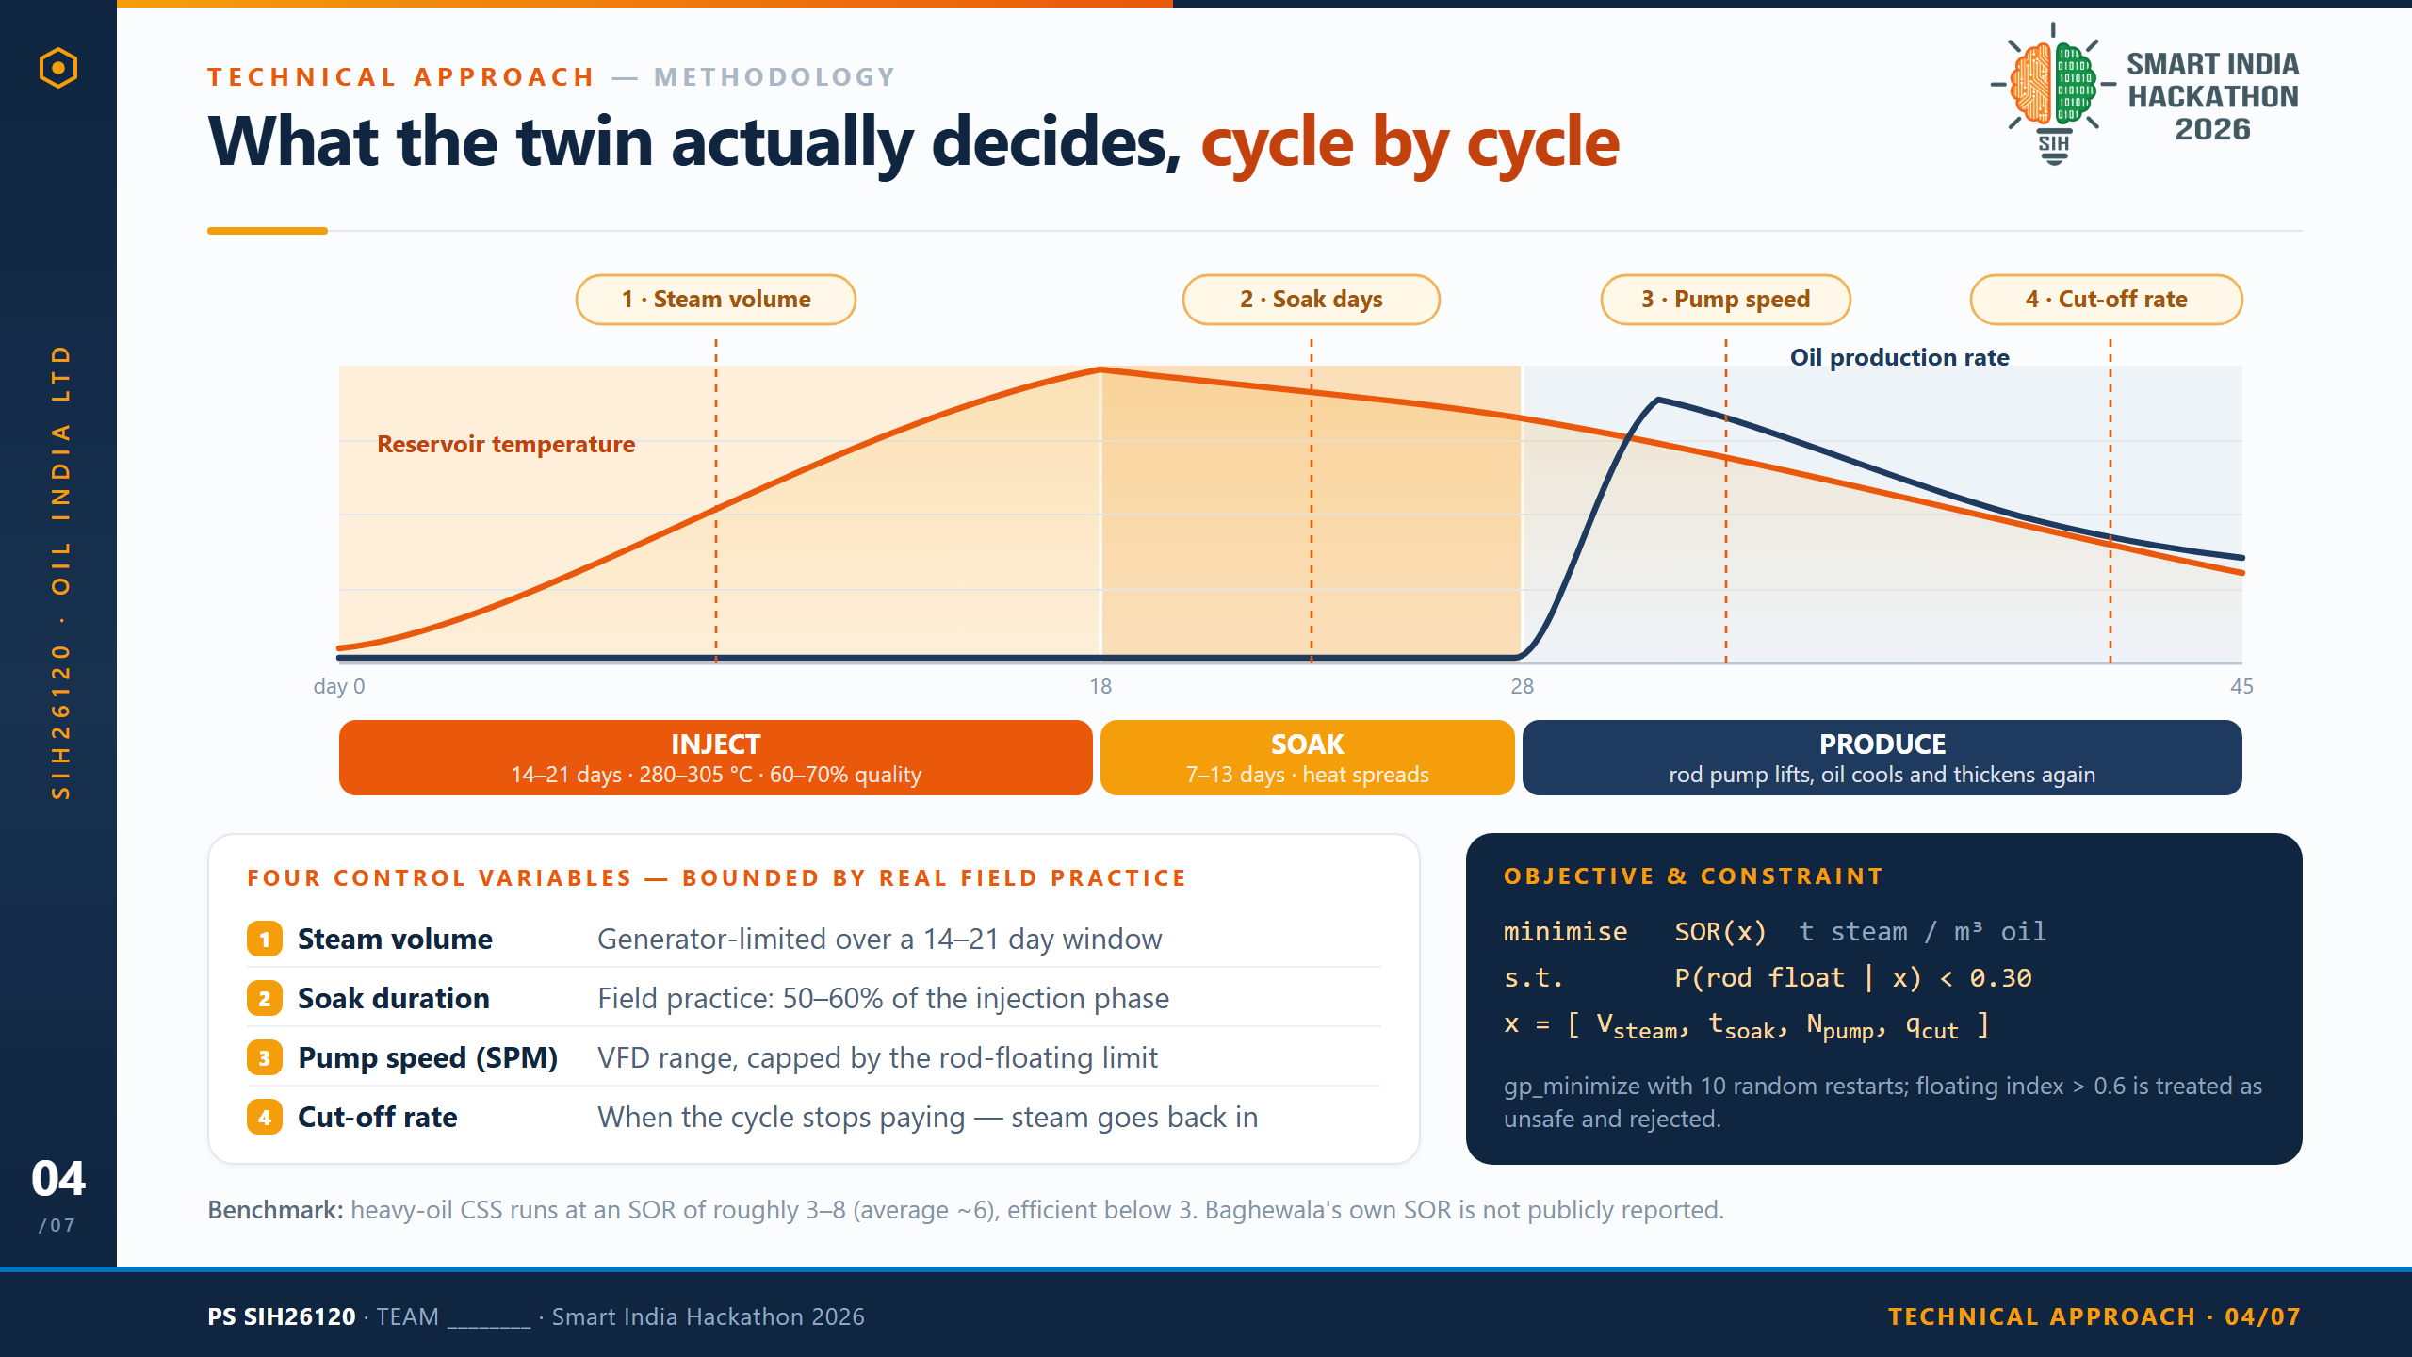
Notes:
SLIDE 4 — TECHNICAL APPROACH (METHODOLOGY)
Headline: What the twin actually decides, cycle by cycle.
THE CSS CYCLE (the chart): a Cyclic Steam Stimulation cycle has three phases.
- INJECT, 14-21 days. Steam at 280-305 degC, 85-97 kgf/cm2 wellhead pressure,
60-70% quality, ~3,100 kg/hr. Reservoir temperature around the wellbore climbs.
- SOAK, 7-13 days (Baghewala practice is 50-60% of the injection phase length).
The well is shut in; heat spreads outward and oil viscosity collapses.
- PRODUCE. The sucker rod pump lifts. Rate peaks early, then declines as the zone
cools and the oil thickens again — which is exactly when you must decide to stop
and re-inject.
THE FOUR CONTROL VARIABLES the optimiser searches:
1. Steam volume — bounded by generator capacity (~3.1 t/hr at BGW-08) across the
injection window.
2. Soak duration — bounded by observed field practice, 50-60% of injection length.
3. Pump speed in strokes per minute, through the VFD — capped by the rod-floating
limit.
4. Production cut-off rate — the point at which the cycle stops paying and steam
should go back in.
OBJECTIVE: minimise SOR(x), tonnes of steam per cubic metre of oil, subject to
P(rod float | x) < 0.30. Solver is scikit-optimize gp_minimize with 10 random
restarts to avoid local minima. A floating index above 0.6 is treated as unsafe
and the candidate is rejected outright.
HONESTY POINT (say this if asked): heavy-oil CSS typically runs at an SOR of 3-8,
lifecycle average about 6, and is considered thermally efficient below 3.
Baghewala's own achieved SOR is NOT publicly reported anywhere we could find, so
we deliberately benchmark against that published literature band rather than
quoting an invented field number.

Slide 5
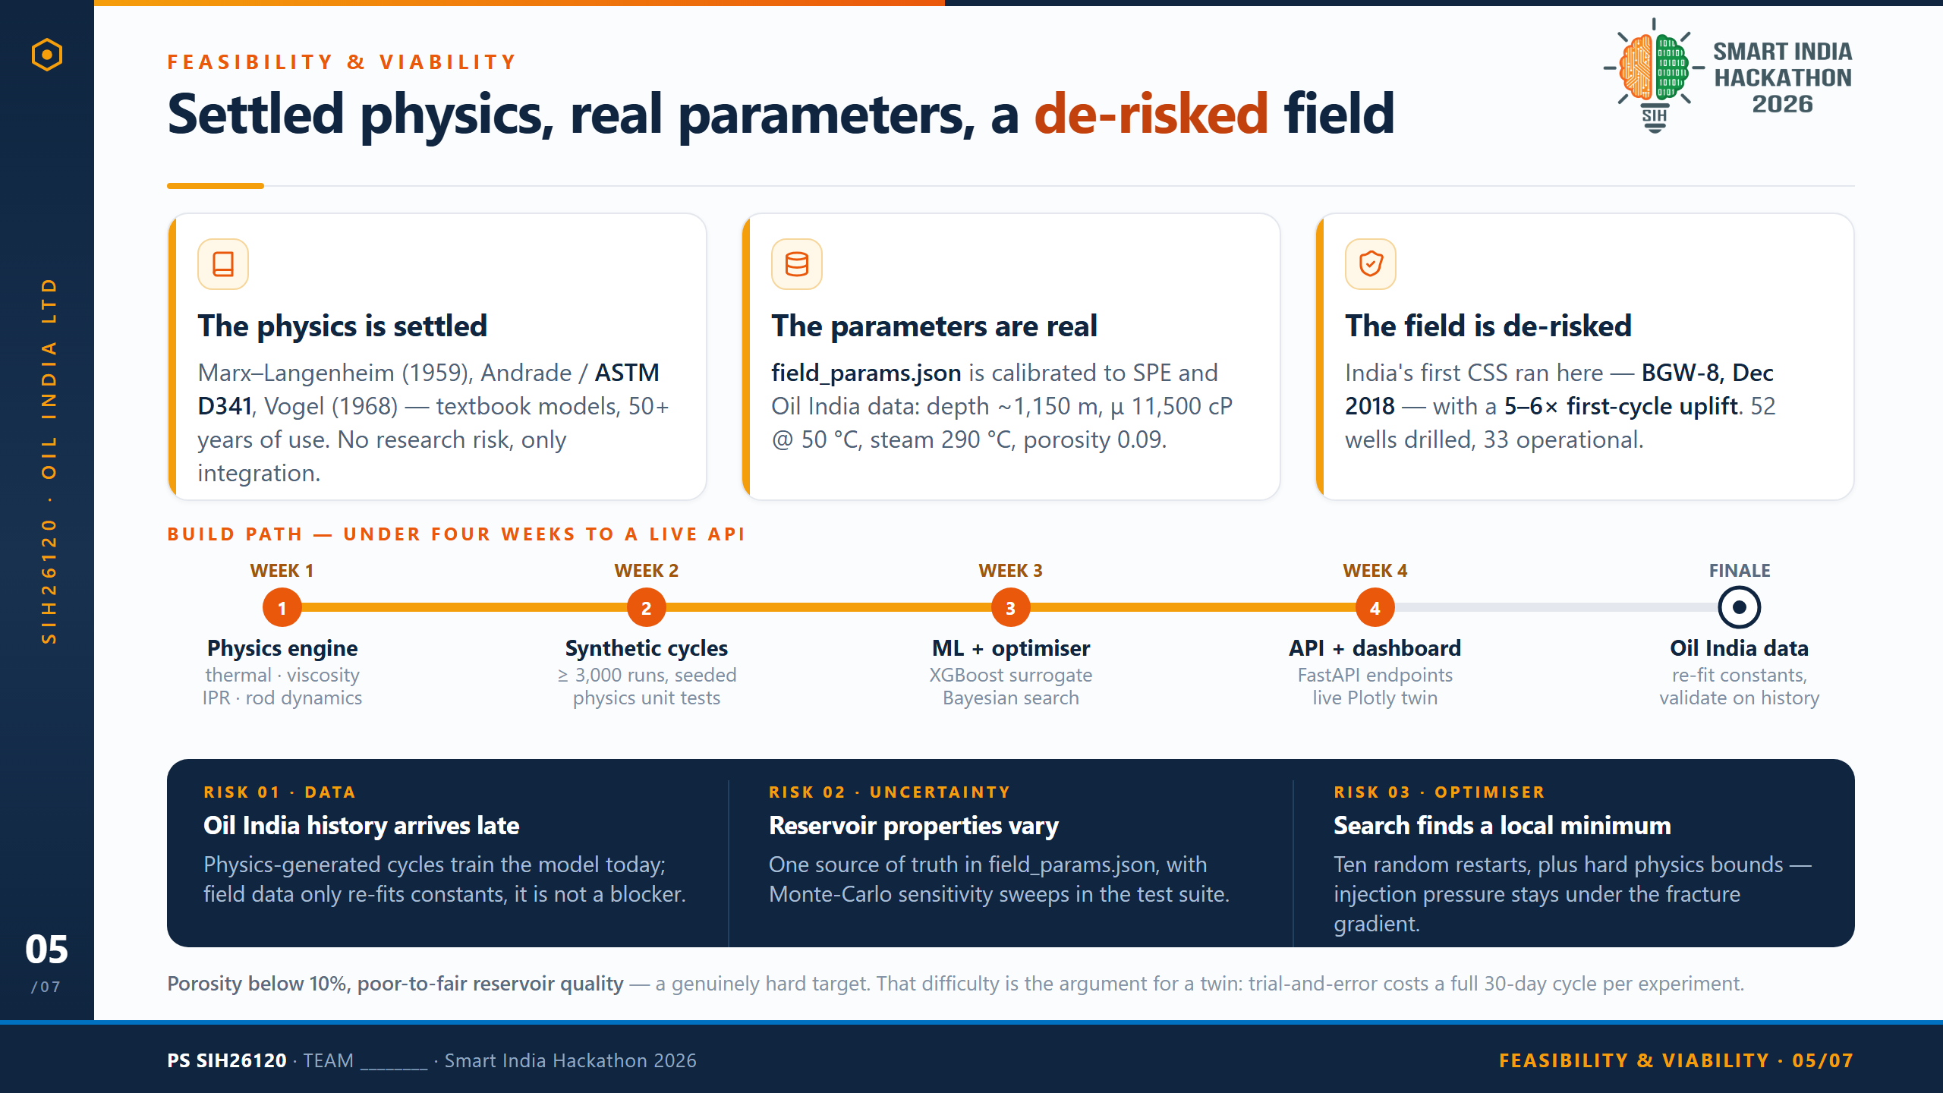
Notes:
SLIDE 5 — FEASIBILITY & VIABILITY
Headline: Settled physics, real parameters, a field that is already de-risked.
PILLAR 1 — THE PHYSICS IS SETTLED. Marx-Langenheim (1959) for steam-zone growth,
the Andrade law (ASTM D341 is the standard viscosity-temperature relation), and
Vogel (1968) for inflow performance. These are textbook, 50+ year old models. We
are not doing novel research; we are doing integration work, which is exactly the
kind of risk a hackathon team can actually retire.
PILLAR 2 — THE PARAMETERS ARE REAL. params/field_params.json is calibrated to
SPE-23APOG-535203 and Oil India data: reservoir depth ~1,150 m, reference
viscosity 11,500 cP at 50 degC, steam injection 290 degC, porosity 0.09, with the
Andrade constants fitted to that anchor (A = 1.164e-6, B = 7436.6 K). These are
not placeholders.
PILLAR 3 — THE FIELD IS DE-RISKED. India's first Cyclic Steam Stimulation ran at
this exact field — well BGW-8, December 2018, with Belgrave Oil & Gas Corp of
Calgary — and delivered a 5-6x first-cycle production uplift. 52 wells drilled,
33 operational, 19 CSS'd in FY2025-26 alone (~72% year-on-year growth). We are
optimising a proven process, not proposing an unproven one.
BUILD PATH — under four weeks to a live API. Week 1 physics engine. Week 2
synthetic cycle generation plus the physics unit tests. Week 3 XGBoost surrogate
and the Bayesian optimiser. Week 4 FastAPI endpoints and the Plotly dashboard.
At the finale: Oil India's historical data re-fits the constants and validates
against real cycles.
RISKS AND MITIGATIONS:
01 Data — if Oil India history arrives late, the physics-generated cycles still
train the model; field data re-fits constants rather than unblocking the build.
02 Uncertainty — reservoir properties vary; field_params.json is the single source
of truth and Monte-Carlo sensitivity sweeps run in the test suite.
03 Optimiser — Bayesian search can settle in a local minimum; we use ten random
restarts and hard physics bounds (injection pressure below fracture gradient).
CLOSING POINT: porosity under 10%, poor-to-fair reservoir quality. That difficulty
is the argument FOR a twin — every trial-and-error experiment in the real field
costs a full ~30-day cycle.

Slide 6
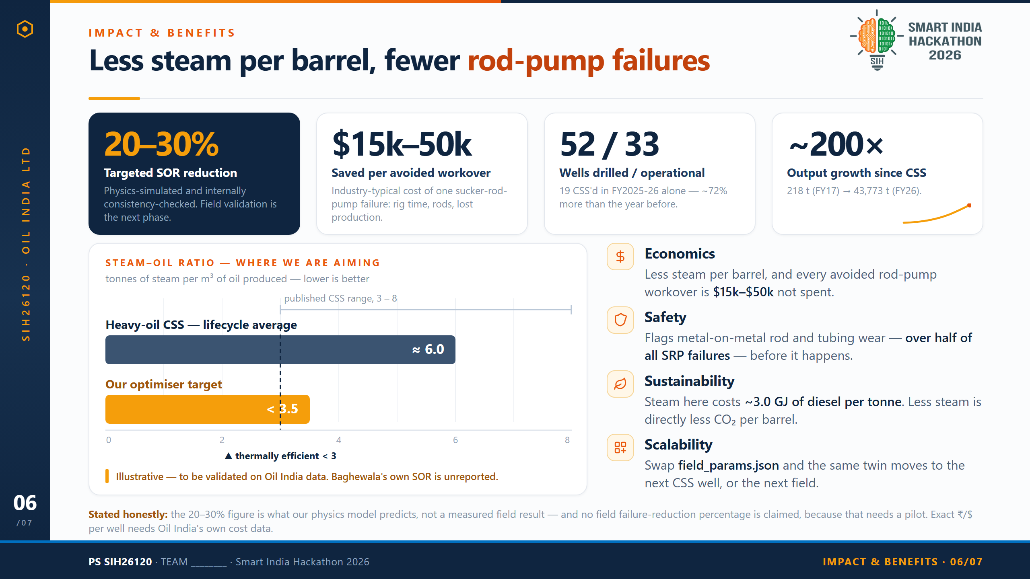
Notes:
SLIDE 6 — IMPACT & BENEFITS
Headline: Less steam per barrel, fewer workovers, on an already-scaling asset.
THE FOUR CALLOUTS:
- 20-30% targeted SOR reduction. Physics-simulated and internally
consistency-checked. NOT a measured field result — field validation is the next
phase. Say this out loud; judges reward the distinction.
- $15,000-$50,000 saved per avoided workover — the industry-typical cost of one
sucker-rod-pump failure (rig time, rod and tubing replacement, lost production).
Source: iFactory / general SRP literature.
- 52 wells drilled, 33 operational at Baghewala; 19 CSS'd in FY2025-26 alone,
about 72% more than the year before.
- ~200x output growth since commercial CSS began: 218 t in FY2016-17 to 43,773 t
in FY2025-26.
THE SOR CHART: heavy-oil CSS runs at an SOR of roughly 3-8 with a lifecycle
average near 6; below 3 is considered thermally efficient. Our optimiser targets
under 3.5. The chart is explicitly labelled illustrative — Baghewala's own
achieved SOR is not publicly reported in any source we could find, so we compare
against the published literature band instead of inventing a field baseline.
BENEFITS:
- Economics: lower steam per barrel plus avoided workovers at $15k-$50k each.
The exact per-well annual figure needs Oil India's own cost data.
- Safety: the floating-risk index targets metal-on-metal rod/tubing wear, which is
over half of all SRP failures. We do not claim a percentage reduction — that
requires a pilot.
- Sustainability: derived from Baghewala's own numbers, steam generation costs
about 71 kg of diesel per tonne of steam, roughly 3.0 GJ per tonne. Less steam
is directly less diesel and less CO2 per barrel.
- Scalability: swap field_params.json and the framework moves to the next CSS
well or another heavy-oil field.
ChemE term: sucker rod floating — loss of pump integrity when viscous drag lifts
the rod string above its neutral point on the downstroke.

Slide 7
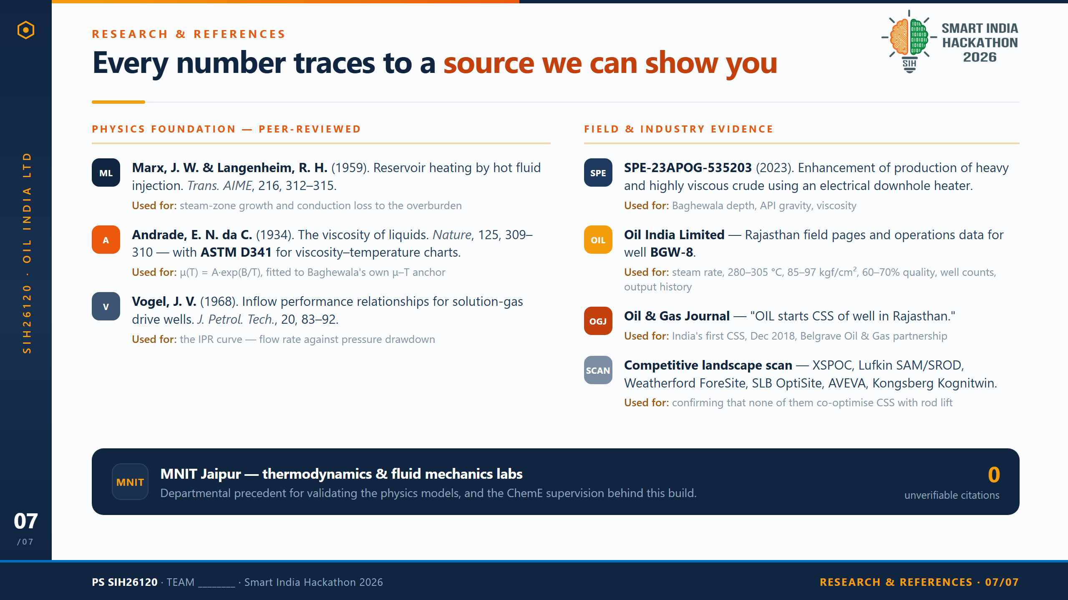
Notes:
SLIDE 7 — RESEARCH & REFERENCES
Headline: Every number on this deck traces to a source we can show you.
PHYSICS FOUNDATION (peer-reviewed):
- Marx, J. W. & Langenheim, R. H. (1959). "Reservoir heating by hot fluid
injection." Trans. AIME, 216, 312-315. Used for steam-zone growth and the
conduction heat loss into the overburden.
- Andrade, E. N. da C. (1934). "The viscosity of liquids." Nature, 125, 309-310,
together with ASTM D341, the standard viscosity-temperature relation. Used for
mu(T) = A exp(B/T), fitted to Baghewala's own measured viscosity anchor rather
than a generic API-gravity correlation.
- Vogel, J. V. (1968). "Inflow performance relationships for solution-gas drive
wells." J. Petrol. Tech., 20, 83-92. Used for the IPR curve.
FIELD & INDUSTRY EVIDENCE:
- SPE-23APOG-535203 (2023), "Case Study for Enhancement of Production of Heavy and
Highly Viscous Crude Oil Using Electrical Downhole Heater" — Baghewala reservoir
depth, API gravity and viscosity.
- Oil India Limited — Rajasthan field pages plus operations data for well BGW-8:
steam rate ~3,100 kg/hr, 280-305 degC, 85-97 kgf/cm2, 60-70% steam quality,
well counts, and the annual production history.
- Oil & Gas Journal, "OIL starts CSS of well in Rajasthan" — India's first CSS,
December 2018, with Belgrave Oil & Gas Corp of Calgary.
- Competitive landscape scan (docs/landscape.md) — ChampionX XSPOC, Lufkin
SAM/SROD, Weatherford ForeSite, SLB OptiSite/ProcessOps, AVEVA, Kongsberg
Kognitwin. Used to confirm that none of them co-optimise CSS steam scheduling
with sucker-rod lift.
MNIT Jaipur thermodynamics and fluid mechanics labs provide the departmental
precedent for validating the physics models.
SOURCING DISCIPLINE (say this if a judge probes a number): every figure in this
deck is tagged CONFIRMED, TYPICAL (industry-standard where no Baghewala-specific
source exists), or DERIVED (calculated from confirmed numbers). Where no source
exists — Baghewala's own achieved SOR, and any field failure-reduction percentage
— we say so on the slide instead of inventing a figure.
ChemE term: Inflow Performance Relationship (IPR) — the map of well flow rate
against pressure drawdown.

