Slide 1

SMART INDIA HACKATHON 2026 · INTERNAL ROUND · SOFTWARE
Digital Twin for Well-to-Surface Optimization of CSS and Sucker Rod Pump Operations
A physics-integrated AI twin for Oil India's Baghewala heavy-oil field, Rajasthan — 8,000–15,000 cP crude, steam cycle and rod pump optimised together in one loop.
PROBLEM ID
ORGANISATION
CATEGORY
THEME
SIH26120
Oil India Limited
Software
Smart Automation
17–19° API per PS · 14–17° in field literature
India's first CSS — BGW-8, Dec 2018
218 t → 43,773 t (FY17 → FY26)
Team MNIT Jaipur · Chemical Engineering (lead) + Software · Bikaner–Nagaur basin · ~550–600 km from Jaipur
PS SIH26120 · TEAM ________ · Smart India Hackathon 2026
TITLE & PS DETAILS · 01/07

Slide 2
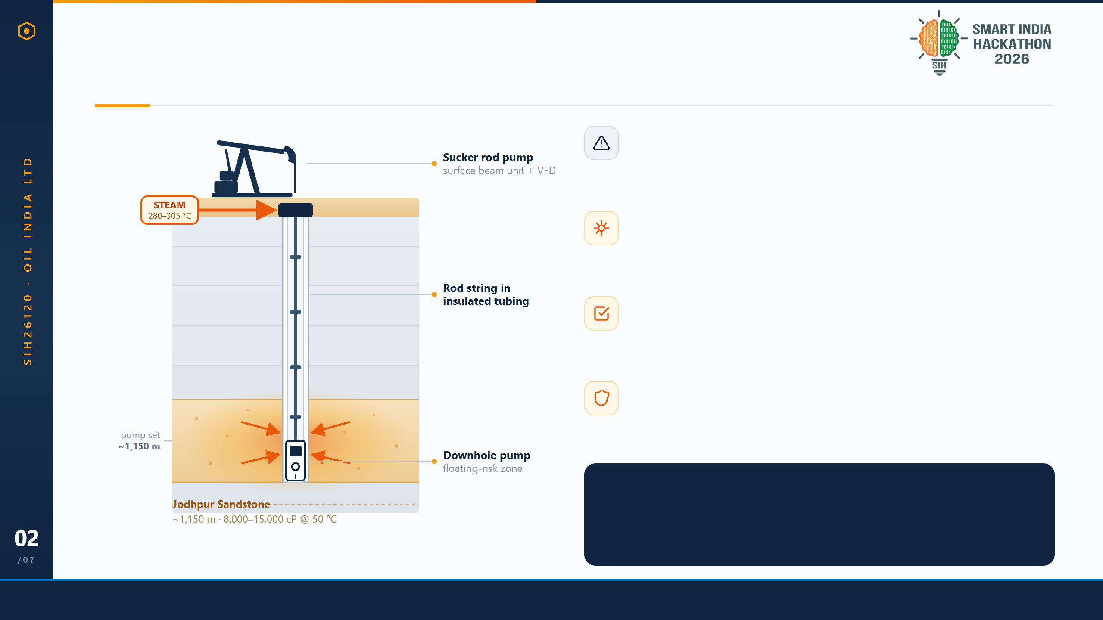
PROPOSED SOLUTION
Steam and pump, optimised as one system — not two
Today: two knobs, two teams
Steam dose and pump speed are set by hand, on separate schedules.
The twin
Heating → viscosity → inflow → rod load, chained in one sub-second pass.
The output
Four set-points per cycle: steam volume, soak days, cut-off, pump speed.
The guardrail
Nothing is recommended unless rod-floating risk stays in the safe band.
WHY THIS IS NEW
No product co-optimises both halves. Pump optimisers (XSPOC, Lufkin SAM) tune lift alone; thermal-EOR twins (SLB, AVEVA, Kongsberg) tune steam alone.
PS SIH26120 · TEAM ________ · Smart India Hackathon 2026
PROPOSED SOLUTION · 02/07

Slide 3

TECHNICAL APPROACH
Four layers: physics in, set-points out
1
DATA
2
PHYSICS
3
LEARNING
4
DELIVERY
Field & synthetic cycles
Well-to-surface engine
Surrogate + optimiser
Twin dashboard & API
Oil India Baghewala CSS-cycle logs
Marx–Langenheim steam-zone growth
XGBoost SOR surrogate on physics runs
FastAPI /simulate /optimize /params
≥ 3,000 physics-simulated cycles
Andrade viscosity–temperature law
Rod-floating risk classifier
SOR gauge, dynamometer card, alerts
Bayesian search under safety constraints
Latin-hypercube sampling, fixed seed
Vogel IPR + rod load & pump efficiency
One recommendation card per cycle
twin/generate_data.py
twin/thermal.py · srp.py
ml/train.py · ml/optimize.py
api/main.py · dashboard/
Closed loop — accepted set-points feed back as new training rows: VFD speed & steam-control schedule → next cycle
THERMAL
FLUID
INFLOW
Marx–Langenheim (1959)
Andrade viscosity law
Vogel IPR (1968)
As(t) = (Qi M h) / (4 kob ρcob ΔT) · F(tD)
μ(T) = A · exp(B / T)
q/qmax = 1 − 0.2(pwf/p̄) − 0.8(pwf/p̄)²
Fitted to Baghewala's own μ–T data.
What the heated reservoir delivers to the pump.
How far the heated zone spreads per unit steam.
STACK
Python 3.12
NumPy · SciPy
XGBoost
scikit-optimize
FastAPI
Plotly dashboard
pytest — physics unit tests
PS SIH26120 · TEAM ________ · Smart India Hackathon 2026
TECHNICAL APPROACH · 03/07

Slide 4
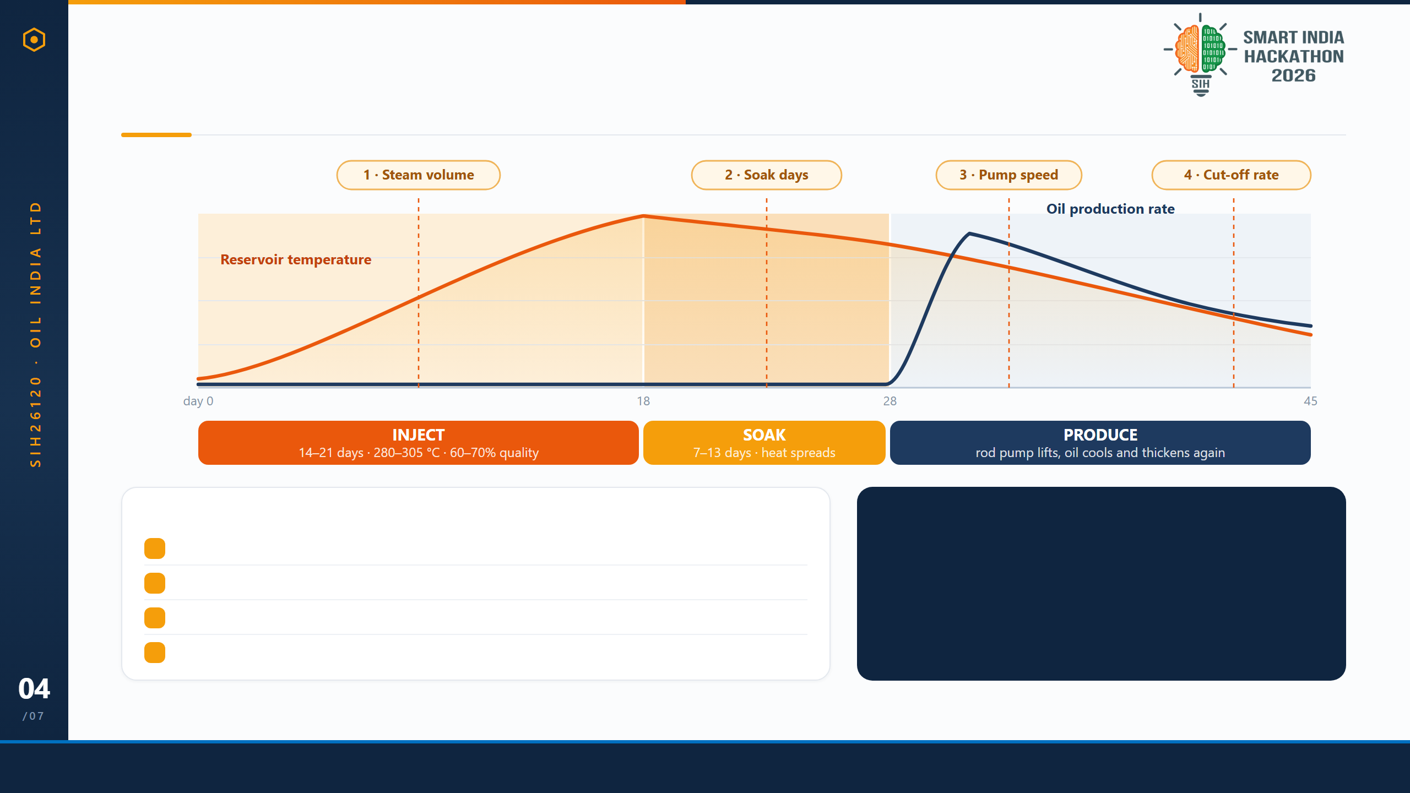
TECHNICAL APPROACH — METHODOLOGY
What the twin actually decides, cycle by cycle
FOUR CONTROL VARIABLES — BOUNDED BY REAL FIELD PRACTICE
OBJECTIVE & CONSTRAINT
1Steam volume
Generator-limited over a 14–21 day window
minimise SOR(x) t steam / m³ oil
2Soak duration
Field practice: 50–60% of the injection phase
s.t. P(rod float | x) < 0.30
x = [ Vsteam, tsoak, Npump, qcut ]
3Pump speed (SPM)
VFD range, capped by the rod-floating limit
4Cut-off rate
When the cycle stops paying — steam goes back in
gp_minimize with 10 random restarts; floating index > 0.6 is treated as unsafe and rejected.
Benchmark: heavy-oil CSS runs at an SOR of roughly 3–8 (average ~6), efficient below 3. Baghewala's own SOR is not publicly reported.
PS SIH26120 · TEAM ________ · Smart India Hackathon 2026
TECHNICAL APPROACH · 04/07

Slide 5
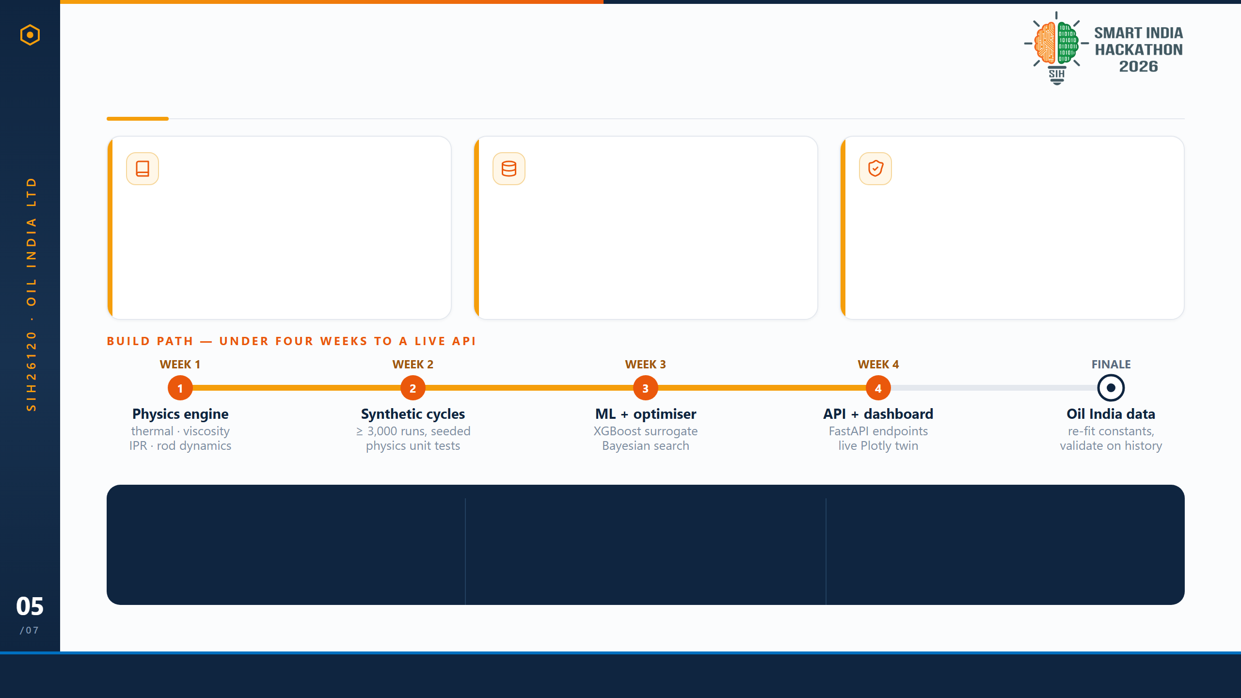
FEASIBILITY & VIABILITY
Settled physics, real parameters, a de-risked field
The physics is settled
The parameters are real
The field is de-risked
Marx–Langenheim (1959), Andrade / ASTM D341, Vogel (1968) — textbook models, 50+ years of use. No research risk, only integration.
field_params.json is calibrated to SPE and Oil India data: depth ~1,150 m, μ 11,500 cP @ 50 °C, steam 290 °C, porosity 0.09.
India's first CSS ran here — BGW-8, Dec 2018 — with a 5–6× first-cycle uplift. 52 wells drilled, 33 operational.
RISK 01 · DATA
RISK 02 · UNCERTAINTY
RISK 03 · OPTIMISER
Oil India history arrives late
Reservoir properties vary
Search finds a local minimum
Physics-generated cycles train the model today; field data only re-fits constants, it is not a blocker.
One source of truth in field_params.json, with Monte-Carlo sensitivity sweeps in the test suite.
Ten random restarts, plus hard physics bounds — injection pressure stays under the fracture gradient.
Porosity below 10%, poor-to-fair reservoir quality — a genuinely hard target. That difficulty is the argument for a twin: trial-and-error costs a full 30-day cycle per experiment.
PS SIH26120 · TEAM ________ · Smart India Hackathon 2026
FEASIBILITY & VIABILITY · 05/07

Slide 6
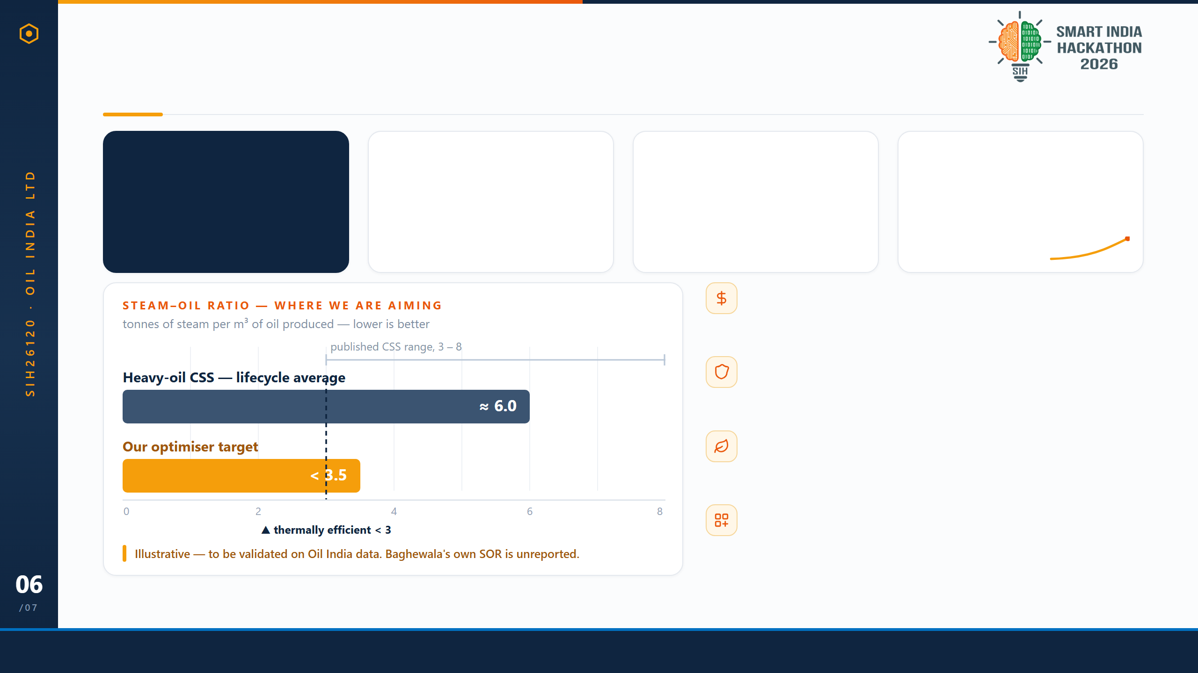
IMPACT & BENEFITS
Less steam per barrel, fewer rod-pump failures
20–30%
$15k–50k
52 / 33
~200×
Targeted SOR reduction
Saved per avoided workover
Wells drilled / operational
Output growth since CSS
Physics-simulated and internally consistency-checked. Field validation is the next phase.
Industry-typical cost of one sucker-rod-pump failure: rig time, rods, lost production.
19 CSS'd in FY2025-26 alone — ~72% more than the year before.
218 t (FY17) → 43,773 t (FY26).
Economics
Less steam per barrel, and every avoided rod-pump workover is $15k–$50k not spent.
Safety
Flags metal-on-metal rod and tubing wear — over half of all SRP failures — before it happens.
Sustainability
Steam here costs ~3.0 GJ of diesel per tonne. Less steam is directly less CO₂ per barrel.
Scalability
Swap field_params.json and the same twin moves to the next CSS well, or the next field.
Stated honestly: the 20–30% figure is what our physics model predicts, not a measured field result — and no field failure-reduction percentage is claimed, because that needs a pilot. Exact ₹/$ per well needs Oil India's own cost data.
PS SIH26120 · TEAM ________ · Smart India Hackathon 2026
IMPACT & BENEFITS · 06/07

Slide 7
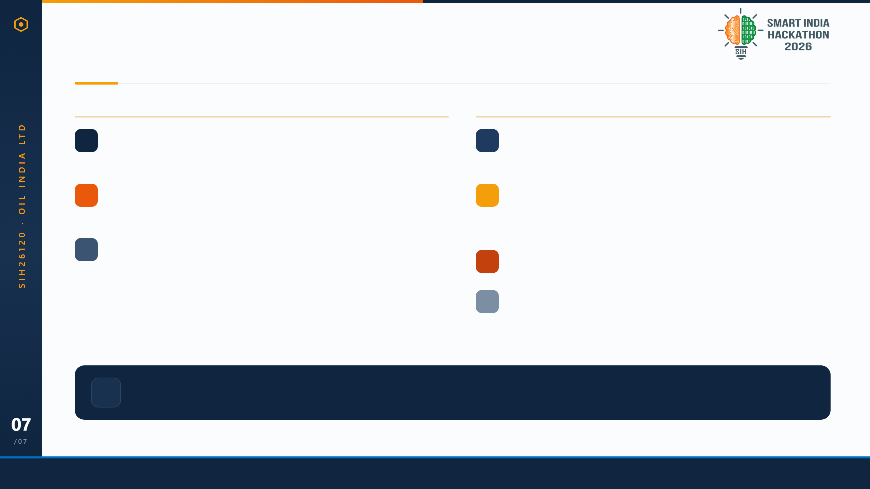
RESEARCH & REFERENCES
Every number traces to a source we can show you
PHYSICS FOUNDATION — PEER-REVIEWED
FIELD & INDUSTRY EVIDENCE
ML
Marx, J. W. & Langenheim, R. H. (1959). Reservoir heating by hot fluid injection. Trans. AIME, 216, 312–315.
SPE
SPE-23APOG-535203 (2023). Enhancement of production of heavy and highly viscous crude using an electrical downhole heater.
Used for: steam-zone growth and conduction loss to the overburden
Used for: Baghewala depth, API gravity, viscosity
A
Andrade, E. N. da C. (1934). The viscosity of liquids. Nature, 125, 309–310 — with ASTM D341 for viscosity–temperature charts.
OIL
Oil India Limited — Rajasthan field pages and operations data for well BGW-8.
Used for: μ(T) = A·exp(B/T), fitted to Baghewala's own μ–T anchor
Used for: steam rate, 280–305 °C, 85–97 kgf/cm², 60–70% quality, well counts, output history
V
Vogel, J. V. (1968). Inflow performance relationships for solution-gas drive wells. J. Petrol. Tech., 20, 83–92.
OGJ
Oil & Gas Journal — "OIL starts CSS of well in Rajasthan."
Used for: the IPR curve — flow rate against pressure drawdown
Used for: India's first CSS, Dec 2018, Belgrave Oil & Gas partnership
SCAN
Competitive landscape scan — XSPOC, Lufkin SAM/SROD, Weatherford ForeSite, SLB OptiSite, AVEVA, Kongsberg Kognitwin.
Used for: confirming that none of them co-optimise CSS with rod lift
MNIT
MNIT Jaipur — thermodynamics & fluid mechanics labs
0
Departmental precedent for validating the physics models, and the ChemE supervision behind this build.
unverifiable citations
PS SIH26120 · TEAM ________ · Smart India Hackathon 2026
RESEARCH & REFERENCES · 07/07

