Slide 1

SMART INDIA HACKATHON 2026
TITLE PAGE
Problem Statement ID – SIH26121
Problem Statement Title- eRTMAC-NWIS (Nearby Wells Intelligence System): An AI-Powered Offset Well Knowledge and Decision Support Platform for Drilling Operations
Theme- Smart Automation
PS Category- Software
Team ID-
Team Name (Registered on portal)
Organisation- Oil India Limited | eRTMAC, Field HQ Duliajan, Assam
“What nearby wells learned,
on screen before the bit gets there”

Slide 2
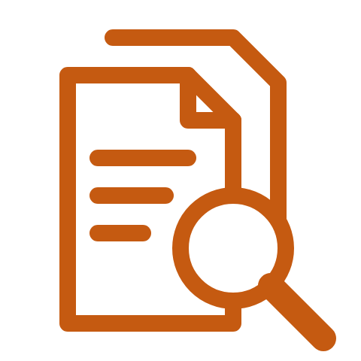





NWIS: Offset-Well Memory with Look-Ahead Alerts
Your Team Name
Proposed Solution (Describe your Idea/Solution/Prototype)
For Oil India's drilling teams at Duliajan and on the rig: a memory of what went wrong in nearby wells, drawn from their old reports, that warns the rig before the bit reaches the same trouble.
Detailed explanation of the proposed solution
How it addresses the problem
Innovation and uniqueness of the solution
A standalone memory beside the live feed:
old well reports become a searchable,
cited record of what went wrong.
Today the answer sits in someone's memory
or a report nobody has time to read;
now it is one question away.
It looks ahead of the bit, not at it —
and shows the report page
behind every warning.
Reads Well Completion + Daily Drilling Reports (WCR, DDR)
Scattered PDFs → one structured incident ledger
Risk per depth, ahead of the bit: we found no prior method
Every extracted incident cites its page + a confidence
Nearest well ≠ best offset → ranked by similarity
Formation depths corrected for dip and its direction
Low-confidence rows wait in an engineer review queue
Wells at different depths → lined up by formation
A missing clue is shown as n/a, never filled with zero
Two views: Duliajan office (full) · rig (alerts first)
Alerts after the event → warning before the bit arrives
Alarm-fatigue control: dedupe, cooldown, hard cap
Runs beside eRTMAC, Duliajan's real-time drilling centre
Hours of manual search → a cited answer in plain words
Local AI model, offline: reports never leave Oil India
Links (fill in before submission)
Live dashboard:
https:// ________________
Demo video:
https:// ________________
GitHub repository:
https:// ________________

Slide 3
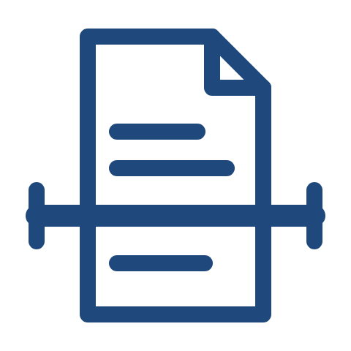







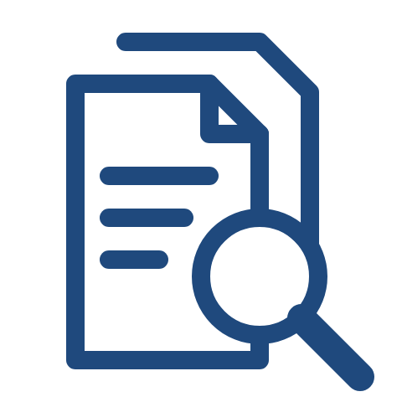



TECHNICAL APPROACH
Your Team Name
Technologies to be used: Python · FastAPI · Ollama qwen2.5 · RapidOCR · XGBoost + SHAP · SQLite/PostGIS · React + Leaflet
Methodology and process for implementation: WCR/DDR PDFs → OCR + local-LLM extraction (cited, confidence-scored) → incident ledger + review queue → similarity map → formation correlation → risk-ahead-of-bit fusion → alerts on the eRTMAC feed
1 · Ingest
2 · Map & similarity
3 · Correlate
4 · Risk ahead of bit
5 · Alert & advise
Old scanned reports
become incident rows,
each citing its page.
Nearby wells on a map,
ranked by likeness,
not just distance.
Wells lined up
on the same rock layer,
its tilt corrected.
Scores the next 200 m
in 50 m steps
and says why.
Warns before the bit
arrives, with what
nearby wells did.
236 reports, 30 % are scans
Distance, formations, well path
Aligned on formation top (TVD)
Precedent + anomaly + model
First advisory in 2 s (replay)
Text (OCR) → incidents (LLM)
Target depth, drilling difficulty
Dip + azimuth plane fit
Unseen wells (AUC 0.86–0.94)
Cited two-line advice (~18 s)
P 0.91 · R 0.95 (synthetic)
Missing clue shown n/a, not 0
Girujan, Tipam, Barail zones
Top 3 reasons shown (SHAP)
No alarm floods (ISA-18.2)
Engineer approvals come back → the models re-learn
What the engineer gets
What it leads to
Ranked offset wells
on one map
Risk for the next
200 m, with reasons
What offsets did,
with the page
Less lost
rig time
Fewer kicks
and losses
Skills stay
in Oil India
Numbers from a synthetic Upper Assam field (30 wells) · checked on real North Sea reports · offline

Slide 4



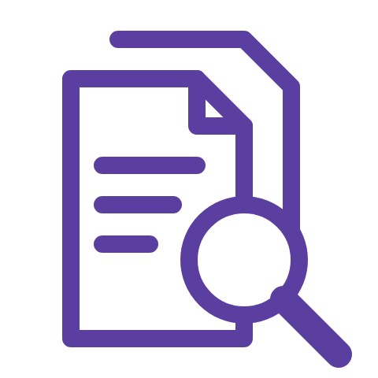


FEASIBILITY AND VIABILITY
Your Team Name
Feasibility and viability — a working prototype, its honest gaps, and how each gap closes once Oil India's own reports flow in.
Analysis of the feasibility of the idea
Potential challenges and risks
Strategies for overcoming these challenges
Built and running today —
end to end, offline,
on one laptop.
Old paper, shifting formats
and no live feed yet —
the real risks.
Every weak spot has a fallback
and an engineer
in the loop.
All seven asks in the problem statement demoed
Faded scans and stamps defeat text reading (OCR)
Confidence score → doubtful rows go to review
Rock column from Oil India's own paper (SPG 2013)
Report formats drift across decades and fields
Per-template reading profiles, not one parser
Real-report check on Equinor's open Volve data
Terse rig shorthand is missed on real reports
Approvals retrain it: ~60 labelled report-days (DrillScribe)
Open-source stack · no cloud, no licence cost
No eRTMAC access yet; new areas lack offsets
Feed adapter ready (WITSML); basin priors at cold start
Roadmap
Now: working prototype,
office + rig views
Next: sample Oil India
reports → re-tune
Finale: 36-hour build,
live office + rig demo
Pilot: one Duliajan
rig, advisory mode
Team: Chemical Engineering + Software, MNIT Jaipur · open-source, on-premise, slots into Project DRIVE 2.0 beside eRTMAC

Slide 5




IMPACT AND BENEFITS
Your Team Name
Impact and benefits — what changes for Oil India's drilling engineers, and what we honestly do and do not claim yet.
Potential impact on the target audience
Benefits of the solution (social, economic, environmental, etc.)
Oil India plans 200+ wells
in three years — every one
drilled beside old ones.
Economic
Environmental
Social & operational
Every rig hour not lost
is money not spent
Fewer losses and kicks,
less waste at the well
Experience stays with Oil India
when experts retire
Offset study: days of reading → minutes
Cited answer in under a minute (measured)
Less non-productive time (NPT)
Less mud lost to the rock
Juniors learn from cited cases
Warning before the bit reaches a flagged zone
Fewer stuck-pipe fishing jobs
Fewer rig days, less diesel
English and Hindi interface
Rig view built for a thin satellite link
No licence fee: open source
Fewer sidetracks and re-drills
Safer crews: fewer kick surprises
One version of the truth for office and rig
What we do not claim
Accuracy is measured on synthetic reports —
not on Oil India's archive
Real Volve reports: few false alarms, but
much rig shorthand still missed
No Oil India NPT figure, no eRTMAC access yet;
kick risk is an indicator, not a probability
Industry evidence, not our result: Baker Hughes reports offset-well research cut from five days to five hours with automated offset analysis

Slide 6
RESEARCH AND REFERENCES
Your Team Name
Everything we used is public and cited — Oil India's own tenders and papers, open North Sea data, and the drilling-AI work we build on.
Details / Links of the reference and research work
Oil India Ltd — e-RTMAC hiring tender (NIC_CDH6605P21); IDPMS EOI 2023 (eRTMAC feed clause); Project DRIVE 2.0 (oil-india.com/digitalfootprint).
Parmar, H. S. et al. (2025). IPTC-24705-MS: Complex Risk Assessment of Offset Wells Using Cognitive Analysis. IPTC 2025, Kuala Lumpur.
Mandal, K. L. & Dasgupta, R. (2013). Upper Assam Basin and its basinal depositional history. SPG India, 10th Biennial, P292.
Lu, R. (2026). TADI: Tool-Augmented Drilling Intelligence via Agentic LLM Orchestration over Heterogeneous Wellsite Data. arXiv:2605.00060.
Wandrey, C. J. (2004). Sylhet-Kopili/Barail-Tipam Composite Total Petroleum System, Assam Province, India. USGS Bulletin 2208-D.
DrillScribe (2026), open repository: Volve DDR → NPT classifier; cross-operator AUC 0.69 → 0.785 with 60 local labelled report-days.
DGH, MoPNG — National Data Repository (ndr.dghindia.gov.in): India's well completion reports are held largely as unstructured documents.
ANSI/ISA-18.2-2016. Management of Alarm Systems for the Process Industries.
Equinor (2018). Volve field data set: daily drilling reports, WITSML streams and final well reports — Equinor Open Data Licence.
Chen & Guestrin (2016). XGBoost, KDD · Lundberg & Lee (2017). A Unified Approach to Interpreting Model Predictions (SHAP), NeurIPS.
Sodir, Norwegian Offshore Directorate. FactPages: wellbore history, formation tops and coordinates, under the NLOD licence.
Baker Hughes — JewelSuite Offset Well Analyzer ("five days to five hours"); SLB × Dataiku — NLP extraction from daily drilling reports.
Links (fill in before submission)
Live dashboard:
https:// ________________
Demo video:
https:// ________________
GitHub repository:
https:// ________________
Oil India and Indian sources for the setting · open North Sea data for real reports · full list with links in the repository (research/)

