Slide 1
Retail Insights Assistant
GenAI-Powered Multi-Agent Analytics System
LangGraph
Groq LLaMA3
FAISS
HuggingFace
Streamlit
Presented by — Gaurav Anand

Slide 2
System Architecture Overview
Presented by — Gaurav Anand
User
Query
LangGraph DAG — Controlled Acyclic Pipeline
FAISS Index
Agent 1
Query Resolver
FAISS routing + Intent extraction
7 CSV metadata vectors
Groq LLaMA3
llama-3.3-70b-versatile
Agent 2
Data Extractor
Pandas filter + Aggregation
HuggingFace
all-MiniLM-L6-v2 embeddings
Agent 3
Validator
LLM answer + Fallback handling
Streamlit UI
Final
Response
Chat + Summarize modes

Slide 3
LangGraph DAG Design
Presented by — Gaurav Anand
GraphState (TypedDict)
START
• user_query
• intent
Agent 1
Query Resolver
FAISS top-k lookup
Groq intent + best_csv
• filters
• question
• routed_csvs
Agent 2
Data Extractor
Fuzzy CSV load
Pandas filter + aggregation
• context
• final_response
• error
Agent 3
Validator
LLM draft + validation
Fallback on failure
END
Acyclic — no loops. Error channel passes through all nodes. Each node writes to shared GraphState.

Slide 4
Data Flow & Retrieval Strategy
Presented by — Gaurav Anand
1
CSV Ingestion
2
Metadata Embedding
3
FAISS Routing Index
7 CSVs loaded via Pandas
Fuzzy filename matching
Auto-clean: strip, drop nulls
Schema + description per CSV
HuggingFace MiniLM-L6-v2
384-dim normalised vectors
IndexFlatIP (cosine sim)
7 vectors — exact search
Persisted: index.faiss + metadata.json
4
Query-Time Retrieval
5
Pandas Extraction
6
LLM Answer
Embed user query
FAISS top-k candidates
LLM selects best_csv
Load routed CSV only
Apply LLM-extracted filters
Groupby aggregation for top-N
Groq generates answer
Validator cleans response
Fallback on low confidence
Key decision: FAISS indexes only 7 metadata docs (not rows) — routing via semantic search, extraction via Pandas for accuracy.

Slide 5
Scaling to 100GB+ — Architecture Design
Presented by — Gaurav Anand
Layer
Current (MVP)
At 100GB Scale
Ingestion Layer
Pandas (local CSV)
PySpark / Databricks / Dask
Storage Layer
Local filesystem
AWS S3 / Azure Data Lake (Parquet)
Query Layer
Pandas in-memory
DuckDB / BigQuery / Snowflake
Vector Store
FAISS (local)
Pinecone / Weaviate (cloud-native)
LLM Orchestration
Direct Groq calls
LangChain + prompt caching + batching
Monitoring
Loguru + LangSmith
Datadog / Grafana + LangSmith
Strategy: Ingest → S3/Parquet → DuckDB partitioned queries → aggregate stats embedded in Pinecone → LLM receives aggregates, not raw rows.

Slide 6
Key Engineering Decisions
Presented by — Gaurav Anand
Why LangGraph?
Why FAISS metadata-only?
Typed acyclic DAG with shared GraphState. Every node has explicit input/output contract. Debuggable, auditable, production-grade.
Row-level embedding is slow and noisy for structured data. Embed 7 schema descriptors for routing, use Pandas for deterministic extraction.
Why Groq?
Why MiniLM-L6-v2?
Fastest inference for LLaMA3 — near real-time for interactive UI. Cost-effective vs OpenAI for same model tier.
22M params, CPU-friendly, 384-dim vectors. Sufficient for routing over 7 documents. Zero GPU/API cost.
Why Pandas over PySpark?
Retry + Fallback?
Dataset is moderate scale. Pandas is simpler and faster to query. PySpark introduced only at 100GB+ scale.
Tenacity decorators on all LLM/IO calls. Exponential backoff. Validator always returns user-safe fallback on failure.

Slide 7
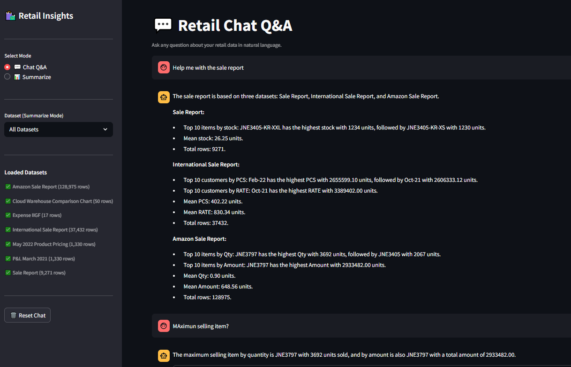
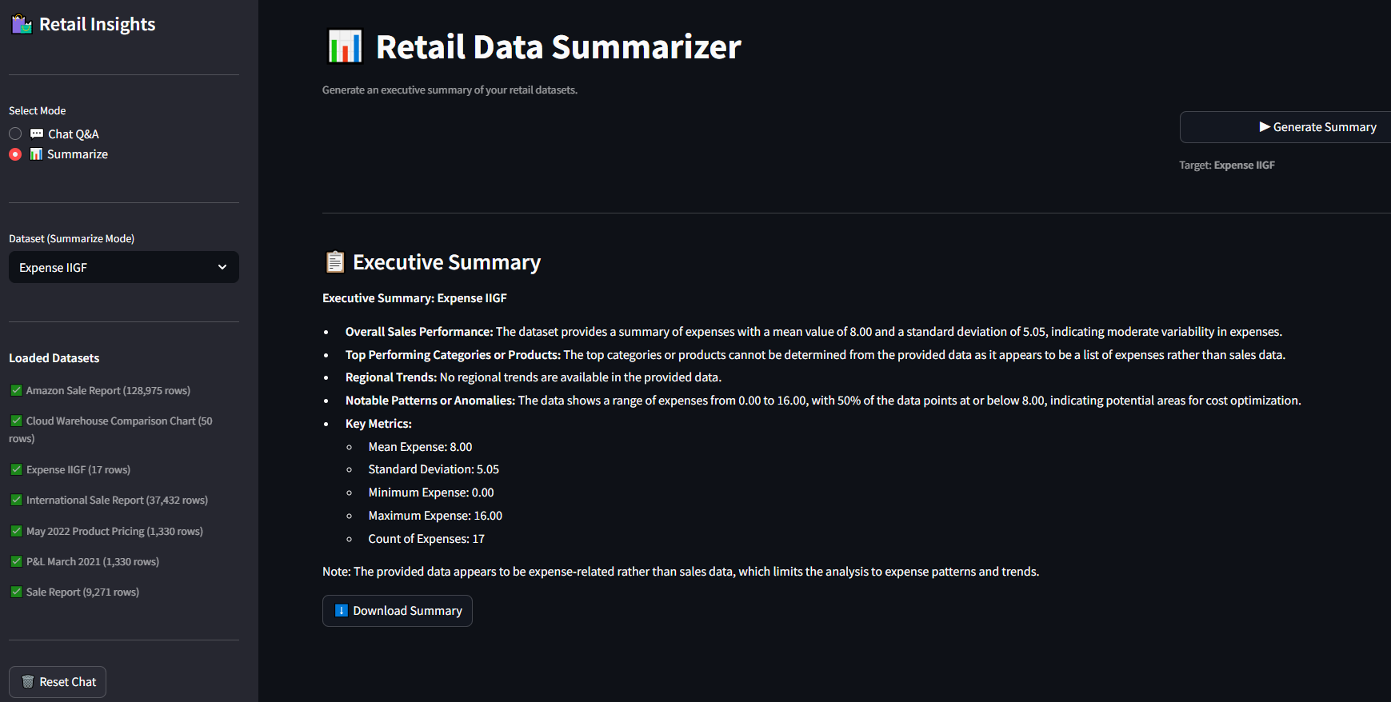
Demo — Streamlit UI
Presented by — Gaurav Anand
Screenshot: Chat Q&A Mode
Screenshot: Summarize Mode

Slide 8
Thank You
Presented by — Gaurav Anand
Retail Insights Assistant | GenAI + LangGraph + FAISS + Groq
https://github.com/grvanand/Blend_Retail_Insights_Assistant
LangGraph 0.4.x
Groq llama-3.3-70b-versatile

