Slide 1
CAPSTONE CHECK POINT 3
Batch A Group 4
Members :
Gokul Prakash Babu
Gomathi Sorna Ganesh
Gourav Kumar
Grace Kollabathula
Gudla Sabarish

Slide 2
Task 3.1 : HDFS, Hive and PySpark (Gokul Prakash Babu & Grace Kollabathula)
Develop a PySpark application to load data Spark DataFrames and save it into Hive tables on a Hadoop cluster in Parquet format.
Perform profiling of the data through PySpark and ensure that it is migrated correctly wherever the source is an RDBMS
Write PySpark routines to cleanse the data, prepare the data to handle missing values, and the data transformations identified in task 1.1 again making sure that the data is written into Hive tables in an efficient format
If the predictive model identified in task 2.4 available in Spark MLlib then develop a PySpark application to implement and evaluate the ML model with appropriate metrics
Ensure that the best practices are followed and the design & code use the features of Spark and take advantage thereof.

Slide 3
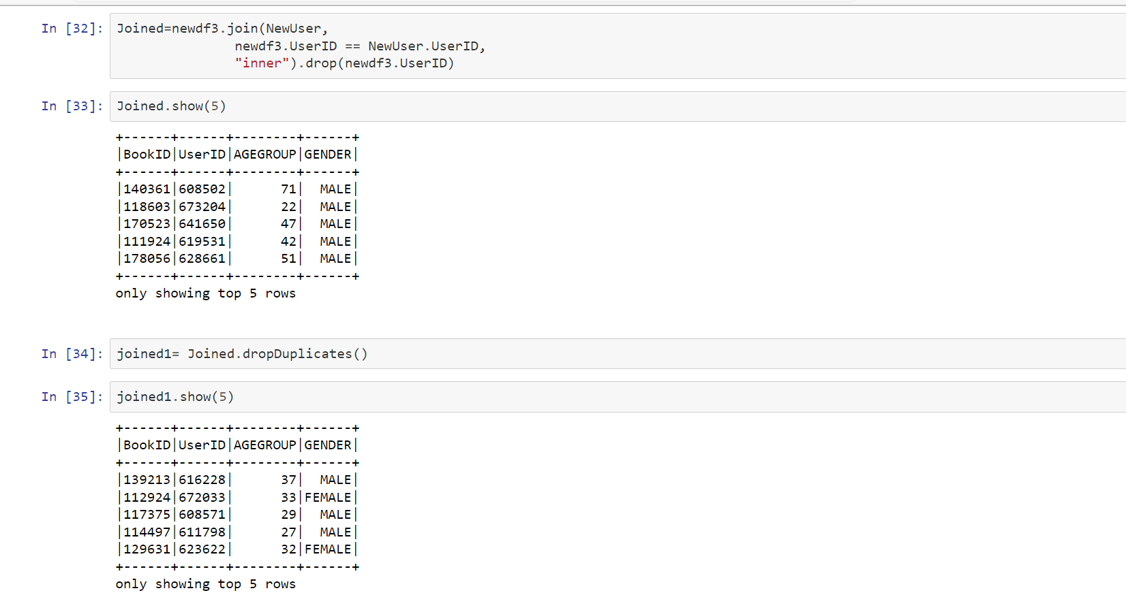
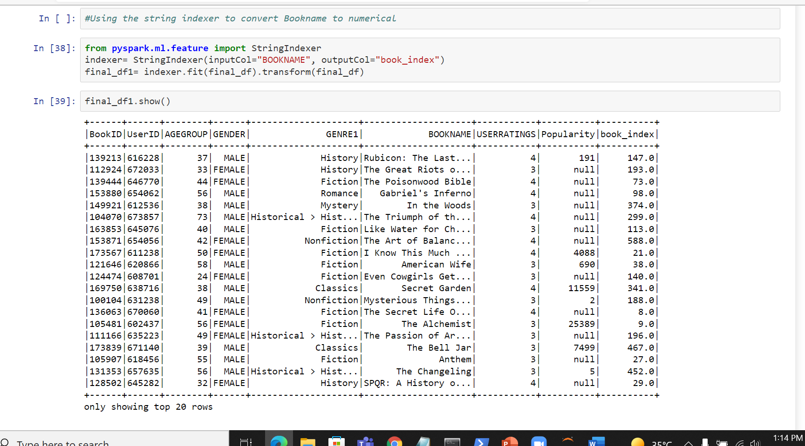
Using Pyspark application we have loaded the data .
We have loaded 3 datasets bookmastertrain.csv as df1, usermaster.csv as df2 and bookpurchasehistory.csv as df3.
Using RDBMS commands we have joined the tables in Pyspark application .
Joined tables with column UserID.
Using StringIndexer converted the book names to numerical.

Slide 4
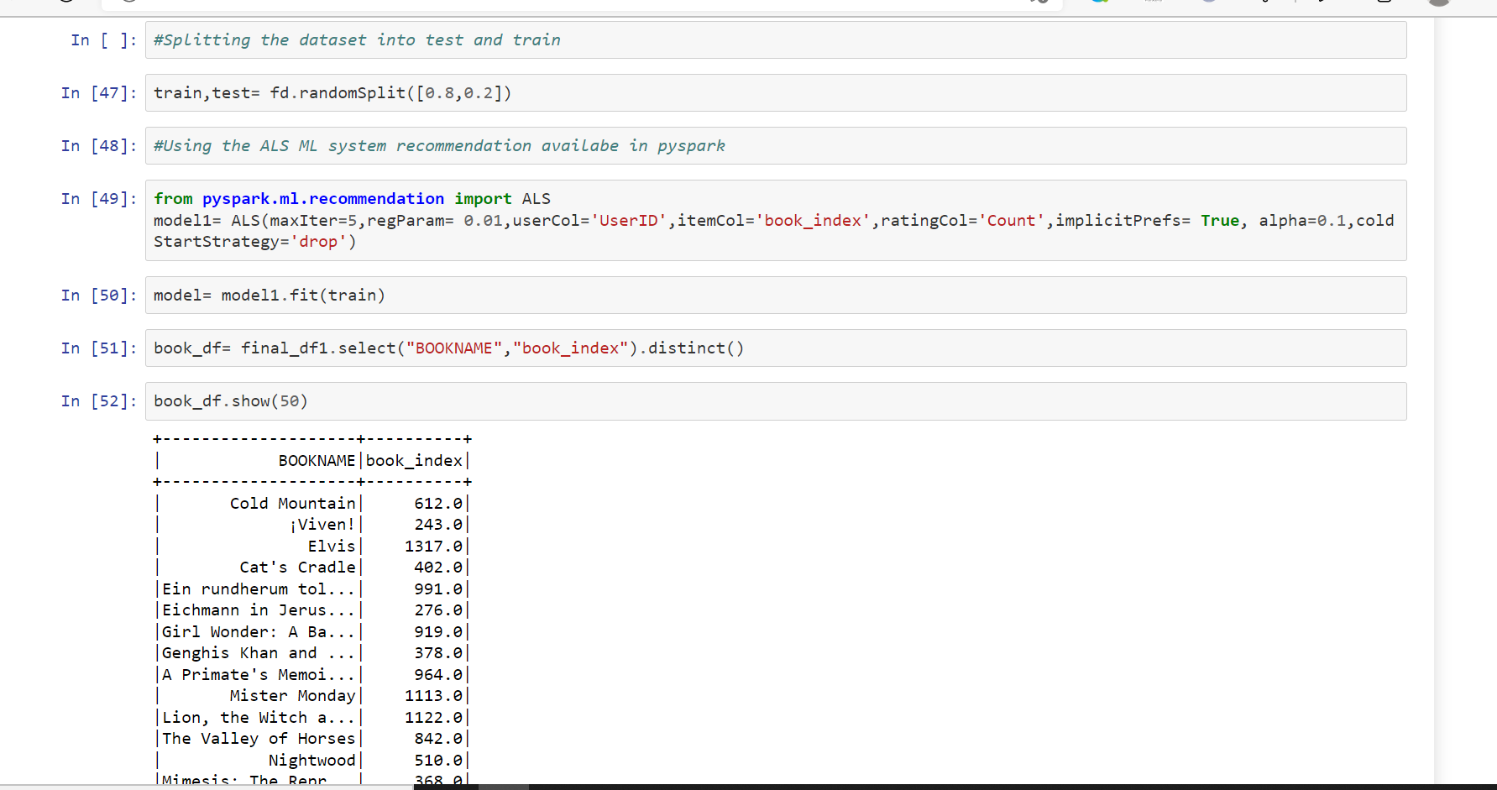
Cleaned the data that is we have dropped the columns which are not needed, fill the null values.
We've used ALS ML system recommendation which is available in Pyspark.
We've splitted the model to train and test.
Fitted up the model.
Used RDBMS command orderby and dispalyed the book_index with BOOKNAME.

Slide 5
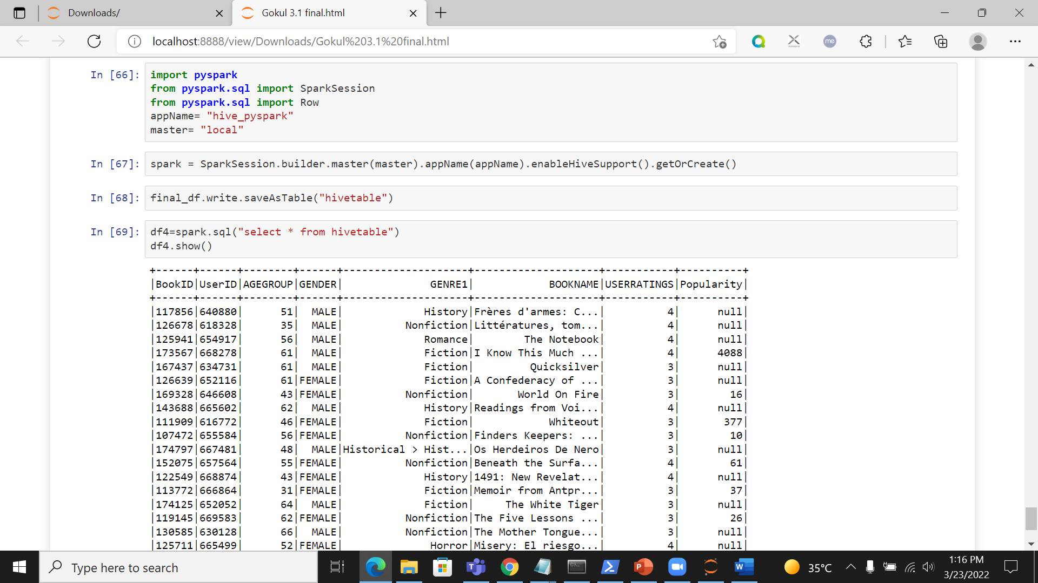
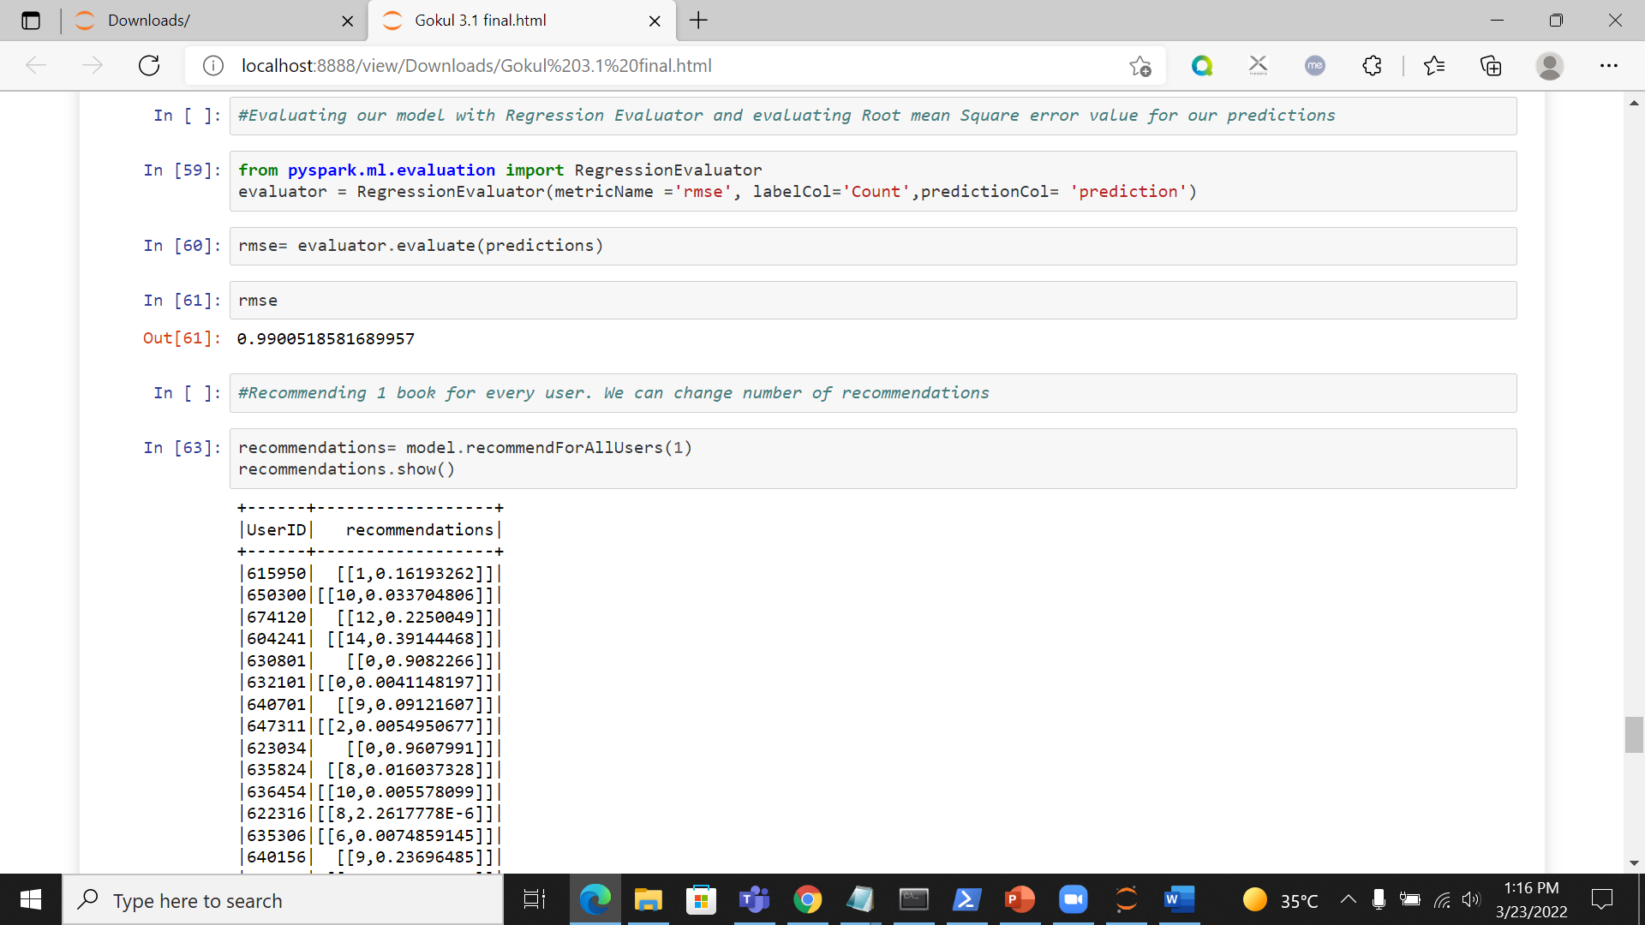
Using RegressionEvaluator predicted the model and have calculated RMSE value.
We've recommended one book for every user.
Imported the data into hive tables by importing SparkSession, Row from pyspark.sql.

Slide 6

Task 3.2 : DATA ANALYSIS ON CLOUD (Gomathi Sorna Ganesh )
Move the Datasets to AWS s3
Create Redshift Instance
Ensure you create required tables in Redshift
Create a data pipeline/copy command to move the data from storage to data warehouse(Redshift).Connect the Redshift data to Power BI
Perform the tasks mentioned in Task 2.3.

Slide 7
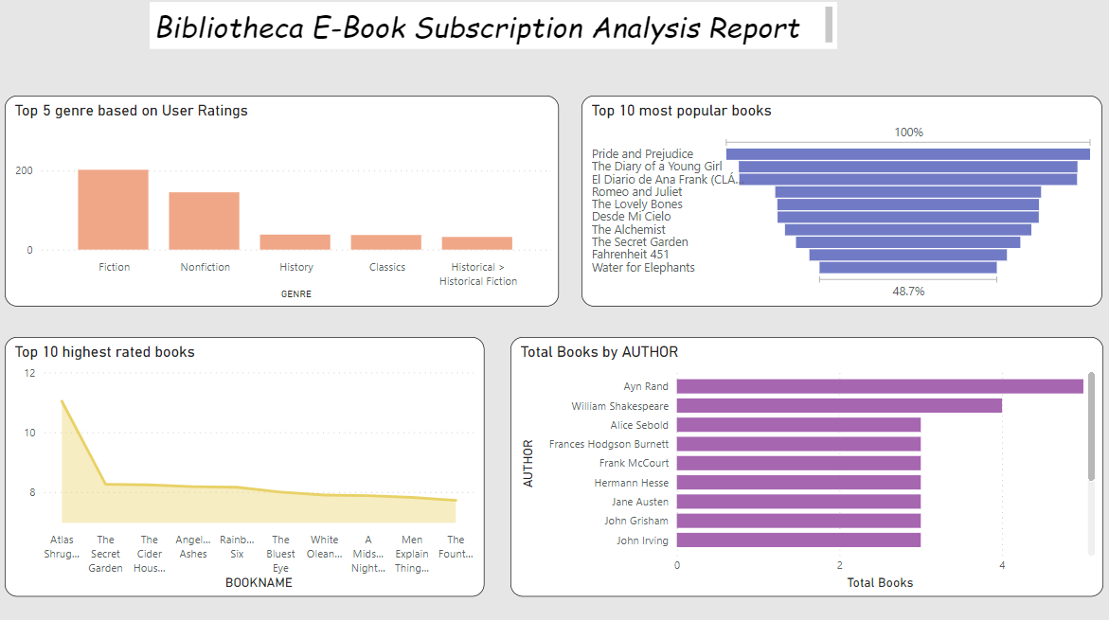
Analysis Report
Inference :
Total Books was highest for J.R.R. Tolkien at 13, followed by C.S. Lewis and William Shakespeare.﻿
﻿Across all 13 AUTHOR, Total Books ranged from 7 to 13.﻿
﻿Across all 10 BOOKNAME, USERRATINGS ranged from 11.40 to 20.65.

Slide 8
Task 3.3 : Deploying ML Model
Deploy the Machine Learning Model created Task 2.4 in flask application.
(Gourav Kumar
&
Gudla Sabarish)

Slide 9


Deploying ML Model

Slide 10

How to deploy an ML Model using Flask?
Writing codes in a python notebook serves the purpose of backend development of a machine learning model.
The backend work of the product is only justified when it’s put into production for use of people.
We deploy our Machine Learning model using Flask, a web application framework written in Python.
We connect and integrate our frontend website and power it with the functionalities of developed python codes for machine learning.
We deploy this model in our local server at address: http://127.0.0.1:5000/.
We can see some snapshots our working model in the previous snapshots.
Likewise, our project can be deployed into a web server too.

