Slide 1



Book Recommendation
CAPSTONE CHECK POINT ONE
BY
GOURAV - GOKUL- GRACE- GOMATHI-SABARISH

Slide 2

OBJECTIVE
To predict the right books and To Maximize the accuracy of an User who is most likely to buy in an Online Platform Bibliotheca that gives its users an exclusive chance to subscribe to E-books at discounted price

Slide 3
contents
DATA MANIPULATION USING PYTHON
ENTITY RELATIONSHIP (ER) DIAGRAM OF THE PROJECT
SQL QUERIES AND OUTPUT
STATISTICAL ANALYSIS USING PYTHON

Slide 4
DATA MANIPULATION USING PYTHON

Slide 5
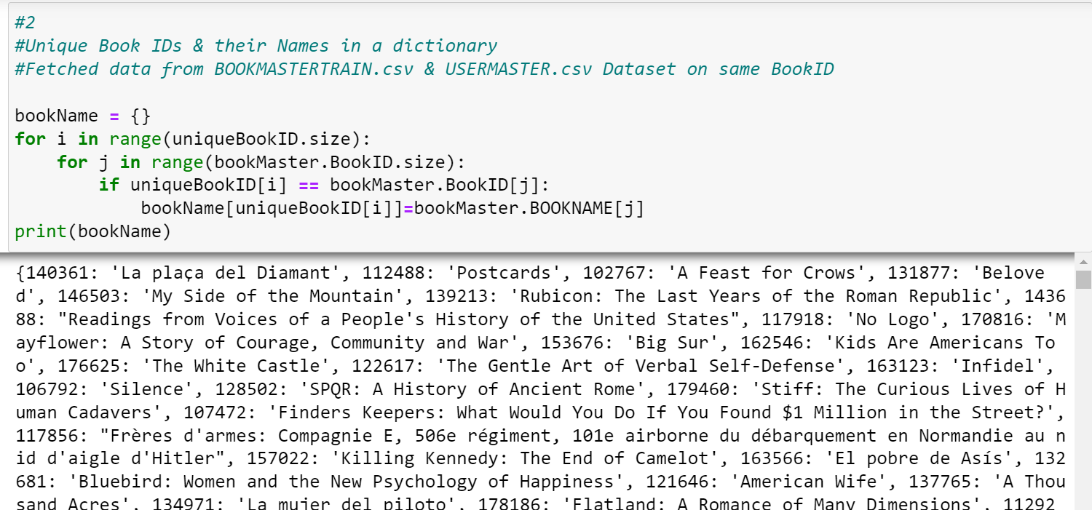
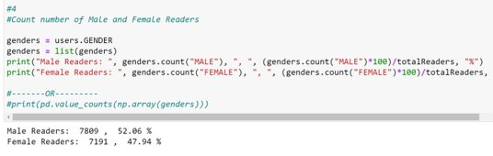
TASK 1: BOOK NAMES IN DICTIONARY
TASK 2:
% OF MALE AND FEMALE READERS

Slide 6
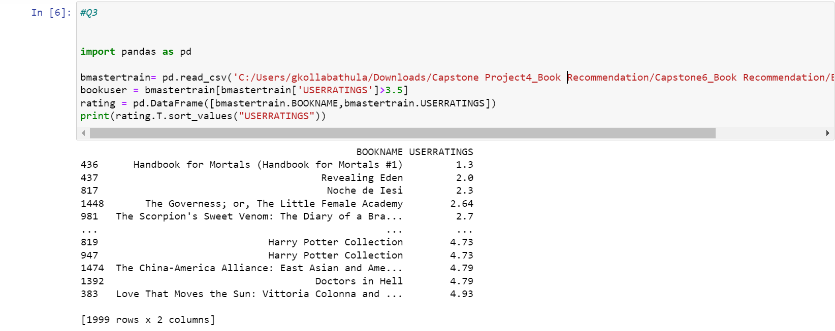
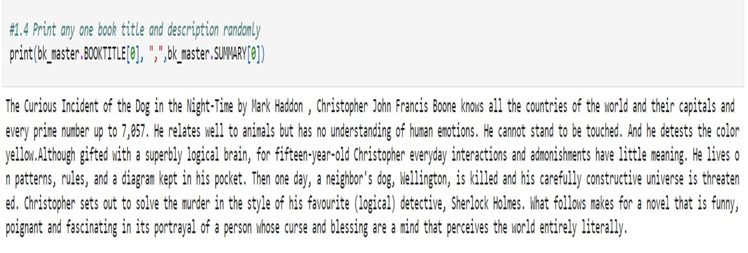
TASK 3: EXTRACT BOOKS THAT HAVE RECEIVED RATINGS MORE THAN 3.5 FROM BOOKMASTER CSV FILE
TASK 4: PRINT ANY ONE BOOK TITLE AND DESCRIPTION RANDOMLY

Slide 7
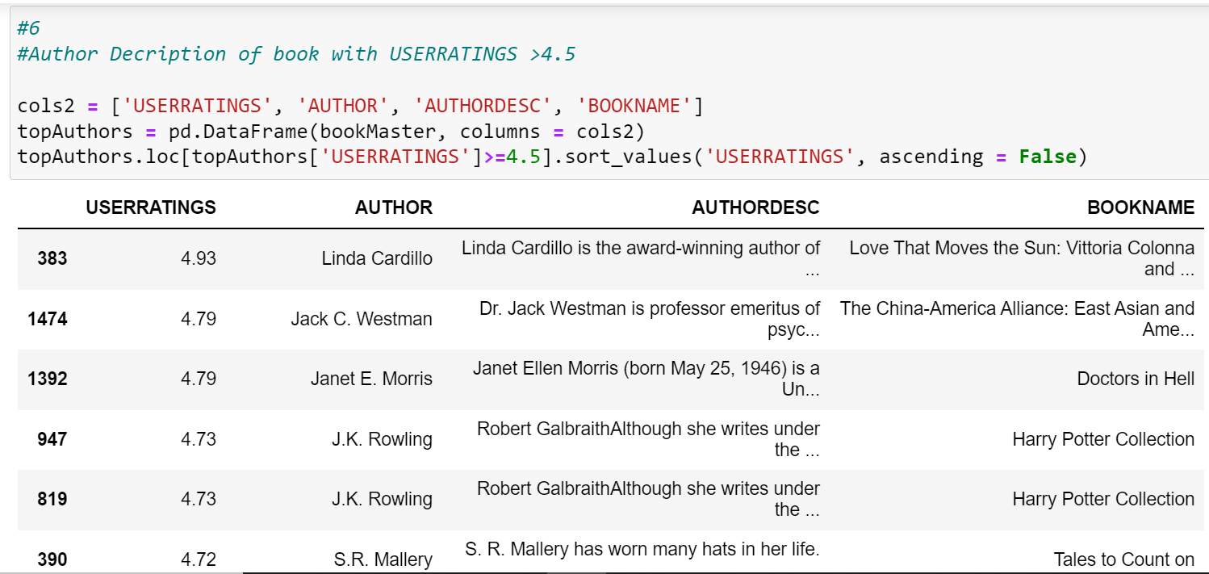
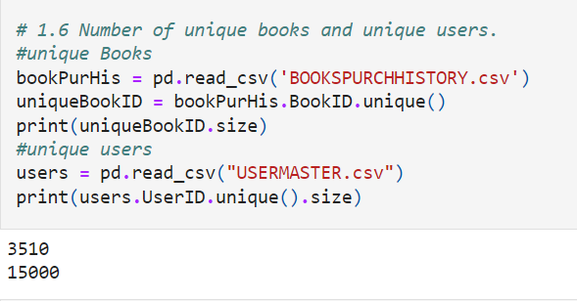
TASK 5: AUTHOR DESCRIPTION OF BOOKS WITH USER RATINGS> 4.5
TASK 6: NUMBER OF UNIQUE BOOKS AND UNIQUE USERS FROM BOOKVISIT HISTORY CSV FILE

Slide 8
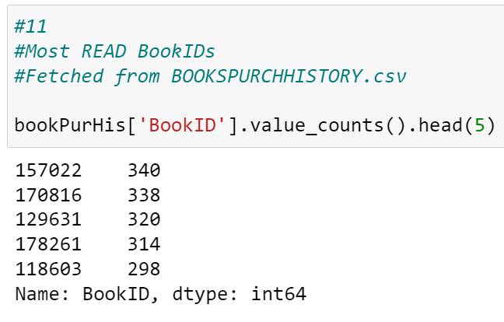
TASK 7: Most read bookS

Slide 9
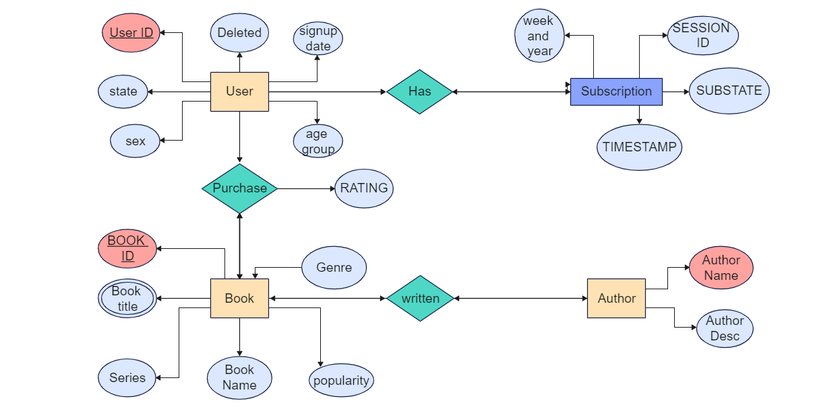

ER Diagram

Slide 10
SQL QUERIES AND OUTPUT

Slide 11
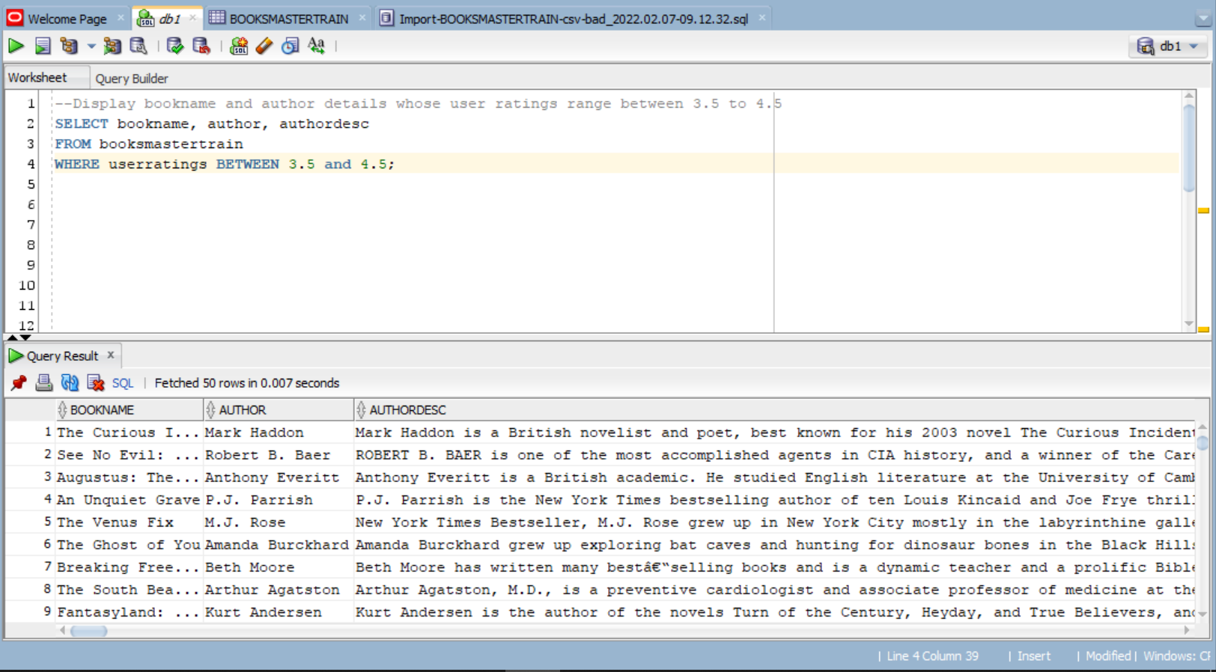
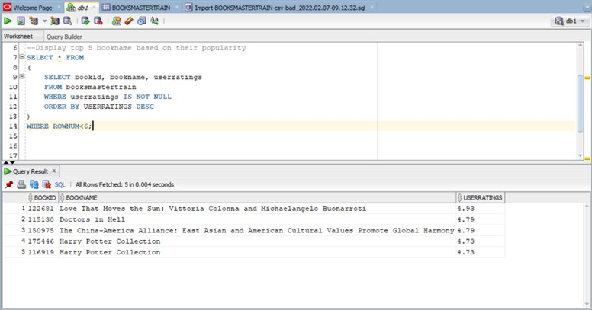
Query 1 Display Book Name and Author details where user-ratings range between 3.5 and 4.5
Query 2: Display Top-5 names of books based on their popularity

Slide 12
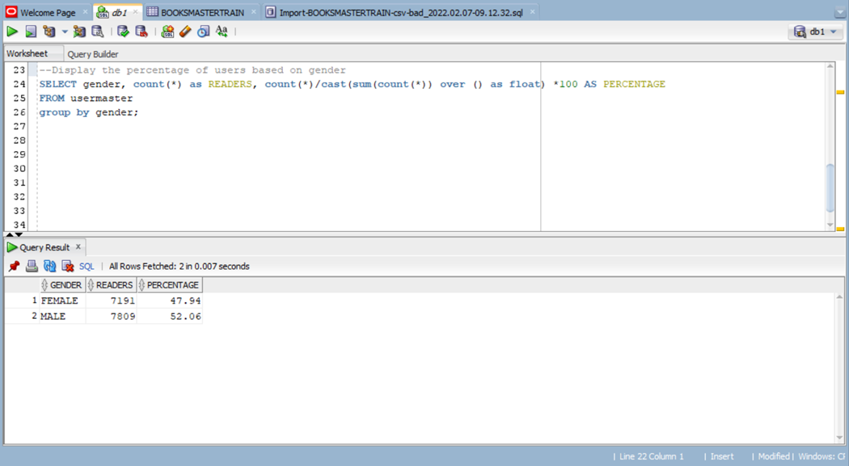
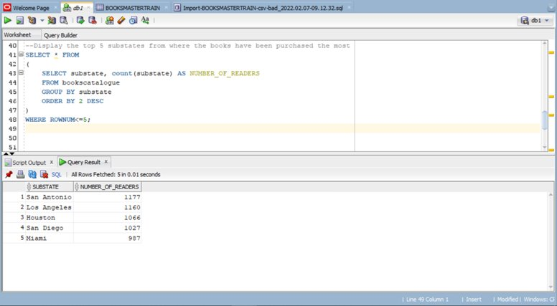
QUERY3: Display the percentage of users based on Gender
QUERY 4: Display the top-5 substates from where the books have been purchased the most

Slide 13
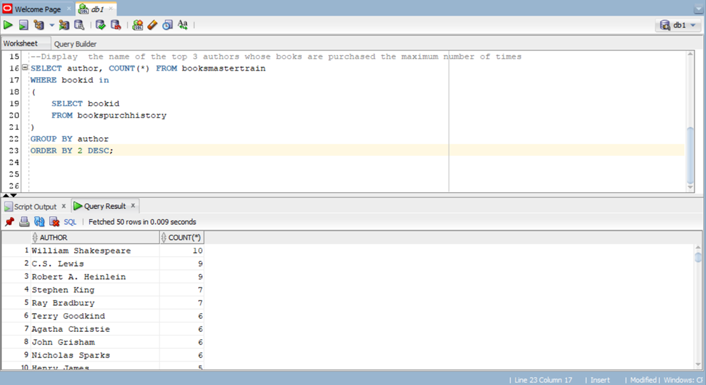
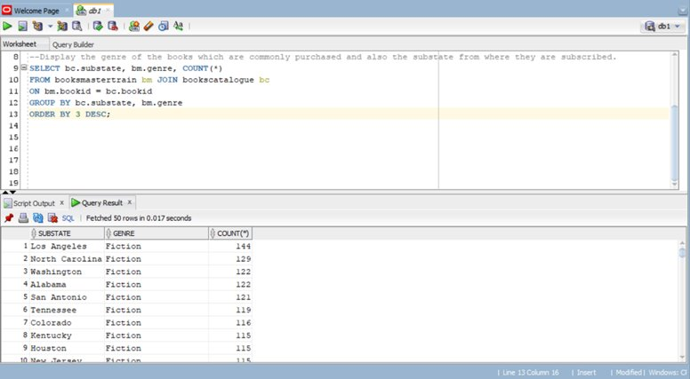
QUERY 5: Display the name of the Top-3 authors whose books are purchased the maximum number of times
QUERY 6: Display the genre of the books which are commonly purchased and also the substate from where they are subscribed

Slide 14
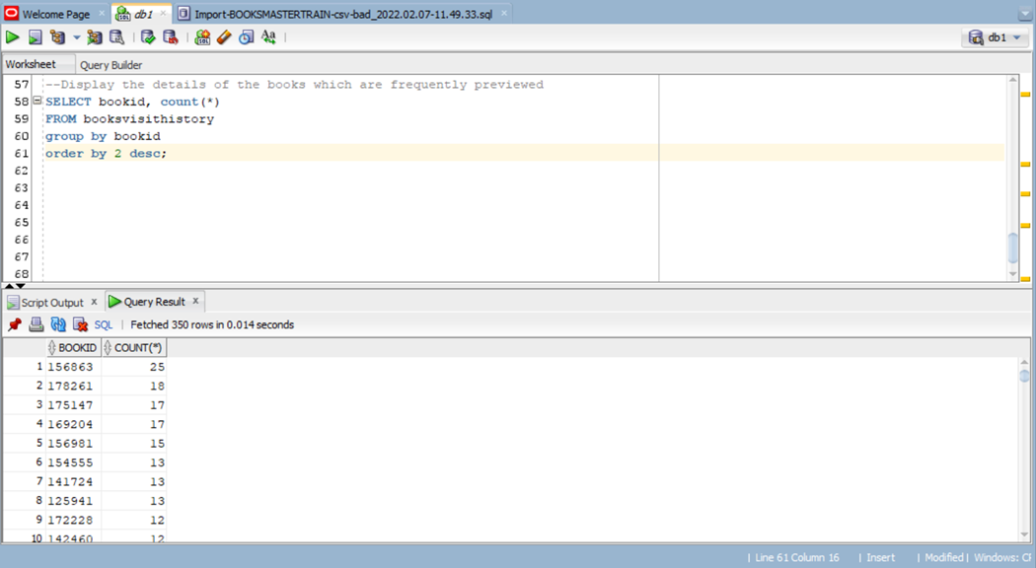
QUERY 7: Display the details of the books which are frequently previewed

Slide 15
Descriptive Statistics & Hypothesis Testing

Slide 16
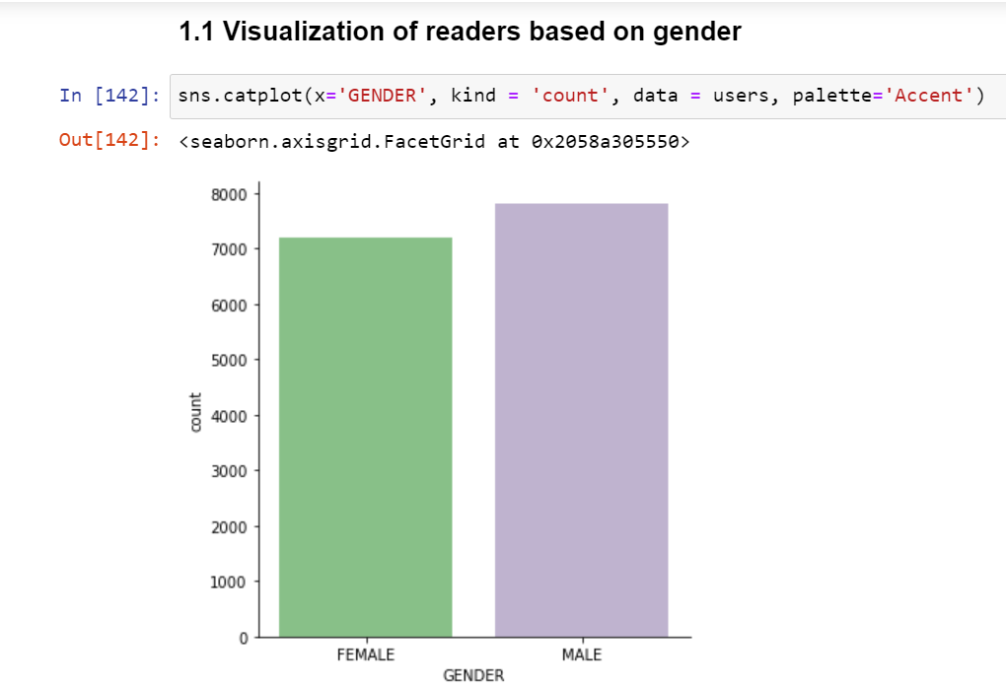
Task 1: Visualization of Readers Based on gender

Slide 17
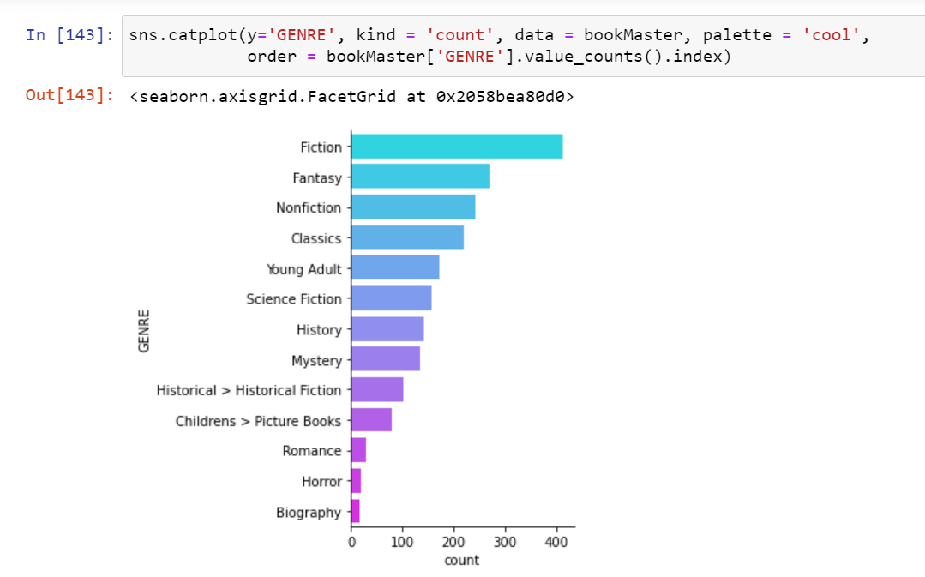
TASK 2: VISUALIZATION OF Popular genres

Slide 18
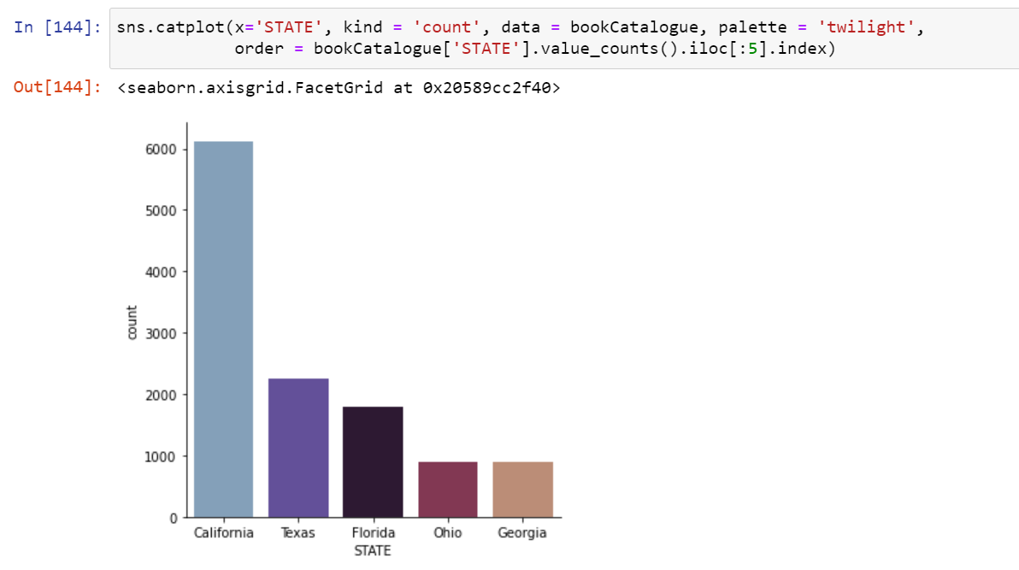
TASK 3: VISUALIZATION OF STATES where most customers belonged to

Slide 19
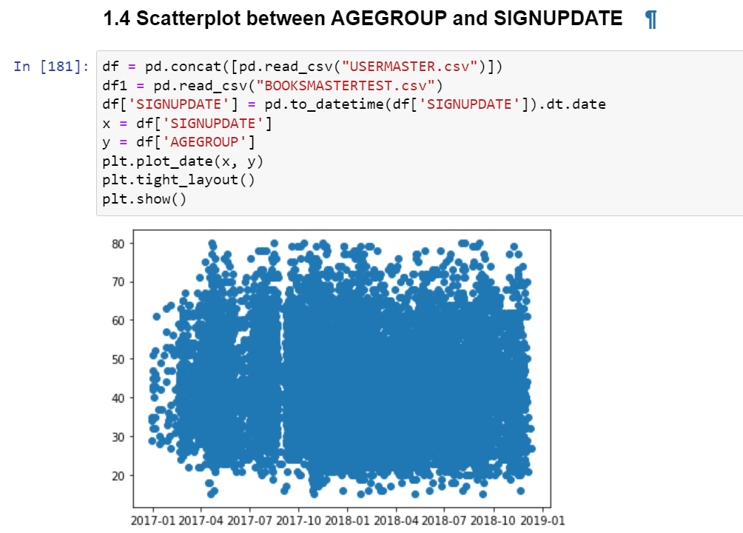
TASK 4: PLOTTING relation between age group and sign update

Slide 20
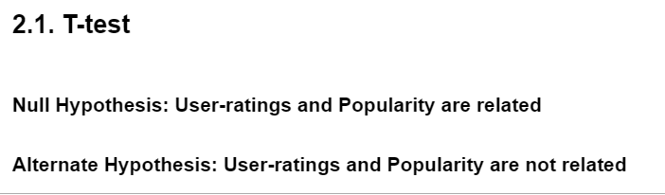
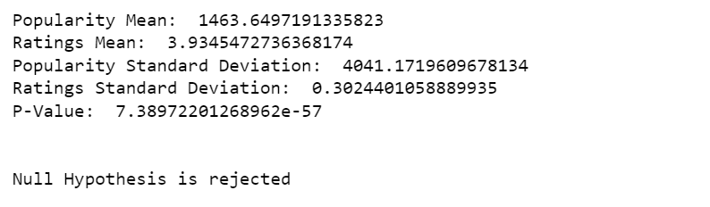
TASK 5: Performing
T-Test

Slide 21
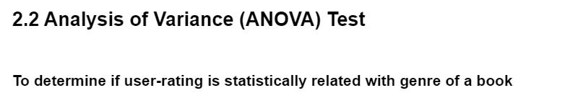
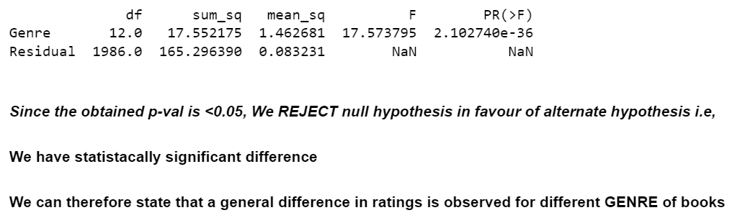
TASK 6: Performing
Analysis of variance (anova)
test

Slide 22
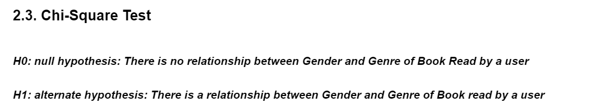
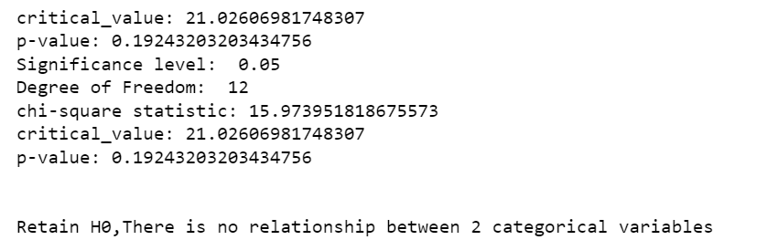
TASK 7: Performing
CHI-square
test

Slide 23

THANK YOU

