Slide 1



Bibliotheca: E-Book Recommendation

Slide 2
Checkpoint Topics and contributions
2.1 Visualization using Python (Grace & Gourav)
Visualization Tasks performed on :
2.2 Exploratory Data Analysis(Gokul & Gourav)
Univariate, Bi- Variate Analysis and Multi- Variate Analysis
Extraction of relevant features
Missing values identification and treatment
Outlier analysis and treatment
Data scaling using min-max and/or Z-score normalisation
Data transformation
Feature Engineering
2.3Visualization using Power-BI (Gomathi)
Top 5 Genre based on User Ratings.
Identify the Best Books based on Popularity belonging Genre categories
Top 10 highest rated books
Top 10 most popular books
Top 10 authors with the most number of books
Top 5 Substates and states based on Book purchase.
Most number of ratings
Which User age group has most read books on Science Fiction?
2.4 - Model Building using ML algorithms (Gokul & Sabarish)
Building appropriate predictive model/s on the data.
Compare various recommendation models
Evaluate the performance of the model.
Identify the right metric to evaluate the performance of the model.
Identify issues and concerns on the given data and suggest the best technique/s to overcome the issues.
Most rated books
most popular books
most popular authors
Average rating distribution for all books
states and substates with most number of books and
Age group of the user with most read books based on Genre.

Slide 3
TASK 2.1 & 2.2 visualization using python & Exploratory data analysis

Slide 4
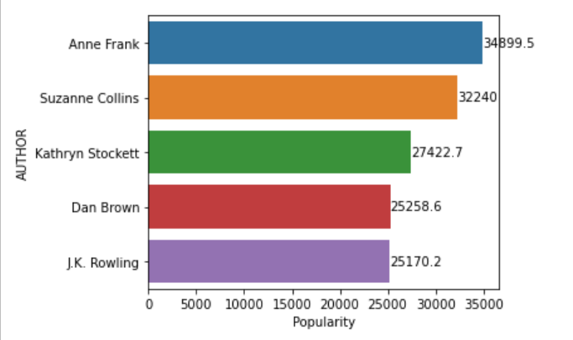
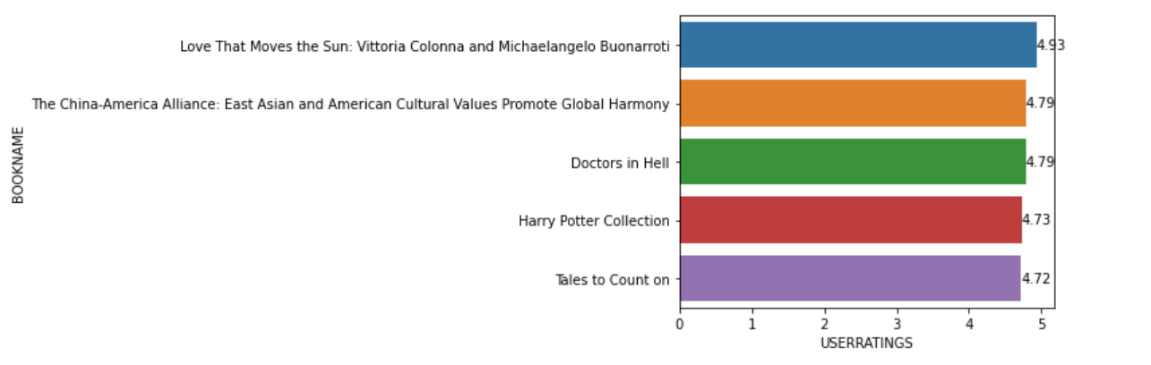
task 2.1 Visualization using Python
Most Popular Authors
Anne Frank is the most popular author followed by others.
The author of the famous Harry Potter Series is one amongst the Top 5 popular authors.
Most Rated Authors
Love That Moves the Sun is the most rated book with a whopping average of 4.93
The China-America and Doctors in Hell shares the average rating of 4.79
The evergreen Harry Potter Series makes its place in the Top 5 with 4.73 average ratings.
Tales to count on follows the suit with 4.72 average ratings.

Slide 5
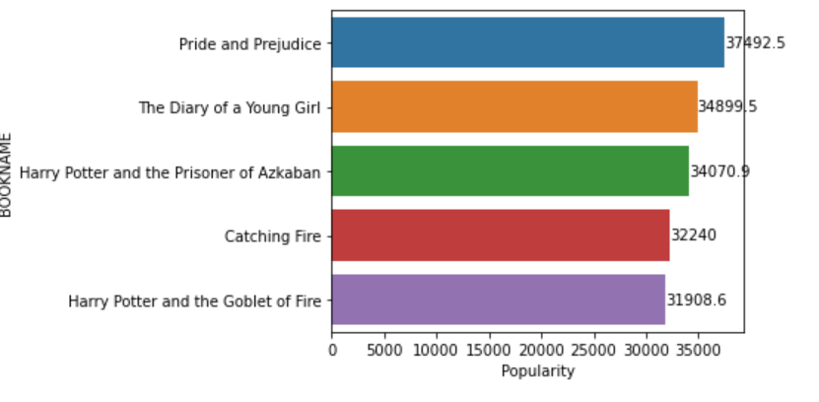
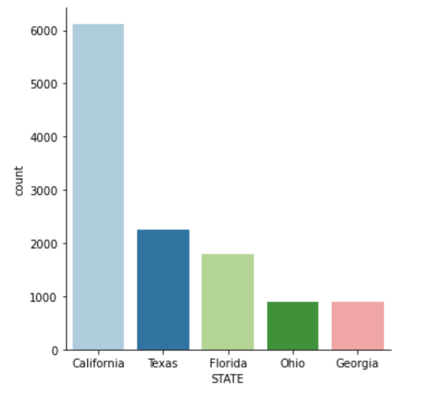
task 2.1 Visualization using Python
Most Popular Books
Pride and Prejudice is the most popular book among all
The beautiful book The Diary of A Young Girl by Anne Frank positions the next.
Two of the Harry Potter books made it to Top 5 most popular book list
States with most readers
California is the state with highest number of Bibliophiles.
Texas follows it but with a large difference.
Florida makes it to the Top 5 States at number 3.
Ohio and Georgia have a similar number of Bibliophiles.

Slide 6
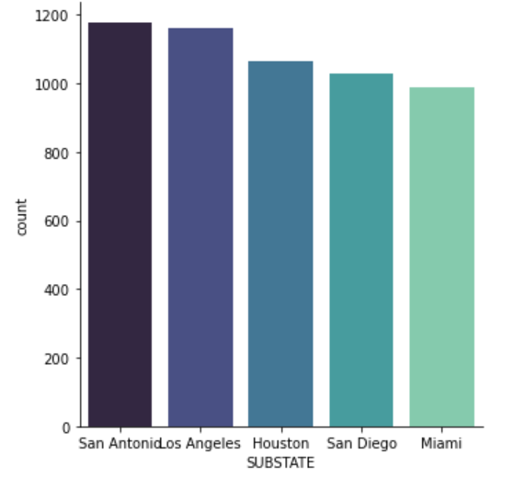
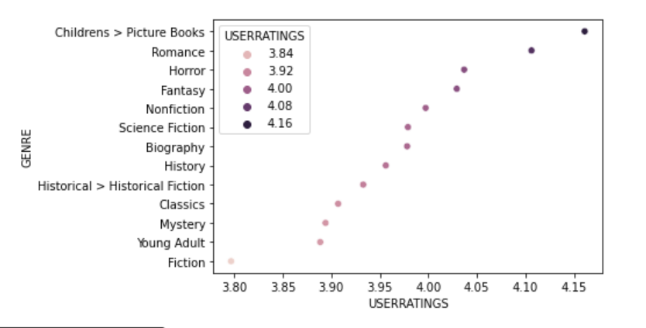
task 2.1 Visualization using Python
Substates with most readers
San Antonio city of Texas settles close with Lon Angeles, a city of California.
Following them, another close call is between Houston, Texas and San Diego, California.
City of Miami of Florida ranks 5th.
Genres with average rating distribution
As obvious, Children’s Picture books have the highest average ratings.
Romance, Horror, Fantasy books are the next most rated genres.
Classics, Mystery, Young Adult & Fiction books are the least average rated genres.

Slide 7
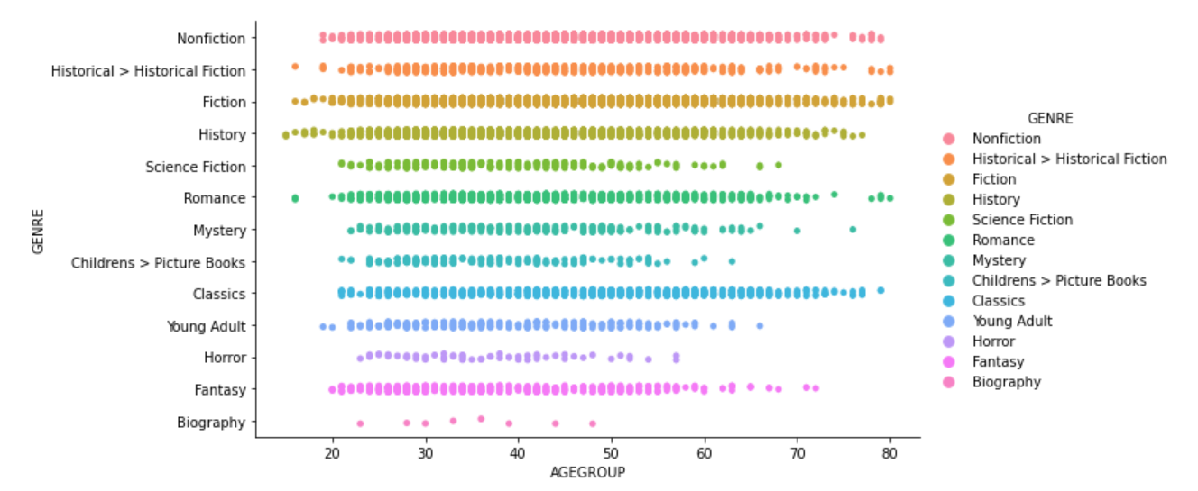
task 2.1 Visualization using Python
Choice of Genres based on Age Group
A lot of observation can be concluded from this distribution.
Fantasy books are mostly read by lower age group. Older people seems to be quite less interested in fantasy.
Horror books are fewer read by readers of young age and no readers of old age reads Horrors. Likewise older folks avoid Mystery & Science Fiction too.
Fiction books are quite evenly spread across all age groups.
Historical Fictions fails to excite people under 20 but seems to be in the list of people in late 70s.

Slide 8
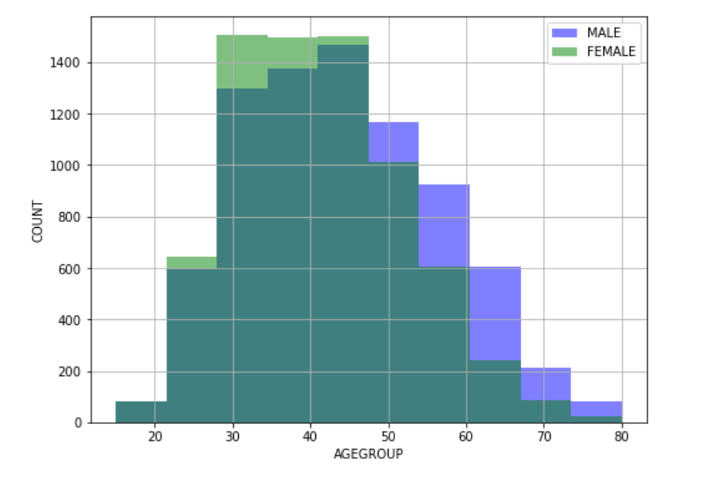
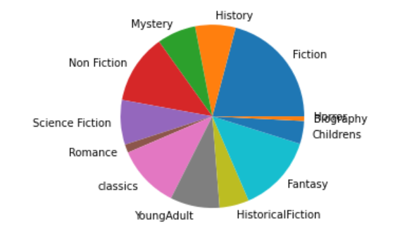
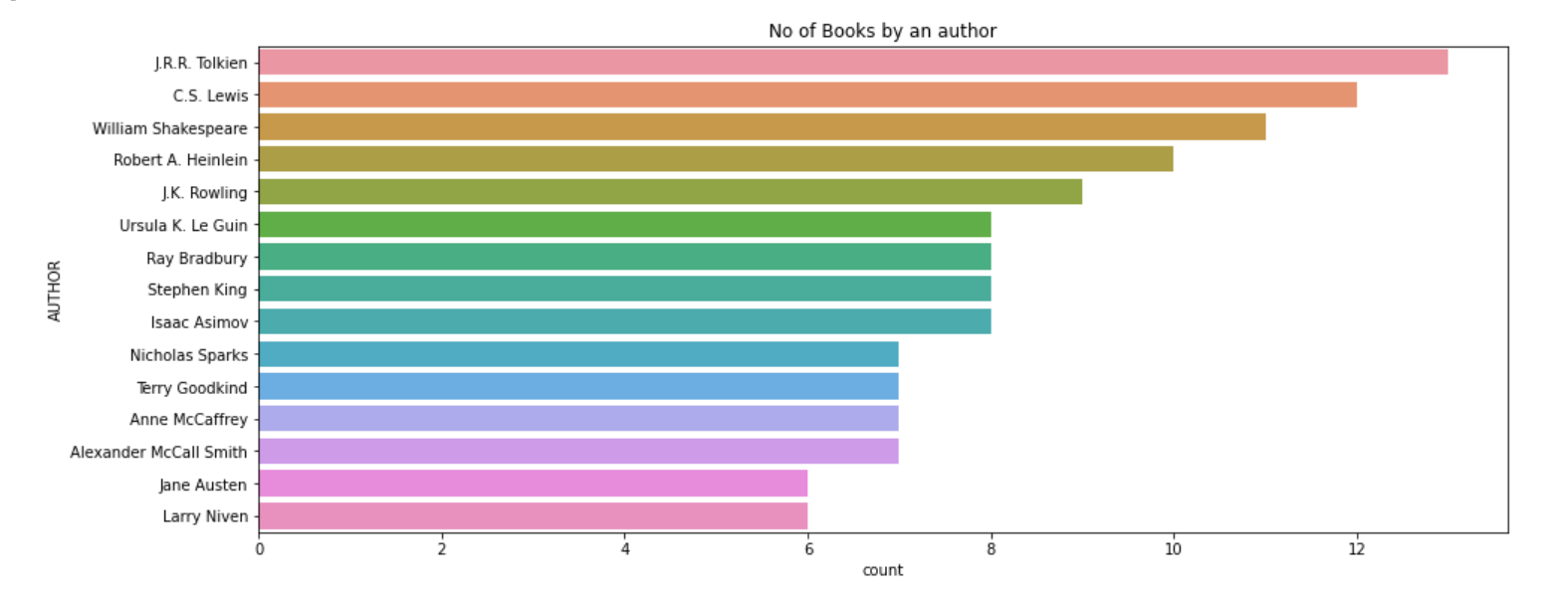
task 2.2 Exploratory data Analysis
Univariate Analysis
Distribution of Age Group among the 2 genders: Male and Female
Distribution of Genres read by users with Fiction leading the pack
Authors with highest number of books with JRR Tolkein authoring more than 12 books.

Slide 9
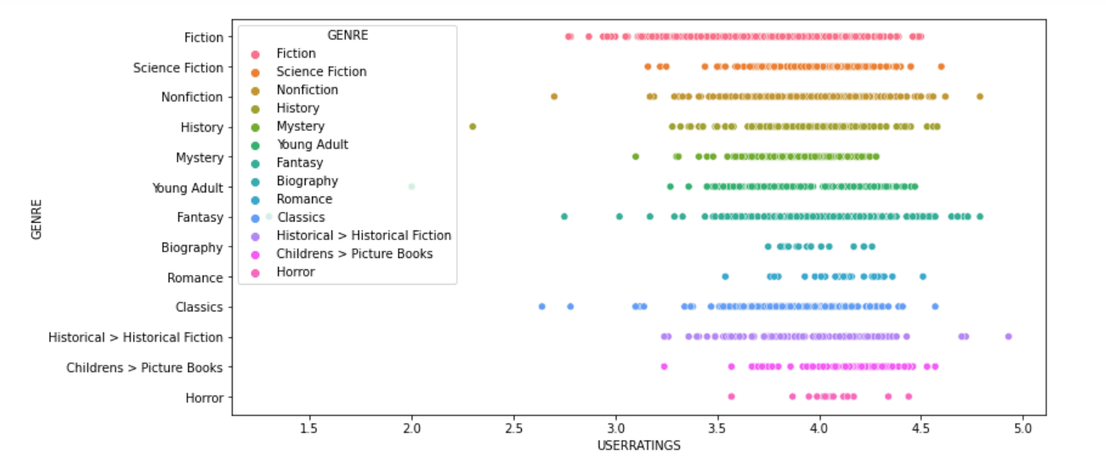
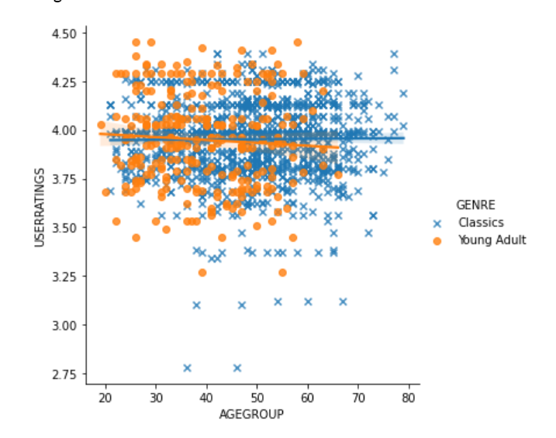
task 2.2 Exploratory data Analysis
Bivariate Analysis
Multivariate Analysis
A Multivariate Analysis between the two genres: Young Adult & Classics plotted among the age group of readers.
As obvious, younger population read Young Adult Fiction more.
Classics doesn’t seem to be a good choice for young people. But old people love reading them.
User rating distribution among different genres.
Fiction seems to have varying ratings.
Horror books, although less rated, have more rated books around 4.0
Fantasy seems to be a great genre with large number of high rated books.

Slide 10
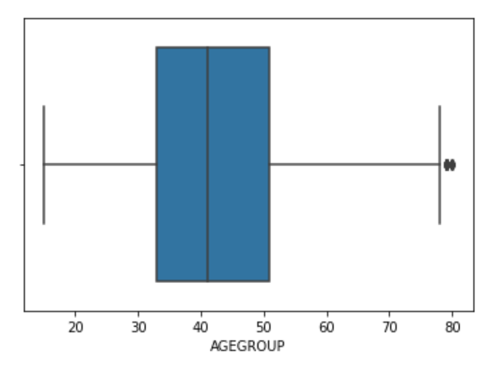
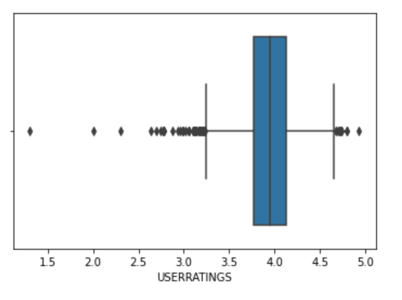
task 2.2 Exploratory data Analysis
Outlier Analysis
Plotting a boxplot is one the many methods to identify outliers in a dataset. We have a few readers in our data who are very old.
Inter-Quartile Range(IQR) is one of the popular methods to handle outliers in a dataset.
IQR is the difference between the 25th percentile (Q1) and the 75th percentile (Q3) in a dataset. It measures the spread of the middle 50% of values.
A data is outlier if it has a value 1.5 times greater than the IQR or 1.5 times less than the IQR.
One of the key steps in preparing a dataset for feeding into a Machine Learning model is Encoding.
Encoding
Encoding helps an important categorical variable in dataset to convert into numerical.
We have several encoding techniques like one-hot encoding, label encoding, etc.

Slide 11
TASK 2.3 visualization using Power-BI

Slide 12
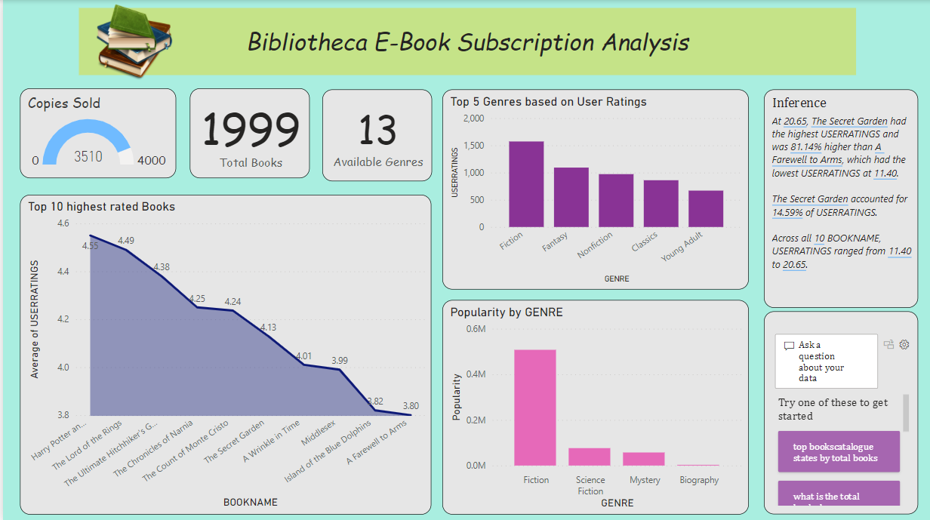

Snapshot 1 on task : Visualization using Power-BI

Slide 13
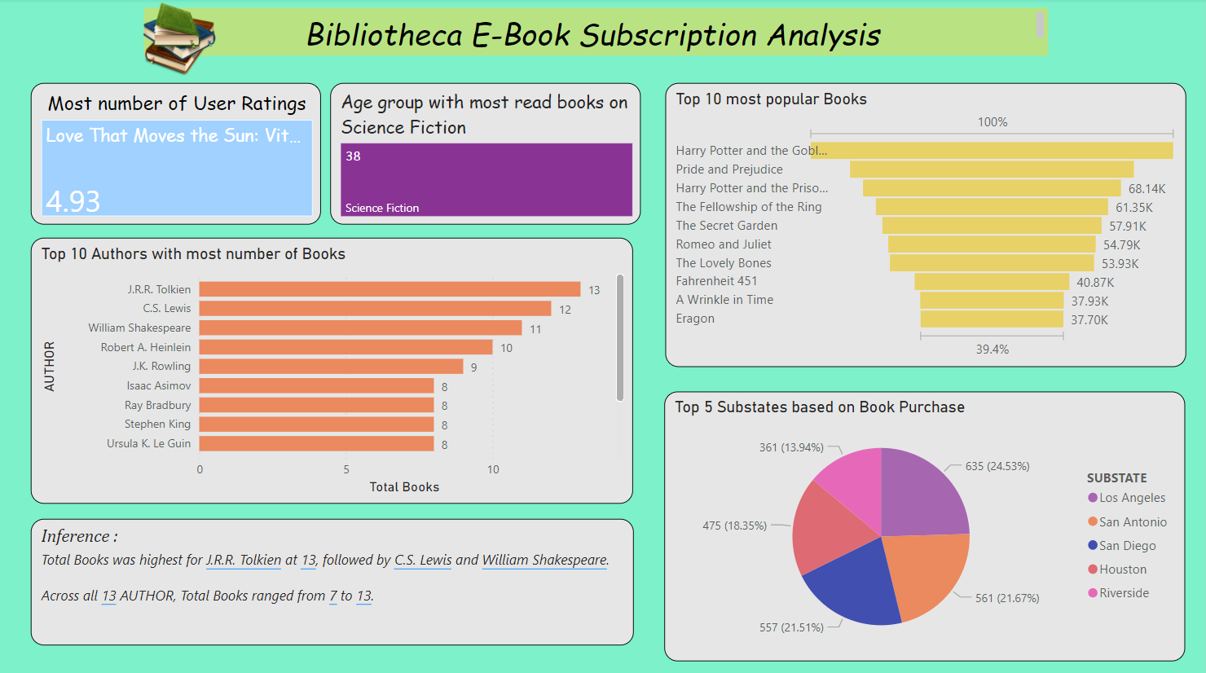
Snapshot 2 on task : Visualization using Power-BI

Slide 14
TASK 2.4 Book recommender system

Slide 15
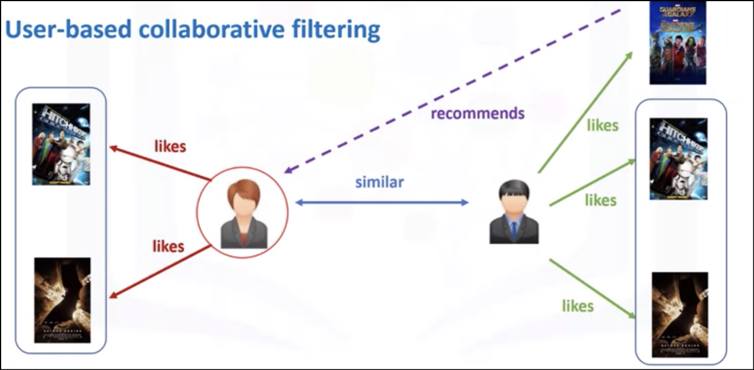
task 2.4 model building using ml algorithms
Book Recommendation System
For the Book Recommendation System, we have used Collaborative filtering approach using the K-Nearest Neighbor (KNN) algorithm.
Collaborative filtering uses similarities between users and books to provide recommendations to user A based on the interests of a similar user B.

Slide 16
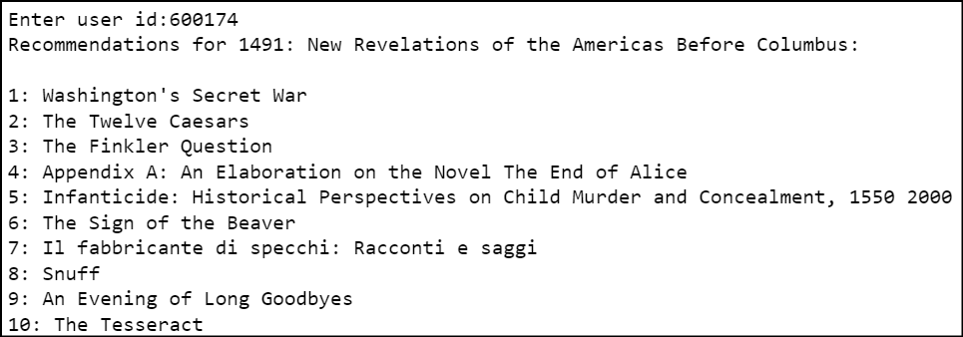
task 2.4 model building using ml algorithms
Book Recommendation System
To create a model for book recommendation system we trained the model with the data of users who have purchased more than 2 books and have reviewed atleast 5 books to avoid the problem of overfitting.
The KNN algorithm calculates Euclidean distance between the points and recommends the 10 nearest neighbors to the user.
If a new user log in to the platform it gives recommends the top 10 highest rated books to the user.
For an existing user it recommends books based on previous book subscribe history.

