Slide 1
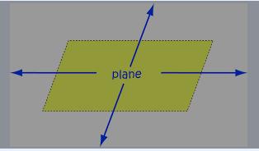
Plane
A plane can be thought of an a flat sheet with no thickness, and which goes on for ever in both directions.

Slide 2


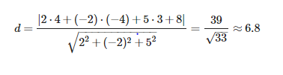
Find the distance from the point P=(4,−4,3) to the plane 2x−2y+5z+8=0.
Solution:

Slide 3
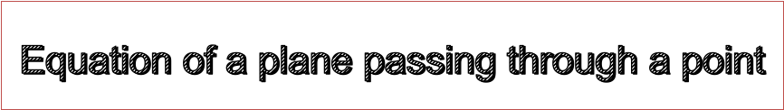
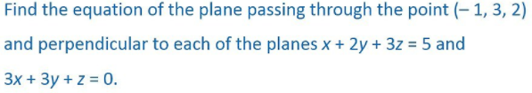
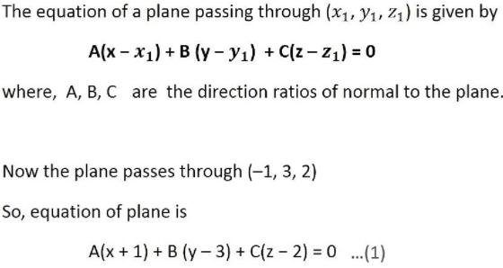

Slide 4
