Slide 1
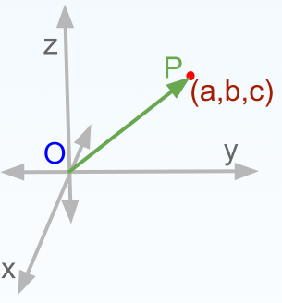
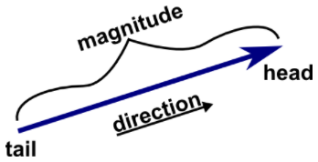
Vector
Position Vector
A vector is an object that has both a magnitude and a direction. Geometrically, we can picture a vector as a directed line segment, whose length is the magnitude of the vector and with an arrow indicating the direction. The direction of the vector is from its tail to its head.
Position vector, straight line having one end fixed to a body and the other end attached to a moving point and used to describe the position of the point relative to the body. As the point moves, the position vector will change in length or in direction or in both length and direction.

Slide 2
Types of Vector
Unit vector - A vector which has a magnitude of unit length is called a unit vector.
Co-initial Vectors - The vectors which have the same starting point are called co-initial vectors.
Collinear Vectors - Vectors which lie along the same line or parallel lines are known to be collinear vectors. They are also known as parallel vectors.
Equal Vectors - Two or more vectors are said to be equal when their magnitude is equal and also their direction is the same.
Negative of a Vector - If two vectors are the same in magnitude but exactly opposite in direction then both the vectors are negative of each other. Assume there are two vectors a and b, such that these vectors are exactly the same in magnitude but opposite in direction then these vectors can be given a = – b.

Slide 3
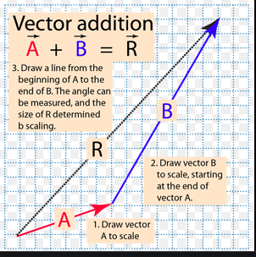
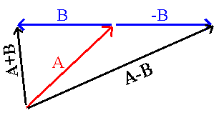
Addition of Vector
Subtraction of Vector
Vector addition is the operation of adding two or more vectors together into a vector sum. As below fig to get R value one need to get A + B = R
Vector subtraction is the process of taking a vector difference, and is the inverse operation to vector addition. As per the below fig :
(A) + (-B) = A - B

Slide 4
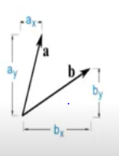
Dot product of two vectors
The dot product is defined as the sum of the products of the corresponding entries of the two sequences of numbers.
formula to calculate :
abc = a1b1+a2b2+a3b3
Example : Let there be two vectors [6, 2, -1] and [5, -8, 2]. Find the dot product of the vectors.
Solution:
Given vectors: [6, 2, -1] and [5, -8, 2] be a and b respectively.
a.b = (6)(5) + (2)(-8) + (-1)(2)
a.b = 30 – 16 – 2
a.b = 12

Slide 5
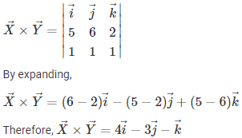
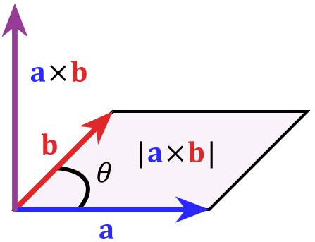
Cross Product of two vectors
Cross product of two vectors is the method of multiplication of two vectors.
The cross product of two vectors is the third vector that is perpendicular to the two original vectors.
Its magnitude is given by the area of the parallelogram between them and its direction can be determined by the right-hand thumb rule.
Example :
Find the cross product of the given two vectors:
X⃗ =5i⃗ +6j⃗ +2k⃗ and
Y⃗ =i⃗ +j⃗ +k⃗

Slide 6
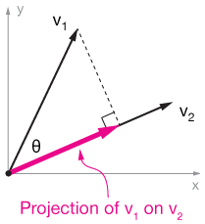

Projection of Vector
The projection of vector V1 on V2 is known as projection of Vector.
Example :
Find the projection of vector
a = {1; 4; 0} on vector b = {4; 2; 4}.
dot product of vectors:
a · b = 1 · 4 + 4 · 2 + 0 · 4 = 4 + 8 + 0 = 12
magnitude of vector b:
|b| = √42 + 22 + 42 = √16 + 4 + 16 = √36 = 6
vector projection:

Slide 7

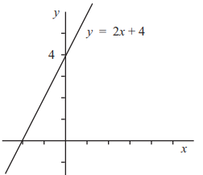
Equation of a straight line
The equation y = mx represents a straight line passing through the origin with gradient m. The equation of a straight line with gradient m passing through the origin is given by y = mx + c
Example :
Find the equation of the line that passes through the points (-2, 4) and (1, 2).
4 = (– 2/3)(–2) + b
4 = 4/3 + b
4 – 4/3 = b
b = 8/3
so, y = ( – 2/3 ) x + 8/3.

