Slide 1
Superstore dataset

Slide 2
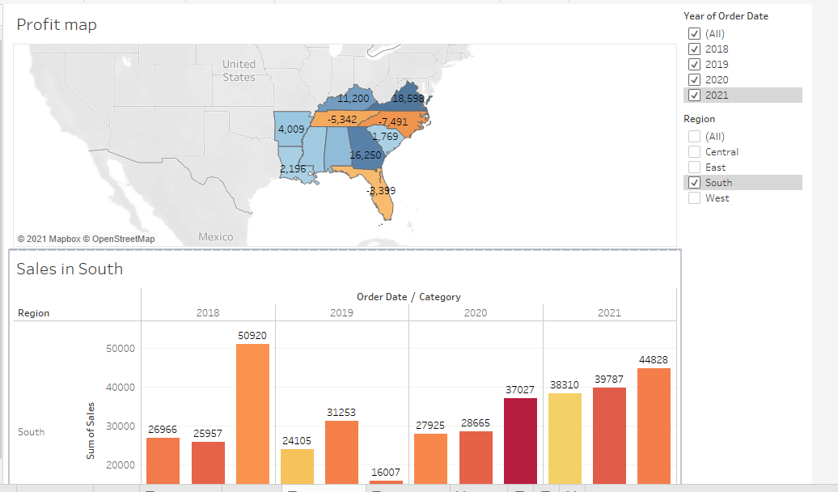
Build dashboard to show some insights.

Slide 3
Remove the subcategory filter option to vacate the space

Slide 4
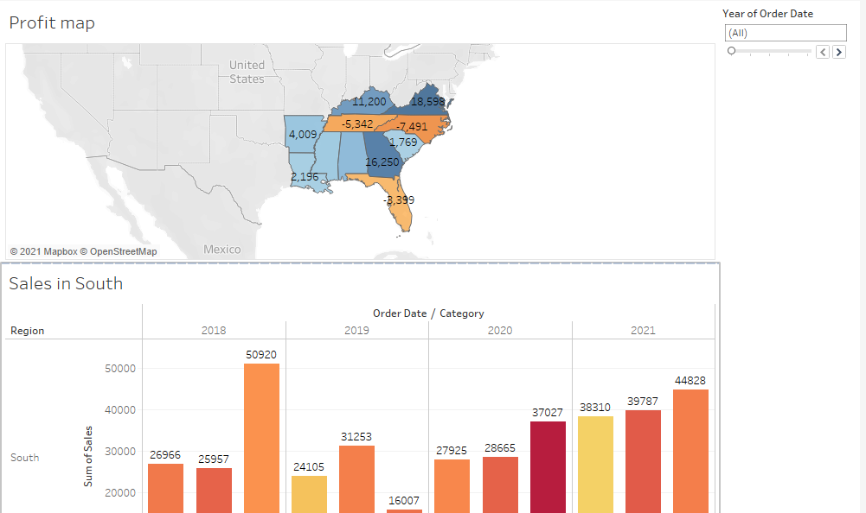
Remove the year of order filter option to vacate the space.

Slide 5
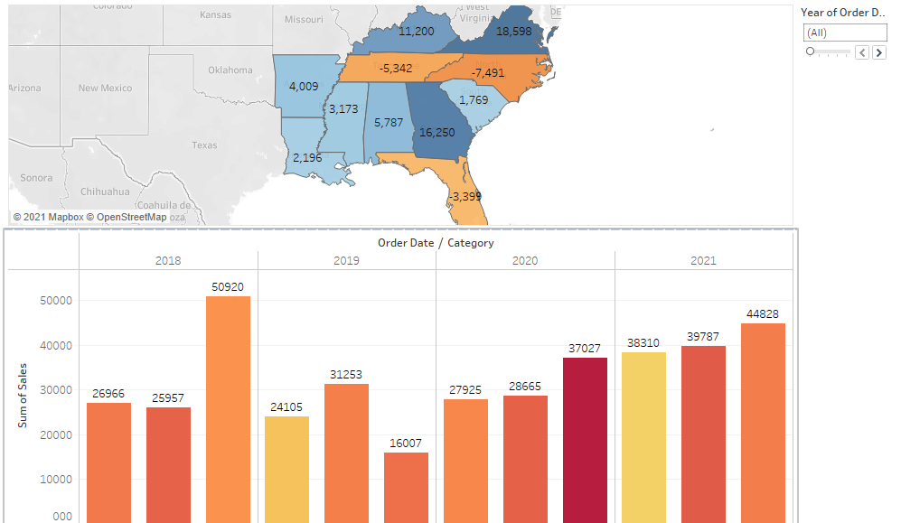
Select Profit color legend and drag it below Sales in the South.

Slide 6
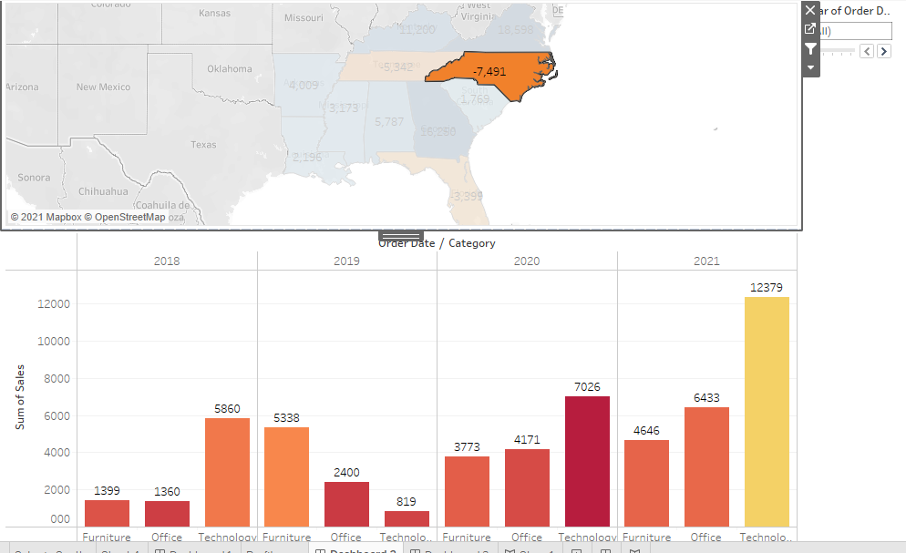
Make your dashboard interactive.

Slide 7
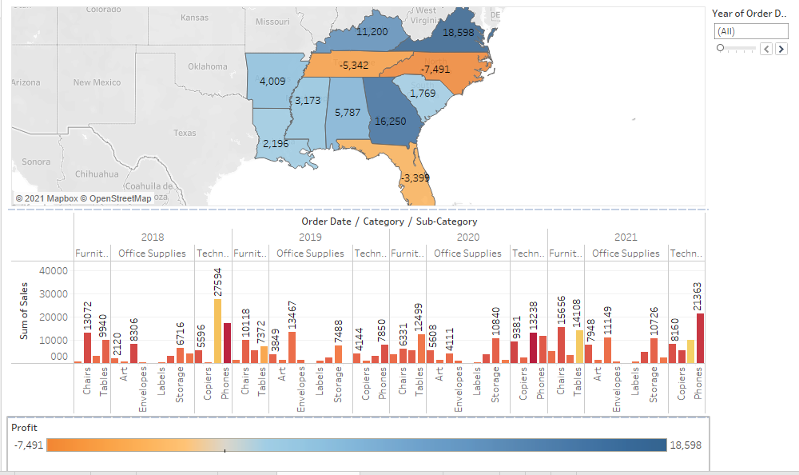
Make the order date filet applicable for sales in the south visual as well.

Slide 8
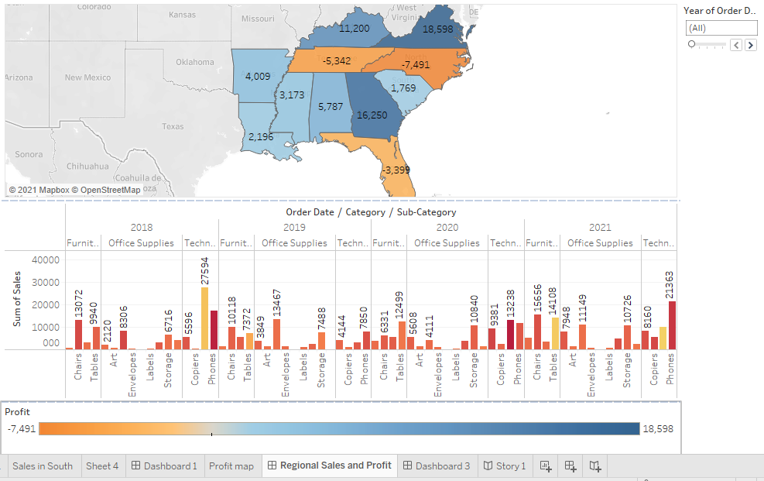
Rename your dashboard and save as Regional Sales and Profit.

