Slide 1



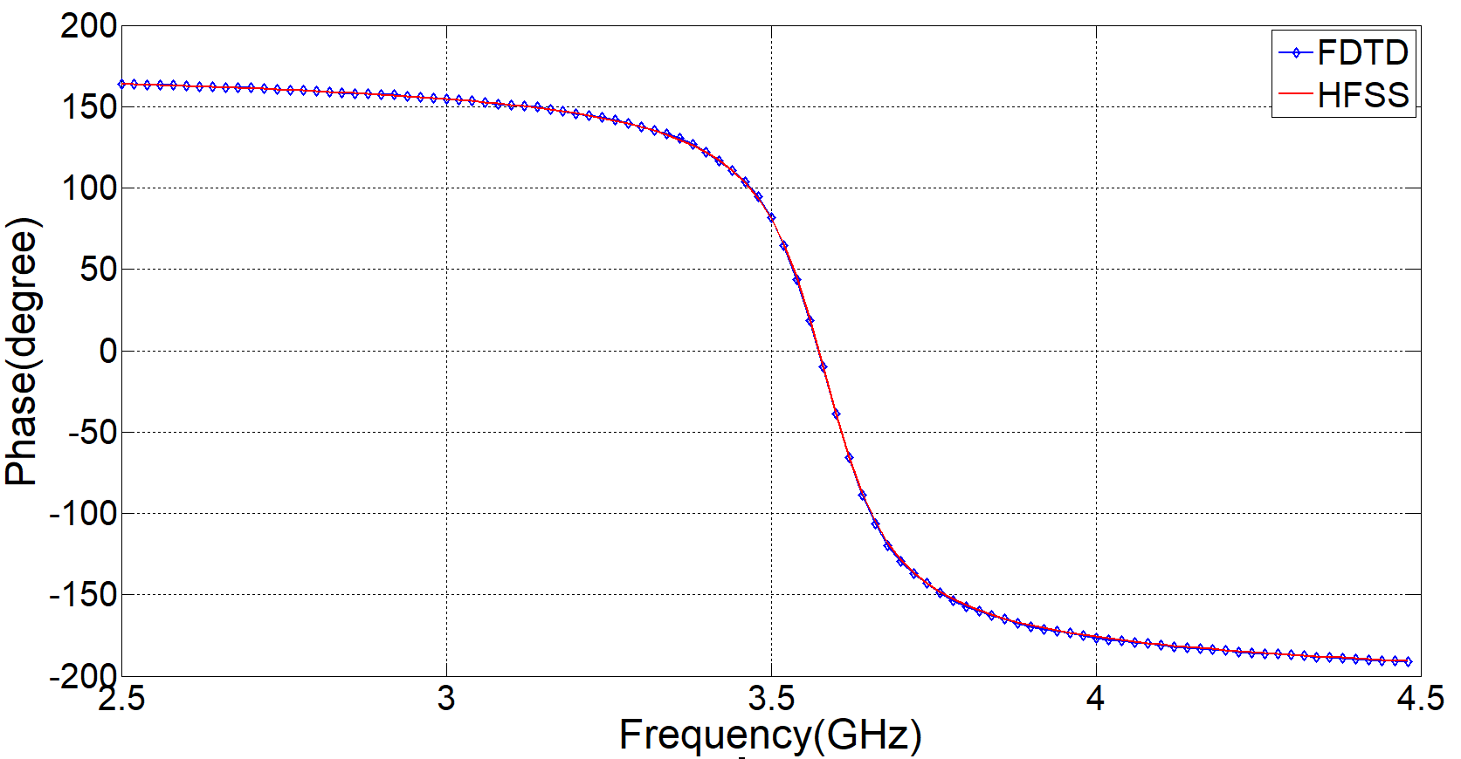
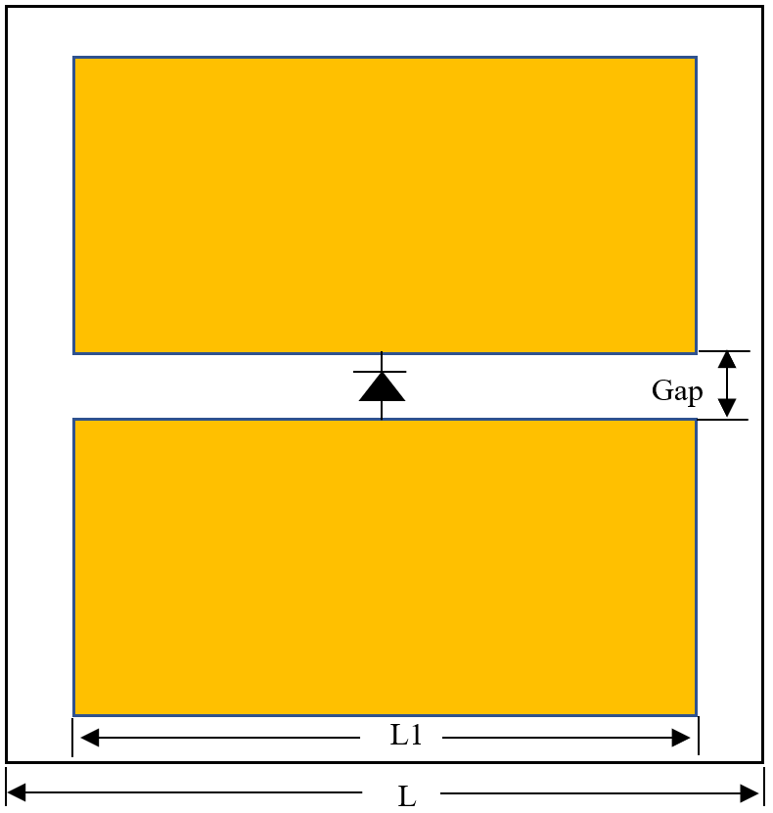
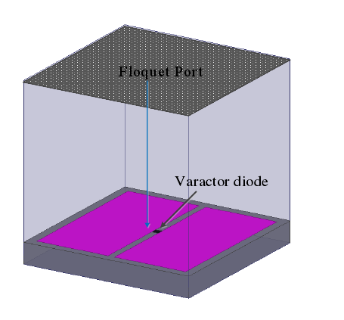
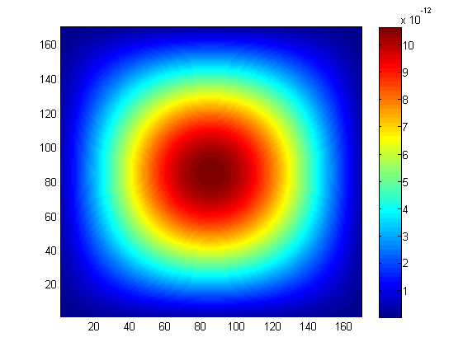
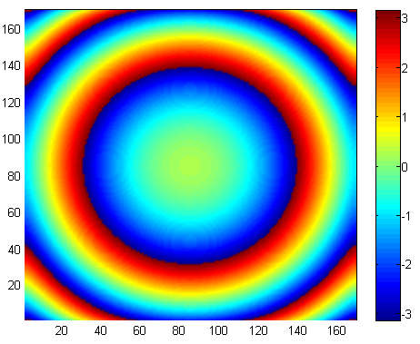
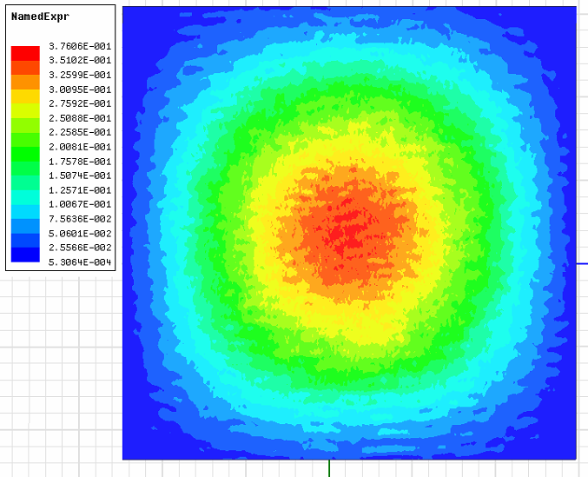
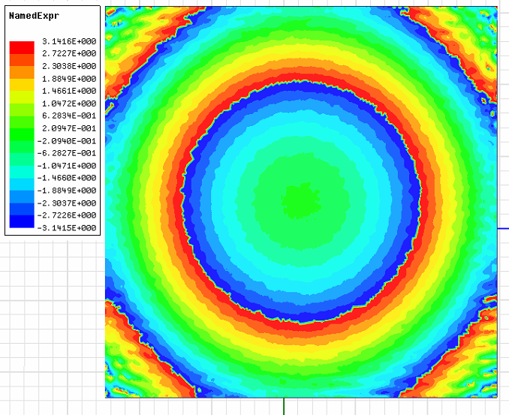
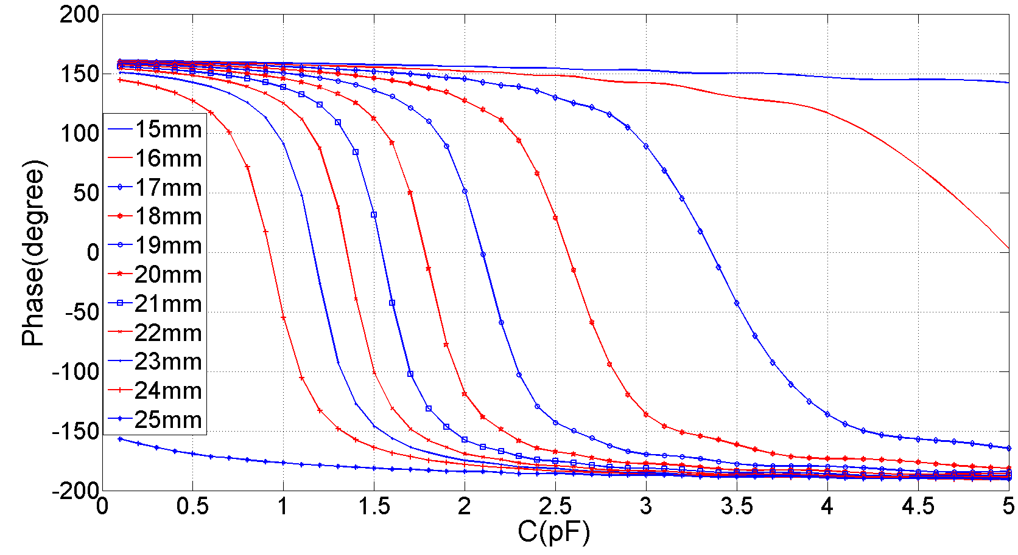
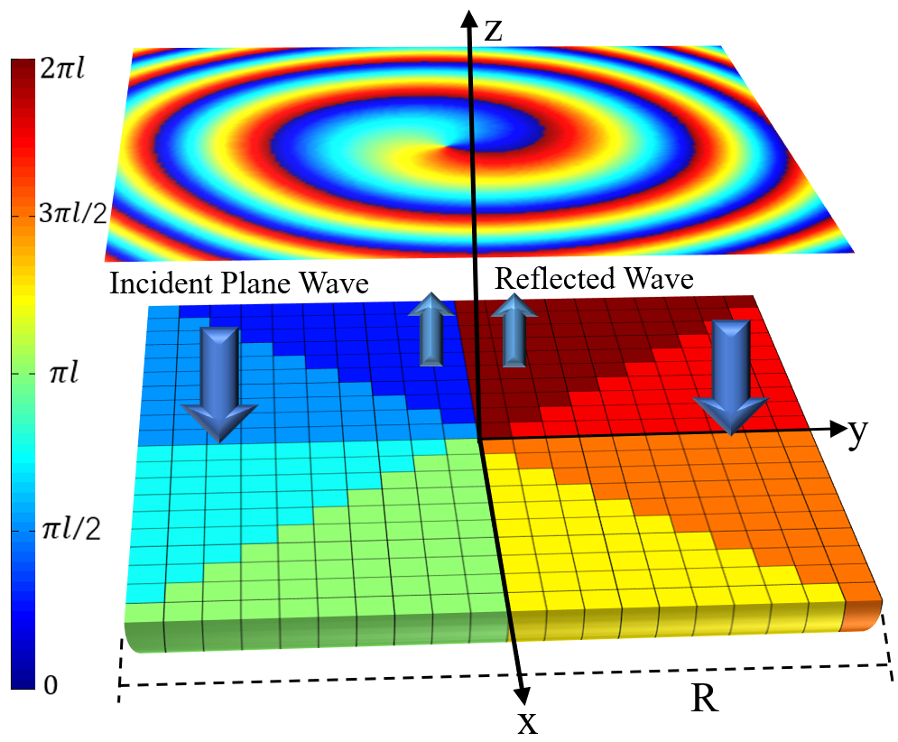
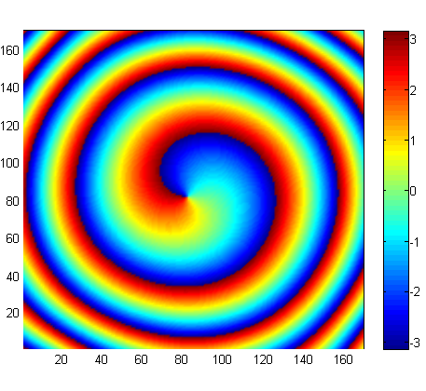
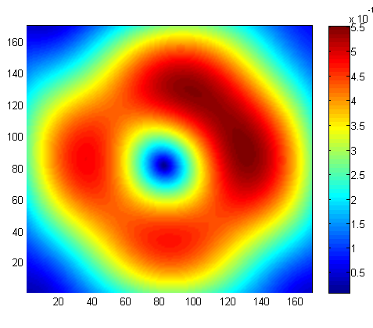
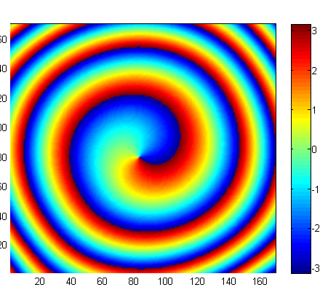
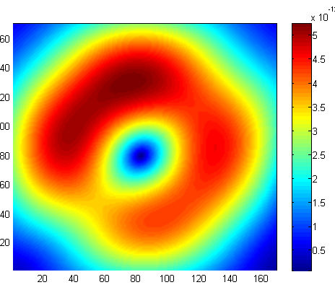
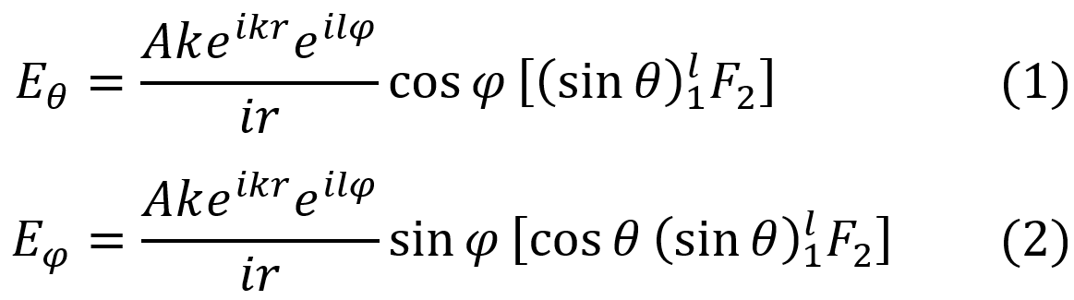
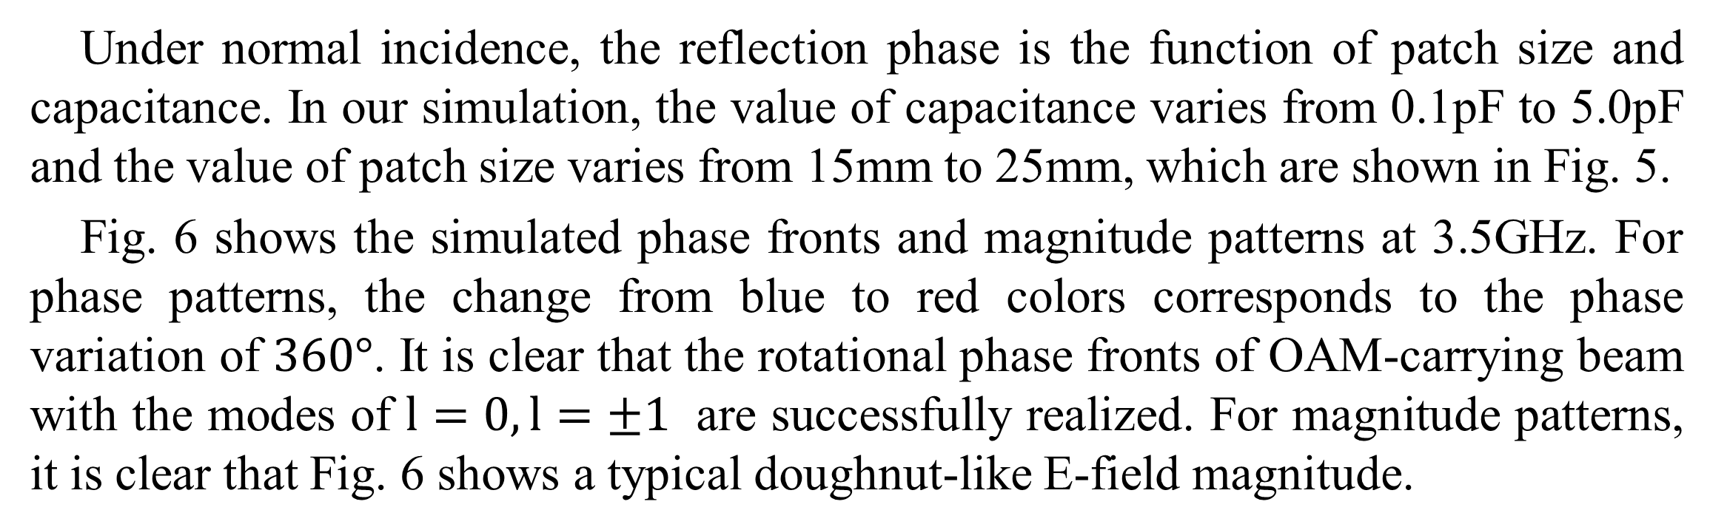
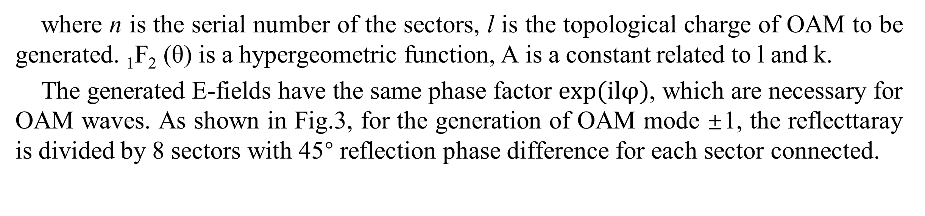
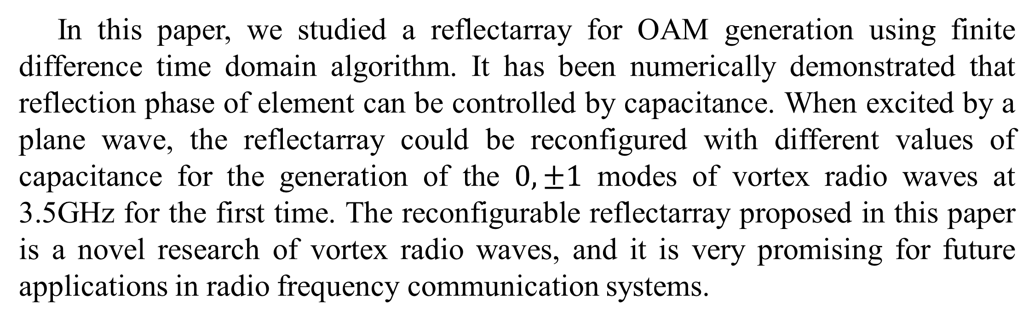
FDTD Modeling of Reconfigurable Reflectarray for Generation of Vortex Radio Waves
Chen-Chen Li¹, Hao Xie¹, and Lin-Sheng Wu²
²Key Laboratory of Ministry of Education of Design and Electromagnetic Compatibility of High-Speed Electronic Systems, Shanghai Jiao Tong University, Shanghai 200240, China.
Abstract- A reconfigurable reflectarray is proposed for the first time to generate vortex radio waves in radio frequency domain. In this paper, OAM generating reflectarray is simulated by our in-house-developed finite difference time domain algorithm, which is validated by comparing the simulated vortex radio waves with its counterpart obtained by commercial software. Simulations show that the 0, ±1 mode of vortex radio waves can be generated at 3.5GHz. The proposed method and reflectarray is a valuable way to generate vortex radio waves for microwave wireless communication systems.
Introduction
Recent studies show that besides the optical regime, orbital angular momentum(OAM) can also be applied in the radio frequency domain. Although OAM is a subset of MIMO, with an OAM based system, it is vital to find functional antennas for the generation of vortex waves. In 2014, a planar-spiral phase plate (planar-SPP) was experimentally demonstrated to generate arbitrary mixed OAM beams. In 2016, L. Long et al. demonstrated experimentally a reflective metasurface for the generation of different modes of vortex radio waves. In the same year, a reconfigurable graphene reflectarray antenna was proposed for generation of vortex THz waves, but in radio frequency domain, antennas for generation of vortex waves remains unreconfigurable.
Unit Structure
Fig. 3. Reflection phase as functions of frequency with patch size L=20mm and capacitance C=1.63μF.
In our simulation, we use equivalent surface currents and the vector potential approach to compute the unknown far fields from the known electric and magnetic currents. Using our FDTD algorithm, we can get E-field distribution at the plane perpendicular to the z ̂ axis and it is located at z=8.0m.
(a) (b)
Fig. 1. (a) Unit structure of reflecttaray (b) Unit model simulated in HFSS
Two metal patches and a gap between them, where in the middle a variable capacitance diode is placed, are selected as the unit cell of the reflectarray proposed in this paper. Each element consists of a substrate (ε_{r}=2.65) of the thick of 2mm with two metal patches printed on the top surface and the length of metal patches is 20mm(L1). Behind the substrate is metal ground that is for reflection. With the control of the voltage between two mental patches, capacitance of variable capacitance diode in each unit can be changed, so that the unit cell has a continuous reflection phase which has a rang more than 300°. As shown in Fig.1(b), we analyze the reflection phase characteristic of elements using an infinite periodic model with ANSYS HFSS, which is based on a finite-element algorithm.
(a) (b) (c) (d)
Fig. 4. Simulated electrical field distribution in the far-field zone of z=8.0m, whose OAM mode number is 0. (a) magnitude distribution using FDTD algorithm, (b) phase distribution using FDTD algorithm, (c) magnitude distribution simulated by HFSS, (d) phase distribution simulated by HFSS.
Numerical Results
Reflectarray Antenna
Fig. 5. Reflection phases as functions of patch size and capacitance
Fig. 2. Reflective surface model that consists of N sectors with varying phase from 0 to 2πl and is excited by plane wave.
(a) (b)
Fig. 6. Simulated phase fronts and magnitude patterns of the vortex radio waves with the modes: (a) l=1; (b) l=$−1$;
A sectored circular reflective surface model consisting of N sectors is used to generate vortex radio waves, which is shown in Fig. 2. It is excited by a normally incident plane wave and the far-field expression of reflective field can be expressed as:
Under normal incidence, the reflection phase is the function of patch size and capacitance. In our simulation, the value of capacitance varies from 0.1pF to 5.0pF and the value of patch size varies from 15mm to 25mm, which are shown in Fig. 5.
Fig. 6 shows the simulated phase fronts and magnitude patterns at 3.5GHz. For phase patterns, the change from blue to red colors corresponds to the phase variation of $360°$. It is clear that the rotational phase fronts of OAM-carrying beam with the modes of $l=0, l=±1$ are successfully realized. For magnitude patterns, it is clear that Fig. 6 shows a typical doughnut-like E-field magnitude.
where n is the serial number of the sectors, l is the topological charge of OAM to be generated. ₁F₂ (θ) is a hypergeometric function, A is a constant related to l and k.
The generated E-fields have the same phase factor $exp⁡(ilφ)$, which are necessary for OAM waves. As shown in Fig.3, for the generation of OAM mode ±1, the reflecttaray is divided by 8 sectors with 45° reflection phase difference for each sector connected.
Conclusion
In this paper, we studied a reflectarray for OAM generation using finite difference time domain algorithm. It has been numerically demonstrated that reflection phase of element can be controlled by capacitance. When excited by a plane wave, the reflectarray could be reconfigured with different values of capacitance for the generation of the $0, ±1$ modes of vortex radio waves at 3.5GHz for the first time. The reconfigurable reflectarray proposed in this paper is a novel research of vortex radio waves, and it is very promising for future applications in radio frequency communication systems.
Algorithm and Validation
A single unit of the reflecttaray is simulated with periodic boundary conditions (PBC) on four sides to model an infinite periodic structure. The reflection phase is calculated as:
2017 IEEE Electrical Design of Advanced Packaging & Systems Symposium (2017 IEEE EDAPS), December 14 to 16, 2017, Haining, China
Fig. 2. Normalized Hz-field distribution around the composite wedge excited by a line source, where conformal FDTD result is compared with that of MOM/PO method.

