Slide 1

Department of Cyber Security
2026 - 2027 - Odd Semester
III Year / V Sem
CS23533 - FOUNDATIONS OF ARTIFICIAL INTELLIGENCE
Zeroth Review - 25.09.2026

Slide 2
ShadowTrace: AI Based Intrusion Detection Game
Batch Members :
1. Name : Nandhini Velmurugan
2. Name : Grisha P
Supervisor:
Dr. S.Bhuvana
Assistant Professor[SG]
241901063
241901030

Slide 3
OUTLINE
Abstract
Objective
Literature Survey
Summary of Literature
Proposed System & Novelty
Block Diagram
Hardware/Software requirements
References

Slide 4
ABSTRACT
AI-based top-down stealth game developed using Python and Pygame.
Player acts as an intruder who must collect 3 evidence items and escape.
AI security guard patrols the environment and investigates suspicious activity.
Minimax + Alpha-Beta Pruning is used for AI decision-making.
A* is used for efficient navigation through the grid.
FSM controls Patrol, Investigate, Chase, and Return states.
Line-of-sight and noise detection provide limited information about the player.
Demonstrates pathfinding, perception, decision-making, and NPC behavior.

Slide 5
OBJECTIVE
Develop an intelligent AI security guard for a stealth-based game.
Implement A* for efficient NPC navigation.
Use FSM to control NPC behavior.
Apply Minimax with Alpha-Beta Pruning for decision-making.
Implement line-of-sight and noise detection.
Evaluate AI using path length, decision time, and nodes explored.

Slide 6
LITERATURE SURVEY
TITLE | YEAR | AUTHOR | TECHNIQUE
A Formal Basis for the Heuristic Determination of Minimum Cost Paths | 1968 | Peter E. Hart et al | A* Search
A Comparative Study of Pathfinding Algorithms | 2005 | Sturtevant | Pathfinding
Artificial Intelligence and Games | 2015 | Georgios N. Yannakakis & Julian Togelius | Game AI
Pathfinding in Games | 2010 | Various researchers | Navigation
Game AI: Simulating Intelligent Behaviour in Games | 2004 | Millington & Funge | Game AI / FSM
Artificial Intelligence for Games | 2016 | Ian Millington & John FungeNPC Behaviourz | NPC Behaviour

Slide 7
EXISTING SYSTEM
NPCs often use predefined paths or simple waypoints.
Basic systems continuously follow or chase the player.
NPC behavior is usually limited to patrol and chase.
Many systems lack realistic perception and investigation.
Decision-making is often simple and does not consider future actions.
Navigation may require frequent path recalculation.

Slide 8
PROPOSED SYSTEM
Core Components:
Grid Environment – Represents walkable and blocked cells.
A* Pathfinding – Finds efficient paths around obstacles.
FSM – Controls Patrol, Investigate, Chase, and Return.
Perception – Uses noise and line-of-sight detection.
Minimax – Selects suitable AI actions.
Alpha-Beta Pruning – Optimizes Minimax decision-making.

Slide 9
NOVELTY IN PROPOSED SYSTEM
The novelty of our project is not the use of A* alone, but the integration of multiple classical AI techniques into a single intelligent security NPC. The security guard combines A* pathfinding with a finite-state machine, line-of-sight detection, noise-based investigation, and Minimax decision-making with Alpha-Beta pruning. The NPC does not continuously know the player's position, instead its behavior changes according to the information it perceives from the environment. Minimax allows the NPC to evaluate possible actions such as investigating a noise or continuing its patrol, while A* determines the efficient path to the selected target. The system creates a strategic stealth experience where the NPC can perceive, decide, and navigate based on the player's actions.

Slide 10
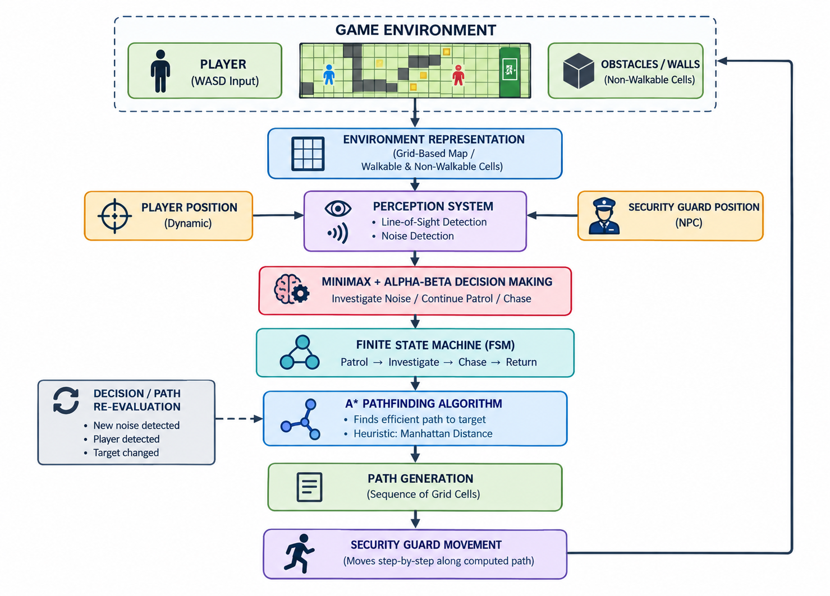
BLOCK DIAGRAM (PROPOSED SYSTEM)

Slide 11
Hardware / Software Requirements
Hardware Requirement:
Processor: Intel Core i3 / equivalent or above
RAM: 4 GB minimum
Storage: 500 MB available
Display: Standard monitor
Keyboard: For player movement
Software Requirement:
Operating System: Windows / Linux
Programming Language: Python
Game Framework: Pygame
Development Environment: VS Code
AI Technique: A* Search Algorithm, Minimax, Alpha-Beta, FSM
Algorithm Support: Priority Queue / Heap-based implementation

Slide 12
References
Jagdale, D. (2021). Finite State Machine in Game Development.
Link: https://doi.org/10.48175/IJARSCT-2062
Rafiq, A., Abdul Kadir, T. A., & Ihsan, S. N. (2020). Pathfinding Algorithms in Game Development.
Link: https://doi.org/10.1088/1757-899X/769/1/012021
Hart, P. E., Nilsson, N. J., & Raphael, B. (1968). A Formal Basis for the Heuristic Determination of Minimum Cost Paths.
Link: https://doi.org/10.1109/TSSC.1968.300136
Millington, I., & Funge, J. (2016). Artificial Intelligence for Games.
Link: Routledge – Artificial Intelligence for Games
Yannakakis, G. N., & Togelius, J. (2018). Artificial Intelligence and Games.
Link: Springer – Artificial Intelligence and Games
Russell, S., & Norvig, P. Artificial Intelligence: A Modern Approach.
Link: AIMA – Official Website

