Slide 1

Department of Computer Science and Engineering
(Cyber Security)
CS23533– Foundations of Artificial Intelligence
2026-2027
ShadowTrace: AI-Based Intrusion Detection Game
Dr. S. Bhuvana
Assistant Professor (SG)
Grisha P - 2116241901030
Nandhini V - 2116241901063

Slide 2
Problem Statement and Motivation
Problem: Basic game NPCs follow fixed routes or chase with perfect knowledge of the player's position, making stealth gameplay predictable.
Need: A guard that reacts only to what it perceives — noise and line of sight — and then decides, plans a route and acts.
Goal: A top-down stealth game in which the player collects three evidence items and escapes without being caught.
Motivation: Demonstrate classical AI — A*, FSM, perception, Minimax and Alpha–Beta pruning — working together in one small, measurable system.

Slide 3
Objectives
1. Develop a compact grid-based stealth game with walls, three evidence items and an exit.
2. Implement player movement, collision handling and evidence collection.
3. Model the guard as an FSM with Patrol, Investigate, Chase and Return states.
4. Implement noise events and line-of-sight detection so the guard has limited information.
5. Apply A* pathfinding for obstacle-aware navigation.
6. Apply Minimax with Alpha–Beta pruning to select the guard's actions.
7. Evaluate path length, nodes explored, decision time and response time.

Slide 4
Abstract
ShadowTrace is a top-down stealth game built with Python and Pygame. The player, an intruder, must collect three evidence items and escape through the exit.
A security-guard NPC never knows the player's exact position; it perceives the world only through noise events and line-of-sight checks.
A finite state machine controls four behaviours: Patrol, Investigate, Chase and Return.
Minimax with Alpha–Beta pruning selects the guard's action, and A* finds the route around obstacles.
The AI is evaluated on path length, nodes explored, decision time and response time.

Slide 5
Literature Survey
S. No. | Author(s) & Year | Paper Title | Methodology / Algorithm | Limitations
1 | Hart, Nilsson & Raphael (1968) | A Formal Basis for the Heuristic Determination of Minimum Cost Paths | A* heuristic search | Efficiency depends on the heuristic and search-space size; covers pathfinding, not NPC behaviour.
2 | Rafiq, Abdul Kadir & Ihsan (2020) | Pathfinding Algorithms in Game Development | Review of pathfinding algorithms used in games | Concerned with navigation; perception and decision-making are outside its scope.
3 | Jagdale (2021) | Finite State Machine in Game Development | Finite state machines for NPC behaviour | FSMs alone give fixed, rule-based behaviour and do not evaluate future actions.

Slide 6
Literature Survey
S. No. | Author(s) & Year | Paper Title | Methodology / Algorithm | Limitations
4 | Millington & Funge (2016) | Artificial Intelligence for Games (3rd ed.) | Game AI techniques: pathfinding, state machines, decision-making | Broad techniques that must be adapted and tuned to a specific game.
5 | Orkin (2006) | Three States and a Plan: The AI of F.E.A.R. | Goal-oriented planning with a small set of states | Designed for a larger action game; heavier than a small prototype needs.
6 | Russell & Norvig (2021) | Artificial Intelligence: A Modern Approach (4th ed.) | Adversarial search: Minimax and Alpha–Beta pruning | Search cost grows quickly with branching factor and depth.

Slide 7
Research Gap/Existing System
1. What existing studies do
Games typically pair fixed patrol routes or direct chasing with FSMs and A* navigation (Hart et al., 1968; Millington & Funge, 2016; Yannakakis & Togelius, 2018).
2. Limitations observed
The guard often knows the player's position, reacts with simple patrol/chase rules and does not weigh future actions; FSMs alone are rule-based.
3. Research gap
The reviewed studies treat navigation, state machines and adversarial search separately. Combining noise-based investigation, visual detection, FSM behaviour, A* and Minimax with Alpha–Beta pruning in one limited-information guard remains to be shown.
4. How our project responds
ShadowTrace integrates perception, Minimax + Alpha–Beta decisions, FSM behaviour and A* navigation in one security guard, and measures path length, nodes explored, decision time and response time.

Slide 8
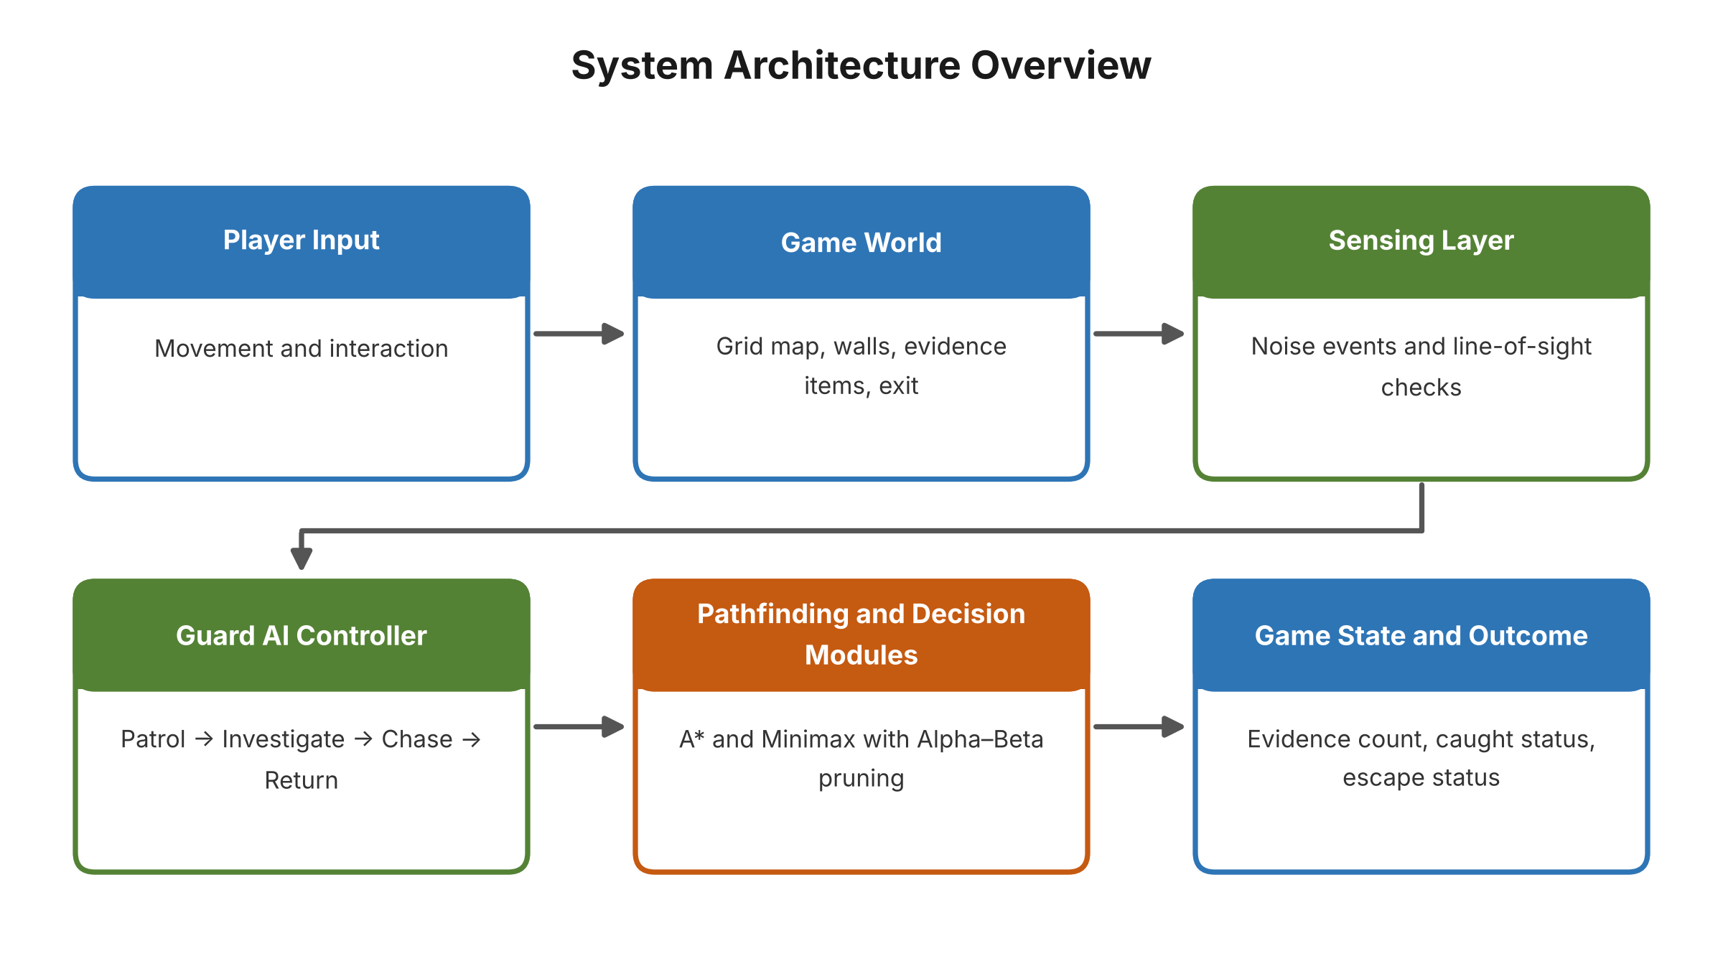
Proposed System
Grid environment: walls, three evidence items and an exit.
Perception: noise events and line-of-sight checks give limited information.
Minimax + Alpha–Beta: chooses Investigate Noise or Continue Patrol.
FSM: Patrol → Investigate → Chase → Return.
A*: shortest route around obstacles to the chosen target.

Slide 9
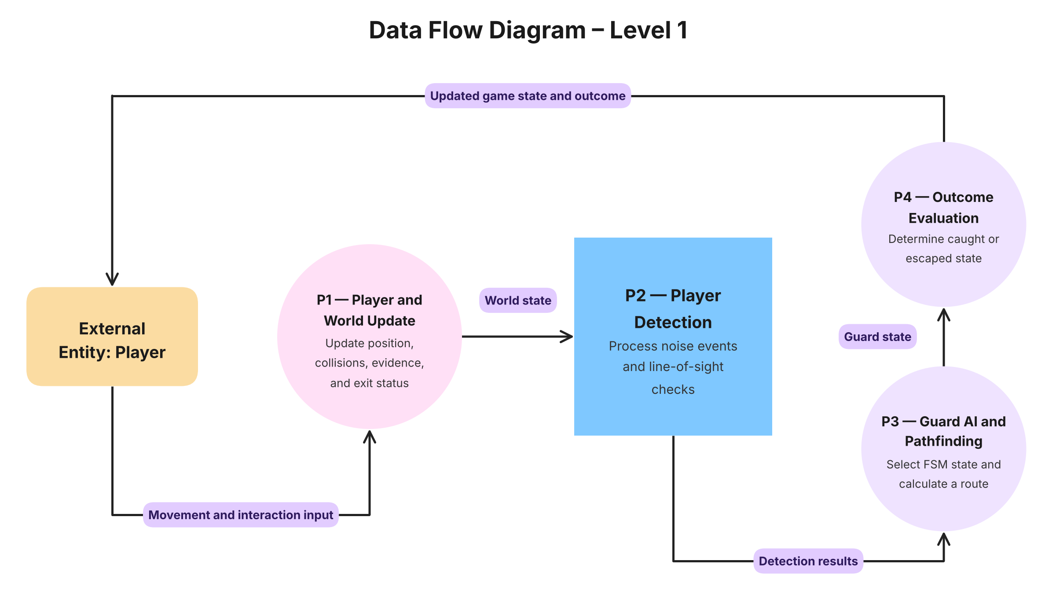
DFD Diagram

Slide 10
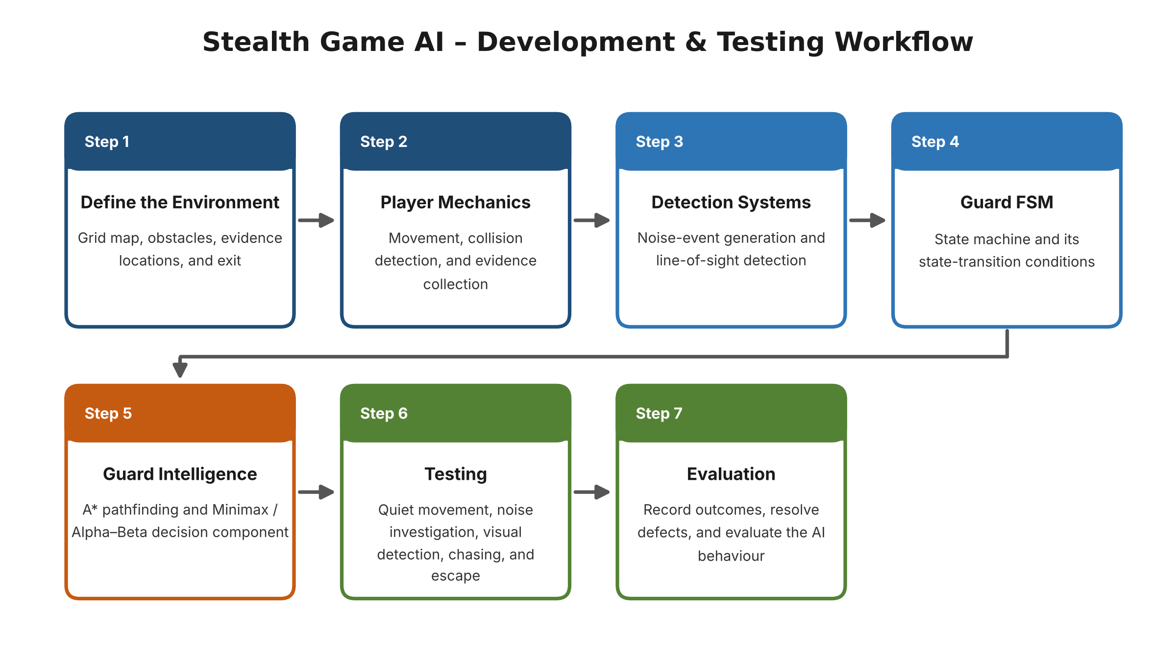
Methodology/Work Flow Diagram

Slide 11
Tools and Technologies
Programming language: Python 3.x
Framework / library: Pygame — 2D graphics, keyboard input, game loop, collision handling
Algorithms: A* (Manhattan heuristic), FSM, Minimax, Alpha–Beta pruning
Perception: line-of-sight and noise detection
Software: VS Code; Windows / Linux
Hardware: Intel Core i3 or above, 4 GB RAM, 500 MB storage, standard display and keyboard
Dataset: none required — 30×24 facility maps are generated in the game; test scenarios are designed manually

Slide 12
List of Modules
1. Grid Map and Collision System
2. Player Movement and Interaction
3. Evidence Collection and Escape Condition
4. Noise and Line-of-Sight Perception
5. Guard FSM (Patrol, Investigate, Chase, Return)
6. A* Pathfinding
7. Minimax with Alpha–Beta Pruning
8. Testing and Performance Evaluation

Slide 13
Module Description (Modules 1–4)
Module 1 – Grid Map and Collision System
Represents the 30×24 facility as walkable cells, walls, evidence locations and an exit; blocks moves into walls and outside the map.
Module 2 – Player Movement and Interaction
Reads WASD input and moves the player one cell at a time with collision checks; interaction picks up evidence.
Module 3 – Evidence Collection and Escape
Tracks the three evidence items (each collectable once) and ends the game with an escape when the player reaches the exit.
Module 4 – Noise and Line-of-Sight Perception
Creates noise events at evidence locations and checks the guard's limited-range vision, so the guard never receives the player's exact position.

Slide 14
Module Description (Modules 5–8)
Module 5 – Guard FSM
Switches between Patrol, Investigate, Chase and Return from perception events; validates state and path after important events.
Module 6 – A* Pathfinding
Grid search using movement cost and a Manhattan-distance heuristic; recalculates when a target becomes unreachable or a path is invalid.
Module 7 – Minimax with Alpha–Beta Pruning
Shallow search over guard choices (Investigate Noise, Continue Patrol) with a simple evaluation function; pruning removes unneeded branches.
Module 8 – Testing and Performance Evaluation
Runs repeatable scenarios and records path length, nodes explored, decision time and response time, with and without Alpha–Beta pruning.

Slide 15
Results & Discussion
Test scenarios
Quiet movement outside the guard's vision → guard stays on Patrol
Noise at an evidence location → guard switches to Investigate
Player enters line of sight → guard switches to Chase
Player leaves vision → guard moves to Return, then Patrol
All evidence collected and exit reached → Mission Accomplished; caught → Mission Compromised
Observations
State transitions and A* routes around obstacles behaved consistently across repeated runs
Alpha–Beta pruning gives the same decision as Minimax while searching fewer nodes
Metrics recorded: path length, nodes explored, decision time, response time

Slide 16
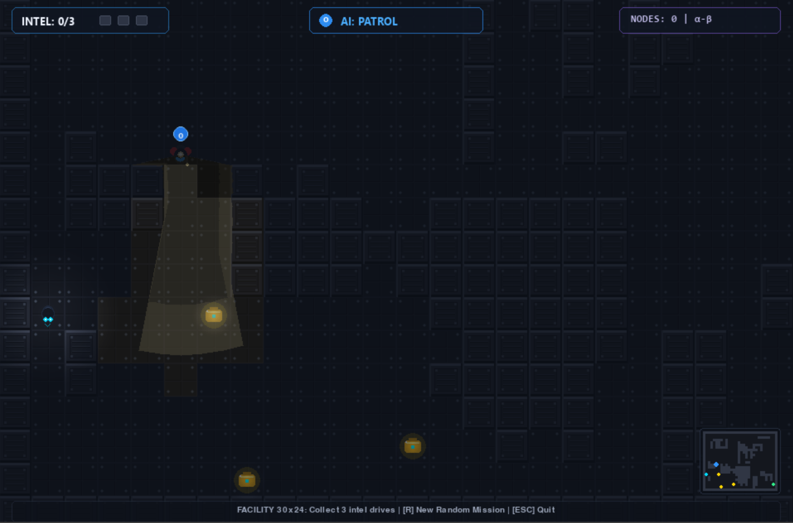
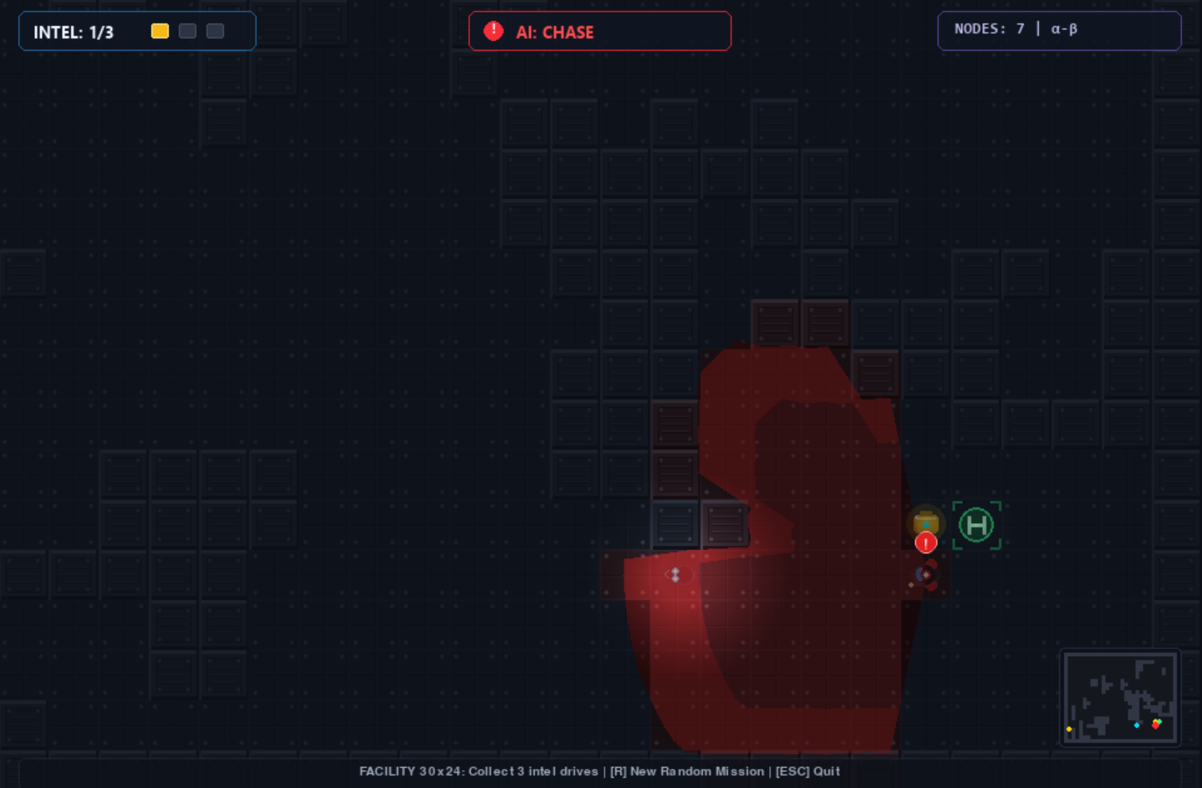
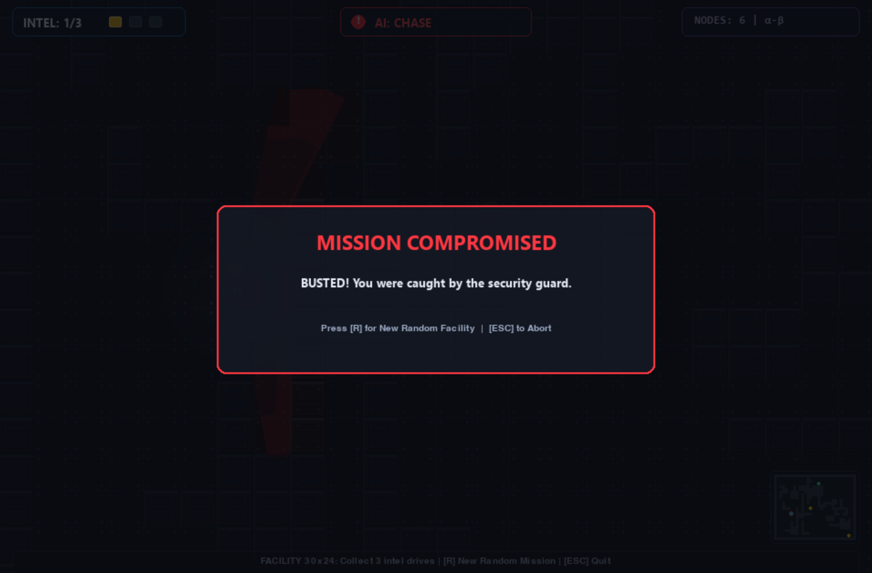
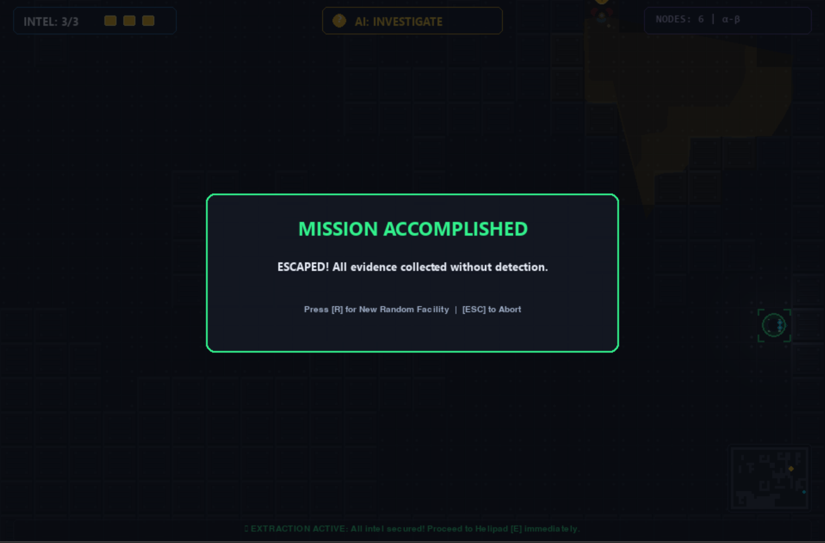
User Interface / Screenshots
What the screens show
HUD: INTEL count (x/3), current AI state and the NODES α-β counter
Patrol: guard sweeps its vision cone
Chase: guard has detected the player
Mission Compromised: player caught by the guard
Mission Accomplished: all evidence collected, player escaped

Slide 17
Conclusion
ShadowTrace delivers a top-down stealth game with an intelligent security guard built from classical AI techniques.
Noise and line-of-sight perception give the guard limited, realistic information about the player.
Minimax with Alpha–Beta pruning decides what to do, the FSM manages behaviour, and A* finds how to get there.
The modular design made each component testable and the guard's behaviour measurable.

Slide 18
Future Work
Add multiple guards that share information and search cooperatively.
Extend to larger, more varied maps and difficulty levels.
Deepen the Minimax search and refine the evaluation function, measuring the effect on decision time.
Model noise by player action (walking vs. running) and distance.
Compare with other approaches such as behaviour trees or Monte Carlo tree search.
Run systematic gameplay testing with more players.

Slide 19
References
[1] Hart, P. E., Nilsson, N. J., & Raphael, B. (1968). A Formal Basis for the Heuristic Determination of Minimum Cost Paths. IEEE Trans. Systems Science and Cybernetics, 4(2), 100–107. https://doi.org/10.1109/TSSC.1968.300136
[2] Rafiq, A., Abdul Kadir, T. A., & Ihsan, S. N. (2020). Pathfinding Algorithms in Game Development. IOP Conf. Ser.: Mater. Sci. Eng., 769, 012021. https://doi.org/10.1088/1757-899X/769/1/012021
[3] Jagdale, D. (2021). Finite State Machine in Game Development. IJARSCT. https://doi.org/10.48175/IJARSCT-2062
[4] Millington, I., & Funge, J. (2016). Artificial Intelligence for Games (3rd ed.).
[5] Orkin, J. (2006). Three States and a Plan: The AI of F.E.A.R. Game Developers Conference.
[6] Russell, S., & Norvig, P. (2021). Artificial Intelligence: A Modern Approach (4th ed.). Pearson.
[7] Yannakakis, G. N., & Togelius, J. (2018). Artificial Intelligence and Games. Springer. https://doi.org/10.1007/978-3-319-63519-4

Slide 20
Thank You

