Slide 1

Department of Computer Science and Engineering
(Cyber Security)
CS23533– Foundations of Artificial Intelligence
2026-2027
ShadowTrace: AI Based Intrution Detection Game — REVIEW 2
Dr. S. Bhuvana
Assistant Professor(SG)
Grisha P - 2116241901030
Nandhini V - 2116241901063

Slide 2
Problem Statement and Motivation
- Problem: Develop a top-down stealth game in which the player must collect three evidence items and escape without being caught by a security guard.
- Existing challenge: A guard following a fixed, predictable route makes stealth gameplay easy to exploit.
- Proposed solution: Use AI techniques to create a guard that reacts to player noise, detects the player through line of sight, and navigates around obstacles.
- Motivation: Demonstrate practical applications of Artificial Intelligence through an interactive game.

Slide 3
Problem Statement and Motivation
- Significance: The project combines game development, intelligent decision-making, pathfinding, and adversarial search in a small, understandable environment.

Slide 4
Objectives
1. Develop a compact, grid-based stealth game environment.
2. Allow the player to collect three evidence items and reach the exit.
3. Implement a Finite State Machine (FSM) for the guard with four states: Patrol, Investigate, Chase, and Return.
4. Use noise events and line-of-sight checks to detect player activity.
5. Apply A* pathfinding to navigate around obstacles.
6. Incorporate Minimax with Alpha–Beta pruning into the decision-planning component.

Slide 5
Objectives
7. Evaluate the guard's behaviour using repeatable gameplay test scenarios.
**Expected outcome:** An interactive prototype demonstrating AI-driven guard behaviour and a clear player objective.

Slide 6
Project Progress Since Review 1
- Refined the project scope to one map, one security guard, three evidence items, and one exit.
- Defined the gameplay sequence: Explore → Collect Evidence → Avoid Guard → Escape.
- Identified the guard's four behaviour states and their intended transitions.
- Planned the integration of noise detection, line-of-sight detection, FSM, and A* pathfinding.
- Identified Minimax with Alpha–Beta pruning as the decision-planning component.
- Defined the modules required for implementation and testing.

Slide 7
Project Progress Since Review 1
**Current status:** The project design and implementation plan are outlined. Update this slide with the actual coding progress achieved since Review 1 before presenting.

Slide 8
Literature Survey
S. No. | Author(s) & Year | Paper Title | Methodology / Algorithm | Limitations
1 | Hart, Nilsson & Raphael (1968) | A Formal Basis for the Heuristic Determination of Minimum Cost Paths | A* heuristic search | Efficiency depends on heuristic quality and search-space size.
2 | Millington & Funge (2016) | Artificial Intelligence for Games, 3rd ed. | Game AI techniques, including pathfinding and state machines | General techniques must be adapted to the requirements of a specific game.
3 | Orkin (2006) | Three States and a Plan: The AI of F.E.A.R. | Goal-oriented planning and layered game AI | The approach addresses a more complex action game than this small prototype.

Slide 9
Literature Survey
S. No. | Author(s) & Year | Paper Title | Methodology / Algorithm | Limitations
4 | Russell & Norvig (2021) | Artificial Intelligence: A Modern Approach, 4th ed. | Adversarial search, Minimax, and Alpha–Beta pruning | Search cost can grow rapidly with branching factor and search depth.
5 | Rabin, ed. (2002) | AI Game Programming Wisdom | Practical game AI techniques and implementation patterns | Techniques may require modification and tuning for the target game.

Slide 10
Research Gap and Project Response
1. Literature Findings
Game AI literature describes pathfinding, state machines, and decision-search algorithms as useful components for developing responsive game agents.
2. Limitations
A small stealth game must balance believable guard behaviour with simple, understandable, and testable rules.
4. Project Response
ShadowTrace proposes a modular design combining FSM, noise and line-of-sight sensing, A* pathfinding, and a Minimax/Alpha–Beta decision component. Implementation and evaluation will determine how effectively these components work together.
3. Refined Research Gap
Integrating noise-based investigation, visual detection, state-based guard behaviour, and obstacle-aware navigation into one compact stealth-game scenario.

Slide 11
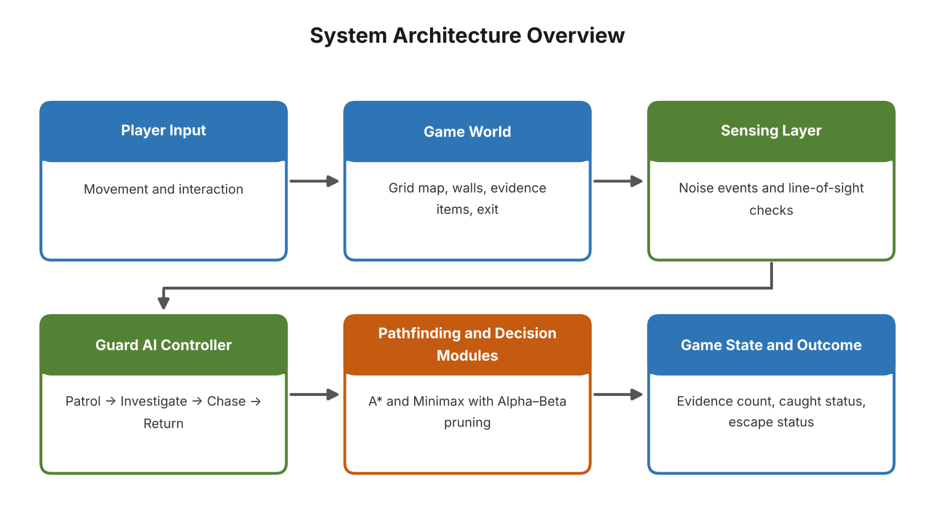
System Architecture / Proposed System

Slide 12
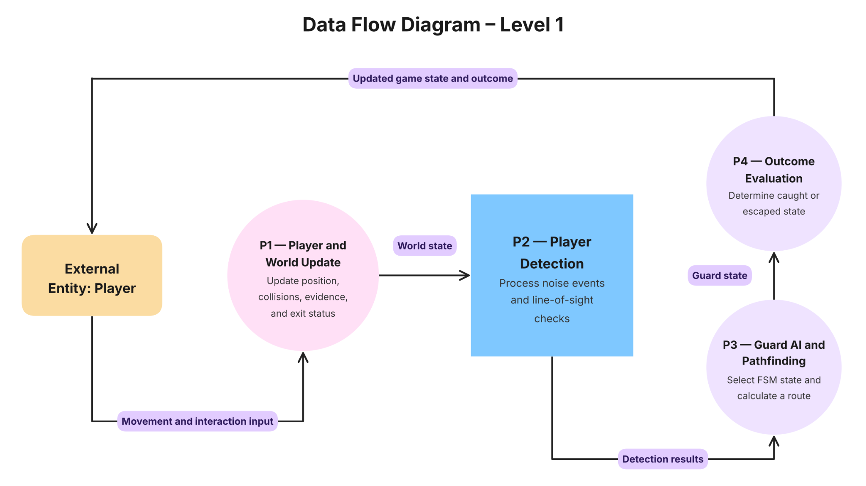
DFD Diagram

Slide 13
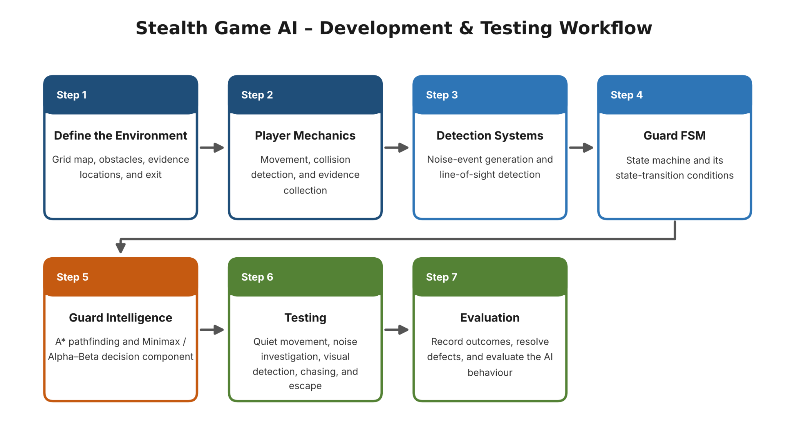
Methodology / Workflow Diagram

Slide 14
Tools and Technologies
Programming Language: Python (planned implementation)
Framework / Library: Pygame for 2D graphics, keyboard input, game loops, and collision handling.
Algorithms:
- Finite State Machine (FSM)
- A* pathfinding
- Minimax search
- Alpha–Beta pruning

Slide 15
Tools and Technologies
Software / Hardware / Dataset: Desktop development environment, a custom grid map, and manually designed gameplay test scenarios.
Justification: Python and Pygame are suitable for a small 2D game prototype. The selected algorithms demonstrate state-based behaviour, obstacle-aware navigation, and adversarial decision-making.
Update the language, framework, and tool details if your actual implementation uses a different stack.

Slide 16
List of Modules
1. Grid Map and Collision System — In Progress
2. Player Movement and Interaction — In Progress
3. Evidence Collection and Escape Condition — In Progress
4. Noise and Line-of-Sight Detection — Planned
5. Guard FSM — Planned
6. A* Pathfinding — Planned
7. Minimax with Alpha–Beta Pruning — Planned
8. Testing and Result Logging — Pending
*Update each status to reflect the actual implementation. Do not label a module as completed until it has been implemented and verified.*

Slide 17
Module Implementation – Part 1
Module 1: World and Player
Purpose: Maintain the game map and allow the player to navigate the environment.
Inputs: Directional key presses and interaction commands.
Outputs: Updated player position and game-world state.

Slide 18
Module Implementation – Part 1
Implementation Approach:
- Represent the environment as a grid containing walkable cells and obstacles.
- Validate player movement against walls and map boundaries.
- Update evidence status when the player collects an item.
- Track the number of collected items.
- Allow escape when the required objective is satisfied.
Current Status: Design and module responsibilities are defined. Add a screenshot and testing evidence after implementation.

Slide 19
Module Implementation – Part 2
Module 2: Guard AI
Inputs: Player position, noise events, line-of-sight result, and map obstacles.
Finite State Machine:
- Patrol: Follow a predefined route.
- Investigate: Move towards the last known noise location.
- Chase: Pursue the player when visual detection succeeds.
- Return: Resume patrol after the player is no longer detected.

Slide 20
Module Implementation – Part 2
Pathfinding: A* calculates a route around obstacles.
Decision Component: Minimax with Alpha–Beta pruning is proposed for decision planning. The game states, available actions, utility values, and role of the adversarial search must be explicitly defined during implementation.
Current Status: Behaviour and module design are specified. Include code evidence and test observations once available.

Slide 21
Preliminary Results and Discussion
Current Evaluation Status:** No measured gameplay results are available to report yet.
Planned Test Cases:
1. Player moves quietly outside the guard's field of view.
2. A noise event causes the guard to enter Investigate.
3. The player enters line of sight and triggers Chase.
4. The guard loses visual contact and returns to patrol.
5. The player collects all three evidence items and reaches the exit.
6. The player is caught before completing the objective.

Slide 22
Preliminary Results and Discussion
Metrics to Record:
- Correct FSM transitions
- Validity of calculated routes
- Detection response
- Escape and caught outcomes
- Decision-making runtime
Baseline Comparison: Compare the AI-controlled guard with a fixed-route guard that does not use sensing or A* pathfinding.

Slide 23
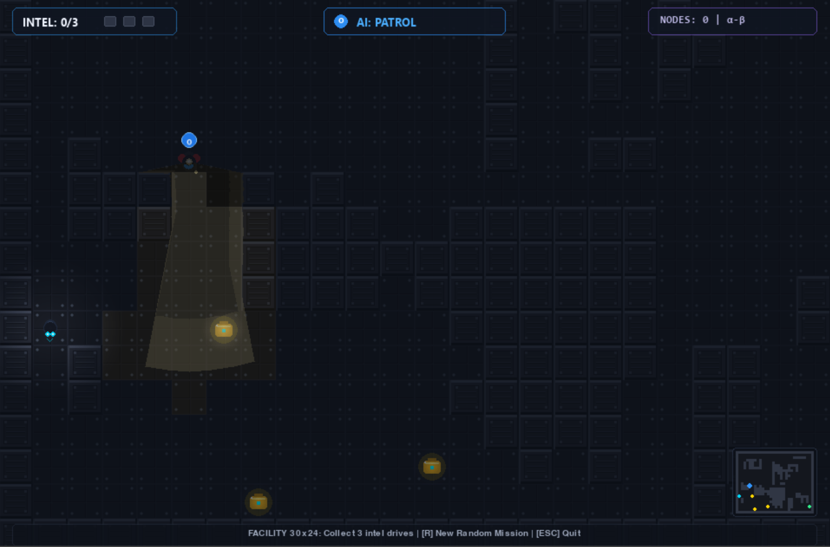
User Interface / Implementation Screenshots

Slide 24
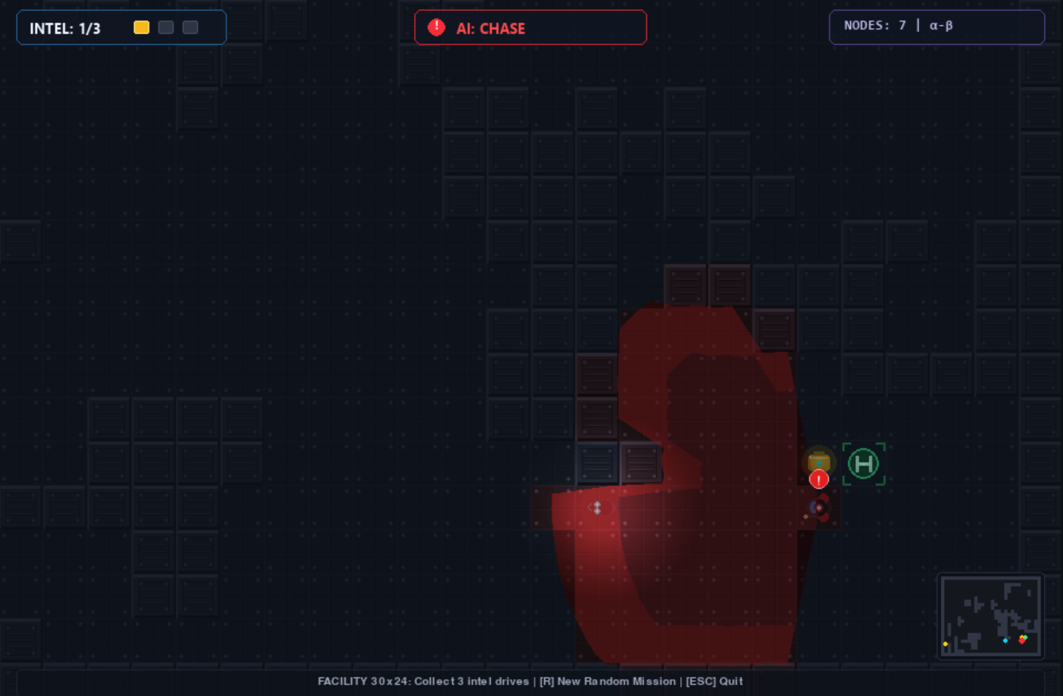
User Interface / Implementation Screenshots

Slide 25
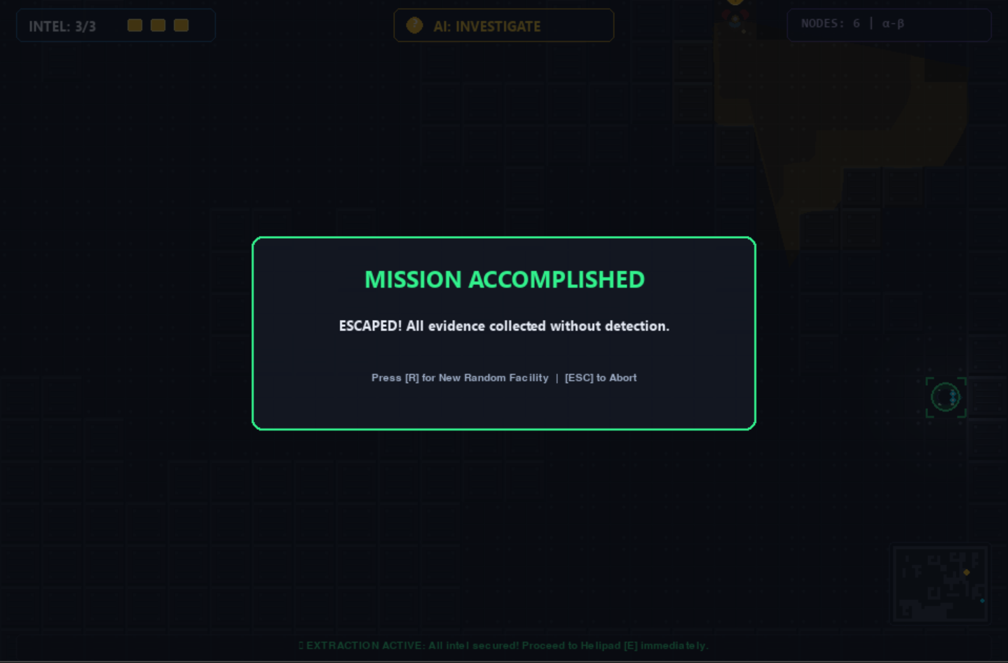
User Interface / Implementation Screenshots

Slide 26
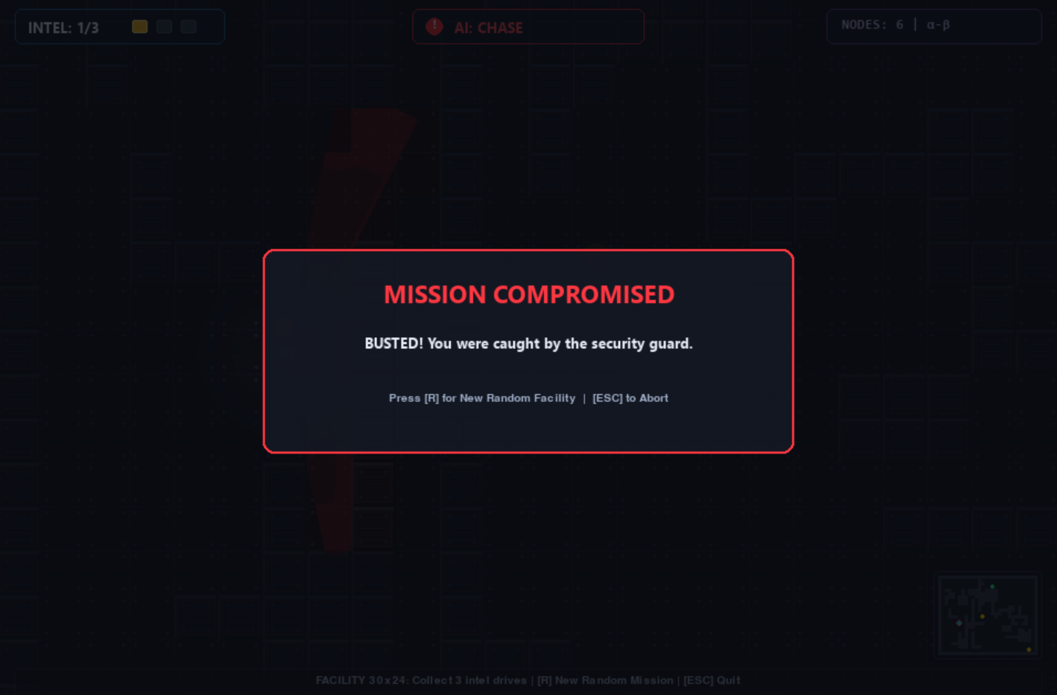
User Interface / Implementation Screenshots

Slide 27
Challenges Faced and Solutions
Guard behaviour: FSM-based state management.
Navigation: A* pathfinding.
Detection: combine noise and line of sight.
Algorithm integration: modular development and testing.

Slide 28
Work Plan Until Final Review
Complete core game implementation.
Integrate and test AI algorithms.
Refine guard behaviour.
Conduct gameplay testing.
Document results and prepare final presentation.

Slide 29
References
Hart, Nilsson and Raphael (1968) — A* Search.
Millington and Funge (2016) — Artificial Intelligence for Games.
Orkin (2006) — Three States and a Plan: The AI of F.E.A.R.
Russell and Norvig (2021) — Artificial Intelligence: A Modern Approach.
Rabin (2002) — AI Game Programming Wisdom.

Slide 30
Thank You

