Slide 1
Yageo-NCKU Research Proposal
Peter (提彼安)
P88097034

Slide 2
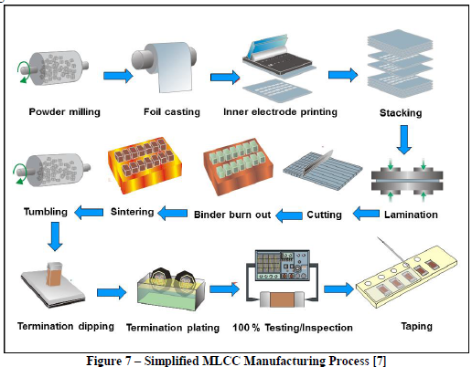

Slide 3
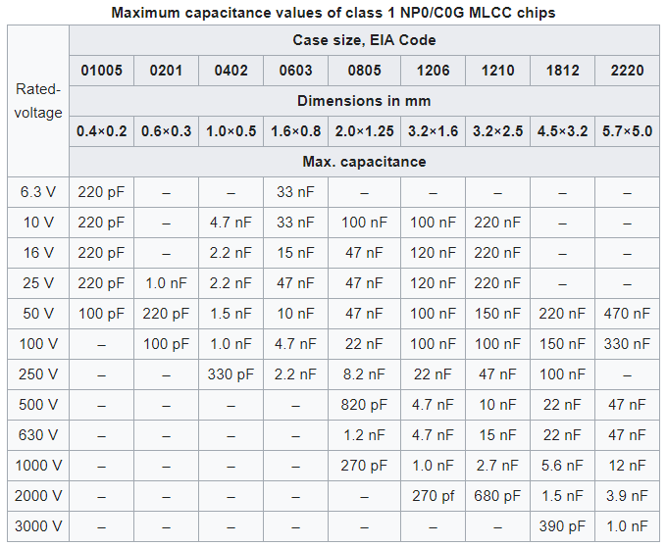
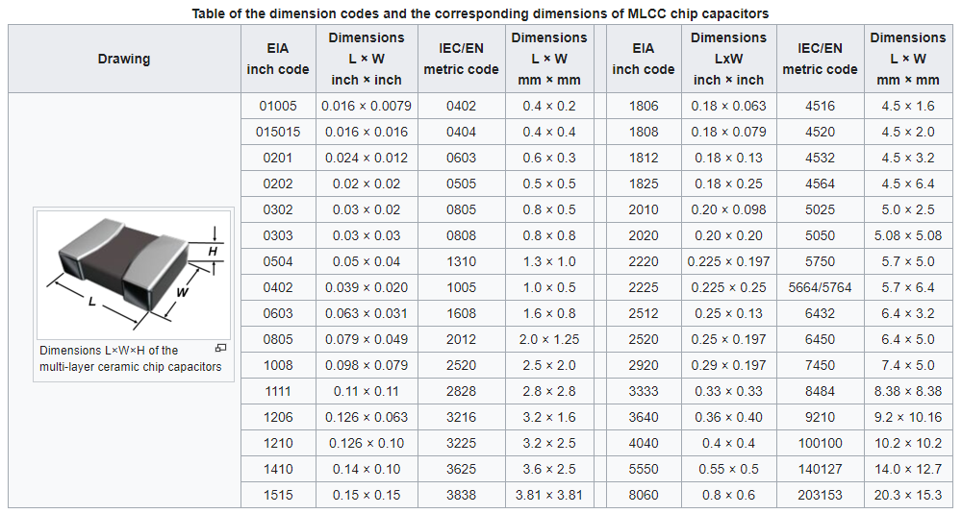
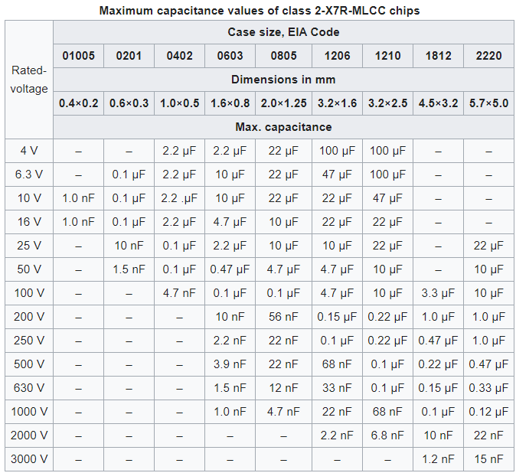
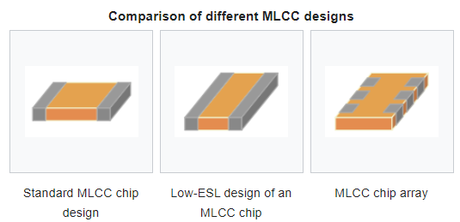
Introduction

Slide 4
Main concerns
In the burn out process, the carbon emission wants to be reduced
But with the superheated steam process that successfully produce less carbon emission
Raised question:
Will it affect the important properties of the MLCC material?
How can the superheated steam affect the carbon emission?
How can such burn out technique instead increase the desired properties of MLCC?

Slide 5
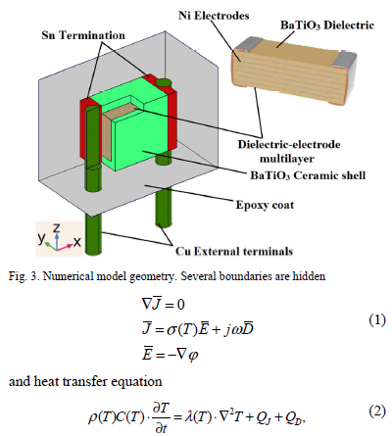
Papers Review
Belko et al 2019
Describe electro-thermal processes
Brown titled Multilayer Ceramic Capacitor
Describe the oxygen vacancies happened after the sintering process
Cai et al 2019
Showed the pores generated after the sintering process
Chae et al 2007
Advantage of using 3D model in FEM
Groh et al 2016
Alternative materials to replace BaTiO3
Scott et al 1990
Emphasized the thermal stress induced by wave soldering process
Song et al 2017
Synthesized modified BaTiO3
Emphasized phase field simulation
Thermal models of multilayer (by KEMET)
Explains about the workflow in creating thermal models of MLCC
Zeb et al 2015
Review the effect of changes in material composition
Provide information about the graph relating the relative permittivity with working temperature

Slide 6
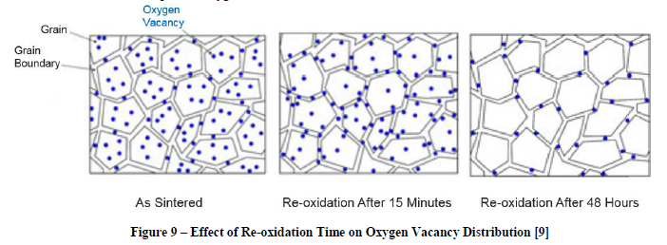
Papers Review
Belko et al 2019
Describe electro-thermal processes
Brown titled Multilayer Ceramic Capacitor
Describe the oxygen vacancies happened after the sintering process
Cai et al 2019
Showed the pores generated after the sintering process
Chae et al 2007
Advantage of using 3D model in FEM
Groh et al 2016
Alternative materials to replace BaTiO3
Scott et al 1990
Emphasized the thermal stress induced by wave soldering process
Song et al 2017
Synthesized modified BaTiO3
Emphasized phase field simulation
Thermal models of multilayer (by KEMET)
Explains about the workflow in creating thermal models of MLCC
Zeb et al 2015
Review the effect of changes in material composition
Provide information about the graph relating the relative permittivity with working temperature

Slide 7
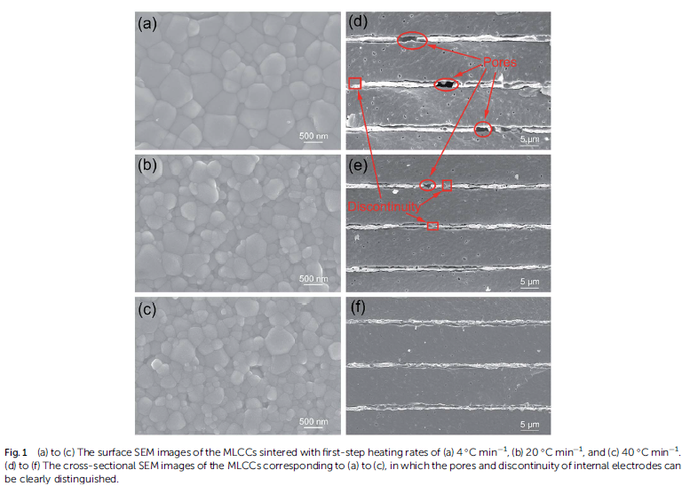
Papers Review
Belko et al 2019
Describe electro-thermal processes
Brown titled Multilayer Ceramic Capacitor
Describe the oxygen vacancies happened after the sintering process
Cai et al 2019
Showed the pores generated after the sintering process
Chae et al 2007
Advantage of using 3D model in FEM
Groh et al 2016
Alternative materials to replace BaTiO3
Scott et al 1990
Emphasized the thermal stress induced by wave soldering process
Song et al 2017
Synthesized modified BaTiO3
Emphasized phase field simulation
Thermal models of multilayer (by KEMET)
Explains about the workflow in creating thermal models of MLCC
Zeb et al 2015
Review the effect of changes in material composition
Provide information about the graph relating the relative permittivity with working temperature

Slide 8
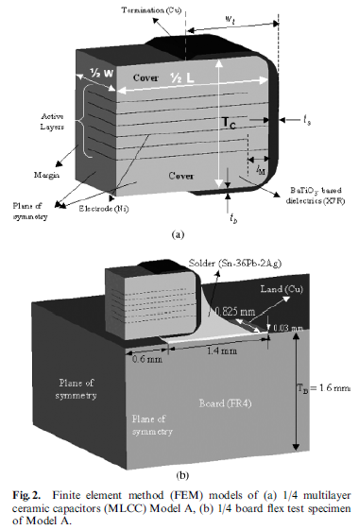
Papers Review
Belko et al 2019
Describe electro-thermal processes
Brown titled Multilayer Ceramic Capacitor
Describe the oxygen vacancies happened after the sintering process
Cai et al 2019
Showed the pores generated after the sintering process
Chae et al 2007
Advantage of using 3D model in FEM
Groh et al 2016
Alternative materials to replace BaTiO3
Scott et al 1990
Emphasized the thermal stress induced by wave soldering process
Song et al 2017
Synthesized modified BaTiO3
Emphasized phase field simulation
Thermal models of multilayer (by KEMET)
Explains about the workflow in creating thermal models of MLCC
Zeb et al 2015
Review the effect of changes in material composition
Provide information about the graph relating the relative permittivity with working temperature

Slide 9
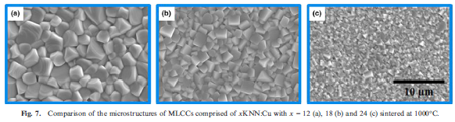
Papers Review
Belko et al 2019
Describe electro-thermal processes
Brown titled Multilayer Ceramic Capacitor
Describe the oxygen vacancies happened after the sintering process
Cai et al 2019
Showed the pores generated after the sintering process
Chae et al 2007
Advantage of using 3D model in FEM
Groh et al 2016
Alternative materials to replace BaTiO3
Scott et al 1990
Emphasized the thermal stress induced by wave soldering process
Song et al 2017
Synthesized modified BaTiO3
Emphasized phase field simulation
Thermal models of multilayer (by KEMET)
Explains about the workflow in creating thermal models of MLCC
Zeb et al 2015
Review the effect of changes in material composition
Provide information about the graph relating the relative permittivity with working temperature

Slide 10
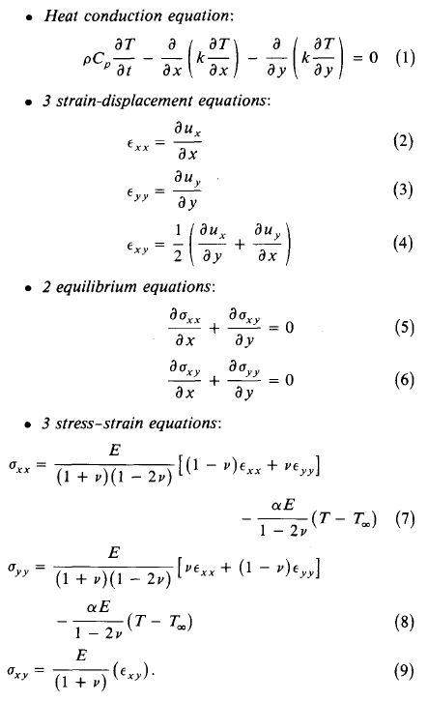
Papers Review
Belko et al 2019
Describe electro-thermal processes
Brown titled Multilayer Ceramic Capacitor
Describe the oxygen vacancies happened after the sintering process
Cai et al 2019
Showed the pores generated after the sintering process
Chae et al 2007
Advantage of using 3D model in FEM
Groh et al 2016
Alternative materials to replace BaTiO3
Scott et al 1990
Emphasized the thermal stress induced by wave soldering process
Song et al 2017
Synthesized modified BaTiO3
Emphasized phase field simulation
Thermal models of multilayer (by KEMET)
Explains about the workflow in creating thermal models of MLCC
Zeb et al 2015
Review the effect of changes in material composition
Provide information about the graph relating the relative permittivity with working temperature

Slide 11
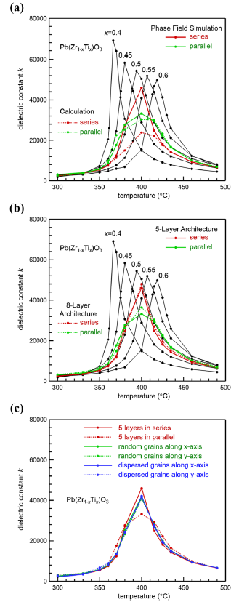
Papers Review
Belko et al 2019
Describe electro-thermal processes
Brown titled Multilayer Ceramic Capacitor
Describe the oxygen vacancies happened after the sintering process
Cai et al 2019
Showed the pores generated after the sintering process
Chae et al 2007
Advantage of using 3D model in FEM
Groh et al 2016
Alternative materials to replace BaTiO3
Scott et al 1990
Emphasized the thermal stress induced by wave soldering process
Song et al 2017
Synthesized modified BaTiO3
Emphasized phase field simulation
Thermal models of multilayer (by KEMET)
Explains about the workflow in creating thermal models of MLCC
Zeb et al 2015
Review the effect of changes in material composition
Provide information about the graph relating the relative permittivity with working temperature

Slide 12
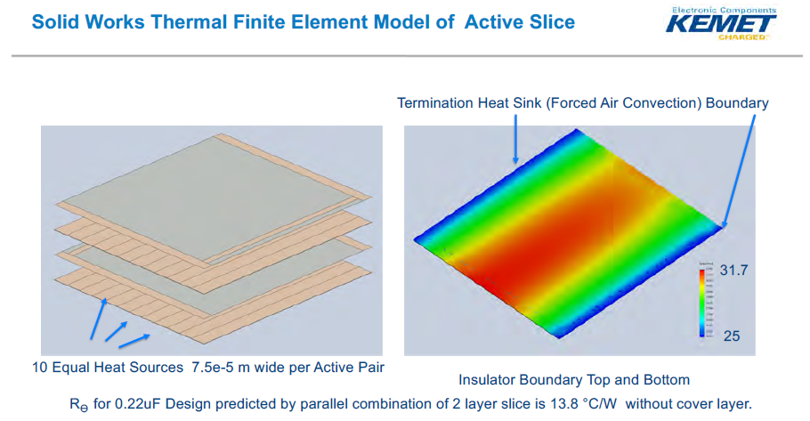
Papers Review
Belko et al 2019
Describe electro-thermal processes
Brown titled Multilayer Ceramic Capacitor
Describe the oxygen vacancies happened after the sintering process
Cai et al 2019
Showed the pores generated after the sintering process
Chae et al 2007
Advantage of using 3D model in FEM
Groh et al 2016
Alternative materials to replace BaTiO3
Scott et al 1990
Emphasized the thermal stress induced by wave soldering process
Song et al 2017
Synthesized modified BaTiO3
Emphasized phase field simulation
Thermal models of multilayer (by KEMET)
Explains about the workflow in creating thermal models of MLCC
Zeb et al 2015
Review the effect of changes in material composition
Provide information about the graph relating the relative permittivity with working temperature

Slide 13
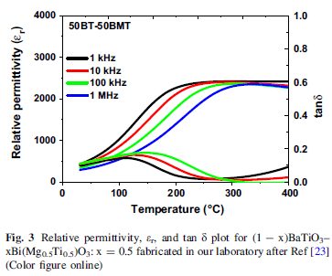
Papers Review
Belko et al 2019
Describe electro-thermal processes
Brown titled Multilayer Ceramic Capacitor
Describe the oxygen vacancies happened after the sintering process
Cai et al 2019
Showed the pores generated after the sintering process
Chae et al 2007
Advantage of using 3D model in FEM
Groh et al 2016
Alternative materials to replace BaTiO3
Scott et al 1990
Emphasized the thermal stress induced by wave soldering process
Song et al 2017
Synthesized modified BaTiO3
Emphasized phase field simulation
Thermal models of multilayer (by KEMET)
Explains about the workflow in creating thermal models of MLCC
Zeb et al 2015
Review the effect of changes in material composition
Provide information about the graph relating the relative permittivity with working temperature

Slide 14
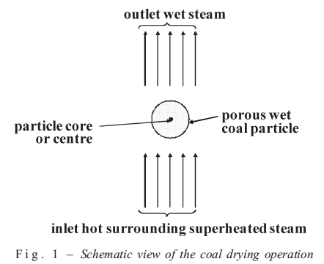
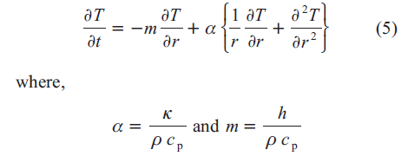
Papers Review
Olufemi and Udefiagbon 2010
Modeling and simulation of drying porous coal particles in superheated steam
Provides mathematical modelling of the drying process

