Slide 1
VILNIUS UNIVERSITY, FACULTY OF MATHEMATICS AND INFORMATICS, INFORMATION TECHNOLOGIES STUDY PROGRAMME
Rover
Done by:
Nedas Janušauskas
Adomas Jonavičius
Aistė Grigaliūnaitė
Gabrielius Drungilas
Supervisor: Linas Bukauskas

Slide 2
Outline
Introduction of idea and vision​
Project requirements​
Technologies used​
Implementation plan​
Current status​

Slide 3
Introduction of idea and vision
Main capabilities:
Sensing
Movement
Intelligence
Basic Rover structure:
Raspberry pi
3D printed casing
Various sensors and motors

Slide 4
Functional requirements
Free movement
Movement is decided without user input
Obstacle detection
Obstacle avoidance
Sound signals

Slide 5
Non-functional requirements
Robot will be operational until turned off
Expected battery life – 2 hours
Easy to operate

Slide 6
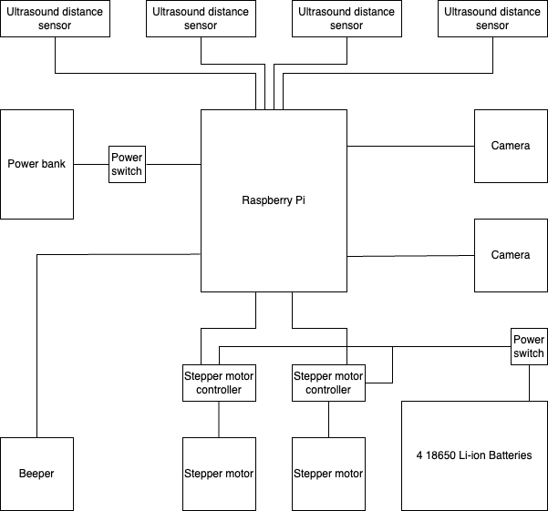
Hardware
Figure 1: "Rover" hardware diagram.

Slide 7
Software
Linux OS
Python
OpenCV
BASH
Git
C++ (Possibly)

Slide 8
Accomplishments
Acquired hardware components
Robot body prototype
Printed robot base
Testing hardware

Slide 9
Current Status
Hardware assembly
Robot body modeling/printing

Slide 10
Future Goals
Moving robot

Slide 11
THANK YOU FOR YOUR ATTENTION

Slide 12
QUESTIONS?

