Slide 1
VILNIUS UNIVERSITY, FACULTY OF MATHEMATICS AND INFORMATICS, INFORMATION TECHNOLOGIES STUDY PROGRAMME
Rover
Done by:
Gabrielius Drungilas
Aistė Grigaliūnaitė
Nedas Janušauskas
Adomas Jonavičius
Supervisor: Linas Bukauskas

Slide 2
Outline
Introduction of idea and vision
Functionality
Software
Hardware
Body
Diagrams
Algorithms
Use of SE practices
Current state
Future plans
What have we learned?

Slide 3
Introduction of idea and vision
Our goal is to build and develop an intelligent autonomous robot companion which would be able to map, detect and avoid objects in an indoor environment.
Main capabilities:
Sensing
Movement
Intelligence
Basic Rover structure:
Raspberry pi
3D printed casing
Various sensors and motors

Slide 4
Functionality
Precise movement.
Autonomous decision making.
Obstacle detection and avoidance.
Object detection and classification.
Depth extraction using stereo computer vision.
Room mapping.
Remote control.
Sound signals.

Slide 5
Software
Linux OS
Python
OpenCV
BASH
Git
AutoCAD

Slide 6
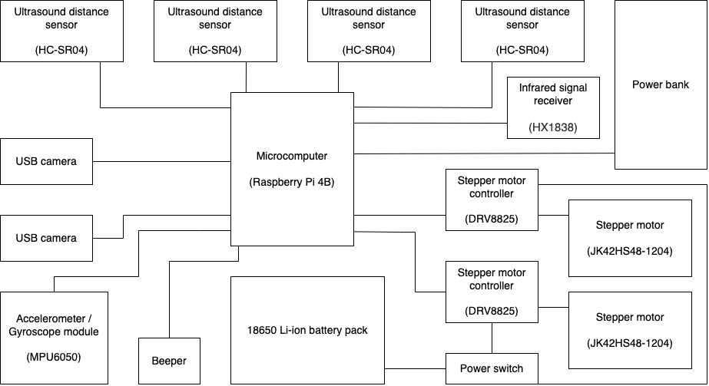
Hardware
Figure 1: Hardware diagram.

Slide 7

Body
All body parts are custom-designed and 3D printed with PLA plastic.
Parts are held down together with bolts.
Bearings are used inside the wheels to reduce friction.
Wheels are geared to prevent track slippage.
Tracks are made of timing belts for precise movement.
​
Figure 2: Computer base plate 3D model

Slide 8
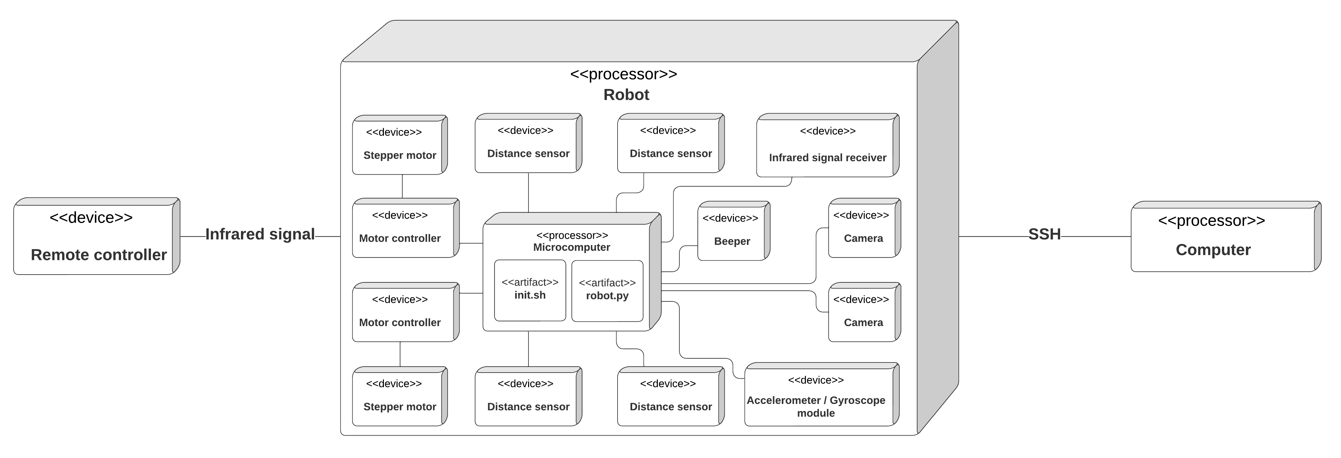
Deployment diagram
Figure 3: Deployment diagram

Slide 9
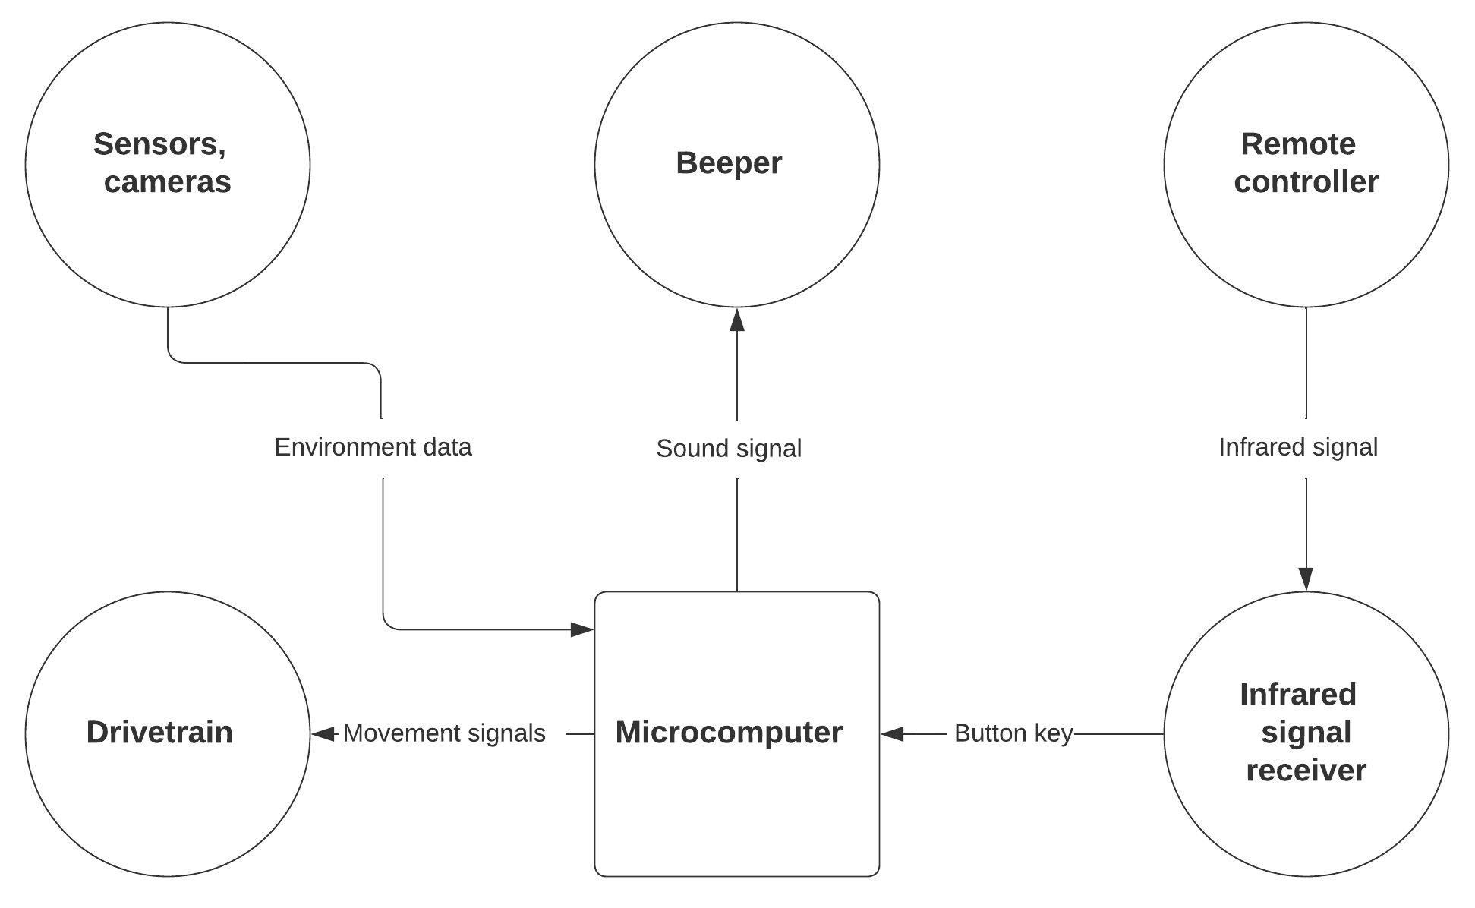
Context diagram
Figure 4: Context diagram

Slide 10
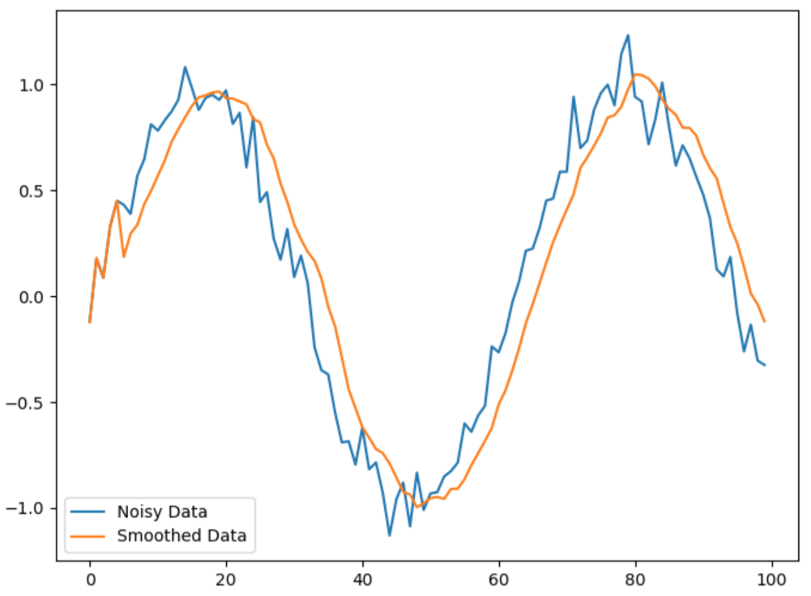
Algorithms: Smoothing data
Using a simple moving average algorithm we get more reliable data from distance sensors.
Figure 5: Example data (Smoothing)

Slide 11
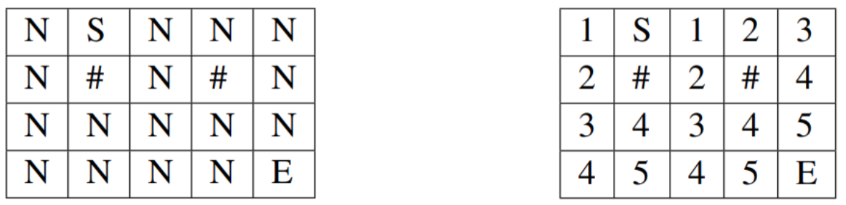
Algorithms: Calculating distances
We can recursively calculate distances to all accessible tiles on the map
Before: After:
Figure 6: Distance map before calculation
Figure 7: Distance map after calculation

Slide 12
Algorithms: Pathfinding
Using calculated distances from a map we can calculate the shortest path to desired location.
Figure 8: Pathfinding algorithm

Slide 13
Algorithms: Exploring
We implemented 2 types of exploring tactics and built the code base for further development.
• Drive while possible, if not turn in random available direction.
• Drive straight until robot finds wall, then drive along the wall, following its every turn.

Slide 14
Algorithms: Controlling
We have also made remote control support with AI mode and manual mode:
AI mode - Rover allows the user to input several tasks into the queue and execute them.
Manual mode - movement of Rover can be controlled by the user manually.

Slide 15
Use of SE practices
Version control
Kanban method
Frequent testing
Use of branching
Code refactoring
Notes:
In our project, we employ a range of software engineering practices to ensure the quality and maintainability of our code. These include using version control to track changes to our code and facilitate collaboration among team members, utilizing the kanban method to manage and prioritize work, conducting frequent testing to catch and fix defects early on, using branching to isolate different lines of development, and periodically refactoring our code to improve its structure and readability.

Slide 16
Current state
Currently, the robot is able to:
Move freely
Recognize obstacles and avoid them
Explore the area
Receive human input using a remote controller
Produce sound signals
Total time spent: ~700 hours
Notes:
Currently, our robot can move freely and navigate around obstacles, allowing it to explore its surroundings. It can also receive input from a remote controller and produce sound signals. So far, the team has invested around 700 hours into the project.

Slide 17
Future plans
In the upcoming weeks we are planning to:
Develop and connect computer vision system
Add tasks, that the robot can execute
Develop algorithms
Notes:
In the upcoming weeks, we have several plans for our project. First, we are working on developing and integrating a computer vision system, which will allow the robot to see and interpret its surroundings in a more sophisticated manner. Additionally, we are adding a range of tasks for the robot to execute, which will allow it to perform more complex actions and complete more advanced tasks. Finally, we are also working on developing algorithms which were already explained.

Slide 18
What have we learned?
Teamwork
Version control
Computer hardware
Electronics
Programming
Planning
3D modeling
Notes:
MAIN LESSON LEARNED: setting deadlines.

Slide 19
THANK YOU FOR YOUR ATTENTION

Slide 20
QUESTIONS?

