Slide 1
TED Talk Project
By: Marcin Grzechowiak, Alex Cathey, Mychael Solis-Wheeler, Mikaela Pisani, Roger Valdez
Notes:
Myke Speaks

Slide 2

Overview
Introduction
Question 1
Question 2
Question 3
Recommendations
Conclusion
Notes:
Myke Speaks

Slide 3
Introduction
Audience
Video publishing companies
Company sponsors
TED Talk presenters
Interests
Analyze factors that impact views
Analyze decisions based on published date
Notes:
Myke Speaks

Slide 4
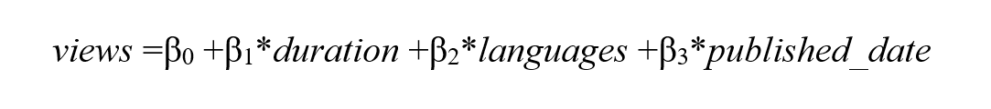
Question 1
What is the relationship between number of unique views and the duration of a video?
Multiple Linear Regression Model:
Notes:
Without looking at the date we expected that the views decrease when the duration increases

Slide 5
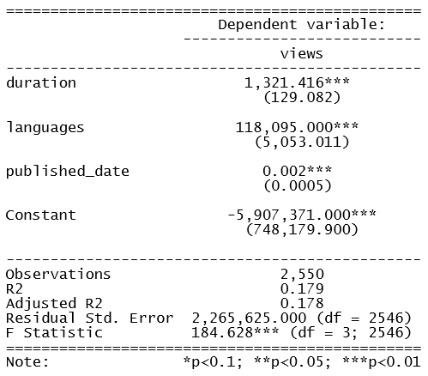
Chosen Model: Question 1
Notes:
3 stars means that is significance

Slide 6
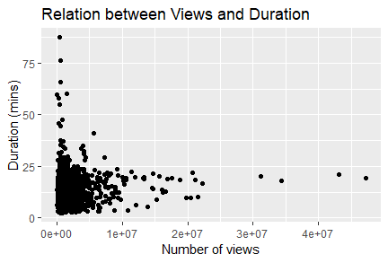
Interpretation for Question 1
Notes:
The independent variables duration, languages and published_date are significant and positively correlated with the amount of views.
Positive correlation between duration and views is up until a certain point (25 minutes)
After that point the views still increase, so there might be other variables that influence the increase after that point.

Slide 7
Interpretation for Question 1
The independent variables duration, languages and published_date are significant and positively correlated with the amount of views.
Positive correlation between duration and views is up until a certain point (25 minutes)
After that point the views still increase, so there might be other variables that influence the increase after that point.
Video production companies will be able to pinpoint the most influential variable (duration, published_date) in determining unique view count, indirectly influencing profit.

Slide 8
Question 2
Does the type of tag affect the number of views?
Notes:
If topic of video affect number of views?
Every video has tags and we divided them into 3 categories as follows:

Slide 9
Question 2
Does the type of tag affect the number of views?
Tags are defined as follows:
Knowledge: space, statistics, economist, brain, education, technology, business, health, science, history, innovation, math
Entertainment: comedy, humor, music
Controversial: race, culture, religion, politics, feminism, crime, gender, equality, war, protests
Notes:
First thought: controversial increases number of views -> Not true -> Surprisingly: Entertainment does!

Slide 10
Question 2
Does the type of tag affect the number of views?
Multiple Linear Regression Model with binary variable:

Slide 11
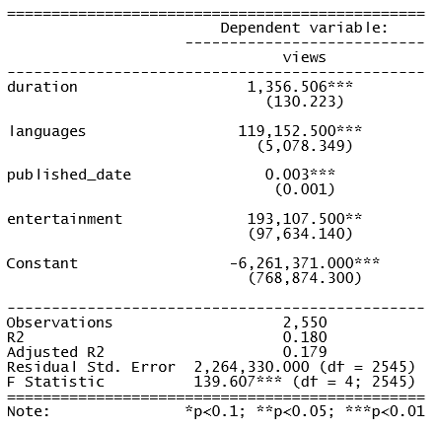
Chosen model for Question 2
Notes:
All coeficients are significant at 5 % lvl of significance (***)

Slide 12
Interpretation
entertainment variable is the most reliable indicator in determining number of unique views

Slide 13
Interpretation
entertainment variable is the most reliable indicator in determining number of unique views
If you want to increase number of views then you should implement humor into your presentation

Slide 14
Question 3
How does the type of tags influence the publish date (Vacation)?
Probit regression model:

Slide 15
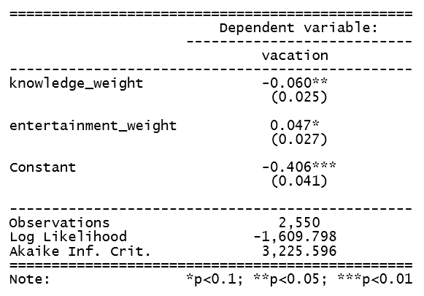
Chosen model for Question 3
Vacation: binary variable
1: May - August.
0: September - April
Knowledge: amount of educational tags in a video
Entertainment: amount of entertaining topics in a video

Slide 16
Chosen model for Question 3
Educational topics are less probable to have a published date during vacations
Entertainment topics are more probable to have a published date during vacations
Controversial variable was not significant so we excluded it from our model

Slide 17
Recommendations
Keep TED Talks under 25 minutes
Include humor when presenting Knowledge topics
Target Entertainment topics for most views to advertise
Publish Entertainment topics between May & August
Avoid publishing Knowledge topics between May & August
Notes:
Myke Speaks
For maximizing views

Slide 18
Conclusion
Introduction
Question 1
Question 2
Question 3
Recommendations
Conclusion
Notes:
Myke Speaks

Slide 19
Thank You

