Slide 1
C# od podstaw
Wykład 1
Konrad Śledziewski Szymon halicki

Slide 2
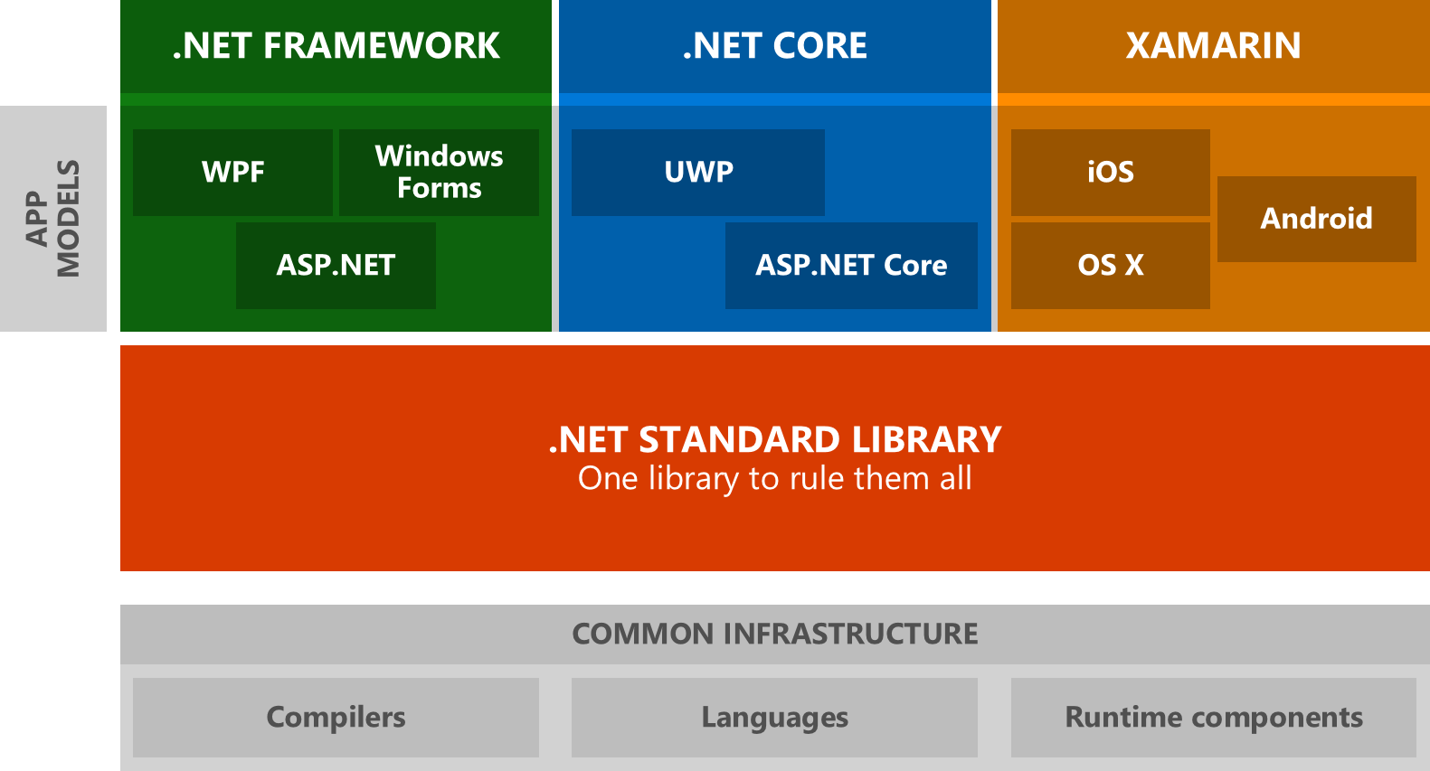
Czym jest c#/.net

Slide 3
pierwszy program – omówienie struktury
using System;
using System.Collections.Generic;
using System.Linq;
using System.Text;
using System.Threading.Tasks;
namespace KursSgh1
{
class Program
{
static void Main(string[] args)
{
Console.WriteLine("Hello world!");
}
}
}
Referencja do przestrzeni nazw z .Net Framework
Nasza przesteń nazw
Nazwa klasy
Metoda główna
Metoda wywołana z klasy Console

Slide 4
Komentarze
static void Main(string[] args)
{
//to jest komentarz jednolinijkowy
/*
*to jest komentarz
*wielolinijkowy
*
* komentarze nie wpływają na działanie programu
*/
Console.WriteLine("Hello world!");
}

Slide 5
zmienne
static void Main(string[] args)
{
//to jest zmienna reprezentująca ciąg znaków
string hello = "Hello world!";
Console.WriteLine(hello);
}

Slide 6
Alias | Type Name | .Net Type
byte | System.Byte | struct
sbyte | System.SByte | struct
int | System.Int32 | struct
uint | System.UInt32 | struct
short | System.Int16 | struct
ushort | System.UInt16 | struct
long | System.Int64 | struct
ulong | System.UInt64 | struct
float | System.Single | struct
double | System.Double | struct
char | System.Char | struct
bool | System.Boolean | struct
object | System.Object | Class
string | System.String | Class
decimal | System.Decimal | struct
DateTime | System.DateTime | struct

Slide 7
Deklaracja I inicjalizacja
static void Main(string[] args)
{
//deklaracja
short a;
int b;
double c;
//inicjalizacja
a = 10;
b = 20;
c = a + b;
//wypisanie
Console.WriteLine("a = {0}, b = {1}, c = {2}", a, b, c);
Console.WriteLine($"a = {a}, b = {b}, c = {c}");
Console.ReadLine();
}

Slide 8
operatory
Operator | Description | Example
+ | Adds two operands | A + B = 30
- | Subtracts second operand from the first | A - B = -10
* | Multiplies both operands | A * B = 200
/ | Divides numerator by de-numerator | B / A = 2
% | Modulus Operator and remainder of after an integer division | B % A = 0
++ | Increment operator increases integer value by one | A++ = 11
-- | Decrement operator decreases integer value by one | A-- = 9
Operator | Description | Example
== | Checks if the values of two operands are equal or not, if yes then condition becomes true. | (A == B) is not true.
!= | Checks if the values of two operands are equal or not, if values are not equal then condition becomes true. | (A != B) is true.
> | Checks if the value of left operand is greater than the value of right operand, if yes then condition becomes true. | (A > B) is not true.
< | Checks if the value of left operand is less than the value of right operand, if yes then condition becomes true. | (A < B) is true.
>= | Checks if the value of left operand is greater than or equal to the value of right operand, if yes then condition becomes true. | (A >= B) is not true.
<= | Checks if the value of left operand is less than or equal to the value of right operand, if yes then condition becomes true. | (A <= B) is true.

Slide 9
Operator | Description | Example
&& | Called Logical AND operator. If both the operands are non zero then condition becomes true. | (A && B) is false.
|| | Called Logical OR Operator. If any of the two operands is non zero then condition becomes true. | (A || B) is true.
! | Called Logical NOT Operator. Use to reverses the logical state of its operand. If a condition is true then Logical NOT operator will make false. | !(A && B) is true.
Operator | Description | Example
& | Binary AND Operator copies a bit to the result if it exists in both operands. | (A & B) = 12, which is 0000 1100
| | Binary OR Operator copies a bit if it exists in either operand. | (A | B) = 61, which is 0011 1101
^ | Binary XOR Operator copies the bit if it is set in one operand but not both. | (A ^ B) = 49, which is 0011 0001
~ | Binary Ones Complement Operator is unary and has the effect of 'flipping' bits. | (~A ) = -61, which is 1100 0011 in 2's complement due to a signed binary number.
<< | Binary Left Shift Operator. The left operands value is moved left by the number of bits specified by the right operand. | A << 2 = 240, which is 1111 0000
>> | Binary Right Shift Operator. The left operands value is moved right by the number of bits specified by the right operand. | A >> 2 = 15, which is 0000 1111

Slide 10
Operatory arytmetyczne
c = a + b;
Console.WriteLine($"a + b = {c}");
c = a - b;
Console.WriteLine($"a - b = {c}");
c = a * b;
Console.WriteLine($"a * b = {c}");
c = a / b;
Console.WriteLine($"a / b = {c}");
c = a % b;
Console.WriteLine($"a % b = {c}");
c = a++;
Console.WriteLine($"a = {a} || c = {c}");
c = ++a;
Console.WriteLine($"a = {a} || c = {c}");
c = b--;
Console.WriteLine($"b = {b} || c = {c}");
c = --b;
Console.WriteLine($"b = {b} || c = {c}");

Slide 11
Operatory porównania
Console.WriteLine("a == b -> {0}", a == b);
Console.WriteLine("a != b -> {0}", a != b);
Console.WriteLine("a > b -> {0}", a > b);
Console.WriteLine("a < b -> {0}", a < b);
Console.WriteLine("a >= b -> {0}", a >= b);
Console.WriteLine("a <= b -> {0}", a <= b);

Slide 12
Operatory logiczne
bool a = true;
bool b = false;
Console.WriteLine("Opertory logiczne: ");
Console.WriteLine("a && b -> {0}", a && b);
Console.WriteLine("a || b -> {0}", a || b);
Console.WriteLine("!a -> {0} !b -> {1}", !a, !b);

Slide 13
Operatory binarne
int x = 0b11001100;
int y = 0b10001111;
Console.WriteLine("Opertory binarne: ");
Console.WriteLine(Convert.ToString(x, 2));
Console.WriteLine(Convert.ToString(y, 2));
Console.WriteLine("x & y -> {0}", Convert.ToString(x & y, 2));
Console.WriteLine("x | y -> {0}", Convert.ToString(x | y), 2);
Console.WriteLine("~x -> {0} {2} ~y -> {1} {3}", Convert.ToString(~x, 2),
Convert.ToString(~y, 2),~x, ~y);
Console.WriteLine("x << 2 -> {0}", Convert.ToString(x << 2, 2));
Console.WriteLine("y >> 4 -> {0}", Convert.ToString(y >> 4, 2));

Slide 14
Operatory przypisania
Operator | Description | Example
= | Simple assignment operator, Assigns values from right side operands to left side operand | C = A + B assigns value of A + B into C
+= | Add AND assignment operator, It adds right operand to the left operand and assign the result to left operand | C += A is equivalent to C = C + A
-= | Subtract AND assignment operator, It subtracts right operand from the left operand and assign the result to left operand | C -= A is equivalent to C = C - A
*= | Multiply AND assignment operator, It multiplies right operand with the left operand and assign the result to left operand | C *= A is equivalent to C = C * A
/= | Divide AND assignment operator, It divides left operand with the right operand and assign the result to left operand | C /= A is equivalent to C = C / A

Slide 15
Pobieranie danych od użytkownika I konwersja
Console.WriteLine("Podaj swoje imię: ");
string imie = Console.ReadLine();
Console.WriteLine("Witaj " + imie + " w naszym pierwszym interaktywnym programie!");
string input = Console.ReadLine();
int wiek = Int.Parse(wiek);

Slide 16
Podejmowanie decyzji
If – else
If – else if – else if – else
switch

Slide 17
if (string.Equals(imie, "Konrad"))
{
//wykonaj coś
}
else if (string.Equals(imie, "Damian"))
{
//wykonaj coś innego
}
else
{
//wykonaj jeżeli żadne z powyższych nie jest spełnione
}
if (string.Equals(imie, "Konrad"))
{
//wykonaj coś
}
else
{
//wykonaj coś innego
}

Slide 18
Praca domowa
Prosty kalkulator obsługujący dziłania -+*/%
Kod kalkulatora przesyłamy jako plik .cs (domyślny plik z Visuala) na adres
konrad.sledziewski17@gmail.com

