Slide 1
Name Artist & Title
Game 0001

Slide 2
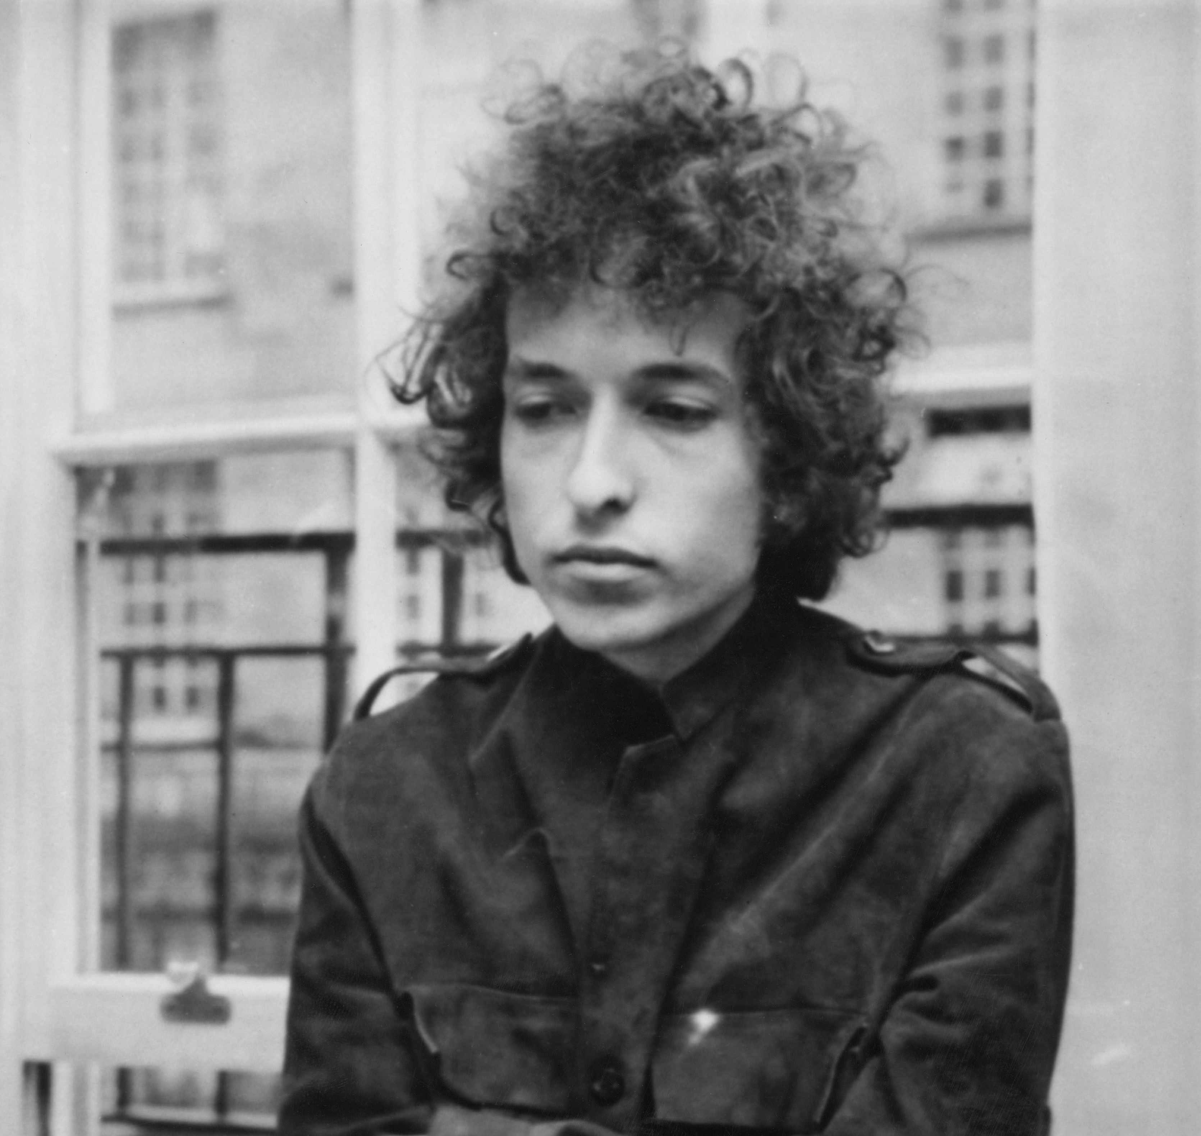
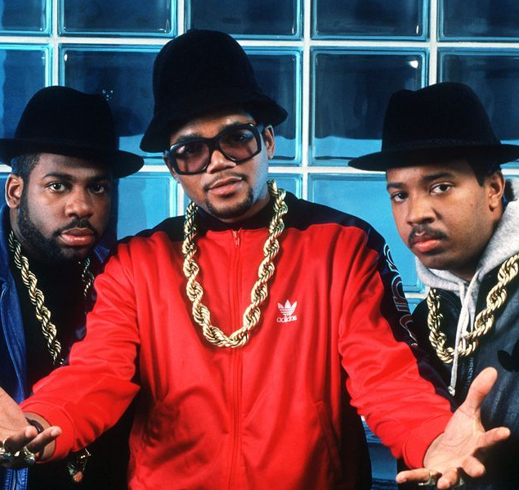
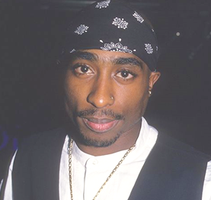
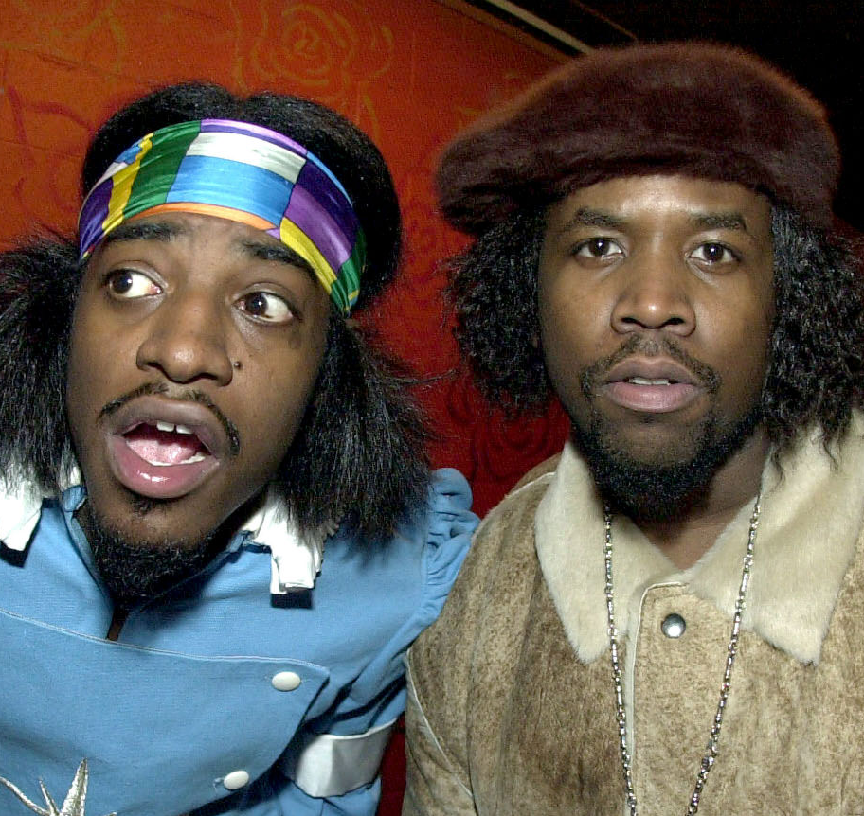


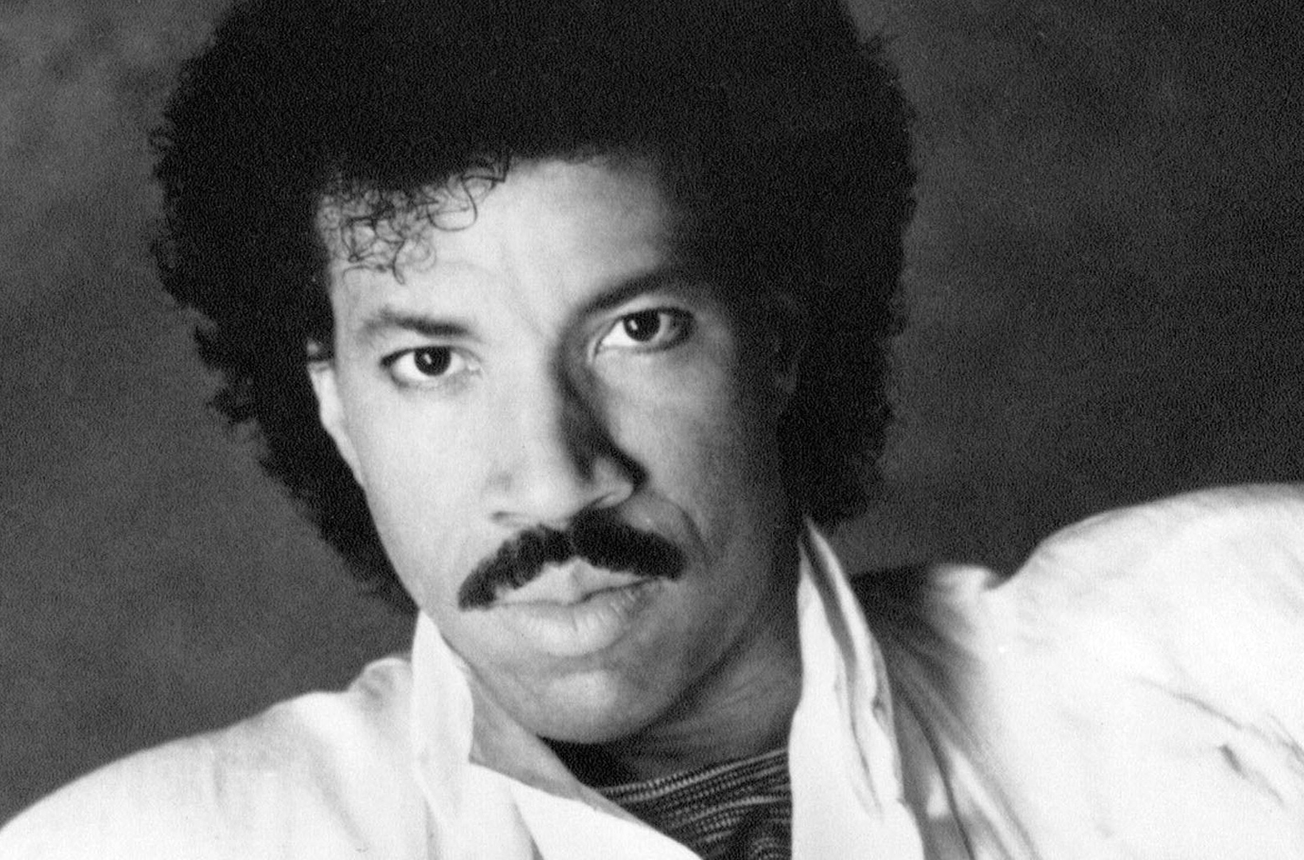


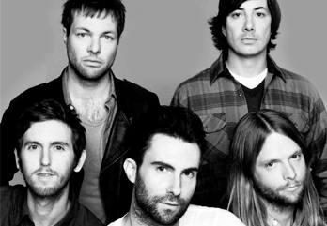
Picture Round
Instructions: Identify the artist or group on the line under each image

Slide 3
Decades In what decade was this version of the song originally released?

Slide 5
General Knowledge
Who wrote the 1964 hit song Oh, Pretty Woman? Roy Orbison
Which of Madonna’s videos is an homage to Marilyn Monroe’s performance of the song Diamonds Are A Girl’s Best Friend in the 1953 movie Gentlemen Prefer Blondes? Material Girl
In December of 1999, who did Billboard Magazine name as Artist of the Decade? Mariah Carey
In 2008 Amy Winehouse joined an elite group (Lauren Hill, Norah Jones, Alicia Keys, and Beyonce) when she won how many Grammy Awards in one night? Five (out of 6 nominations)
Often wearing a wig to obscure her face to protect her privacy, what “Chandelier” singer hails from Australia? Sia
Old-schoolers and DJs often refer to their record collection using what term, which describes a flat disc with a small micro-groove that contains an imprint of recorded sound? Vinyl
Name the two superstars who duetted “Ebony and Ivory”, which became a number one hit in 1982? Paul McCartney and Michael Jackson
Courtney Love, who won a Golden Globe nomination for her role in the film The People vs. Larry Flint was co-founder and lead singer of what grunge band, whose debut album was released in 1991? Hole (Pretty On The Inside)
The UK’s best-selling single of 2003 was Where Is the Love?. Who was the artist? Black Eyed Peas
“Bangtan Sonyeondan” is South Korean for Bulletproof Boy Scouts. What band is called Bangtan Sonyeondan in their home country, but use an acronym for their English name? BTS
In September of 2023, Forbes Magazine called Katy Perry “one of the richest self-made women in America” based on their summation of her net worth. According Forbes estimate, what is her net worth? $340 million

Slide 6
Bob Dylan
Run-D.M.C.
Tupac Shakur
Outkast
Drake
David Bowie
Lionel Richie
Green Day
Linkin Park
Maroon 5

