Slide 1
Name Artist & Title
Game

Slide 2
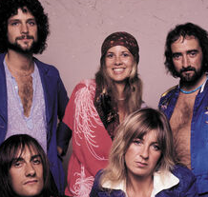
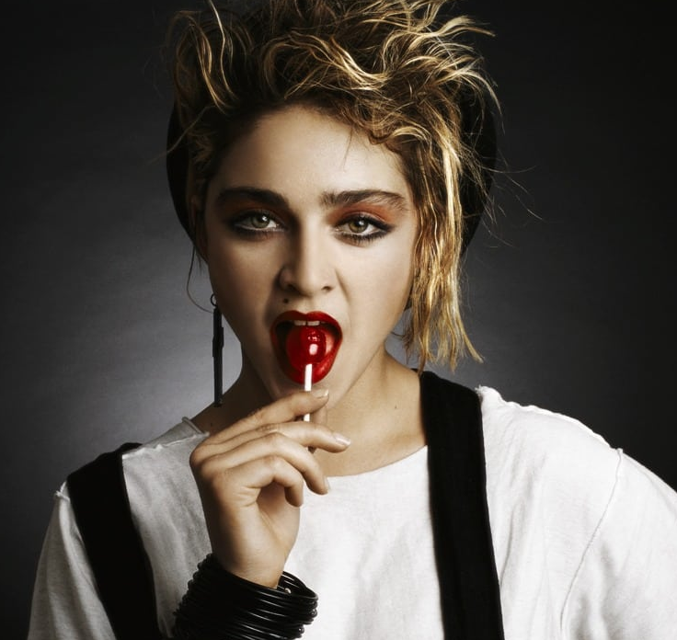
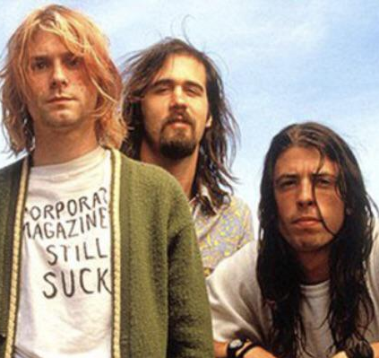
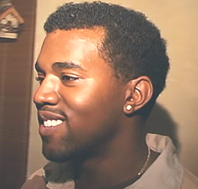
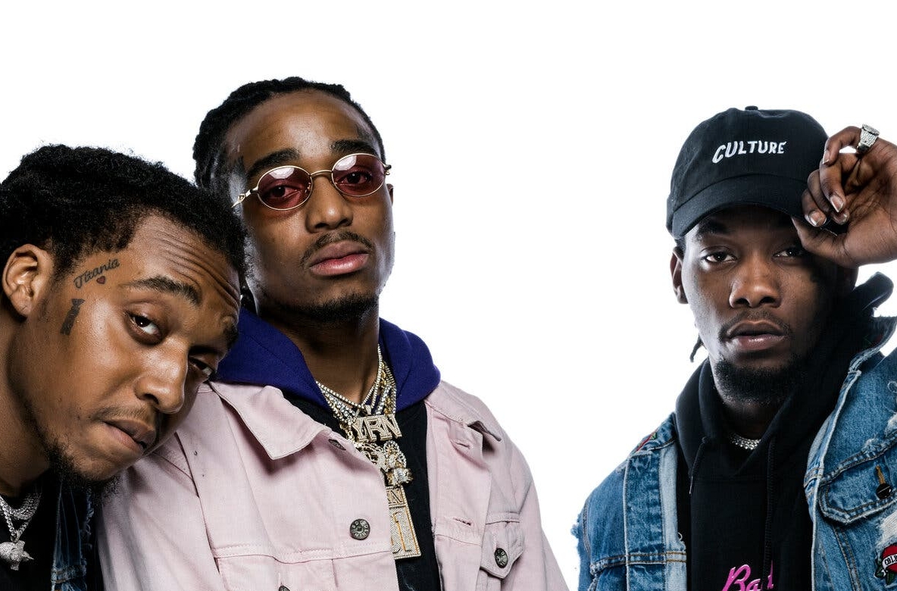
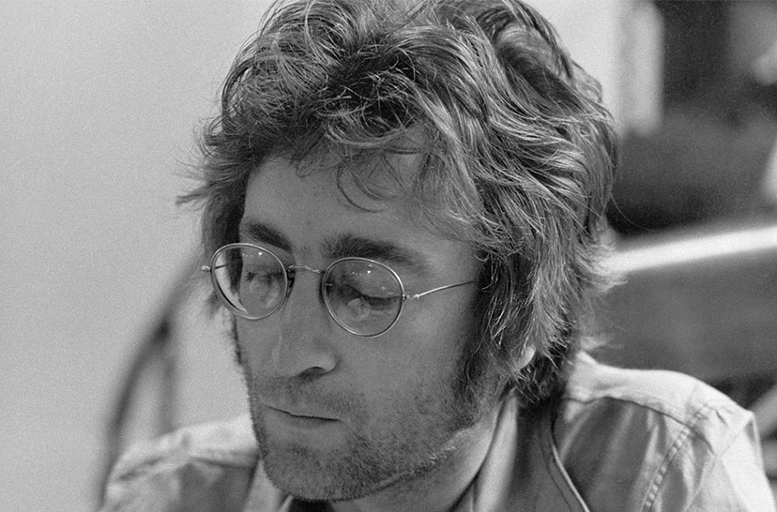
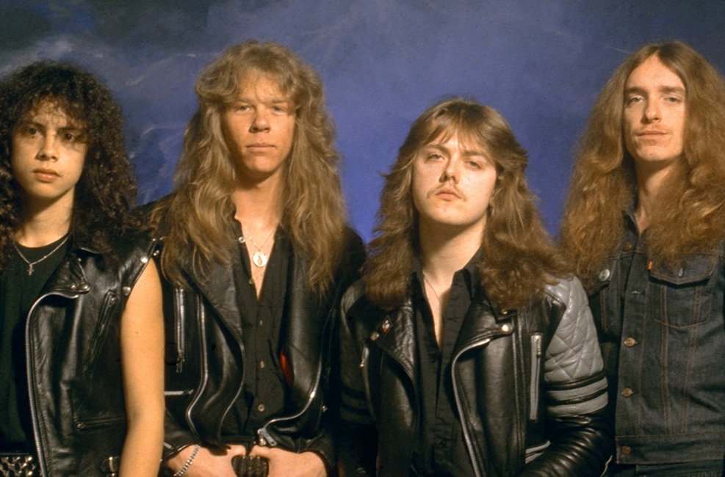
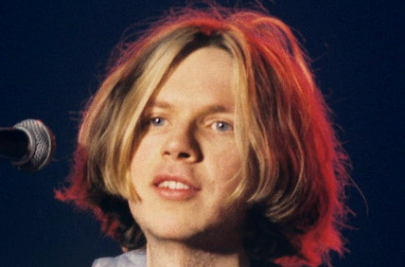
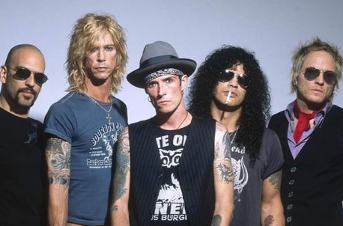
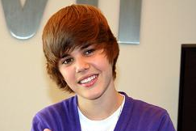
Picture Round
Instructions: Identify the artist or group on the line under each image

Slide 3
Decades In what decade was this version of the song originally released?

Slide 4
General Knowledge
The Mighty Mighty Bosstones and No Doubt are two examples of American ska bands. On what island nation did ska originate in the 1950s? Jamaica
Name the 80s pop singer who won the Tony Award for Best Original Score for her composition of the music and lyrics of the Broadway hit Kinky Boots? Cyndi Lauper
Michael Peter Balzary is best known for being the co-founder and bassist for Red Hot Chili Peppers. What is his professional name? Flea
Billy Paul’s 1972 hit Me and Mrs. Jones was recorded in 2007 by what contemporary crooner, released as the second single from his 3rd studio album, Call Me Irresponsible? Michael Buble
In 2017, what singer wrote the song Still Feel Like Your Man for his ex-girlfriend Katy Perry? John Mayer
Finish this lyric from Roberta Flack’s 1973 ballad, which was covered in 1996 by The Fugees: I heard he sang a good song, I heard he had a style…(next 12 words)? And so I came to see him and listen for a while.
What band was formed in 1985, when two local Los Angeles rock bands Hollywood Rose and L.A. Guns merged? Guns N’ Roses
In the 1996 hit Wannabe, which Spice Girl sings first, belting out, “Yo I’ll tell you what I want, what I really really want…”? Mel B (also accept Scary Spice, Melanie B or Melanie Brown)
Name the chart-topping country pop song released by Lee Ann Womack in 2000, which won numerous awards and prompted Billboard to call it “a career record”. I Hope You Dance
Name the drummer and co-front man of The Roots who made his directorial debut with the 2021 documentary film Summer of Soul, about the 1969 Harlem Cultural Festival. Questlove (Ahmir K. Thompson)
According to Billboard Magazine, Adele’s album entitled 30 sold more than any other album in 2021. How many copies of 30 did Adele sell that year? 1,464,000

Slide 6
The Moody Blues
Madonna
Nirvana
Kanye West
Migos
John Lennon
Metallica
Beck
Velvet Revolver
Justin Bieber

