Slide 1
Name Title & Artist
Game 0007
Love On Top – Beyonce
Beyond The Sea – Bobby Darin
Every Rose Has It’s Thorne – Poison
It’s Five O’clock Somewhere – Alan Jackson & Jimmy Buffett
Love Will Keep Us Together – Captain & Tenille
Every Everybody – Black Box
Butterfly – Crazy Town
Girlfriend – Pebbles
Ain’t It Fun – Paramore
Basket Case – Green Day

Slide 2
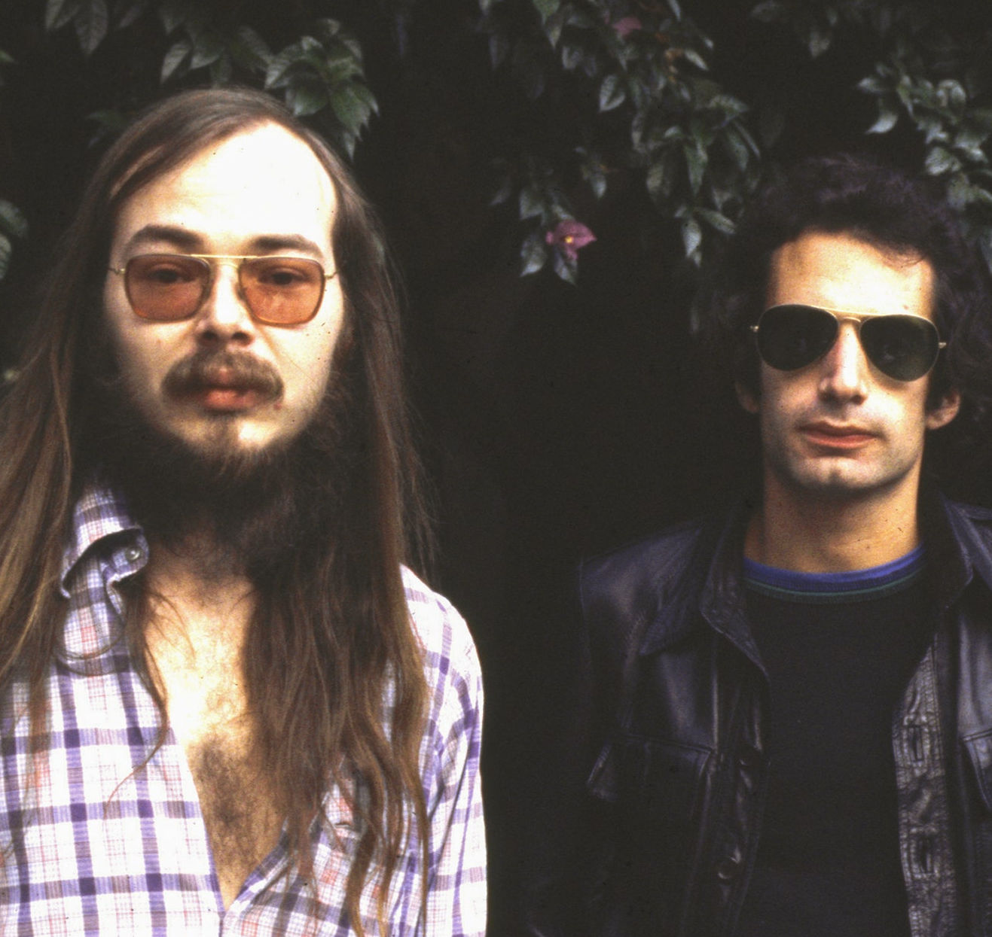
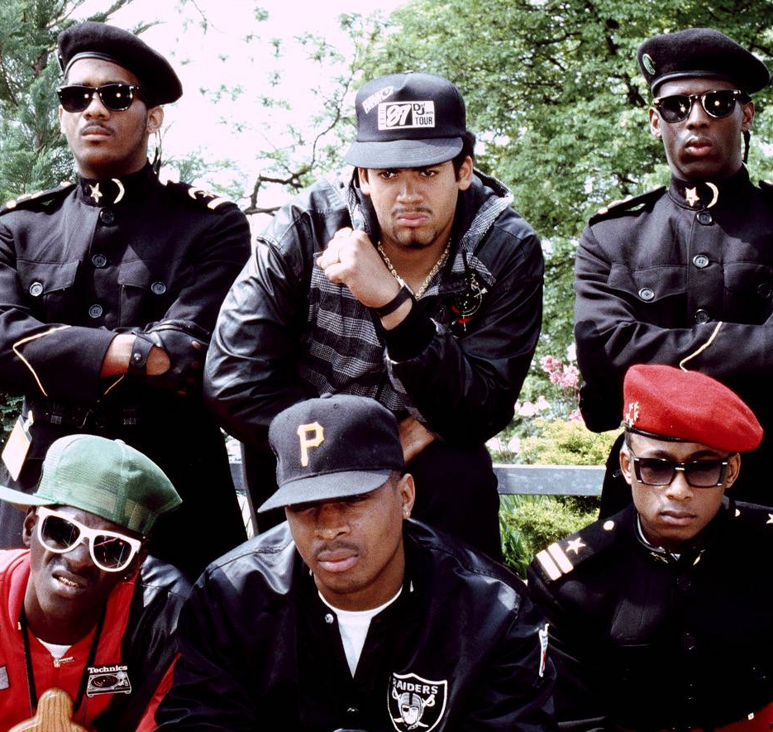
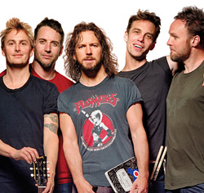
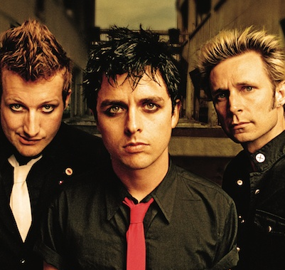
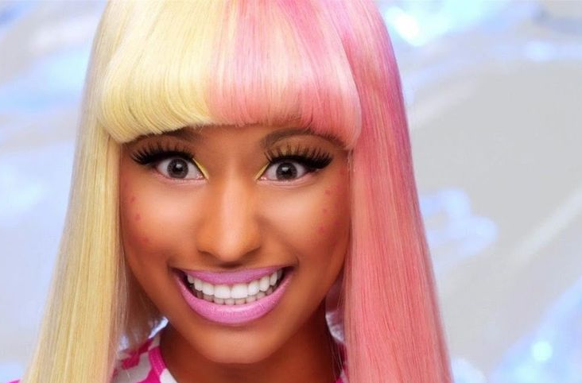
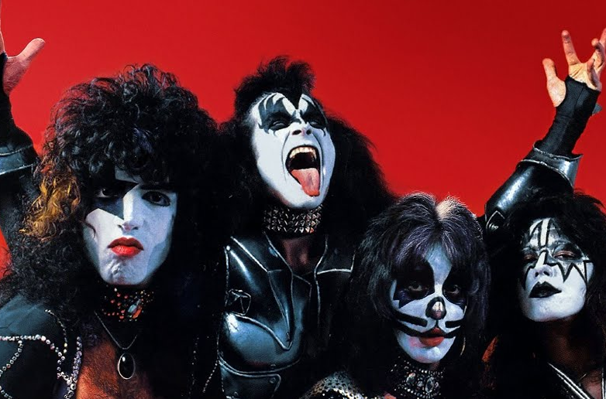
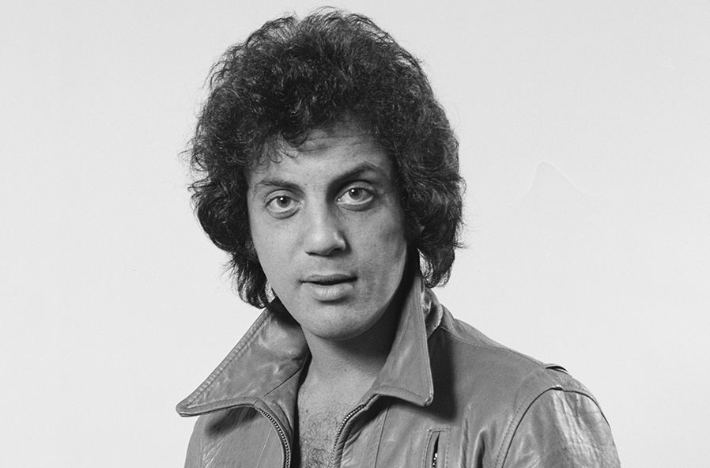
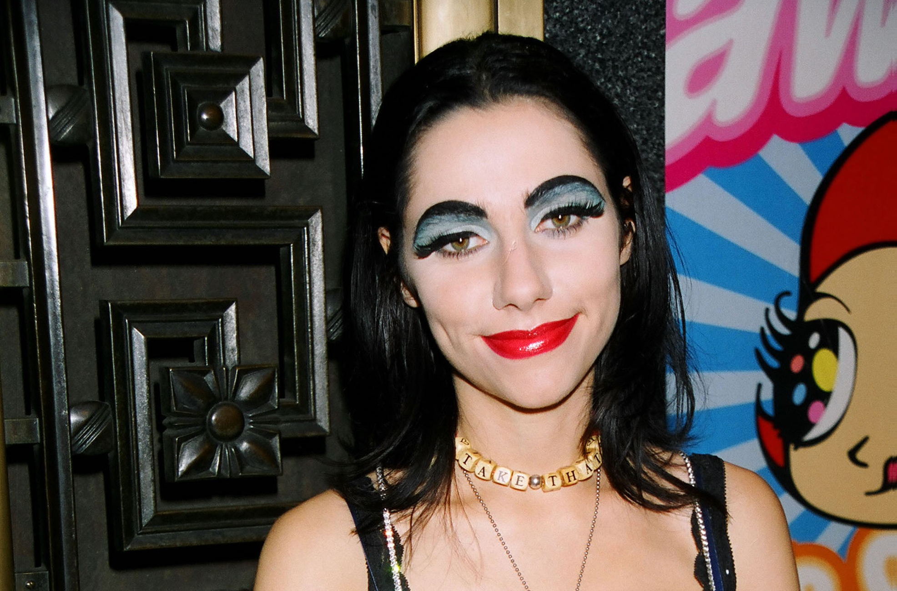
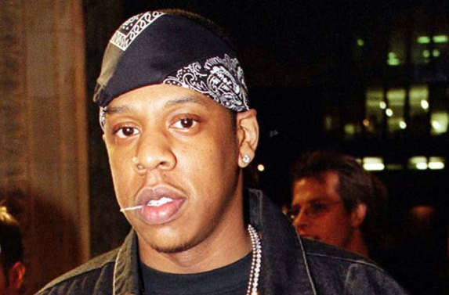
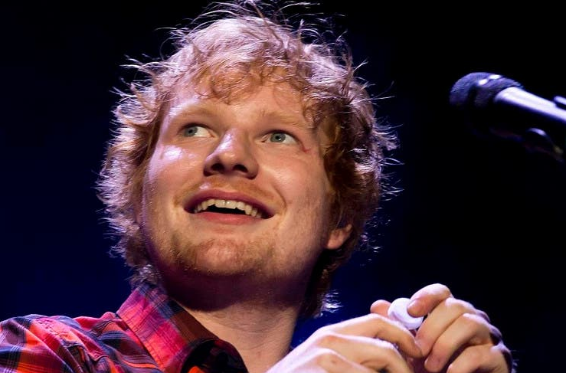
Picture Round
Instructions: Identify the artist or group on the line under each image

Slide 3
Decades In what decade was this version of the song originally released?
I Want You to Want Me (live) – Cheap Trick – 1979
Take Me Out – Franz Ferdinand – 2004
Hold the Line – Toto - 1978
Funky Cold Medina – Tone Loc - 1988
No Diggity – Blackstreet - 1996
Great Balls of Fire – Jerry Lee Lewis - 1957
Sweet Escape – Gwen Stefani - 2006
Renegade – Styx - 1979
Drop It Like It’s Hot – Snoop Dogg & Pharrell - 2004
Everyday People – Sly & the Family Stone - 1968

Slide 4
General Knowledge
Elvis Presley’s last #1 hit was in 1969. What is the title of the song? Suspicious Minds
In Back to the Future, Marty McFly’s band auditions for Battle of the Bands – a scene that ends with a cameo of what famous musician, playing a school official, saying, “Hold it fellas…I’m afraid you’re just too darn loud”? Huey Lewis
With what ticket sales company did Pearl Jam have an ongoing battle in the 90s over ticket prices and fees? Ticketmaster
My Boo, Alicia Keys’ 2004 duet with what artist became her second #1 single? Usher
Released in 2021, what was the name of the last Foo Fighters album, recorded with their now-deceased drummer, Taylor Hawkins? Medicine at Midnight
Name the Bay City Rollers cover song that hit #1 on the UK Singles Chart for 6 weeks in 1975 and is played in the film Love Actually after Liam Neeson’s character delivers his wife’s eulogy. Bye, Bye Baby (originally recorded by The Four Seasons)
In Sting’s background vocals in the 1985 Dire Straits song Money for Nothing what song by The Police does his melody imitate? Don’t Stand So Close To Me (“I want my MTV”)
What boy band, famous for their one big 1999 hit Summer Girls, lost 2 of its 3 members to cancer within 8 years of each other? LFO
After going on hiatus to battle a prescription drug addiction, what artist returned to the music industry in 2009 with a 6th album called Relapse, and a 7th album in 2010 called Recovery? Eminem
In 2019 a poll was conducted with 174 living composers, who named what 16th-17th century German composer (known for his Brandenburg Concertos) the greatest composer of all time? Johann Sebastian Bach
According to celebritynetworth.com in October of 2023, what is Miley Cyrus’ net worth? $160 million

Slide 6
Steely Dan
Public Enemy
Pearl Jam
Green Day
Nicki Minaj
KISS
Billy Joel
PJ Harvey
Jay Z
Ed Sheeran

