Slide 1
Name Title & Artist
Game 0009
Sex Type Thing – Stone Temple Pilots
Melt With You - Modern English
Love Song – Sara Barellis
Promiscuous – Nelly Furtado
Sway – Pussy Cat Dolls
7 – Prince
Toosie Slide – Drake
I’m on Fire – Bruce Springsteen
Hold Me Now – Thompson Twins
Waiting For Tonight – Jennifer Lopez

Slide 2
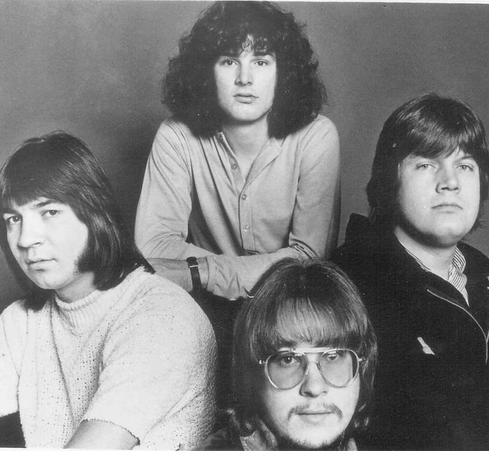
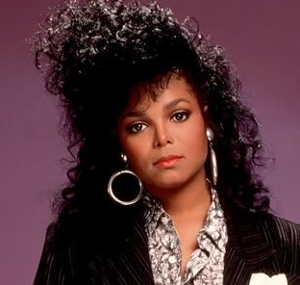
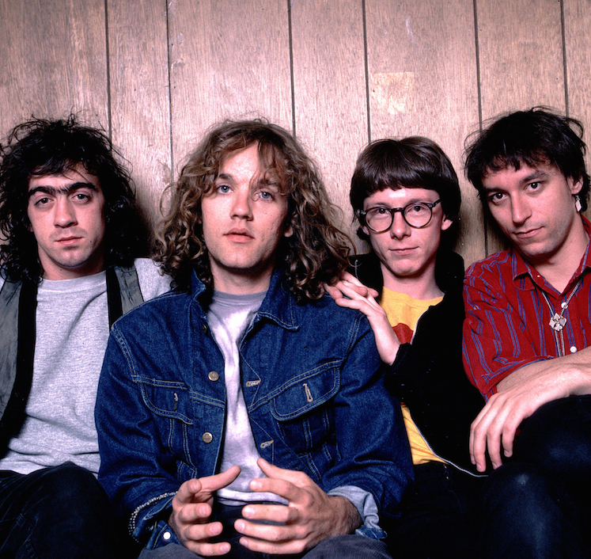
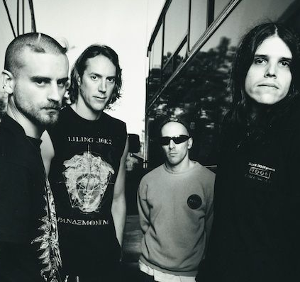
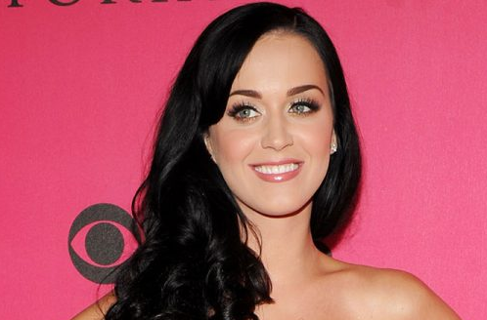
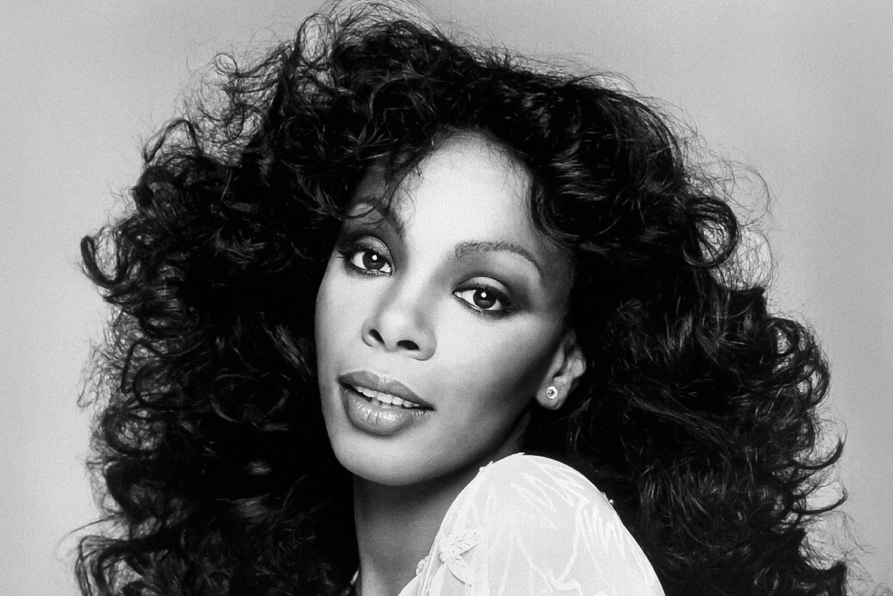
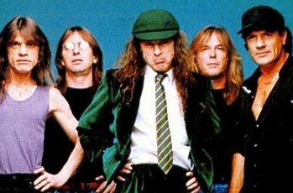
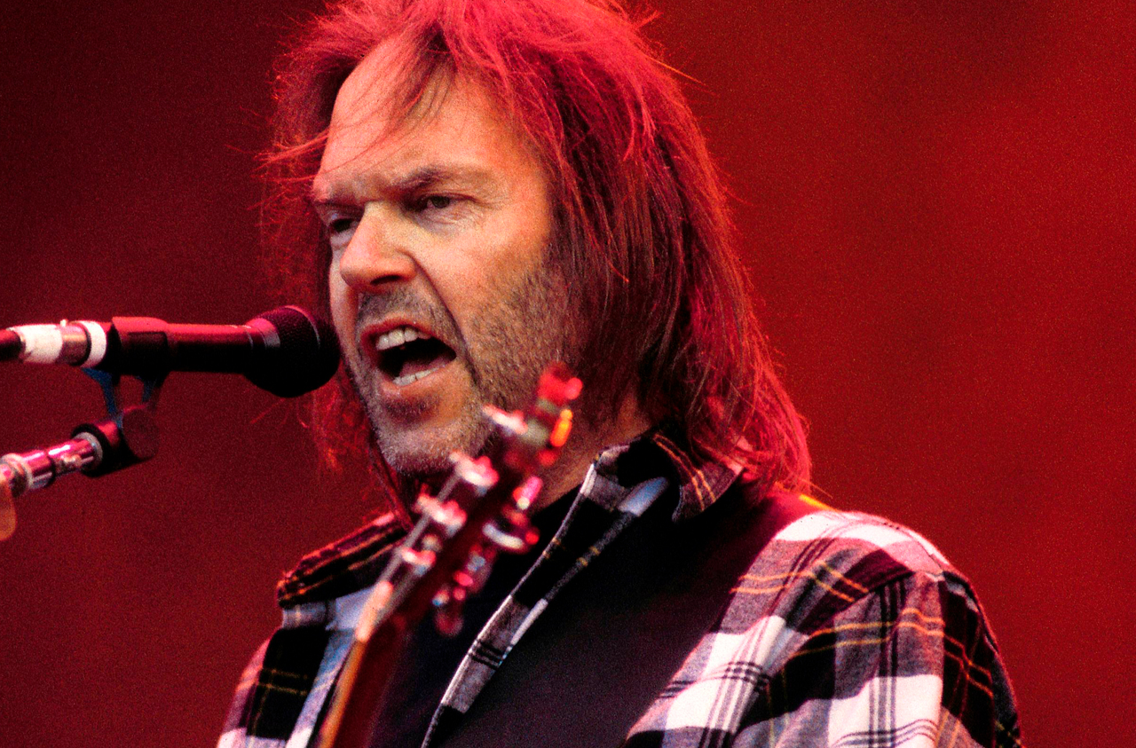
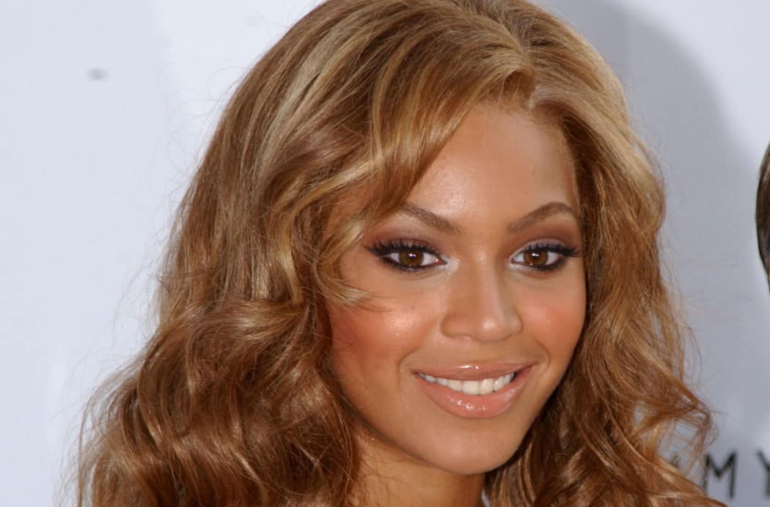
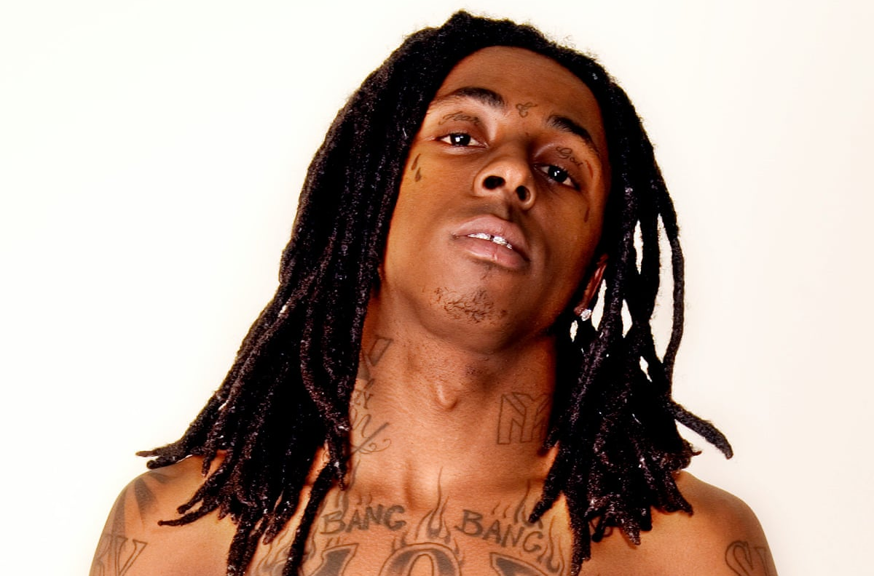
Picture Round
Instructions: Identify the artist or group on the line under each image

Slide 3
Decades In what decade was this version of the song originally released?
This Will Be– Natalie Cole - 1975
Over & Over - Nelly & Tim McGraw - 2004
Loverboy – Billy Ocean - 1984
Royals – Lorde - 2013
Counting Blue Cars – Dishwalla - 1995
Before He Cheats – Carrie Underwood - 2006
22 – Taylor Swift - 2013
Crash Into Me – Dave Matthews Band - 1996
Pump It Up – Elvis Costello - 1978
Heartbreak Hotel – Elvis Presley - 1956
None

Slide 4
General Knowledge
Releasing 64 albums in a career that spanned 5 decades, what Rhinestone Cowboy is one of the most accomplished singer/songwriters of all time? Glen Campbell
Innovative music producer Grandmaster Flash invented the slipmat – a round, slippery mat that DJs can place on what piece of equipment to help them manipulate their records? Turntable
Blues phenom Kenny Wayne Shepherd (whose signature song is Blue on Black) said that he got serious about music at the age of 7, after meeting and being mesmerized by what other blues icon, who died tragically in a 1990 helicopter crash? Stevie Ray Vaughan
Feels Good, Inc. was a 2005 hit by what virtual band consisting of 4 fictional members whose universe can be seen in music videos, comics, and cartoons? Gorillaz
In a departure from her usual style, what artist’s 10th album -The Storm Before the Calm is hosted on the meditation app Calm, indicating that life really does have “a funny way of helping you out”? Alanis Morissette
The terminology of 17^{th-}century Italian composers is still widely used today in music notation. The word “allegro” instructs the tempo of the music. Does “allegro” mean to play a song slow, moderate, or fast? Fast
Poison Arrow and The Look of Love are two hits songs from the 1982 debut studio album by what English pop band? ABC
What two singers meet in a 1997 song to “sit and talk face to face”…each planning to convince the other that “The Boy Is Mine”? Brandy & Monica
A form of official guardianship, what term describes the package of legal rights that Britney Spears’ father had over her and her affairs between 2008 and 2021? Conservatorship
Starring Kristen Stewart and Dakota Fanning, what 2010 film is about the 70s band whose members included Joan Jett, Sandy West, and Lita Ford? The Runaways
One of the longest-running musicals in history, how many regular shows did Les Miserables run during its 16 years on Broadway? 6,680 shows

Slide 6
The Guess Who
Janet Jackson
R.E.M.
Tool
Katy Perry
Donna Summer
AC/DC
Neil Young
Beyonce
Lil Wayne

