Slide 1
Name Title & Artist
Game 010
Makes Me Wonder – Maroon 5
Forget You – Cee Lo Green
Brass In Pocket – The Pretenders
Gimme One Reason – Tracy Chapman
Pride & Joy – Stevie Ray Vaughn
Backstabbers – The O’Jays
Feels Good – Tony Toni Tone
One Thing Leads To Another – The Fixx
What it’s Like – Everlast
Lido Shuffle – Boz Scaggs

Slide 2
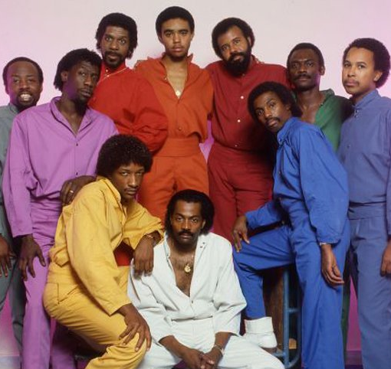
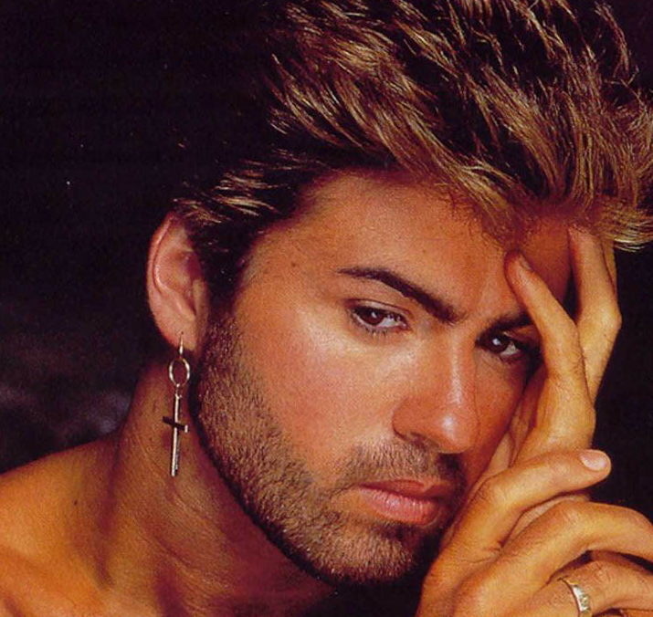
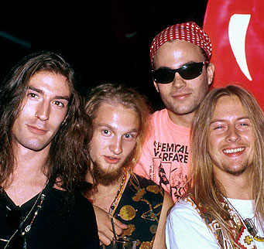

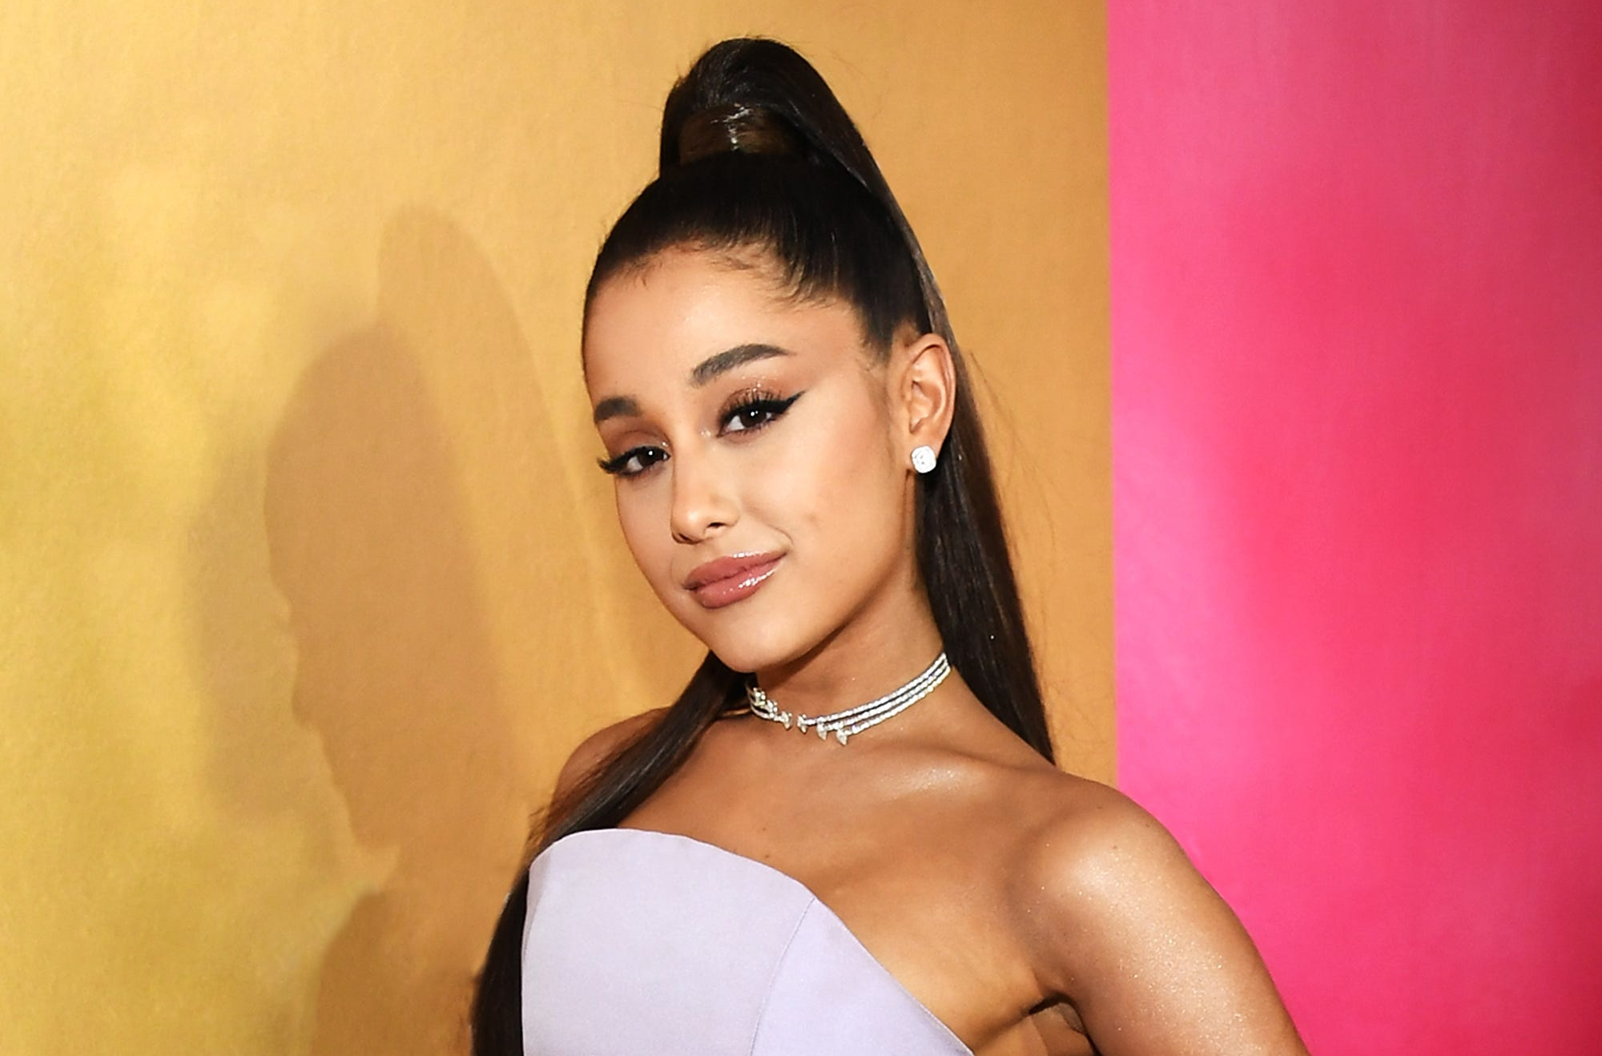
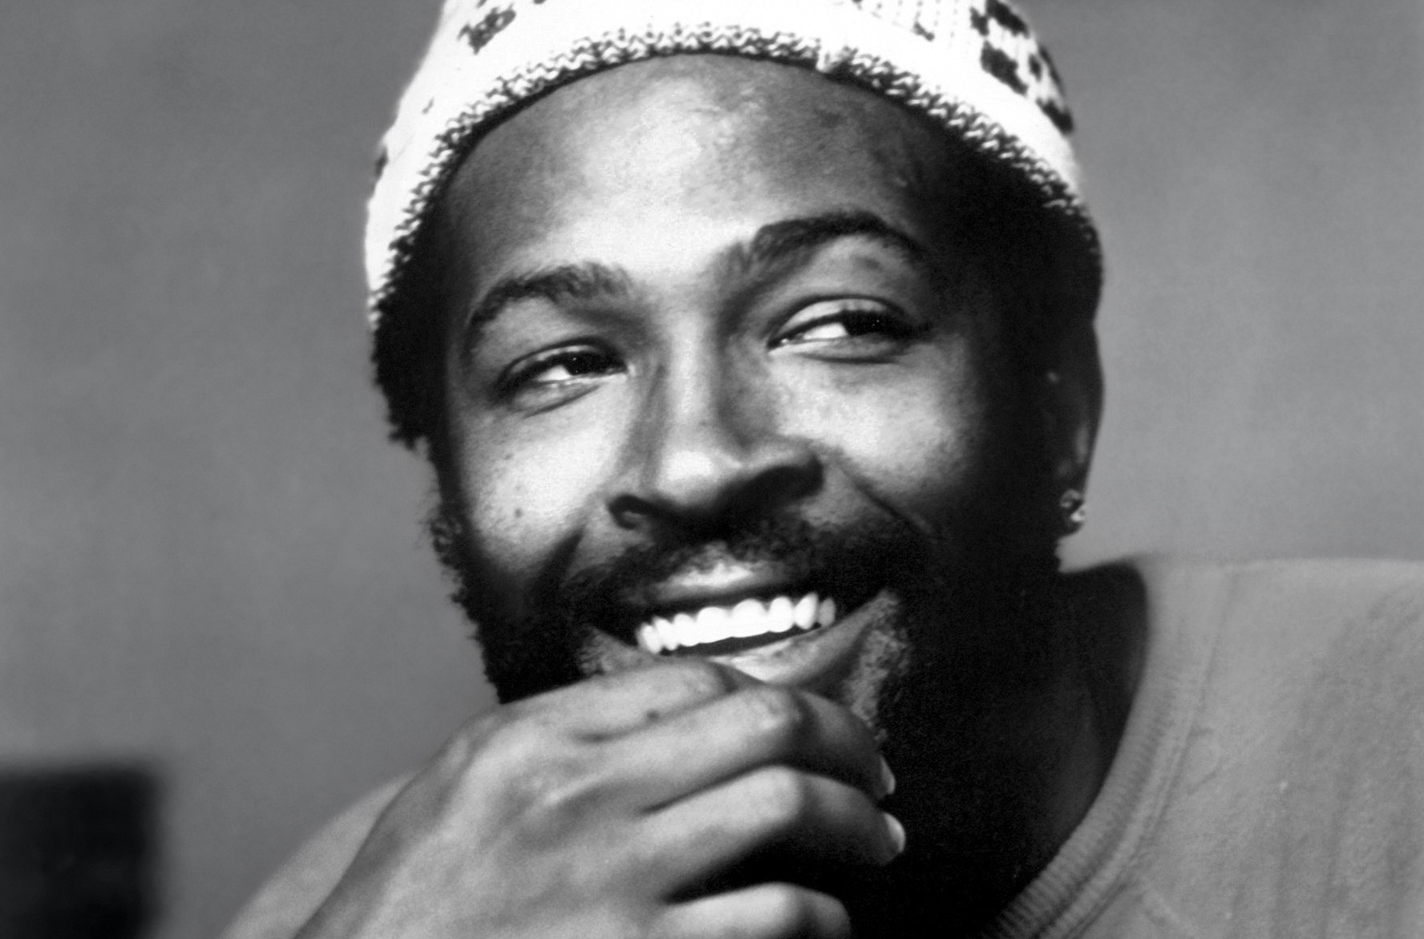
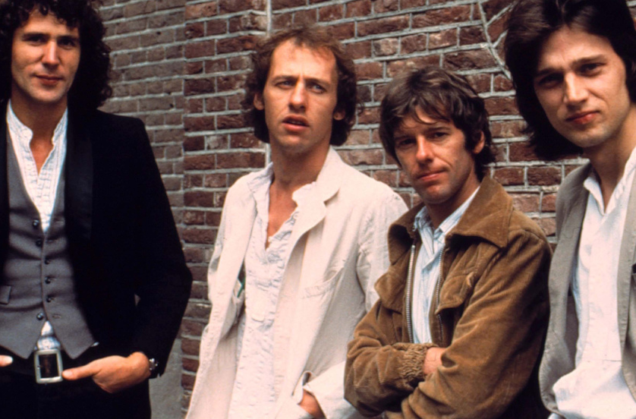
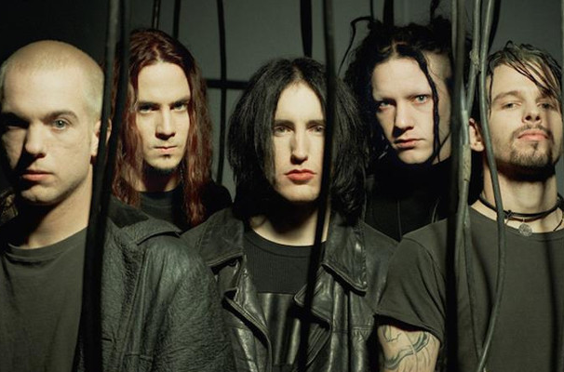

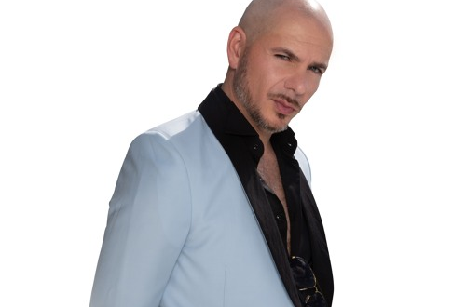
Picture Round
Instructions: Identify the artist or group on the line under each image

Slide 3
Decades In what decade was this version of the song originally released?
Roll Toi Me - Del Amitri - 1995
One Week – Bare Naked Ladies - 1998
Old Town Road – Lil Nas X & Billy Ray Cyrus - 2018
Bennie & The Jets – Elton John - 1973
Louie Louie – The Kingsmen - 1959
Loser – Beck - 1994
Lights – Ellie Goulding - 2011
All For You – Janet Jackson - 2001
Blue (Ba Ba Dee) – Eiffel 65 - 1998
Take Me Out – Franz Ferdinand - 2004
None

Slide 4
General Knowledge
What 1975 Broadway musical reveals the many challenges and personal stories of dancers eager to be chosen from a dance audition lineup? A Chorus Line
Things Can Only Get Better and No One Is to Blame are two hit songs by what English synth-pop star who released 15 Top 40 hit singles between 1983 and 1992? Howard Jones
What article clothing has been the most loved, hated, or talked about of all the items in MC Hammer’s wardrobe? His pants (Hammer Pants)
The song Sandstorm by Darude can best described as an example of what music genre: New Wave, Trance, or Alternative? Trance
In 2020 who was the first woman and youngest artist in Grammy history to win all 4 general field categories – Record of the Year, Album of the Year, Song of the Year, and Best New Artist? Billie Eilish
A didgeridoo is a long (3-10 ft) wind instrument whose popularity has spread around the world in recent years, but was developed over 1000 years ago by the Aboriginal people of what country? Australia
Complete this Joe Jackson lyric: “Is she really going out with him, cause if my eyes don’t deceive me…”. (6 words) …there’s something going wrong around here” (from Is She Really Going Out With Him?)
In the 1998 movie The Wedding Singer, who was Adam Sandler talking about when he said to his ex-girlfriend, “Now please get out of my (name the rock band) t-shirt before you jinx the band and they break up”? Van Halen
What Complicated singer, once married to Sum 41’s Deryck Whibley and once to Nickelback’s Chad Kroeger, broke up with her fiance (Derek Smith, aka Mod Sun) in February of 2023? Avril Lavigne
Flowers, River, and Jaded are 3 singles from what singer’s 8th studio album entitled Endless Summer Vacation, on which Brandi Carlisle and Sia are both featured as guest vocalists? Miley Cyrus’
In 1961, Ray Charles cancelled his show at Bell Auditorium in Augusta, Georgia after learning that whites could sit on the main floor while blacks would be confined to the balcony. The promoter sued him for breach of contract. In dollars, how much did he sue him for? $757

Slide 6
Kool and the Gang
George Michael
Alice In Chains
Gorillaz
Ariana Grande
Marvin Gaye
Dire Straits
Nine Inch Nails
The White Stripes
Pitbull

