Slide 1
Name Title & Artist
Game
On & On – Erykah Badu
Private Eyes – Hall & Oates
Where The party At – Jagged Edge ft Nelly
What A Fool Believes – Doobie Brothers
Say You’ll be mine – Christopher Cross
She Bop – Cyndi Lauper
Dancing With Myself – Billy Idol
Some Nights - Fun
Silly Love Songs – Paul McCartney
Blister in The Sun – Violent Femmes

Slide 2
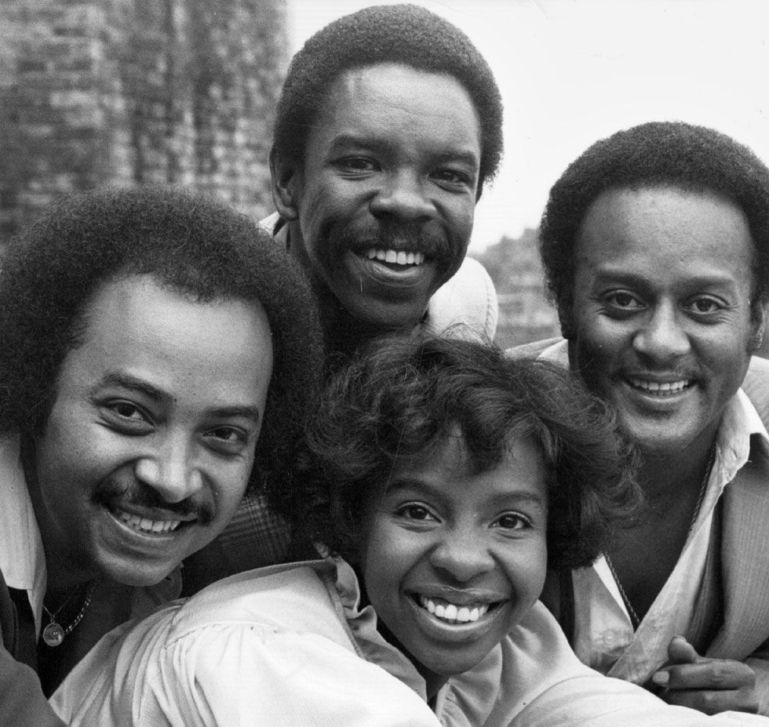
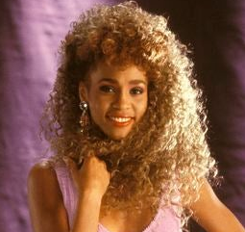
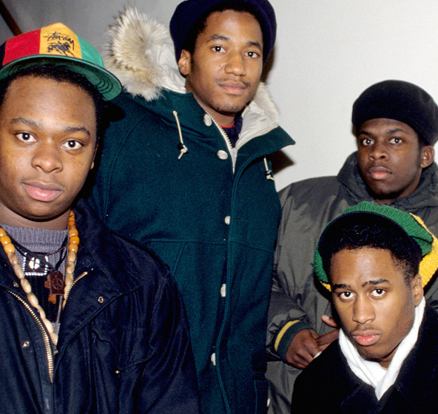
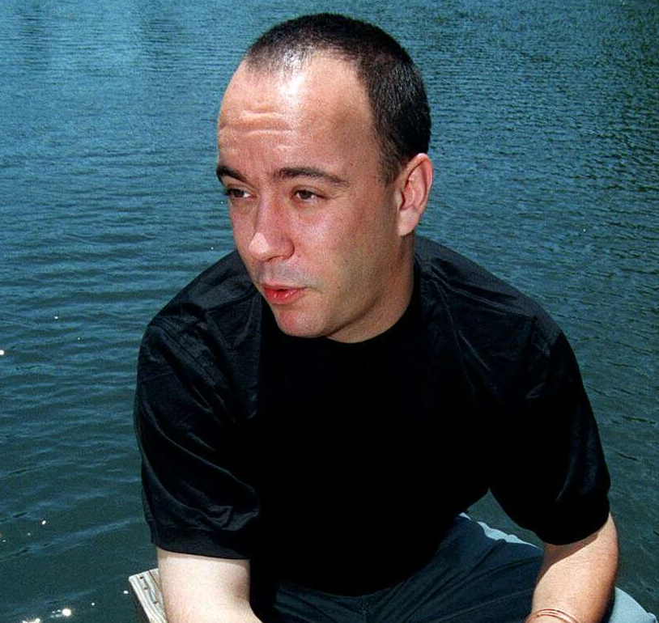
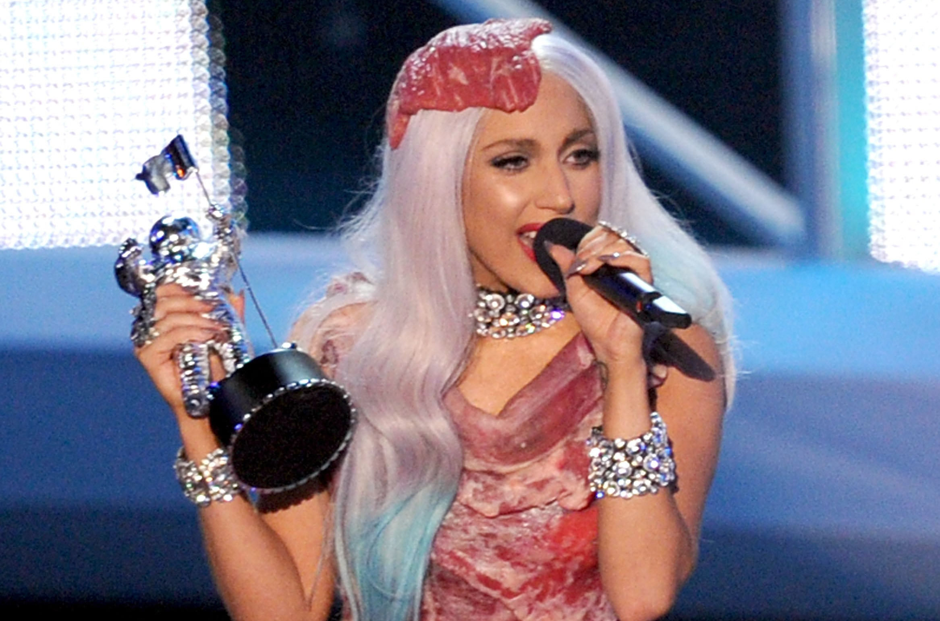
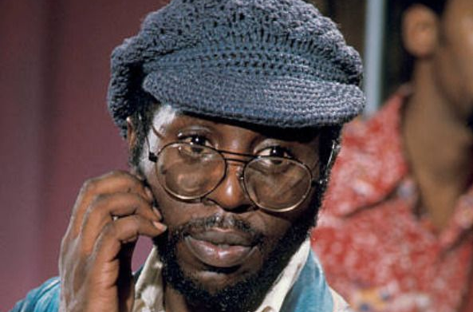
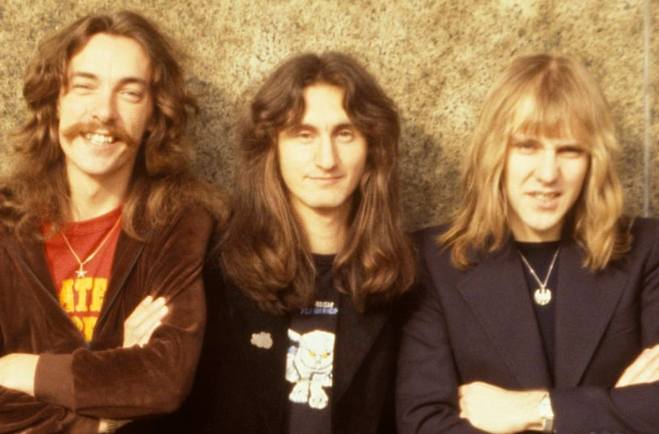
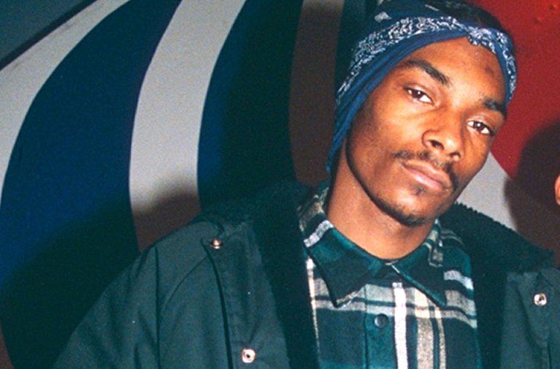
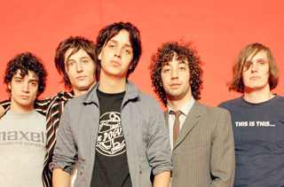
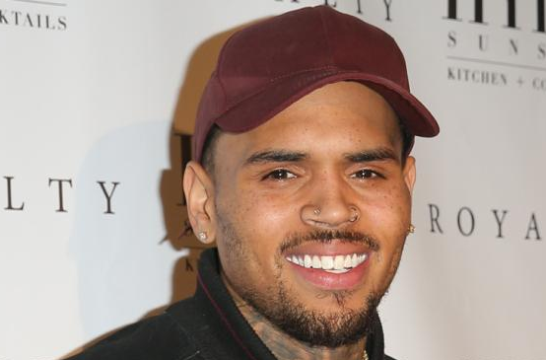
Picture Round
Instructions: Identify the artist or group on the line under each image

Slide 3
Decades In what decade was this version of the song originally released?
Darling Nickki – Prince - 1984
Steal Away – Robbie Dupree - 1980
Sex and Candy – Marcy Playground - 1997
Drive By – Train - 2012
21 Questions – 50 Cent ft Nate Dogg - 2003
Mirror In The Bathroom – English Beat - 1980
Tessie – Drop Kick Murphys - 2004
Rude Boy – Rihanna - 2009
Allison – Elvis Costello - 1977
Groove Is In The Heart – Deee Lite - 1990
None

Slide 4
General Knowledge
Salvatore and Cherilyn are the birth names of what two singer-entertainers whom Rolling Stone ranked at #18 on its list of the 20 Greatest Duos of All Time? Sonny & Cher
Name the American rock band that became famous when their 1982 single Mexican Radio became a hit on MTV. Wall of Voodoo
In the 80s, thanks to bands like Motley Crue, Cinderella, and Twisted Sister, a renewed trend for ”big hair” resulted in the widespread use of hair spray, with what brand becoming a staple in every rocker’s bathroom? Aqua Net
Which guitar virtuoso, one of three artists to sue Coldplay for copyright infringement over their song Viva La Vida, alleged that they stole passages from his song If I Could Fly? Joe Satriani
With over 200 million followers in 2023, what Trinidadian-born rapper is the most followed rapper on Instagram? Nicki Minaj
From the era of cassettes to DATs to Mini Discs to CDs and now to digital flash memory, the iconic Walkman player has been a product of what Japanese company since 1979? Sony
“She was gonna shake her ass…on the hood of Whitesnake’s car” is a line from Bowling For Soup’s hit song 1985. Which iconic Whitesnake video were they referencing? Here I Go Again
Credited with helping to redefine R&B, pop, and hip hop in the 90s, what singer, who died in a plane crash at the age of 22, spent 6 weeks at #1 on Billboard‘s R&B/Hip-Hop Airplay chart with the song One In A Million? Aaliyah
Name the international superstar whose band is called The Hooligans. Bruno Mars
In December of 2020, what former boy band singer-turned solo artist became the first man ever to appear on the cover of Vogue (in the U.S.) – and did so wearing a dress? Harry Styles
In 2001 the National Recording Industry Association of America released a list of the top 365 Songs of the 20th Century, for which people from many walks of life and professions voted. At what number on the list did Little Richard’s Tutti Frutti land? #125

Slide 6
Gladys Knight and the Pips
Whitney Houston
A Tribe Called Quest
Dave Matthews
Lady Gaga
Curtis Mayfield
Rush
Snoop Dogg
The Strokes
Chris Brown

