Slide 1
Name Artist & Title
Game 015
Roxy Music – Love Is The Drug
Glen Campbell – Southern Nights
Santana Ft Michelle Branch – Game of Love
Guns N’ Roses – Used To Love Her
Classics IV – Spooky
Rock n Roll Waltz – Kay Star
Billy Preston – Nothing From Nothing
Survivor – Burning Heart
Janet Jackson – That’s The Way Love Goes
Ciara Ft Petey Pablo - Goodies

Slide 2
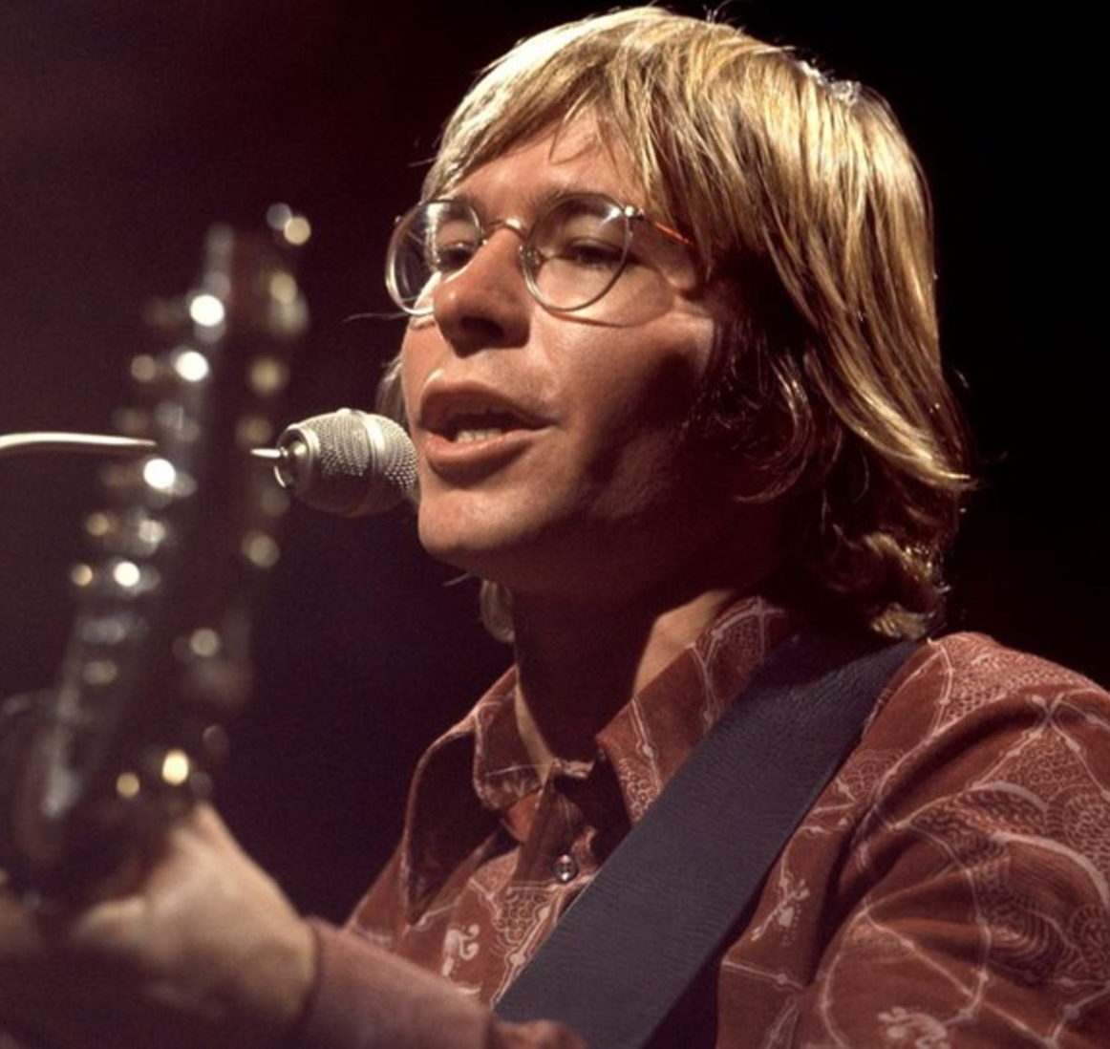
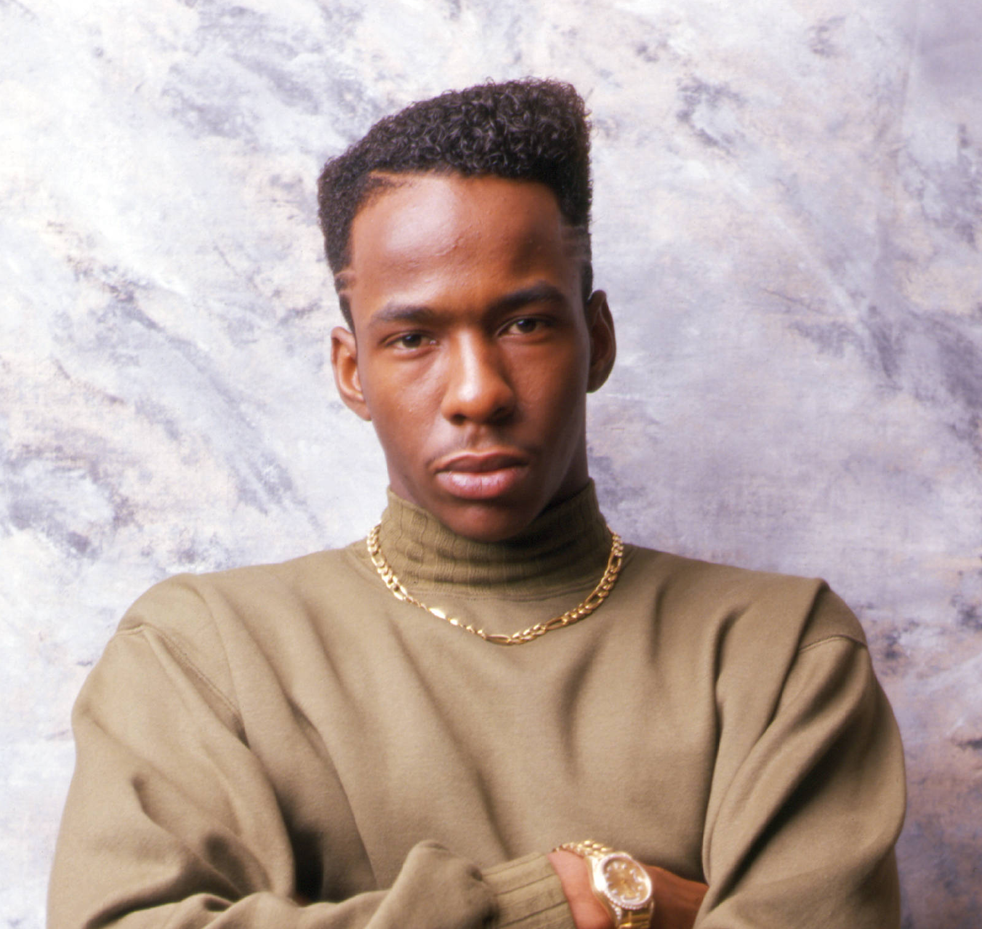
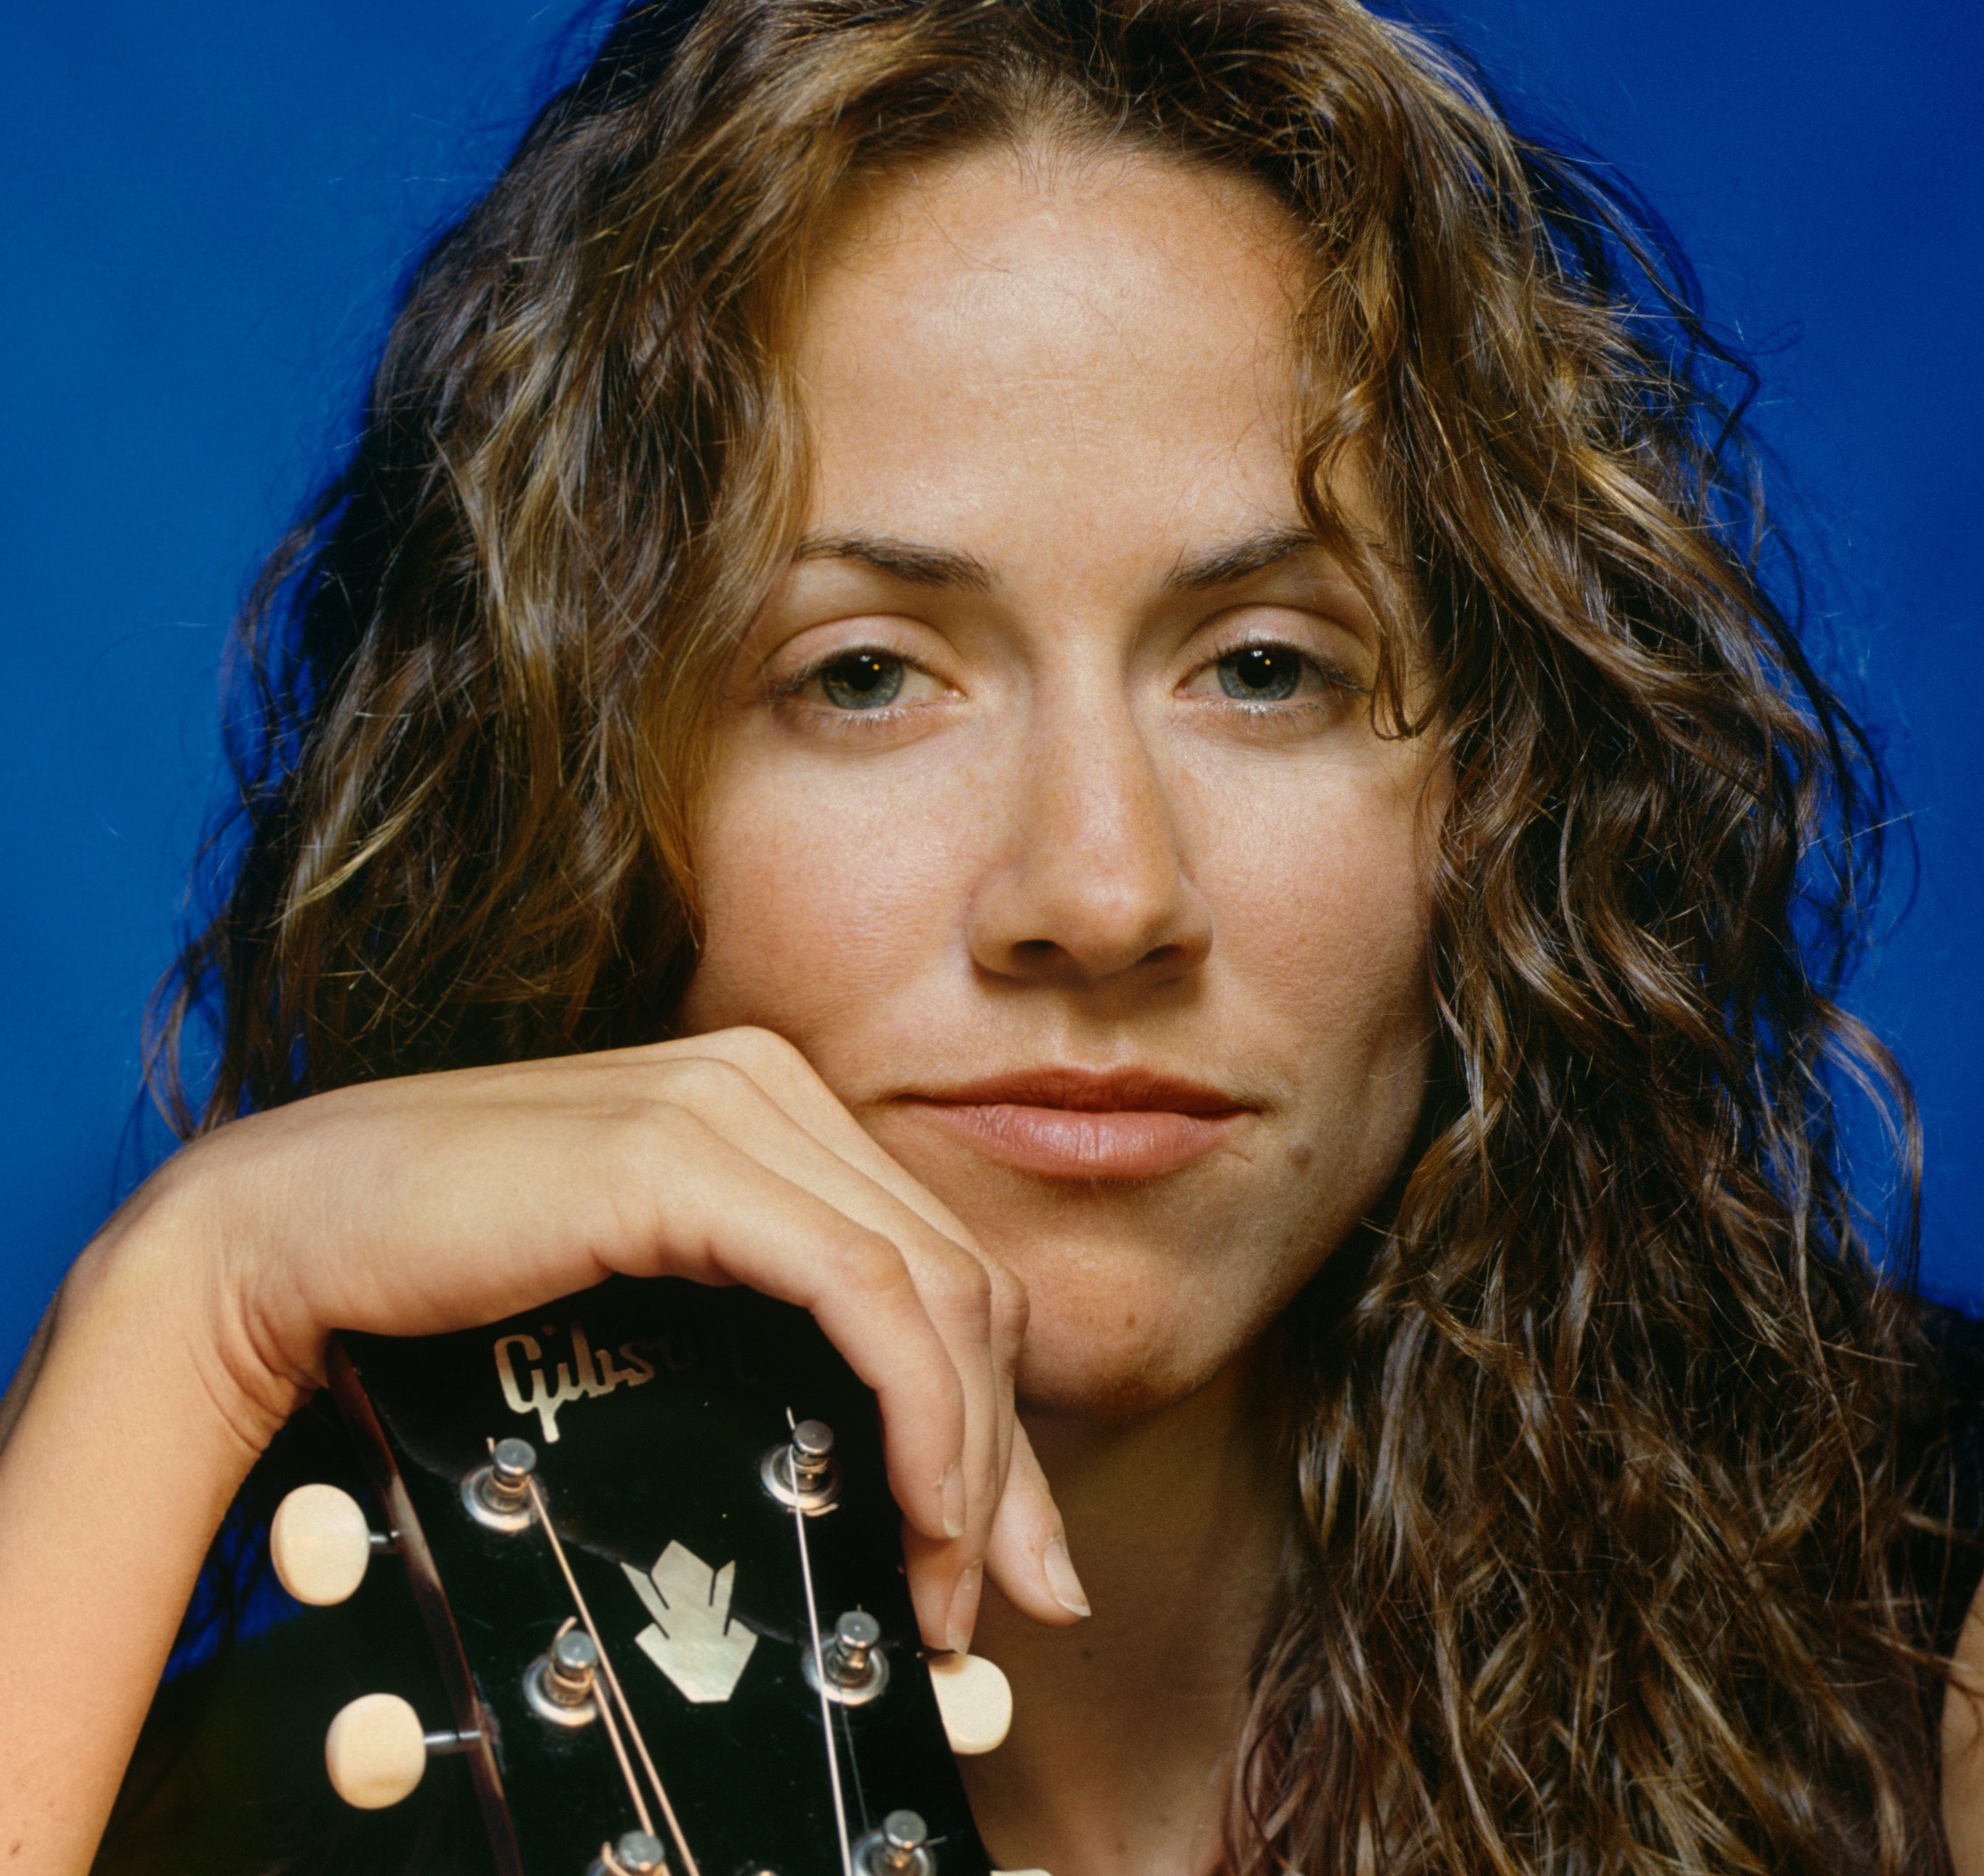
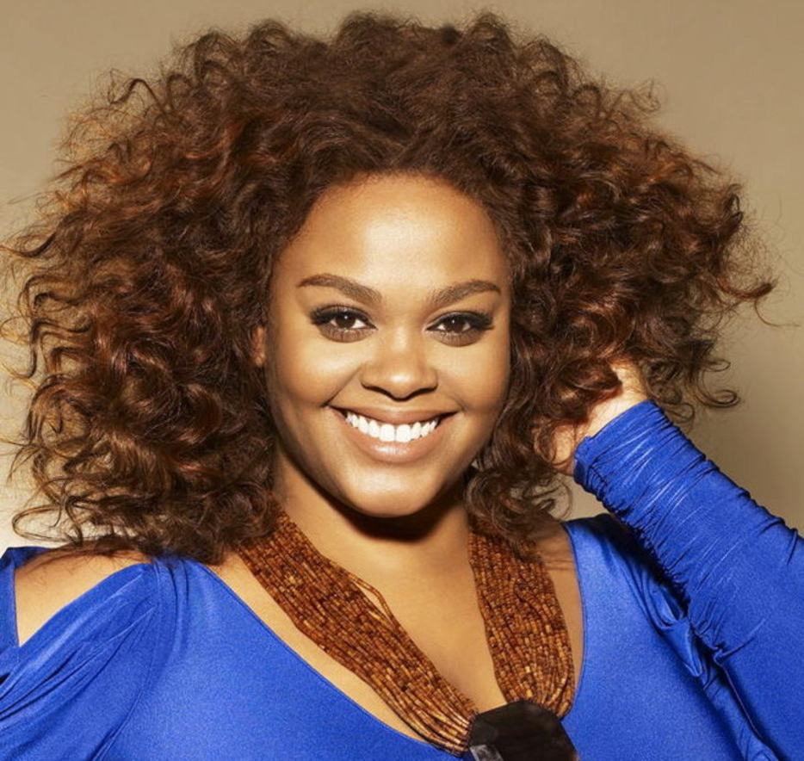
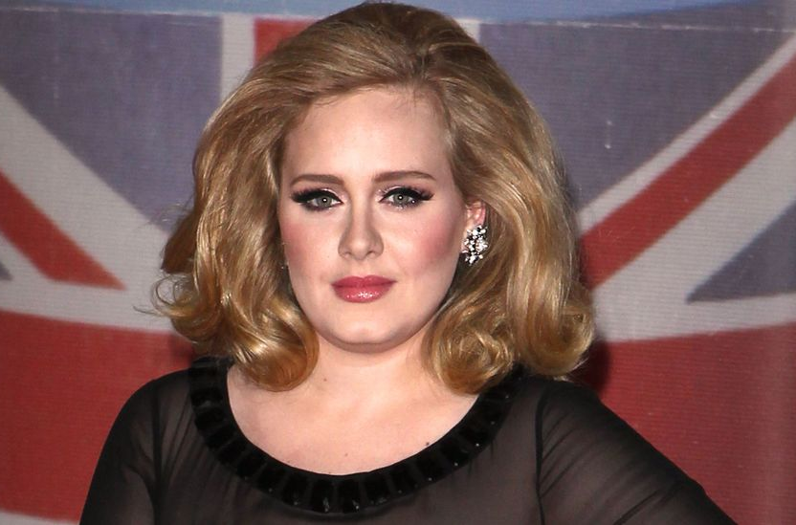
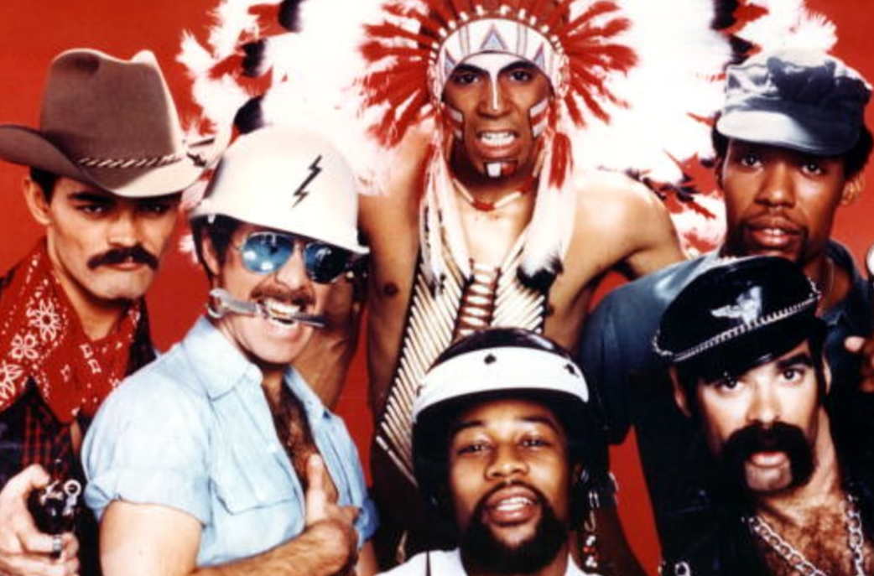
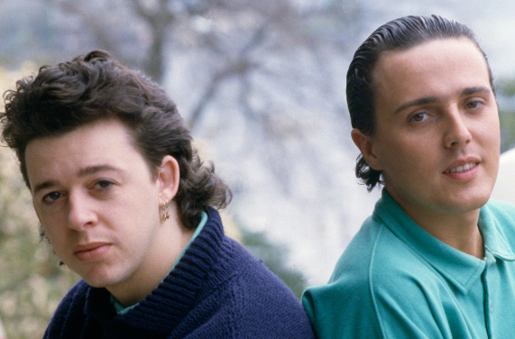
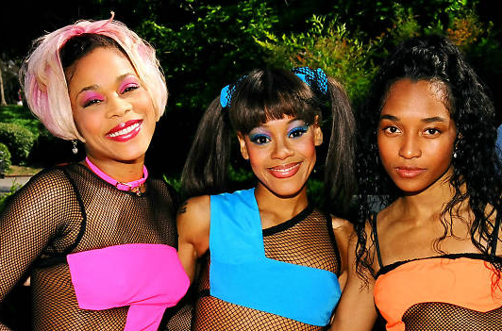
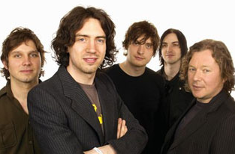
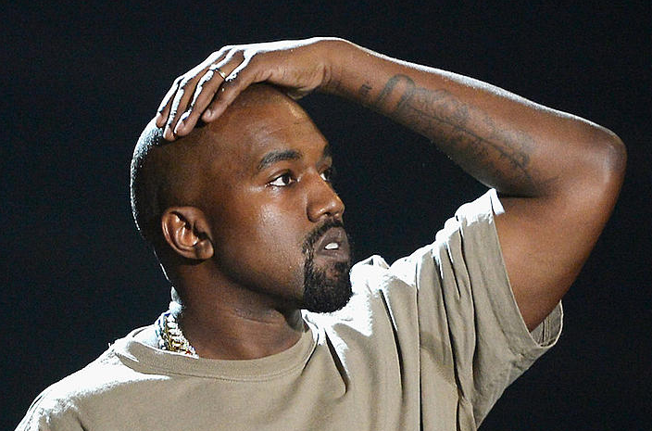
Picture Round
Instructions: Identify the artist or group on the line under each image

Slide 3
Decades In what decade was this version of the song originally released?
Kevin Lyttle – Turn Me On (2003)
Scandal – The Warrior (1984)
Jerry Lee Lewis - Great Balls of Fire (1957)
Prince and The New Power Generation – 7 (1992)
Steve Winwood – Higher Love (1986)
Destiny’s Child – Say My Name (1999)
KISS – Beth (1976)
Cream – Sunshine of Your Love (1967)
Pink – Raise Your Glass (2010)
The Baby’s – Back On My Feet Again (1979)
None

Slide 4
General Knowledge
The Bump and the Hustle are two dance styles that were developed during the craze of what music genre? Disco
Although the band Toto initially played along with the rumor that their song Rosanna was written for what actress (who was then Steve Porcaro’s girlfriend), the song’s writer David Paich has since come clean, saying it was not. Rosanna Arquette (Paich said the song is based on numerous girls he had known.)
Which lead singer of Journey shares his first and last name with the lead singer of the Cherry Poppin’ Daddies, whose biggest hit to date is the song Zoot Suit Riot? Steve Perry
What southern hip hop duo consisted of rappers Big Boi and Andre 3000? Outkast
In his book Promise Me, Dad, Joe Biden called which New Radicals song his family’s ”rallying theme song” during his late son Beau Biden’s terminal battle with cancer? You Get What You Give
Vinyl records are categorized by the speed at which the record spins on a player, measured in RPMs, hence the names “78s”, “45s”, and “33s”. 33s are also known as “LPs”, which stands for what? Long Play
Mountain Music was the lead-off single and title track of what band’s 1982 album? Alabama
After his death in 2022, some of the ashes of what Gangsta’s Paradise rapper were encased in jewelry, including necklaces, for his family to wear? Coolio
In 2006 what band collaborated with U2 to record (the Skids song) The Saints Are Coming to benefit Music Rising – an organization that raised money to replace instruments lost during Hurricane Katrina? Green Day
Who departed from the girl group Fifth Harmony in 2016 to embark full time on her solo career? Camila Cabello
At what number did Carrie Underwood appear on Rolling Stone’s 2023 list of the 200 Greatest Singers of All Time? #158

Slide 6
John Denver
Bobby Brown
Sheryl Crow
Jill Scott
Adele
The Village People
Tears for Fears
TLC
Snow Patrol
Kanye West

